Slide 1
SITE DETAILS
ALAPPUZHA

Slide 2
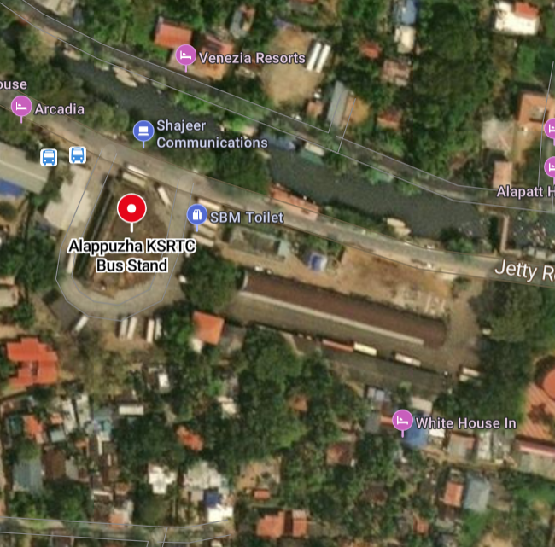
FEASIBILITY
In order to facilitate comfortable seamless travel and make Alappuzha a better tourist destination, the Government of Kerala have initiated the Mobility Hub Project at Alappuzha. The Special Officer of Alappuzha Mega Toursim Project had submitted a proposal in this regard.
- The project is sanctioned on 11/06/2018 by the Principal secretary, K.R. Jyothilal, by the order of the Governor.
- The proposed project can create many direct and indirect job opportunities during construction and operational phases
Since the Govt. have land in the project area, no displacement will happen and hence no need of resettlement & rehabilitation.

Slide 3
CONTEXTUAL FEASIBILITY
Alappuzha is situated -55 km from Kochil and 155 km north of Trivandrum. A town with canals, backwaters, beaches, and lagoons, Alappuzha was described by George Curzon, Viceroy of India at the start of the 20th century, as the "Venice of the East." Hence, it is known as the "Venetian Capital" of Kerala.
It is an important tourist destination in India. The Backwaters of Alappuzha is one of the most popular tourist attractions in Kerala which attracts millions of domestic and international tourists to the district and employs vast number of locals in the private sector. It connects Kumarakom and Cochin to the North and Quilon to the South.

Slide 4
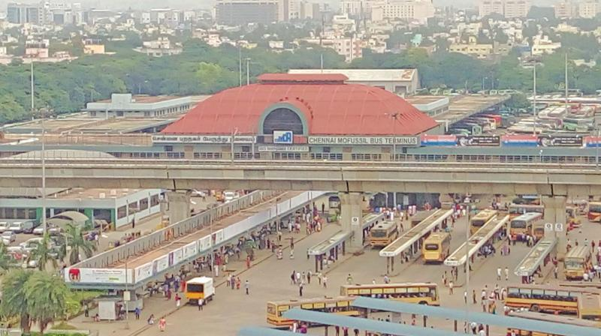
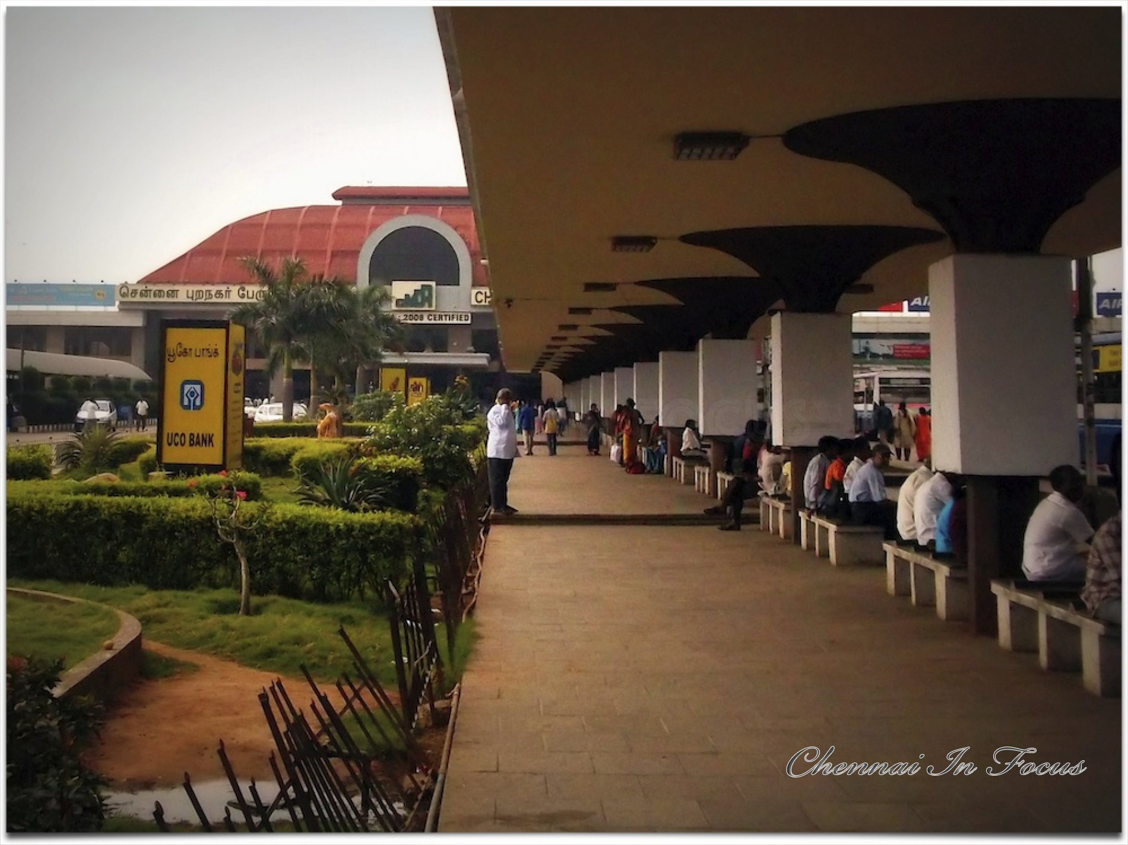
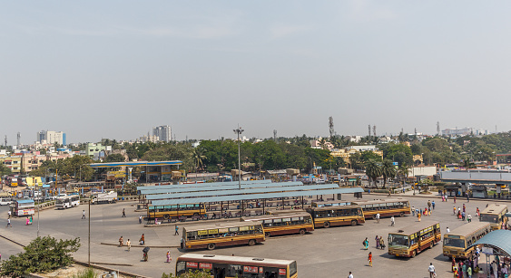
LITERATURE CASE STUDIES
CHENNAI MOFUSSIL BUS TERMINAL

Slide 5
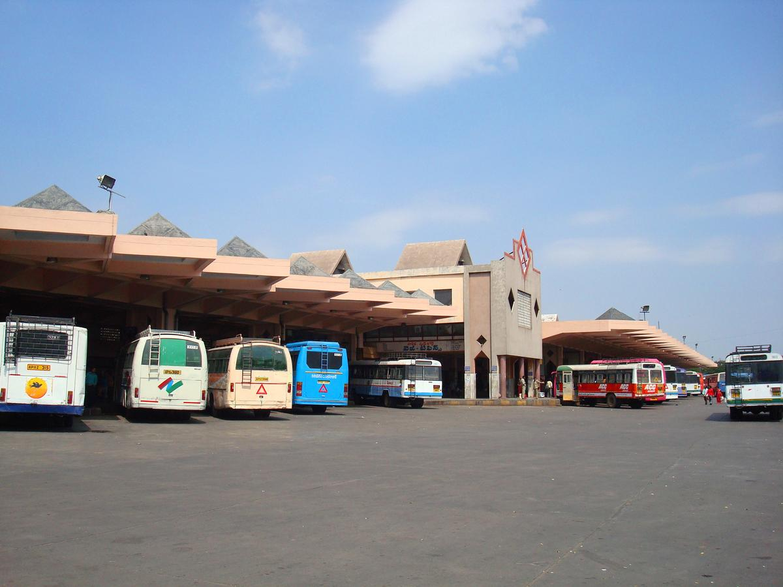
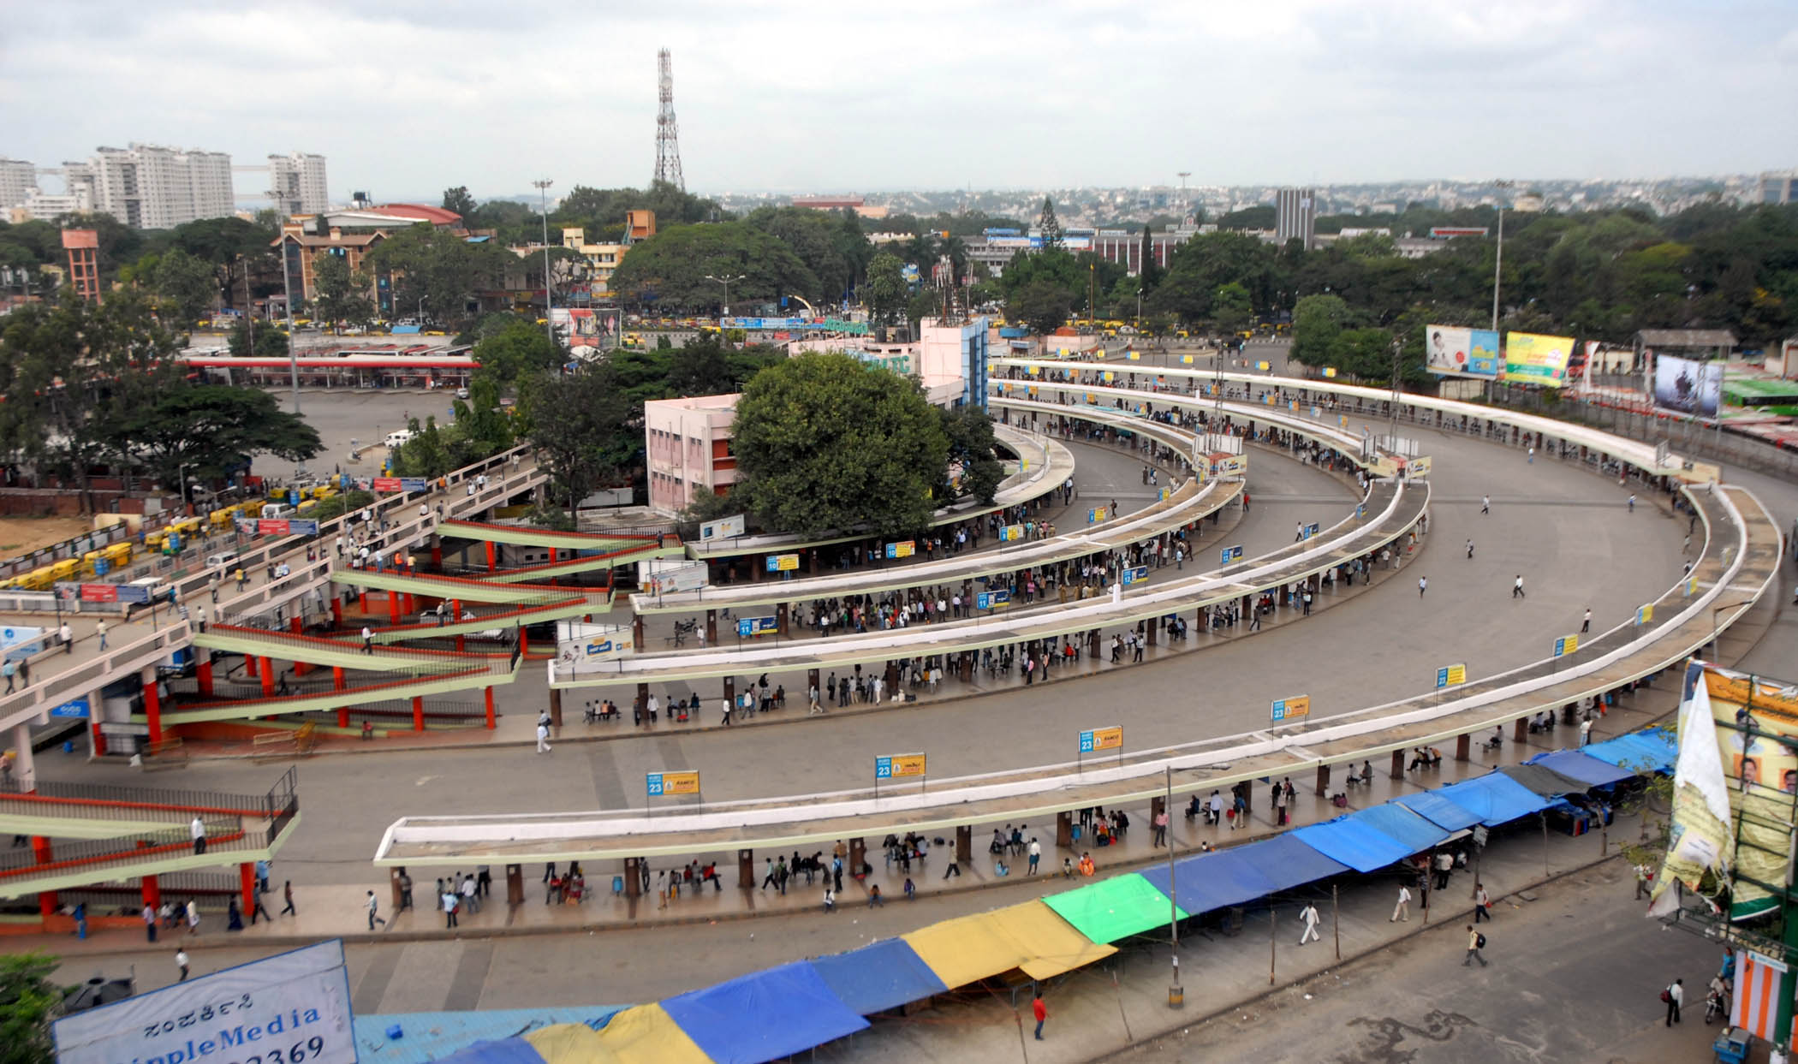
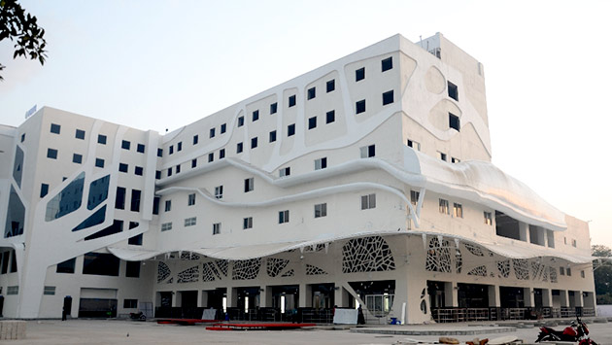
LIVE CASE STUDY
MAHATMA GANDHI BUS STATION, HYDERABAD
KEMPEGOWDA BUS TERMINAL, BANGALORE
VADODARA BUS STATION

