Slide 1
PROPENSITY SCORE ANALYSIS TO STUDY THE IMPACT OF D-PENICILLAMINE IN THE TREATMENT OF LIVER CIRRHOSIS
PRESENTED BY:
Arunima Srivastava

Slide 2
Liver cirrhosis
Liver cirrhosis is a significant global health concern, characterized by the replacement of healthy liver tissue with scar tissue (fibrosis), which impairs liver function.
This chronic and progressive condition can result from various causes, including alcohol-related liver diseases, viral hepatitis, non-alcoholic fatty liver disease (NAFLD), metabolic syndrome, and autoimmune disorders.
Symptoms include yellowing of the skin (jaundice), muscle loss, fatigue, loss of appetite, and weakness. Prolonged liver damage leads to inflammation, causing liver cell death and the migration of inflammatory cells.
While the liver tries to regenerate damaged cells, this process triggers scar tissue production by cells like fibroblasts, leading to fibrosis. As fibrosis progresses, it disrupts the liver's structure and function, causing portal hypertension and affecting blood flow within the liver. This increases the risk of liver cancer.

Slide 3
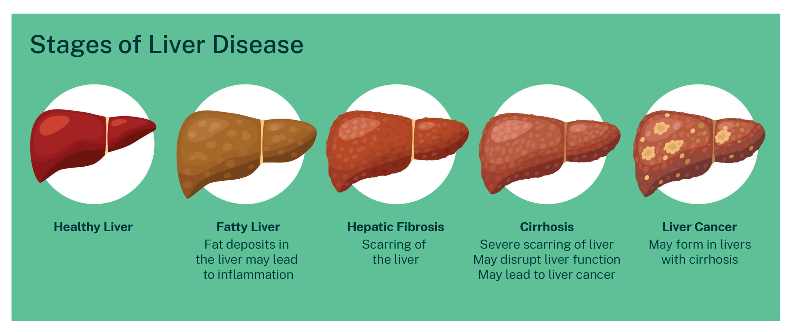
Liver cirrhosis typically progresses through four stages :

Slide 4
Observational studies
According to Cochran (1965), an observational study is an empirical investigation whose objective is to elucidate causal relationships (i.e., cause and effect) when it is infeasible to use controlled experimentation and to assign participants at random to different procedures.
Data are observed and collected on each subject, with the goal of understanding a cause-effect relationship. Unlike experiments, the independent variable is not under control of the researcher.

Slide 5
Observational studies over rct
Real-World Applicability: Reflect real-life settings and behaviors, making findings more generalizable.
Ethical Feasibility: Suitable for studying harmful exposures or long-term effects where RCTs would be unethical.
Long-Term Insights: Ideal for chronic conditions and long-term outcomes.
Cost-Effective: Generally cheaper and simpler to conduct using existing data.
Larger and Diverse Samples: Include broader populations, enhancing the relevance of findings.

Slide 6
Treatment of liver cirrhosis
Treatment of cirrhosis depends on the cause and extent of your liver damage. A low-sodium diet and medicine to prevent fluid buildup in the body may help control ascites and swelling.
In advanced cases of cirrhosis, when the liver stops working properly, a liver transplant may be the only treatment option.
Researchers are working on therapies that will specifically target liver cells, helping to slow or even reverse the fibrosis that leads to cirrhosis. However, no targeted therapy is quite ready.

Slide 7
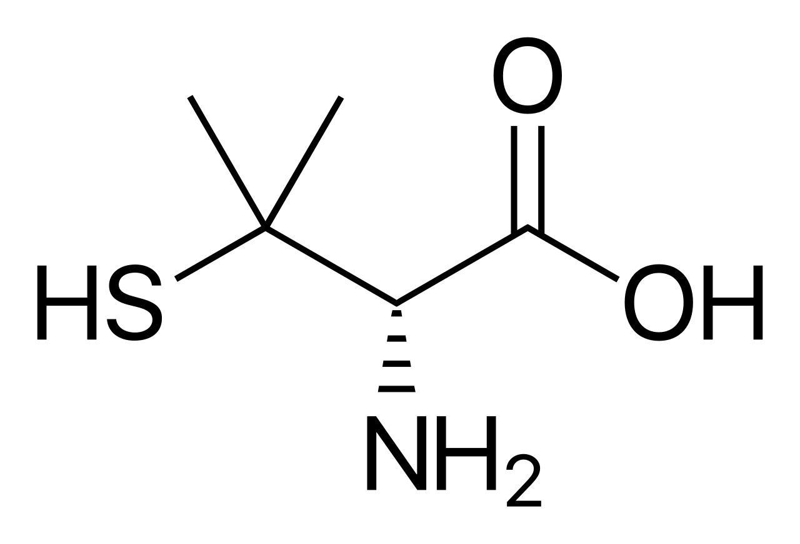
d-penicillamine
D‐penicillamine is used for patients with primary biliary cirrhosis due to its hepatic copper decreasing and immunomodulatory potentials.
Composition(C₅H₁₁NO₂S) : Penicillamine is a trifunctional organic compound, consisting of a thiol, an amine, and a carboxylic acid. It is an amino acid structurally similar to cysteine, but with geminal dimethyl substituents α to the thiol.
Common side effects include rash, loss of appetite, nausea, diarrhea, and low white blood cell levels, swollen and/or painful glands, joint pain. Other serious side effects include liver problems, obliterative bronchiolitis, and myasthenia gravis.

Slide 8
Data description
Dataset consists of 312 patients suffering from liver cirrhosis.
Out of 312 patients, 158 were assigned to the treatment group and 154 to the control group.
The data provided is sourced from a Mayo Clinic study on primary biliary cirrhosis (PBC) of the liver carried out from 1974 to 1984.
DATA SOURCE : KAGGLE

Slide 9
Data description
Categorical features
Continuous features
Age
N_Days
Bilirubin
Platelets
Prothrombin
Copper
Alk_Phos
SGOT
Cholesterol
Albumin
Triglycerides
Sex
Ascites
Hepatomegaly
Spiders
Edema
Drug
Stage of liver cirrhosis

Slide 10
Brief description of some biological covariates:
Ascites: Abnormal build-up of fluid in the abdomen.
Hepatomegaly: Enlargement of the liver, which indicates dysfunction in the liver.
Spiders: A spider angioma or spider naevus is a type of swollen, spider-like blood vessels on the skin found slightly beneath the skin's surface, often containing a central red spot and deep reddish extensions.
Edema: Swelling in the legs, ankles, or feet.
Bilirubin: Main pigment in bile, is produced when red blood cells are broken down in the liver.
Albumin: Protein made in the liver, used as a non-specific indicator of the synthetic function of the liver with a long half-life (20 days).
Alkaline Phosphatase: Non-specific liver enzyme mainly found in the bile ducts of the liver.
Triglycerides: High triglyceride levels can raise your risk for certain health conditions, including heart attack and liver disease.
Prothrombin: Protein made by the liver to help blood clot. Prothrombin Time (PT) measures how long it takes for blood to clot.

Slide 11
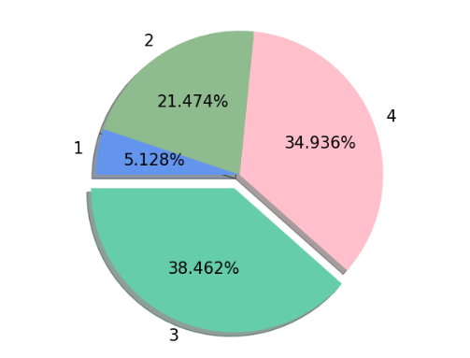
Stagewise proportion of cirrhosis

Slide 12
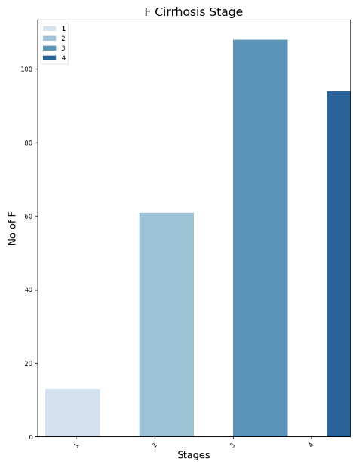
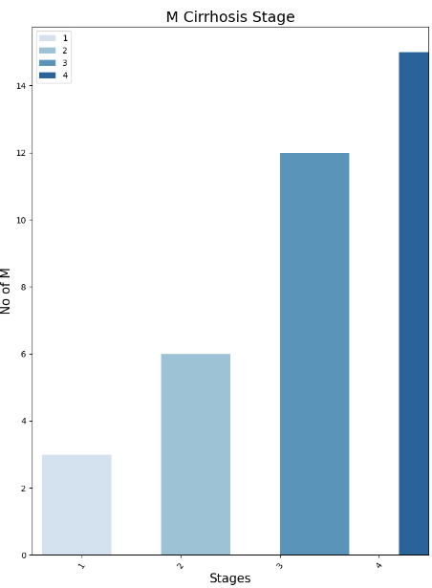
Presence of cirrhosis stagewise in females Presence of cirrhosis stagewise in males

Slide 13
Data cleaning
Data cleaning is an important early step in the data analytics process.
Checking for missing values:
Feature | Missing Values
ID | 0
N_Days | 0
Status | 0
Drug | 0
Age | 0
Sex | 0
Ascites | 0
Hepatomegaly | 0
Spiders | 0
Edema | 0
Bilirubin | 0
Cholesterol | 28
Albumin | 0
Copper | 2
Alk_Phos | 0
SGOT | 0
Triglycerides | 30
Platelets | 4
Prothrombin | 0
Stage | 0

Slide 14
Based on the table, four predictors which consist of missing values, namely, ‘Cholesterol’, ‘Copper’, ‘Triglycerides’ & ‘Platelets’. All these four covariates are continuous in nature.
For 'Copper' (2 missing) and 'Platelets' (4 missing), we replaced missing values with the overall median.
For 'Cholesterol' (28 missing) and 'Triglycerides' (30 missing), we used stagewise medians, calculated separately for each stage of the response variable ('Stage' 1, 2, 3, 4). Missing values were replaced with the median corresponding to the same stage.
This approach ensures transparent and stage-specific handling of missing data.

Slide 15
Feature selection
The main objective of feature selection is to improve the model's performance by eliminating irrelevant or redundant data, which can lead to several benefits.
We've employed two distinct methods for feature selection.
Ordinal logistic regression was utilized to identify the continuous independent variables that influence the stage of cirrhosis.
Additionally, Cohen's Kappa was applied to assess the impact of categorical independent variables.

Slide 16
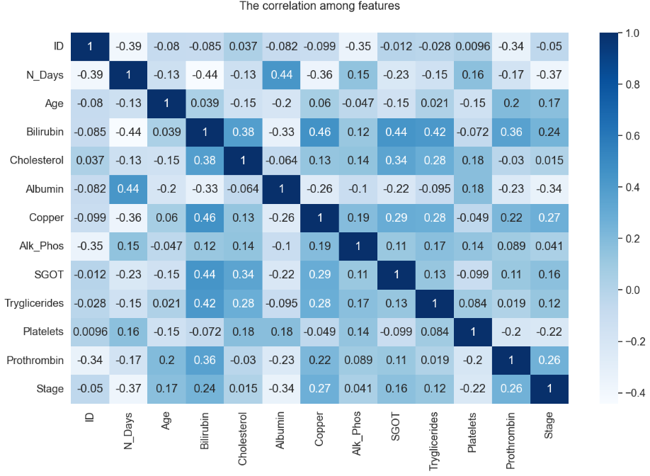
Correlation heatmap
None of the variables are highly correlated. Hence, we proceed with ordinal logistic regression to identify significant variables, i.e., those that impact the stage of cirrhosis.

Slide 17
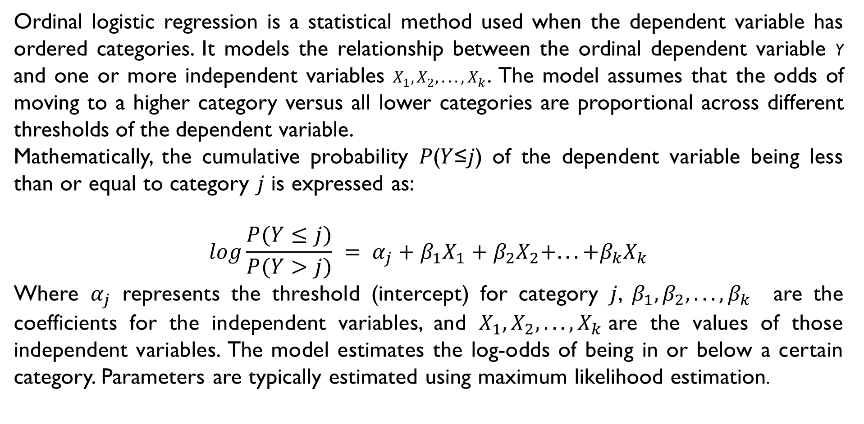
Ordinal logistic regression is a statistical method used when the dependent variable has ordered categories. It models the relationship between the ordinal dependent variable Y and one or more independent variables $X_{1},X_{2},...,X_{k}$. The model assumes that the odds of moving to a higher category versus all lower categories are proportional across different thresholds of the dependent variable.
Mathematically, the cumulative probability 𝑃(𝑌≤𝑗) of the dependent variable being less than or equal to category 𝑗 is expressed as:
$$\log{\frac{P(Y≤j)}{P(Y>j)} = α_{j}+β_{1}X_{1}+β_{2}X_{2}+...+β_{k}X_{k}}$$
Where $α_{j}$ represents the threshold (intercept) for category 𝑗, $β_{1},β_{2},...,β_{k}$​ are the coefficients for the independent variables, and $X_{1},X_{2},...,X_{k}$are the values of those independent variables. The model estimates the log-odds of being in or below a certain category. Parameters are typically estimated using maximum likelihood estimation.

Slide 18
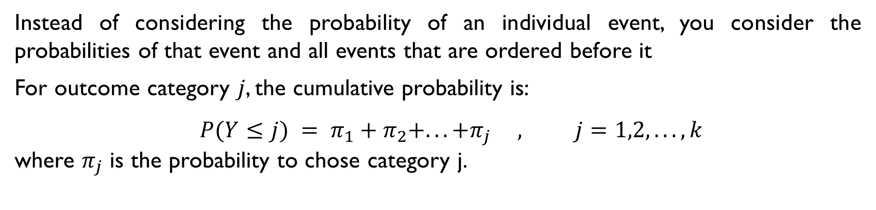
Instead of considering the probability of an individual event, you consider the probabilities of that event and all events that are ordered before it
For outcome category 𝑗, the cumulative probability is:
$$P(Y≤j) = π_{1}+π_{2}+...+π_{j} , j=1,2,...,k$$
where $π_{j}$ is the probability to chose category j.

Slide 19
 | coef | std err | z | P > |z| | 0.025 | 0.975
Bilirubin | 0.0154 | 0.038 | 0.406 | 0.684 | -0.059 | 0.090
Cholesterol | -0.0006 | 0.001 | -1.098 | 0.272 | -0.002 | 0.000
Albumin | -1.1486 | 0.307 | -3.743 | 0.000 | -1.750 | -0.547
Copper | 0.0038 | 0.002 | 2.313 | 0.021 | 0.001 | 0.007
SGOT | 0.0022 | 0.002 | 0.959 | 0.338 | -0.002 | 0.007
Triglycerides | 0.0025 | 0.002 | 1.183 | 0.237 | -0.002 | 0.007
Platelets | -0.0032 | 0.001 | -2.638 | 0.008 | -0.006 | -0.001
Prothrombin | 0.4105 | 0.146 | 2.803 | 0.005 | 0.123 | 0.698
1/2 | -2.2998 | 2.135 | -1.077 | 0.281 | -6.484 | 1.885
2/3 | 0.7078 | 0.122 | 5.793 | 0.000 | 0.468 | 0.947
3/4 | 0.6911 | 0.082 | 8.471 | 0.000 | 0.531 | 0.851
To shortlist statistically significant variables, we examine the p-values corresponding to each covariate. A p-value less than 0.05 indicates statistical significance.
Albumin (p = 0.000), Copper (p = 0.021), Platelets (p = 0.008), and Prothrombin (p = 0.005) have p-values less than 0.05, indicating that these variables significantly affect the odds of progressing to a higher stage of cirrhosis. Other variables, such as Bilirubin, Cholesterol, SGOT, and Triglycerides, do not have statistically significant effects. Therefore, we have excluded these variables from further analysis.

Slide 20
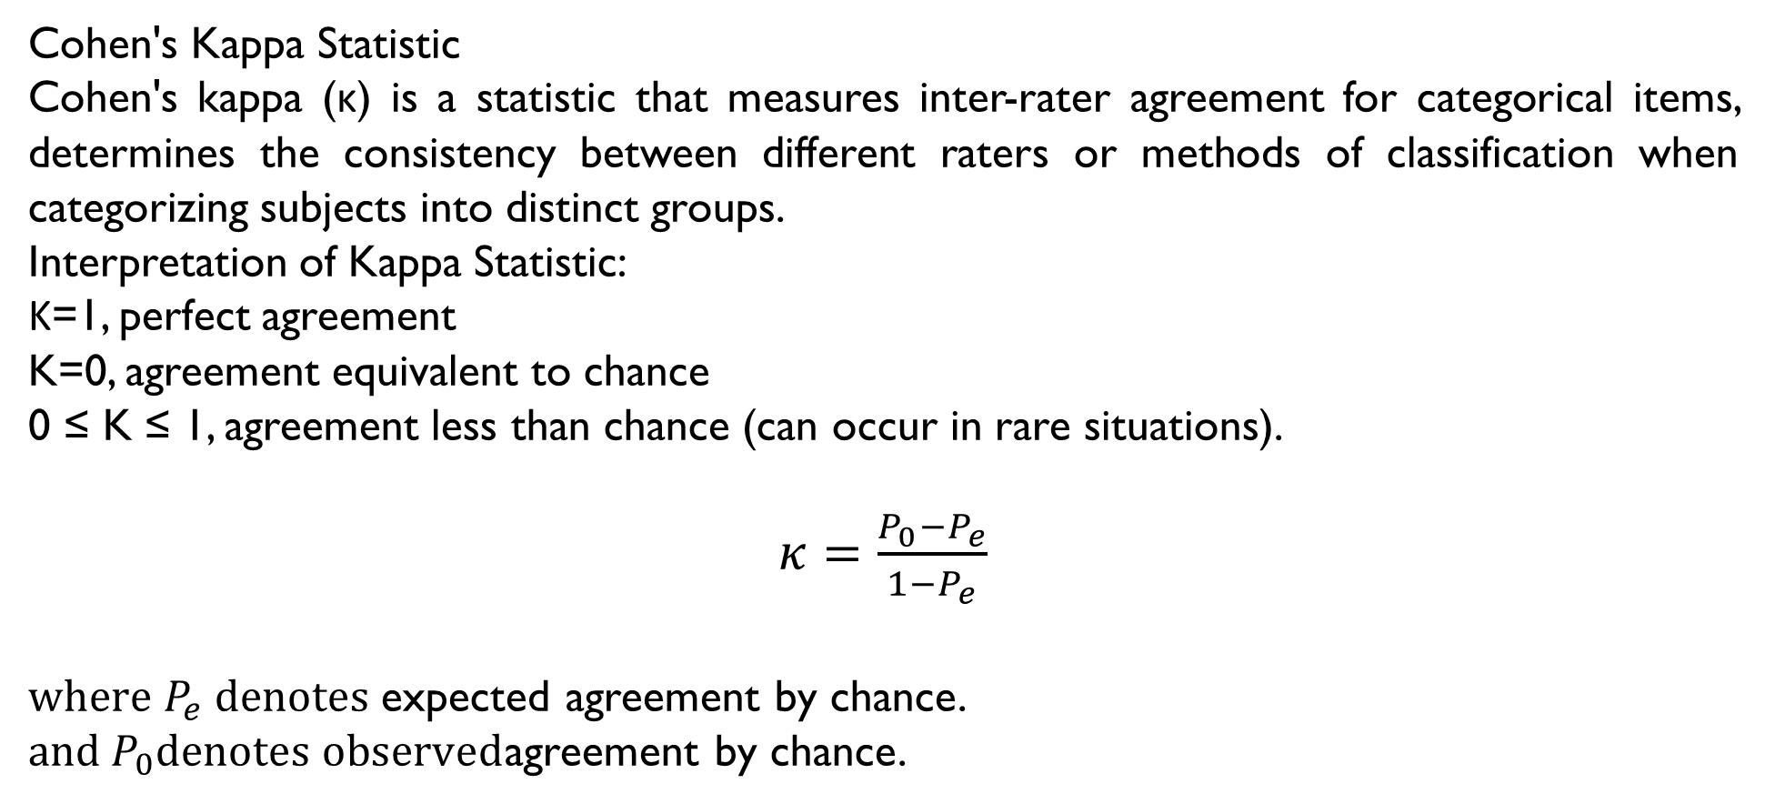
Cohen's Kappa Statistic
Cohen's kappa (κ) is a statistic that measures inter-rater agreement for categorical items, determines the consistency between different raters or methods of classification when categorizing subjects into distinct groups.
Interpretation of Kappa Statistic:
Κ=1, perfect agreement
K=0, agreement equivalent to chance
0 ≤ K ≤ 1, agreement less than chance (can occur in rare situations).
$κ=\frac{P_{0}−P_{e}}{1−P_{e}}$
${where P}_{e} denotes$expected agreement by chance.
${and P}_{0}denotes observed$agreement by chance.

Slide 21
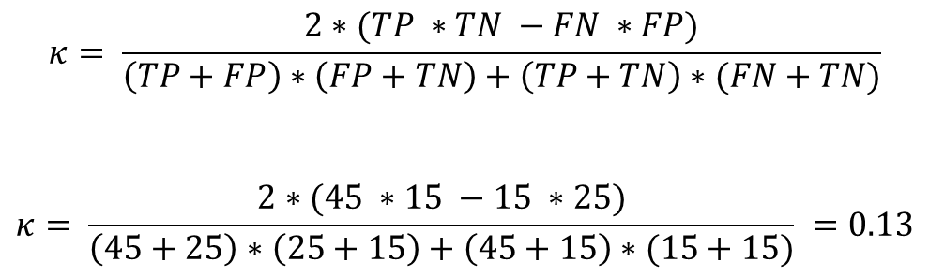
Let us understand Cohen’s Kappa Statistic with an example,
Actual
YES
NO
$$κ= \frac{2∗(TP ∗TN −FN ∗FP)}{\left(TP+FP\right)∗\left(FP+TN\right)+\left(TP+TN\right)∗(FN+TN)}$$
$$κ= \frac{2∗(45 ∗15 −15 ∗25)}{\left(45+25\right)∗\left(25+15\right)+\left(45+15\right)∗(15+15)} =0.13$$
Predicted
YES
45 (TP)
15 (FN)
NO
25 (FP)
15 (TN)

Slide 22
Kappa Scores of categorical variables
Feature 1 | Feature 2 | Kappa Statistic
Drug | Ascites | 0.0
Drug | Hepatomegaly | 0.0
Drug | Spiders | 0.0
Drug | Edema | 0.0
Ascites | Hepatomegaly | 0.08397683
Ascites | Spiders | 0.12135176
Ascites | Edema | 0.39431818
Hepatomegaly | Spiders | 0.26439024
Hepatomegaly | Edema | 0.08418254
Spiders | Edema | 0.17713547

Slide 23
WHY PROPENSITY SCORE ?
In the presence of confounding, differences in outcomes between the treatment groups may not be attributable only to the treatment or intervention. Instead, some, or all, of the differences in outcomes between treatment groups may be due to differences in the distribution of baseline covariates between groups. Accordingly, statistical methods must be used in an attempt to remove the effects of confounding due to measured baseline covariates.
The primary property of the propensity score is that it is a balancing score: conditional on the true propensity score, treated and control subjects have the same distribution of measured baseline variables. Thus, conditioning on the propensity score allows one to mimic some of the characteristics of an RCT.
The primary focus is typically on the overall treatment effect – the average effect of treatment in the overall population of interest.

Slide 24
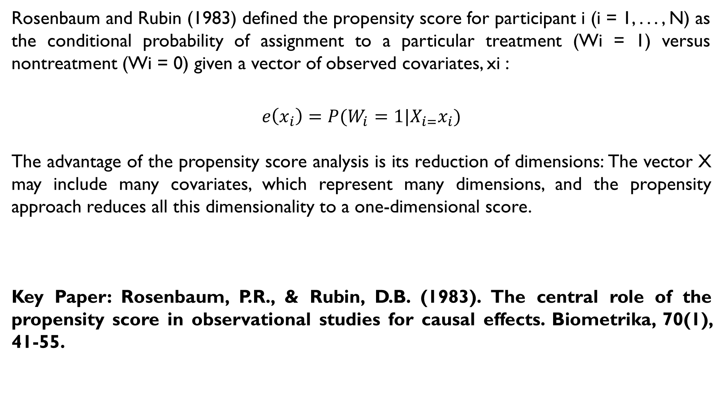
Rosenbaum and Rubin (1983) defined the propensity score for participant i (i = 1, . . . , N) as the conditional probability of assignment to a particular treatment (Wi = 1) versus nontreatment (Wi = 0) given a vector of observed covariates, xi :
$$e\left(x_{i}\right)=P(W_{i}=1|X_{i=}x_{i})$$
The advantage of the propensity score analysis is its reduction of dimensions: The vector X may include many covariates, which represent many dimensions, and the propensity approach reduces all this dimensionality to a one-dimensional score.
Key Paper: Rosenbaum, P.R., & Rubin, D.B. (1983). The central role of the propensity score in observational studies for causal effects. Biometrika, 70(1), 41-55.

Slide 25
Methods of propensity score
Stratification:
Stratification divides individuals into many groups (or subclasses) on the basis of their propensity score values. It is similar to full matching but creates fewer groupings. The optimal number of strata depends on the sample size and the amount of overlap or common support between the treatment and control groups’ propensity scores.
Key Paper: Rosenbaum, P.R., & Rubin, D.B. (1984). Reducing bias in observational studies using subclassification on the propensity score. Journal of the American Statistical Association, 79(387), 516-524

Slide 26
Matching:
The goal of matching is to obtain similar groups of treatment and control subjects by matching individual observations on their propensity scores. Nearest neighbor (NN) or greedy matching selects a control unit for each treated unit based on the smallest distance from that treated unit in PS. The selection process can be done without replacement, i.e., subjects are not returned to the sample after being pair-matched.
Key Paper: Rosenbaum, P.R., & Rubin, D.B. (1984). Reducing bias in observational studies using subclassification on the propensity score. Journal of the American Statistical Association, 79(387), 516-524

Slide 27
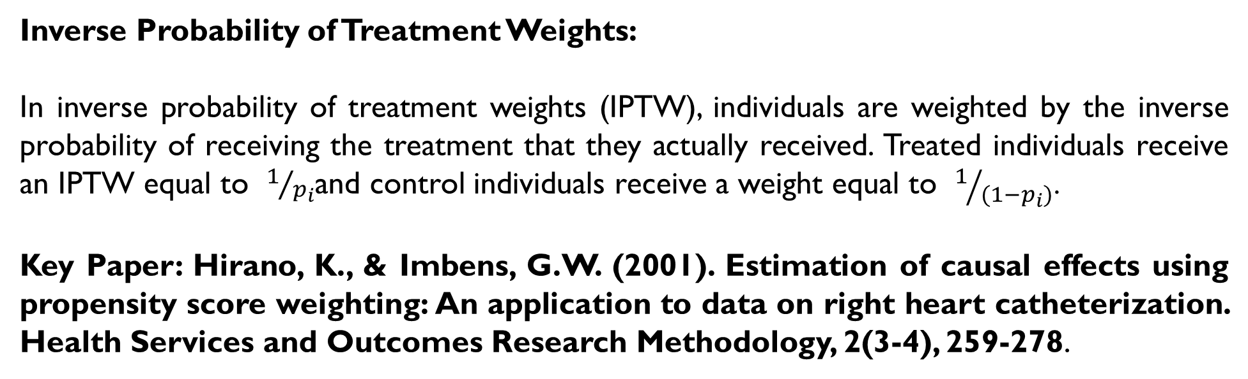
Inverse Probability of Treatment Weights:
In inverse probability of treatment weights (IPTW), individuals are weighted by the inverse probability of receiving the treatment that they actually received. Treated individuals receive an IPTW equal to $1/{p_{i}}$and control individuals receive a weight equal to $1/{(1−p_{i})}$.
Key Paper: Hirano, K., & Imbens, G.W. (2001). Estimation of causal effects using propensity score weighting: An application to data on right heart catheterization. Health Services and Outcomes Research Methodology, 2(3-4), 259-278.

Slide 28
Estimation of propensity score
Several methods for estimating the conditional probability of receiving treatment using a vector of observed covariates are available. These methods include logistic regression, the probit model, and discriminant analysis. Out of these methods, logistic regression is the most prevailing approach.
Binary Logistic Regression:
Binary logistic regression models are the relationship between a set of independent variables and a binary dependent variable. It is useful when the dependent variable is dichotomous in nature, like death or survival, absence or presence and so on. Independent variables can be categorical or continuous, for example, gender, age, income or geographical region.

Slide 29
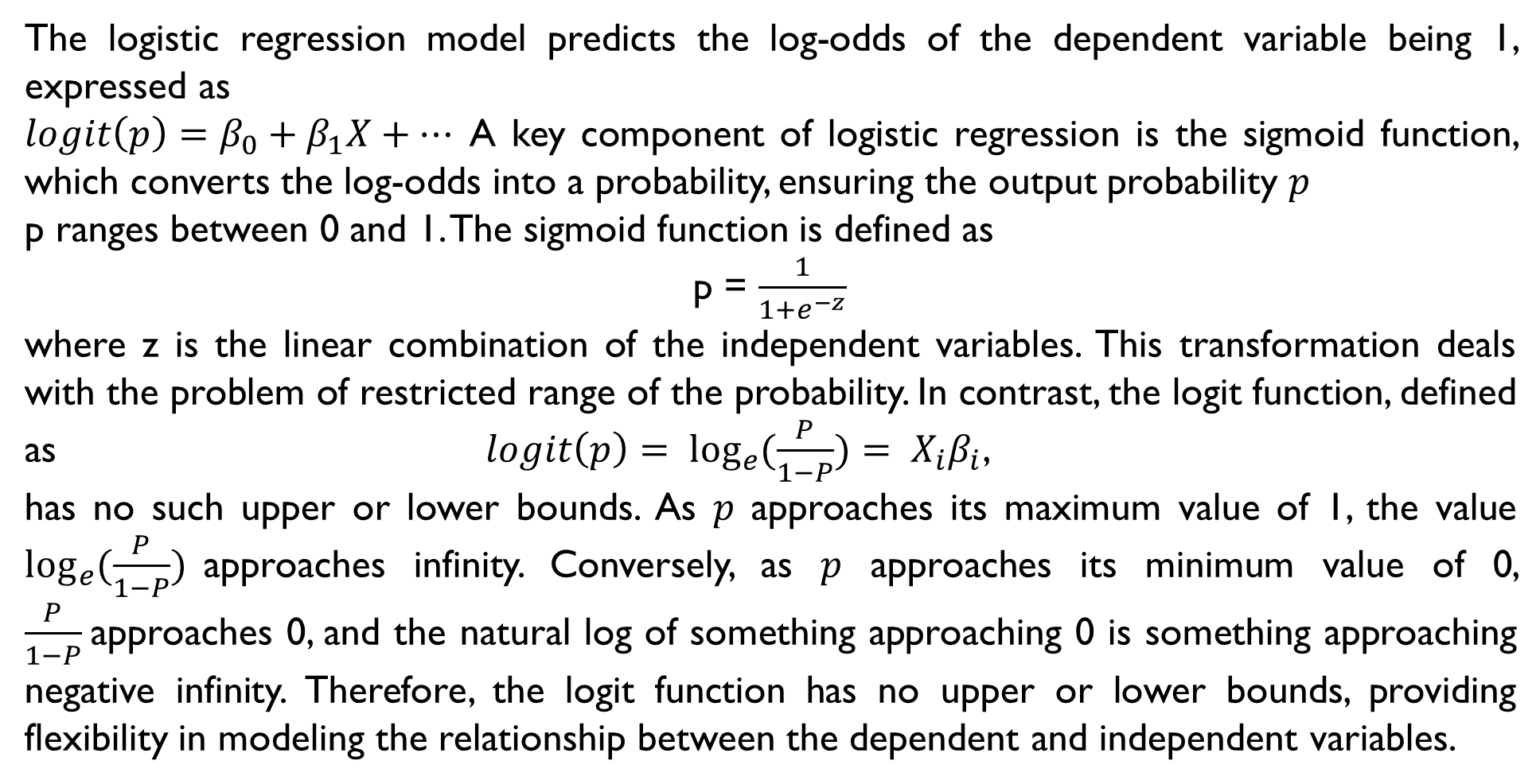
The logistic regression model predicts the log-odds of the dependent variable being 1, expressed as
$logit\left(p\right)=β_{0}+β_{1}X+…$ A key component of logistic regression is the sigmoid function, which converts the log-odds into a probability, ensuring the output probability 𝑝
p ranges between 0 and 1. The sigmoid function is defined as
p = $\frac{1}{1+e^{−z}}$
where z is the linear combination of the independent variables. This transformation deals with the problem of restricted range of the probability. In contrast, the logit function, defined as $logit\left(p\right)= \log_{e}{(\frac{P}{1−P})}= X_{i}β_{i}$,
has no such upper or lower bounds. As 𝑝 approaches its maximum value of 1, the value $\log_{e}{(\frac{P}{1−P})}$approaches infinity. Conversely, as 𝑝 approaches its minimum value of 0, $\frac{P}{1−P}$approaches 0, and the natural log of something approaching 0 is something approaching negative infinity. Therefore, the logit function has no upper or lower bounds, providing flexibility in modeling the relationship between the dependent and independent variables.

Slide 30
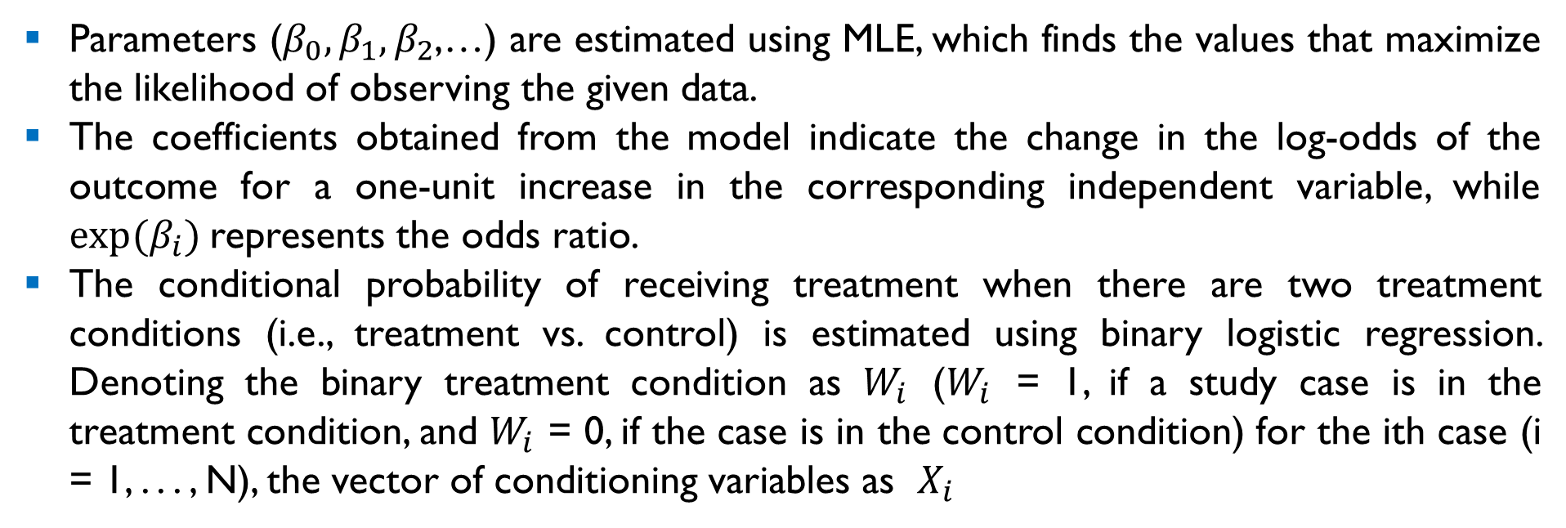
Parameters ($β_{0},β_{1},β_{2}$,…) are estimated using MLE, which finds the values that maximize the likelihood of observing the given data.
The coefficients obtained from the model indicate the change in the log-odds of the outcome for a one-unit increase in the corresponding independent variable, while $exp⁡(β_{i})$represents the odds ratio.
The conditional probability of receiving treatment when there are two treatment conditions (i.e., treatment vs. control) is estimated using binary logistic regression. Denoting the binary treatment condition as $W_{i}$ ($W_{i}$ = 1, if a study case is in the treatment condition, and $W_{i}$ = 0, if the case is in the control condition) for the ith case (i = 1, . . . , N), the vector of conditioning variables as $X_{i}$

Slide 31
We performed binary logistic regression using the variables ID, N_Days, Age, Albumin, Copper, Platelets, Prothrombin, Sex, Ascites, Hepatomegaly, Spiders, and Edema as predictors, and Drug as the outcome variable, to compute the propensity score. The propensity score represents the estimated probability that a patient will be prescribed D-Penicillamine, based on the observed covariates. To account for the categorical nature of Sex, Ascites, Hepatomegaly, Spiders, and Edema, we introduced dummy variables. This transformation allowed us to include these categorical predictors in the logistic regression model appropriately.

Slide 32
ID | N_ Days | Age | Albumin | Copper | Platelets | … | Drug | Sex | Propensity Score | Propensity Logit
43 | 4556 | 17850 | 3.64 | 36.0 | 203.0 | … | D-Penicillamine | F | 0.425154 | -0.30165
52 | 2386 | 18460 | 3.70 | 158.0 | 363.0 | … | D-Penicillamine | M | 0.491873 | -0.03250
53 | 1000 | 24621 | 3.10 | 94.0 | 214.0 | … | D-Penicillamine | F | 0.673086 | 0.72217
81 | 2540 | 23107 | 3.65 | 34.0 | 385.0 | … | D-Penicillamine | F | 0.579954 | 0.32258
94 | 750 | 19693 | 3.11 | 178.0 | 188.0 | … | D-Penicillamine | F | 0.458014 | -0.16834
: | : | : | : | : | : | … | : | : | : | :
312 | 788 | 12109 | 3.79 | 186.0 | 200.0 | … | Placebo | F | 0.464156 | -0.14362
304 | 1230 | 12979 | 3.93 | 22.0 | 246.0 | … | D-Penicillamine | F | 0.274639 | -0.97121
: | : | : | : | : | : | … | : | : | : | :
311 | 839 | 13879 | 3.16 | 69.0 | 335.0 | … | D-Penicillamine | F | 0.521098 | 0.08444
The resulting propensity scores reflect the likelihood of each patient receiving the drug D-Penicillamine, given their specific combination of covariates.

Slide 33
matching
After propensity scores are estimated, the next step of analysis often entails matching treated to control participants based on the estimated propensity scores. The core idea of matching, after obtaining estimated propensity scores, is to create a new sample of cases that share approximately similar likelihoods of being assigned to the treatment condition. Perhaps the most common matching algorithm is the so-called greedy matching.
Several metrics employed to perform greedy matching includes Mahalanobis metric matching, Mahalanobis metric matching with propensity scores, nearest neighbor matching, caliper matching, nearest neighbor matching within a caliper, and nearest available Mahalanobis metric matching within a caliper defined by the propensity score. All methods are called greedy matching.

Slide 34
Propensity matching has multiple strengths. First, because propensity matching requires only the single propensity score to select a comparison group, the sample size limitations associated with covariate matching are avoided. Second, the independence of the propensity score from the outcome variable of interest makes it a good proxy for random assignment. Third, research shows that estimated propensity scores are better than the true propensity score at removing bias.

Slide 35
K-NEAREST NEIGHBOR
K-Nearest Neighbor is one of the simplest Machine Learning algorithms based on Supervised Learning technique.
K-NN algorithm can be used for Regression as well as for Classification but mostly it is used for the Classification problems.
K-NN is a non-parametric algorithm, which means it does not make any assumption on underlying data. It is also called a lazy learner algorithm because it does not learn from the training set immediately.

Slide 36
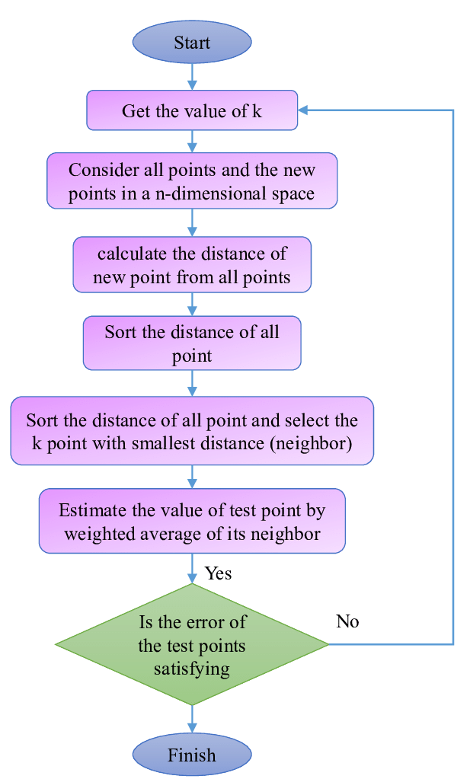

Slide 37
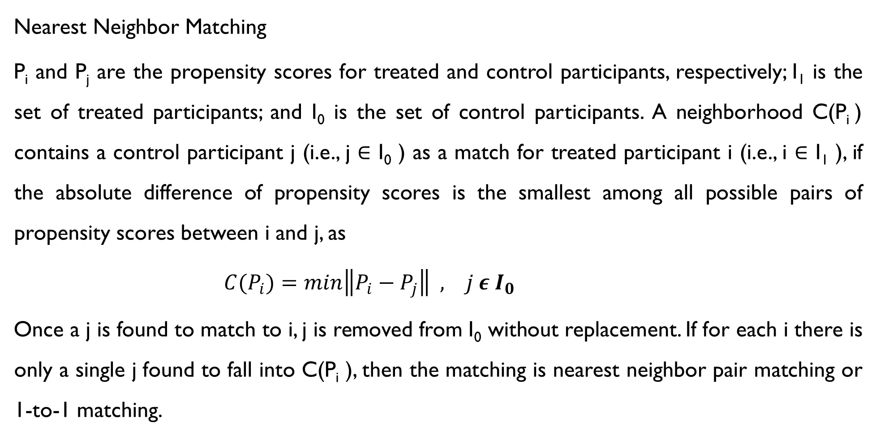
Nearest Neighbor Matching
P_{i} and P_{j} are the propensity scores for treated and control participants, respectively; I₁ is the set of treated participants; and I₀ is the set of control participants. A neighborhood C(P_{i} ) contains a control participant j (i.e., j ∈ I₀ ) as a match for treated participant i (i.e., i ∈ I₁ ), if the absolute difference of propensity scores is the smallest among all possible pairs of propensity scores between i and j, as
${C(P}_{i})=min\left\|P_{i}−P_{j}\right\| , j ε I_{0}$
Once a j is found to match to i, j is removed from I₀ without replacement. If for each i there is only a single j found to fall into C(P_{i} ), then the matching is nearest neighbor pair matching or 1-to-1 matching.

Slide 38
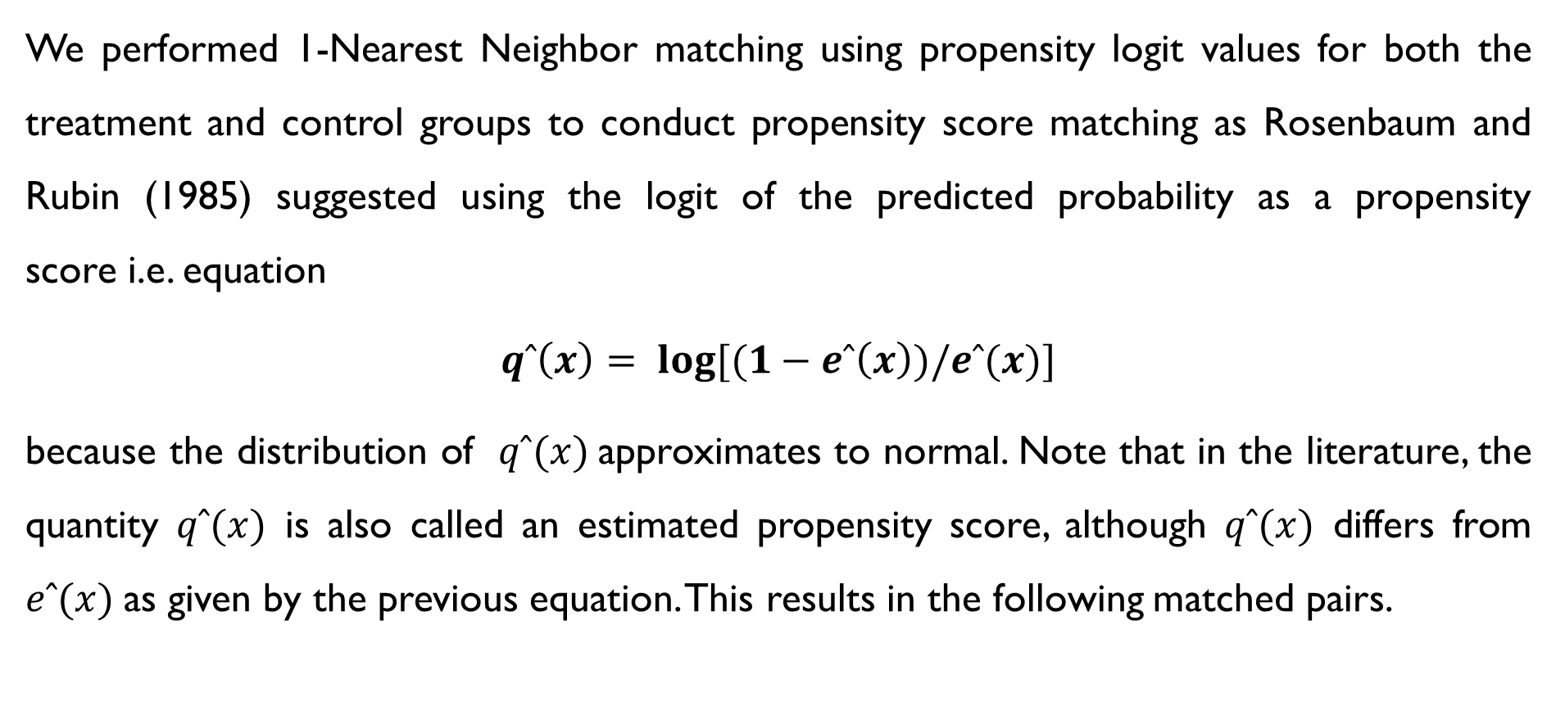
We performed 1-Nearest Neighbor matching using propensity logit values for both the treatment and control groups to conduct propensity score matching as Rosenbaum and Rubin (1985) suggested using the logit of the predicted probability as a propensity score i.e. equation
$$qˆ\left(x\right)= \log{[(1−eˆ\left(x\right))/eˆ(x)}]$$
because the distribution of $qˆ(x)$approximates to normal. Note that in the literature, the quantity $qˆ(x)$ is also called an estimated propensity score, although $qˆ(x)$ differs from $eˆ(x)$as given by the previous equation. This results in the following matched pairs.

Slide 39
ID | MATCHED ID
16 | 247
21 | 50
26 | 213
29 | 186
30 | 123
: | :
306 | 207
307 | 147
312 | 116
The given table displays the IDs of the matched pairs.
During the matching process, not all treated units were able to find a corresponding control unit with a similar propensity score, and vice versa. Consequently, in our obtained output, 4 units did not have any matches and will therefore be excluded from the analysis.

Slide 40
POSTMATCHING ANALYSIS
In the context of Propensity Score Matching (PSM), effect size refers to the estimated impact of the treatment on the outcome variable. This effect size is calculated by comparing the outcomes of the treated and control groups after adjusting for differences in covariates that predict treatment assignment. The primary goal is to isolate the effect of the treatment itself, thereby reducing the bias that may arise from confounding variables. This provides a more accurate estimation of the treatment's true effect. The importance of effect size in Propensity Score Matching (PSM) lies in its ability to reduce bias, enhance causal inference.

Slide 41
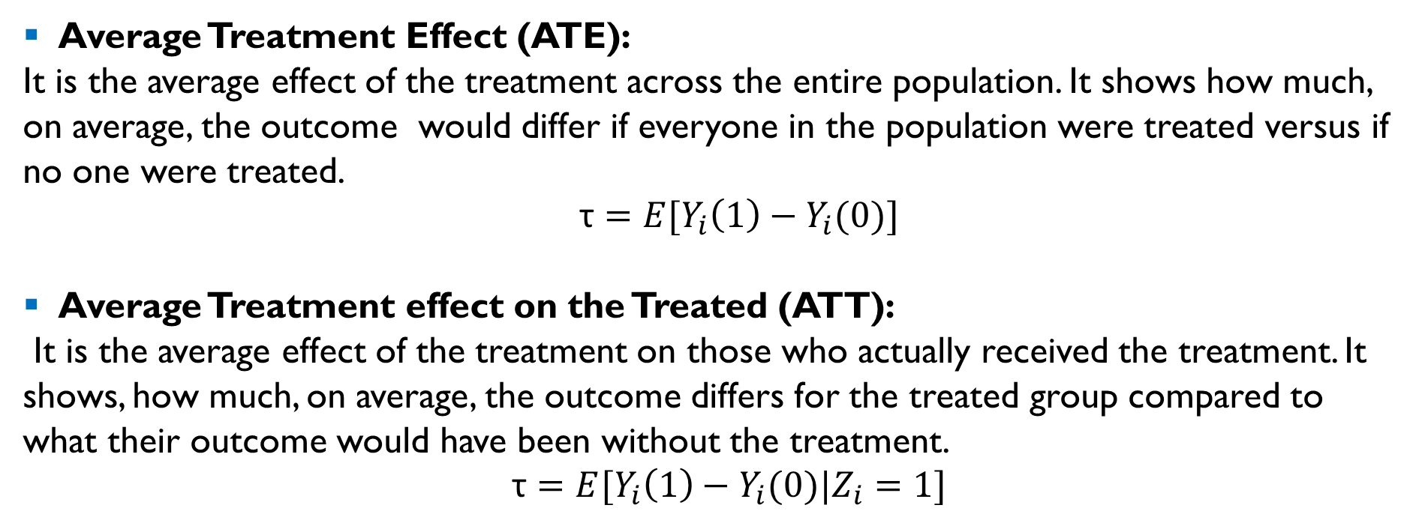
By matching treated and control subjects with similar propensity scores, reducing bias from confounding variables. This process enables a clearer understanding of the causal impact of the treatment, as the effect size represents the difference in outcomes between comparable individuals who differ only in their treatment status.
Average Treatment Effect (ATE):
It is the average effect of the treatment across the entire population. It shows how much, on average, the outcome would differ if everyone in the population were treated versus if no one were treated.
τ $=E[Y_{i}\left(1\right)−Y_{i}(0)]$
Average Treatment effect on the Treated (ATT):
It is the average effect of the treatment on those who actually received the treatment. It shows, how much, on average, the outcome differs for the treated group compared to what their outcome would have been without the treatment.
τ $=E[Y_{i}\left(1\right)−Y_{i}(0)|Z_{i}=1]$

Slide 42
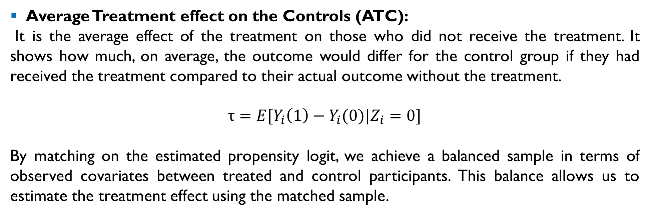
Average Treatment effect on the Controls (ATC):
It is the average effect of the treatment on those who did not receive the treatment. It shows how much, on average, the outcome would differ for the control group if they had received the treatment compared to their actual outcome without the treatment.
τ $=E[Y_{i}\left(1\right)−Y_{i}(0)|Z_{i}=0]$
By matching on the estimated propensity logit, we achieve a balanced sample in terms of observed covariates between treated and control participants. This balance allows us to estimate the treatment effect using the matched sample.

Slide 43
Variable | Before | After
N_Days | 0.016672 | 0.018487
Age | 0.270088 | 0.235156
Albumin | 0.017989 | 0.011533
Copper | 0.000076 | 0.001976
Platelets | 0.065092 | 0.052940
Prothrombin | 0.146361 | 0.138579
Sex | 0.110958 | 0.104630
Variable | Before | After
Ascites | 0.088640 | 0.075900
Hepatomegaly | 0.206322 | 0.202226
Spiders | 0.016277 | 0.010163
Edema(N) | 0.041668 | 0.056042
Edema(S) | 0.578707 | 0.068744
Edema(Y) | 0.006690 | 0.001714

Slide 44
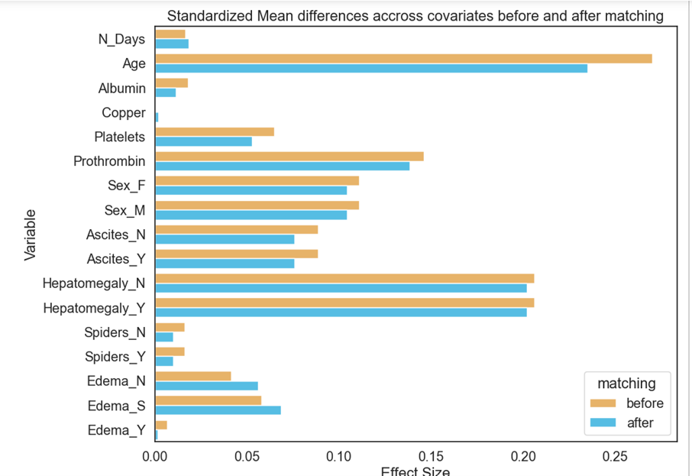

Slide 45
We aimed to study the impact of D-Penicillamine on Cirrhosis. Ideally, for the drug to demonstrate a meaningful impact, the Average Treatment Effect (ATE) should have been significantly high. However, the results suggest that while there is a trend towards a reduction in cirrhosis severity due to the treatment, the evidence is not statistically significant at the conventional 0.05 significance level.
 | EST. | S.E. | Z | P>|Z| | [95% CONF. INT]
ATE | -0.171 | 0.130 | -1.316 | 0.188 | (-0.426,0.084)
ATC | -0.238 | 0.142 | -1.677 | 0.094 | (-0.517,0.040)
ATT | -0.106 | 0.152 | -0.698 | 0.485 | (-0.404,0.192)
Outputs of average treatment effect in python

Slide 46
Software Tools:
Development of software packages in Python, R, Stata, SAS, and other statistical software, making it easier for researchers to implement propensity score methods. Packages like MatchIt in R, psmypy in Python and psmatch in Stata have become standard tools for applied researchers.

Slide 47
limitations
According to Rubin (1997), the primary limitations of PSM include that it works better in larger samples. In smaller samples, it may be challenging to find appropriate matches for each treated unit, leading to imbalances between the treatment and control groups. Larger samples provide a greater pool of potential matches, increasing the likelihood of finding good matches and improving the quality of the causal inference.
Matching at times may lead to significant data loss, especially if matches are not found for many treated or control units, reducing the sample size and statistical power.
PSM results are specific to the matched sample and may not generalize to the broader population, limiting the applicability of findings. These limitations necessitate careful consideration and possibly the use of additional methods.

Slide 48
Current AND FUTURE DIRECTIONS
Machine Learning Integration: Use of machine learning algorithms to improve the estimation of propensity scores and handle large-scale data.
High-Dimensional Propensity Score (hdPS): Methods to handle high-dimensional data, particularly in fields like epidemiology and health services research.
Causal Inference Frameworks: Integration with broader causal inference frameworks, including the potential outcomes approach and structural equation modeling.

Slide 49
CONCLUSIONS
The findings of this study indicate that D-Penicillamine exhibits minimal to no efficacy in the treatment of cirrhosis. Nonetheless, this investigation highlights the utility of propensity score analysis in evaluating the effects of a drug within a clinical trial context. When appropriately implemented, this method facilitates a more efficient and robust examination of treatment effects, provided that rigorous steps and methodologies are carefully followed.

Slide 50
REFERENCES
Propensity Score Analysis, Statistical Methods and Applications by Shenyang Guo, Mark W. Fraser Assessing liver function and interpreting liver blood tests https://www.sps.nhs.uk/articles/assessing-liver-function-and-interpreting-liver-blood-tests
Penicillamine https://en.wikipedia.org/wiki/Penicillamine
D‐penicillamine for primary biliary cirrhosis https://www.ncbi.nlm.nih.gov/pmc/articles/PMC8846335
Penicillamine Side Effects https://www.drugs.com/sfx/penicillamine-side-effects.html
A Complete Guide to Causal Inference in Python
https://analyticsindiamag.com/a-complete-guide-to-causal-inference-in-python/

Slide 51
Detecting Individuals at High Risk of Liver Cirrhosis with Artificial Intelligence Deep Learning Algorithms
https://www.clinicsearchonline.org/article/detecting-individuals-at-high-risk-of-liver-cirrhosis-with-artificial-intelligence-deep-learning-algorithms
Cohen’s Kappa Statistic for Measuring Agreement https://online.stat.psu.edu/stat509/lesson/18/18.7
Interrater reliability: the kappa statistic
https://www.ncbi.nlm.nih.gov/pmc/articles/PMC3900052
Research and scholarly methods: Propensity scores
https://www.ncbi.nlm.nih.gov/pmc/articles/PMC9980423
An Introduction to Propensity Score Methods for Reducing the Effects of Confounding in Observational Studies
https://www.ncbi.nlm.nih.gov/pmc/articles/PMC3144483
psmpy 0.3.13 documentation
https://pypi.org/project/psmpy
Ordinal Logistic Regression https://bookdown.org/chua/ber642_advanced_regression/ordinal-logistic-regression.html

Slide 52
THANK YOU !

