Slide 1
TA3
Arun Kumar Rajasekaran

Slide 2
Linear Regression
Just to extend upon our discussion from last TA

Slide 3
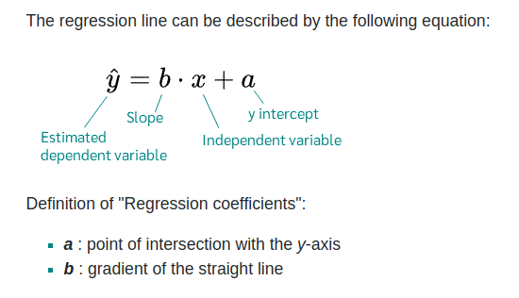
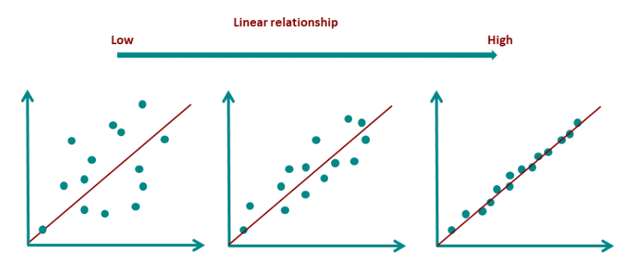
Linear Regression

Slide 4
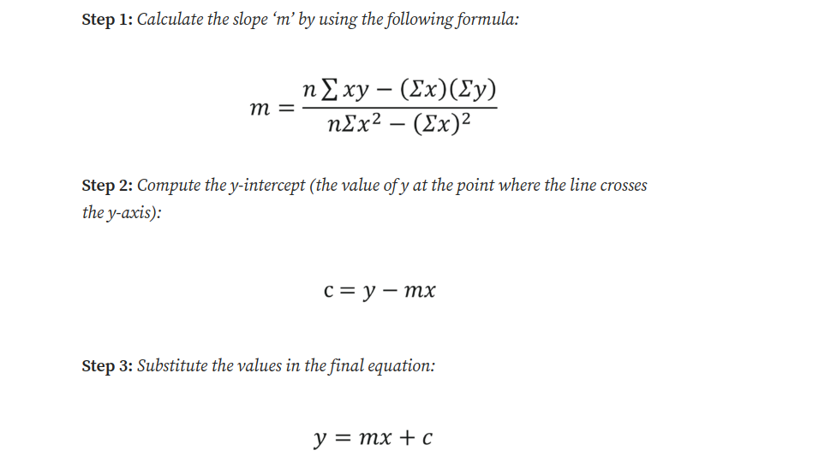
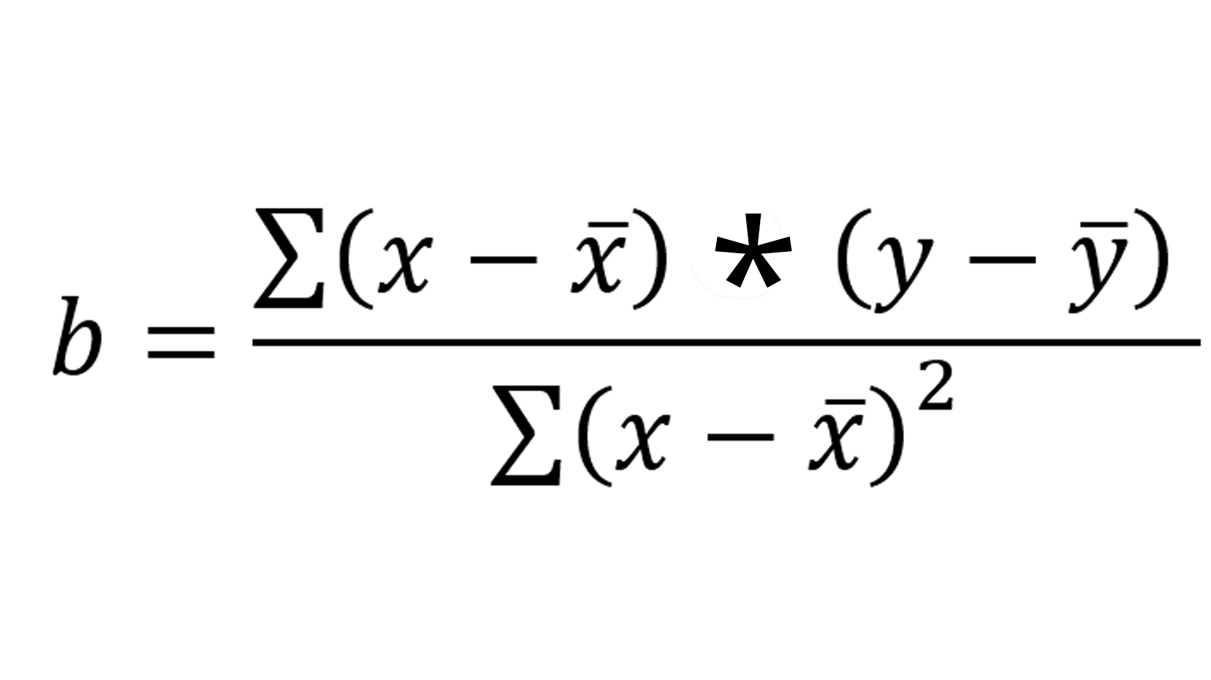

Assumptions of Linear Regression
Generic ‘Least square method’ (ref. Next slide)

Slide 5
Assumptions of Linear Regression
https://www.technologynetworks.com/informatics/articles/calculating-a-least-squares-regression-line-equation-example-explanation-310265

Slide 6
Assumptions of Linear Regression
Linearity: There must be a linear relationship between the dependent and independent variables.
Homoscedasticity: The residuals must have a constant variance.
Normality: Normally distributed error
No multicollinearity: No high correlation between the independent variables
No auto-correlation: The error component should have no auto-correlation

Slide 7
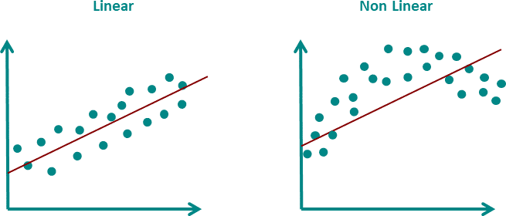
Linearity
In linear regression, a straight line is drawn through the data. This straight line should represent all points as good as possible. If the points are distributed in a non-linear way, the straight line cannot fulfill this task.

Slide 8
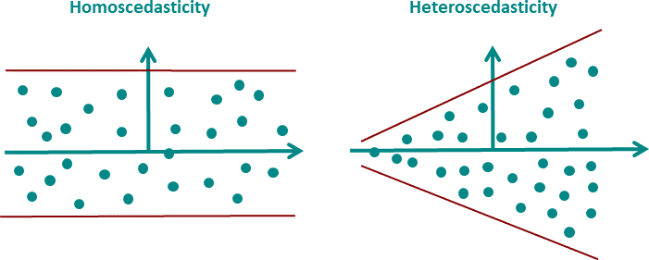
2. Homoscedasticity
Since in practice the regression model never exactly predicts the dependent variable, there is always an error. This very error must have a constant variance over the predicted range.

Slide 9
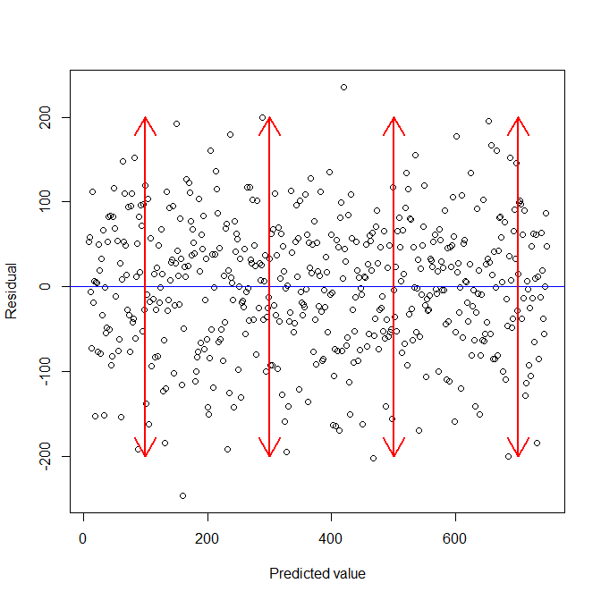
2. Homoscedasticity
Advanced analysis include,
F-Test
Modified Levene Test
Breusch-Pagan Test
Bartlett's Test

Slide 10
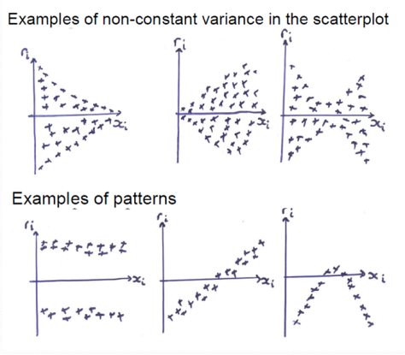
2. Homoscedasticity
Advanced analysis include,
F-Test
Modified Levene Test
Breusch-Pagan Test
Bartlett's Test

Slide 11
2. Homoscedasticity (how to fix?)
Variance stabilizing transformation: A transformation of the outcome used to correct non-constant variance is called a “variance stabilizing transformation.” common transformations are the natural logarithm, square root, inverse, and Box-Cox
Advanced methods such as weighted or generalized least squares can be used to handle non-constant variance.
Non-constant variance may co-occur with non-linearity and/or non-normality.

Slide 12
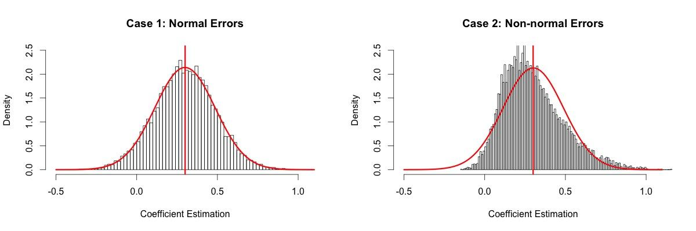
3. Normal distribution of error

Slide 13
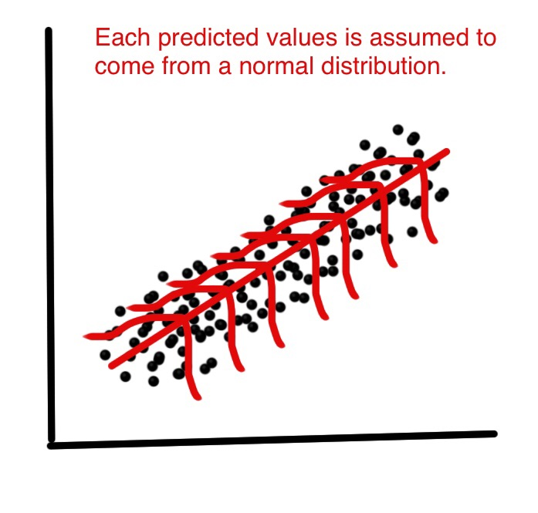
3. Normal distribution of error

Slide 14
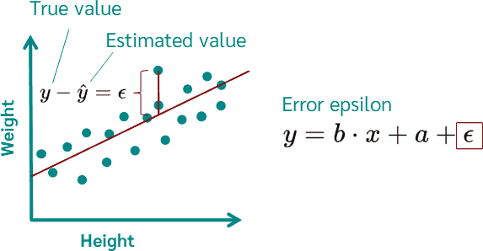

Slide 15
Multiple LR vs Multivariate

Slide 16
Simply…
“Regression analysis results in a formula of the form Y=a+bX. A multiple regression has more than one X in one formula. A multivariate regression has more than one Y, but in different formulae. And a multivariate multiple regression has multiple X’s to predict multiple Y’s with each Y in a different formula, usually based on the same data.”

Slide 17
A bit more, equations…
Simple regression pertains to one dependent variable (y) and one independent variable (x): y=f(x)
Multiple regression (aka multivariable regression) pertains to one dependent variable and multiple independent variables: y=f(x1,x2,...,xn)
Multivariate regression pertains to multiple dependent variables and multiple independent variables: y1,y2,...,ym=f(x1,x2,...,xn)
.

Slide 18
TA Open Discussion

Slide 19
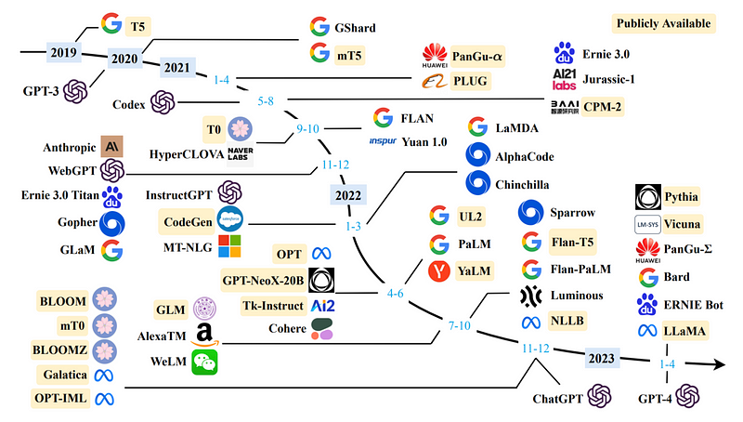
Large language models

