Slide 1
Mathematical Methods for Physics and Engineering
TA Session 1
Arun Kumar

Slide 2


Slide 3


Slide 4


Slide 5
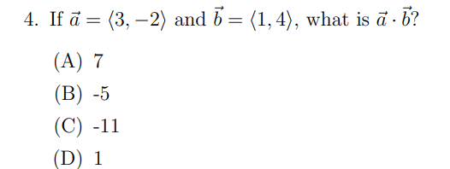

Slide 6

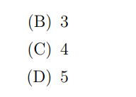

Slide 7


Slide 8
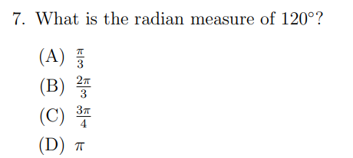

Slide 9
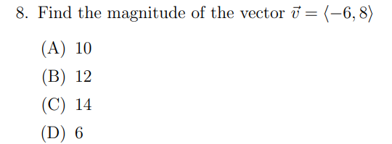

Slide 10
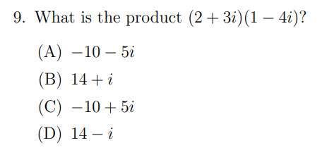

Slide 11
