Slide 1
TA 1
Arun Kumar Rajasekaran

Slide 2
Outline
~ 13 weeks of Lectures and TA
~ Independent research project

Slide 3
Coding interests anyone?

Slide 4
Python
https://www.python.org/downloads/
Jupyter
https://jupyter.org/
Google colab
https://colab.research.google.com/?utm_source=scs-index

Slide 5
Why Python?
(Extensive libraries and frameworks)
NumPy: NumPy is a fundamental Python library for efficient numerical computations and array operations.
Scikit-learn: Scikit-learn is a comprehensive machine learning library that offers a wide range of tools for various tasks, including classification, regression, clustering, and more.
Pandas: Pandas is a powerful library for data analysis and manipulation, providing intuitive data structures like DataFrames and Series.
TensorFlow: TensorFlow is a cutting-edge deep learning library known for its distributed computing capabilities and robust ecosystem.
Theano: Theano is a Python library designed for fast numerical computation, particularly useful for training deep learning models.
Keras: Keras is an easy-to-use deep learning API that acts as an interface for TensorFlow, Theano, or Microsoft Cognitive Toolkit (CNTK), simplifying the creation and training of neural networks.
PyTorch: PyTorch is a dynamic deep learning library with a flexible computation graph, making it ideal for developing and training complex neural networks.

Slide 6
Why Python?
Easy-to-read syntax
Cross-platform compatibility
Scaling and Performance
Community Support and Documentation
(Applications: Youtube, Google, Spotify, Reddit, Instagram, ChatGPT etc)

Slide 7
Python performance?
Performance and Efficiency:
Python: Python's performance has improved significantly with libraries like NumPy and JIT compilation techniques. Though not as fast as Java or C++, it provides an acceptable level of performance for most machine learning tasks.
R: R can be slower than Python for certain operations, particularly when handling large datasets.
Java/C++: Java and C++ are known for their high performance and efficiency, especially in computationally intensive tasks, but they often require more code to achieve the same functionality.

Slide 8
Coding standards
• Coding standards are guidelines for code style and documentation.
• They may be formal (IEEE) standards, or company specific standards.
• The aim is that everyone in the organization will be ableto read and work on the code.
• Coding standards cover a wide variety of areas:
– Program design
– Naming conventions
– Formatting conventions
– Documentation
– Use (or not) of language specific features

Slide 9
• Why bother with a coding standard?
– Consistency between developers
– Ease of maintenance and development
– Readability, usability
• Example should make this obvious!
• No standard is perfect for every application.
– If you deviate from the standard for any reason,
document it!

Slide 10
Coding style
• There are several examples of coding styles. Often they differ from company to company
• They typically have the following in common:
– Names
• Use full English descriptors
• Use mixed case to make names readable
• Use abbreviations sparingly and consistently
• Avoid long names
• Avid leading/trailing underscores
– Documentation
• Document the purpose of every variable
• Document why something is done, not just what

Slide 11
Coding style
– Accessors
• Use getX(), setX() functions on all class variables.
– Member function documentation
• What & why member function does what it does
• Parameters/return value
• How function modifies object
• Preconditions/postconditions
• Concurrency issues
• Restrictions
– Document why the code does things as well as what
it does.

Slide 12
Standards
• Standards rare documented agreements containing technical specifications or other precise criteria to be
used consistently as guidelines, rules, or definitions of characteristics, to ensure that materials, products,
processes and services are for for their purpose.
• International standards are supposed to contribute to making life simpler, and to increasing reliability and
effectiveness of the goods and services we use.
• Standards represent best, or most appropriate, practice:
– They encapsulate historical knowledge often gained through trail and error.
– They preserve and codify organizational knowledge and memory
– They provide a framework for quality assurance.
– Ensure continuity over a project’s lifecycle.

Slide 13
Standards
There are many industry standards governing all aspects of software development:
– Terminology
– Notation
– Requirements gathering
– Design
– Coding
– Documentation
– Human computer interaction
– Verification and validation
– Quality assurance
– Even ethics!

Slide 14
Who writes standards?
– ISO
International Organization for Standardization
– SAA
Standards Australia
– BSI
British Standards Institute
– ANSI
American National Standards Institute
– IEEE
Institute for Electronic and Electrical
Engineers
– And about 80 or so others!

Slide 15
Relevant standards
• ISO 646 – 7-bit ASCII with national variants
• ISO 8859 – several 8-bit ASCII extensions:
– ISO 8859-1: West European languages (Latin-1)
– ISO 8859-2: East European languages (Latin-2)
– ISO 8859-5: Latin/Cyrillic
• ISO 6429 – ASCII control codes
• ISO 2382 – Information technology vocabulary
• ISO 8652 – the Ada programming language
• ISO 9899 – the C programming language
• ISO 9660 – CD-ROM volume and fie structure
• ISO 3166 – codes for the representation of names of counties:
– Defines a 2-letter, 3-letter and numeric code for every country.
– US/USA/840 = United States
– GB/GBR/826 = United Kingdom
• The 2-letter codes are well known as the internet top level domain names.

Slide 16
Why math?
Vector calculus
Fourier Analysis
Complex Analysis
Numerical methods
Used in classical, quantum mechanics; fluid dynamics and signal processing

Slide 17
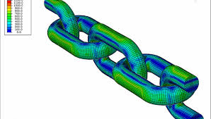
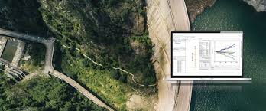
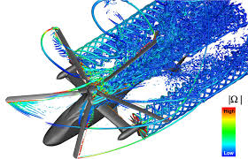
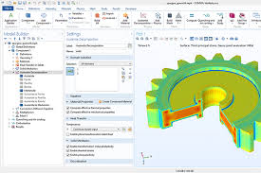
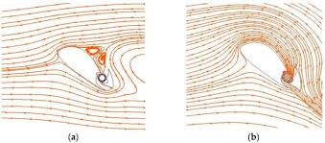

Slide 18
Machine learning/ AI interests anyone?

Slide 19
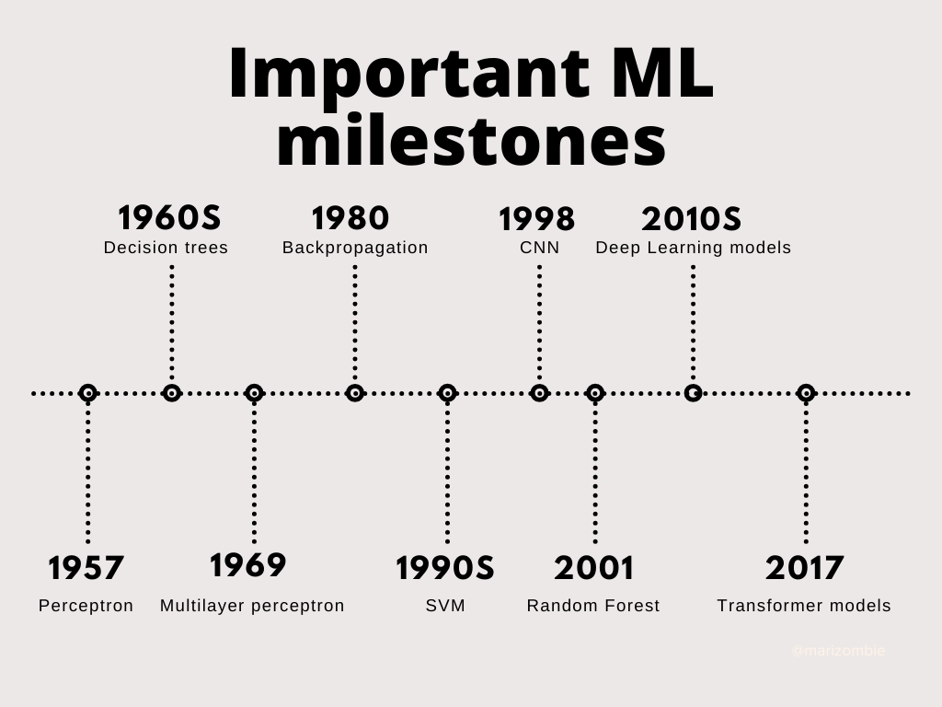
Machine learning

Slide 20
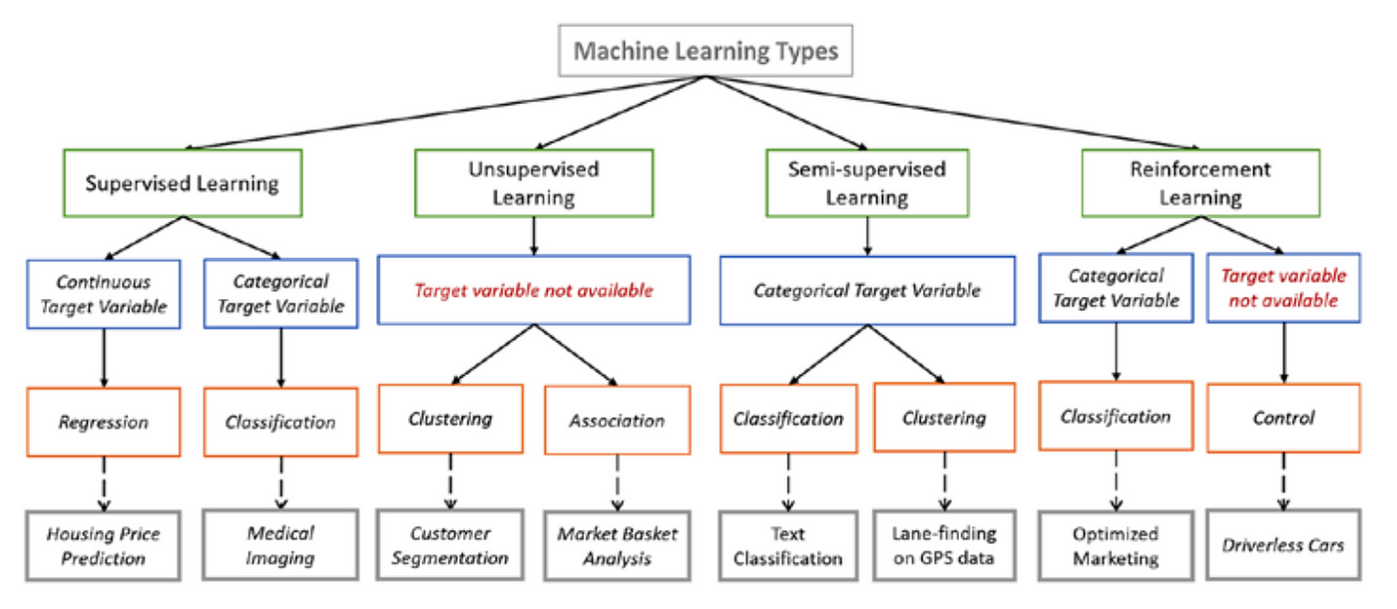
ML types

Slide 21
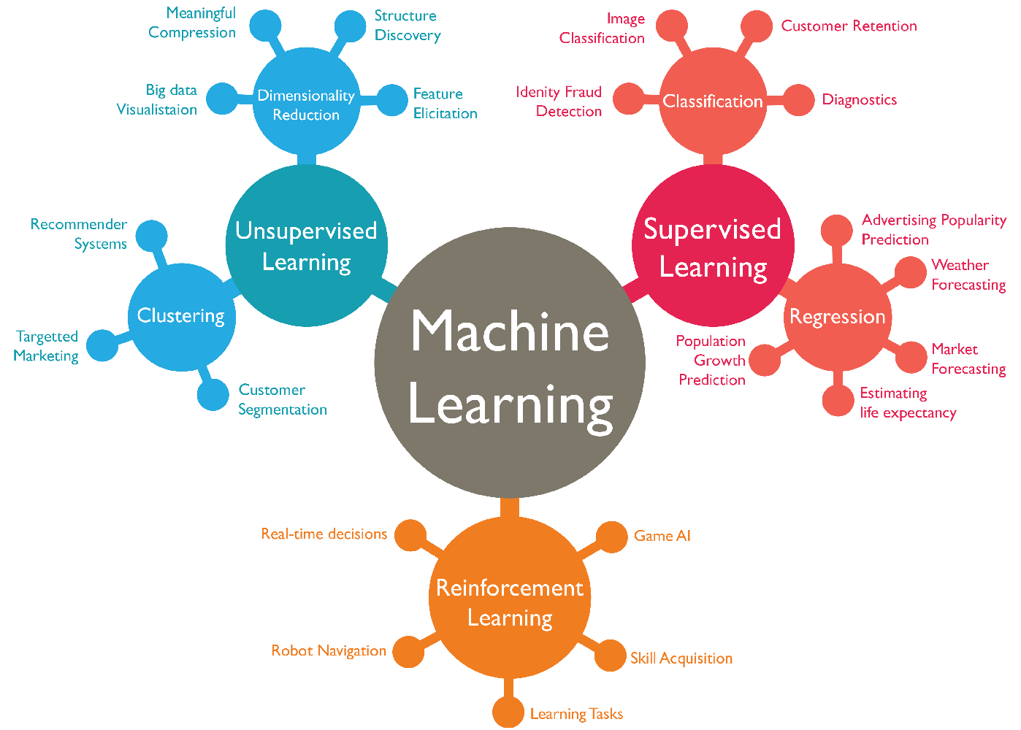
ML applications

Slide 22
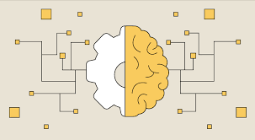
Some interesting applications
Chatbots
Fraud detection
Self driving cars
Stock/Finance
Translation/NLP
Healthcare/Climate research

Slide 23
A bit about course, timings, research project, post-course

Slide 24
Question session recommended by Dr. Rana

