Slide 1
NLP Pipeline Overview
&
STEMMING
TA session

Slide 2
Aims
NLP enables machines to understand and interpret human language by extracting metadata from content. It performs the following tasks:
Helps analyze different aspects of language.
Helps map the input in natural language into valid representations.

Slide 3
Major issues
Lexical ambiguity:
This means that one word holds several meanings. For example, "The man is looking for the match." The sentence is ambiguous as ‘match’ could mean different things such as a partner or a competition.
Syntactic ambiguity:
This refers to a sequence of words with more than one meaning. For example, "The fish is ready to eat.” The ambiguity here is whether the fish is ready to eat its food or whether the fish is ready for someone else to eat. This ambiguity can be resolved with the help of the part-of-speech tagging technique.
Referential ambiguity:
This involves a word or a phrase that could refer to two or more properties. For example, Tom met Jerry and John. They went to the movies. Here, the pronoun ‘they’ causes ambiguity as it isn’t clear who it refers to.

Slide 4
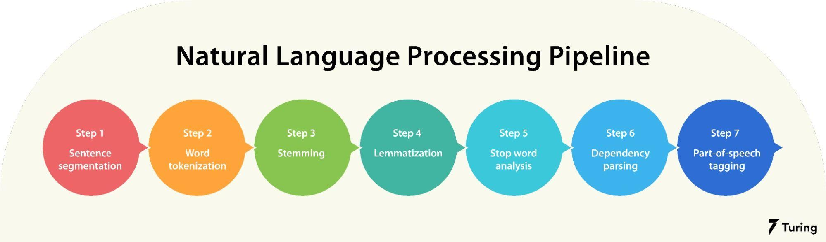
The pipeline

Slide 5
Working by example
"London is the capital and most populous city of England and the United Kingdom. Standing on the River Thames in the southeast of the island of Great Britain, London has been a major settlement for two millennia. It was founded by the Romans, who named it Londinium."

Slide 6
Step 1: Sentence segmentation
﻿ After using sentence segmentation, we get the following result:
“London is the capital and most populous city of England and the United Kingdom.”
“Standing on the River Thames in the southeast of the island of Great Britain, London has been a major settlement for two millennia.”
“It was founded by the Romans, who named it Londinium.”

Slide 7
Step 2: Word tokenization
When tokenizing the sentence “London is the capital and most populous city of England and the United Kingdom”, it is broken into separate words, i.e.,
“London”, “is”, “the”, “capital”, “and”, “most”, “populous”, “city”, “of”, “England”, “and”, “the”, “United”, “Kingdom”, “.”

Slide 8
Step 3: Stemming
Stemming helps in preprocessing text. The model analyzes the parts of speech to figure out what exactly the sentence is talking about.
Stemming normalizes words into their base or root form. In other words, it helps to predict the parts of speech for each token. For example, intelligently, intelligence, and intelligent. These words originate from a single root word ‘intelligen’. However, in English there’s no such word as ‘intelligen’.

Slide 9
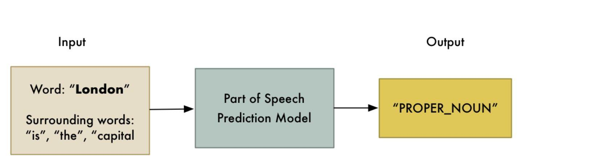
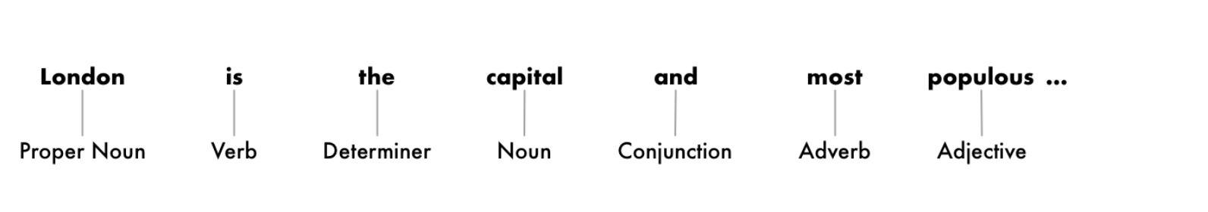

Slide 10
Step 4: Lemmatization
Lemmatization removes inflectional endings and returns the canonical form of a word or lemma. It is similar to stemming except that the lemma is an actual word. For example, ‘playing’ and ‘plays’ are forms of the word ‘play’. Hence, play is the lemma of these words. Unlike a stem (recall ‘intelligen’), ‘play’ is a proper word.

Slide 11
Step 5: Stop word analysis
The next step is to consider the importance of each and every word in a given sentence. In English, some words appear more frequently than others such as "is", "a", "the", "and". As they appear often, the NLP pipeline flags them as stop words. They are filtered out so as to focus on more important words.

Slide 12
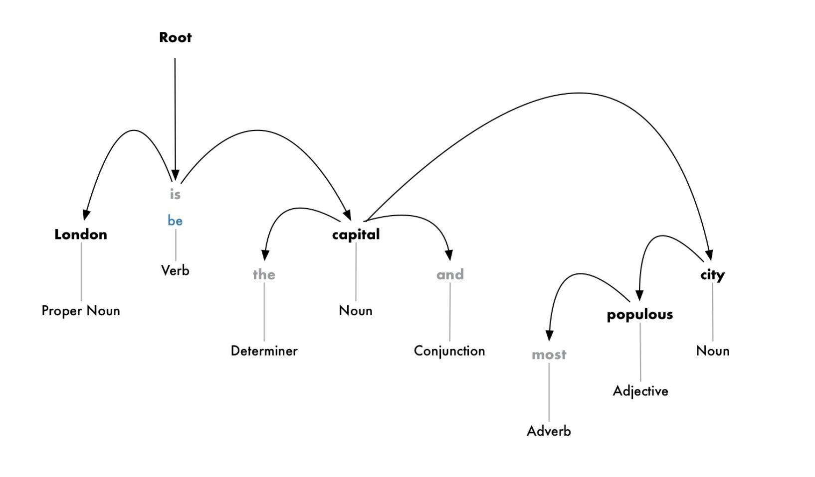
Step 6: Dependency parsing
Next comes dependency parsing which is mainly used to find out how all the words in a sentence are related to each other. To find the dependency, we can build a tree and assign a single word as a parent word. The main verb in the sentence will act as the root node.

Slide 13
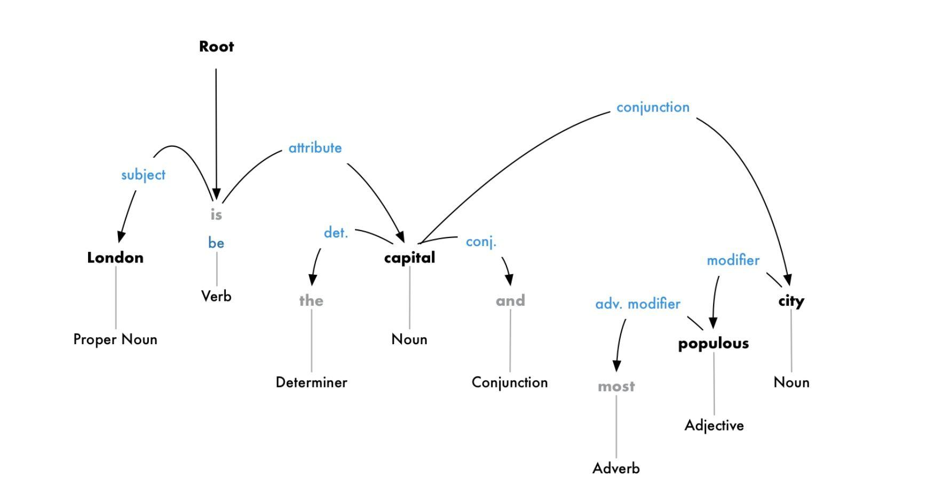
Step 7: Part-of-speech (POS) tagging
POS tags contain verbs, adverbs, nouns, and adjectives that help indicate the meaning of words in a grammatically correct way in a sentence.

Slide 14
The course project
Multilingual dependency parsing (roughly parsing for languages other than English)
Choosing target languages
Implementing a perceptron-based classifier and applying it to solve part-of-speech tagging

Slide 15
Stemming (Some theory)
To be followed after google colab code tutorial

Slide 16
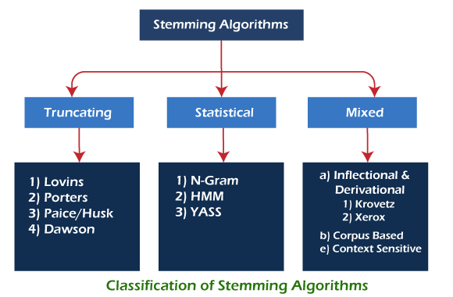
Classification of Stemming Algorithms

Slide 17
1. Truncating or Affix Removal Methods
As the name suggests, these methods are related to removing the suffixes or prefixes of a word. The most basic stemmer was the Truncate (n) stemmer which truncated a word at the nth symbol, i.e., keep n letters and remove the rest. In this method, words shorter than n are kept as it is. The chances of over stemming increase when the word length is small. Another simple approach was the S-stemmer, which is an algorithm conflating singular and plural forms of English nouns. The algorithm has rules to remove suffixes in plurals to convert them to singular forms.

Slide 18
Lovins stemmer
The Lovins algorithm is bigger than the Porter algorithm because of its very extensive endings list. Lovins proposed it in 1968 that removes the longest suffix from a word, and then the word is recorded to convert this stem into valid words. The main advantage of Lovins stemmer is it is faster. It has effectively traded space for time, and with its large suffix set, it needs just two major steps to remove a suffix, compared with the eight of the Porter algorithm.
The Lovins stemmer has 294 endings, 29 conditions, and 35 transformation rules. Each end is associated with one of the conditions. The longest ending is found in the first step, which satisfies its associated condition and is removed. In the second step, the 35 rules are applied to transform the ending. The second step is done whether or not an ending is removed in the first step.
For example: sitting -> sitt -> sit
Advantage: It is fast and handles irregular plurals like 'teeth' and 'tooth' etc.
Limitation: It is time and data-consuming. It is sometimes highly unreliable and frequently fails to form words from the stems or match the stems of like-meaning words. Furthermore, many suffixes are not available in the table of endings.

Slide 19
Porter’s Stemmer algorithm
This stemmer is known for its speed and simplicity. It is one of the most popular stemming methods proposed in 1980. It is based on the idea that the suffixes in the English language are made up of a combination of smaller and simpler suffixes. Its main concern is removing the common endings to words so that they can be resolved to a common form.
The main applications of Porter Stemmer include data mining and Information retrieval. However, its applications are only limited to English words. Also, the group of stems is mapped onto the same stem, and the output stem is not necessarily a meaningful word. The algorithms are fairly lengthy and are known to be the oldest stemmer. Typically, it's a basic stemmer, but it's not advised to use it for any production or complex application. Instead, it has its place in research as a basic stemming algorithm that can guarantee reproducibility.
For example, EED -> EE means "if the word has at least one vowel and consonant plus EED ending, change the ending to EE" as 'agreed' becomes 'agree'.
Advantage: It produces the best output as compared to other stemmers, and it has less error rate.
Limitation: Morphological variants produced are not always real words.

Slide 20
Paice/Husk Stemmer
The Paice/Husk stemmer is an iterative algorithm with one table containing about 120 rules indexed by the last letter of a suffix. Each rule specifies either a deletion or replacement of an ending. On each iteration, it tries to find an applicable rule by the last character of the word. If there is no such rule, it terminates. It also terminates if a word starts with a vowel and only two letters are left or if a word starts with a consonant and only three characters are left. Otherwise, the rule is applied, and the process repeats.
Advantage: It is simple, and every iteration takes care of both deletion and replacement as per the rule applied.
Limitation: It is a very heavy algorithm, and over stemming may occur.

Slide 21
Dawson Stemmer
This stemmer extends the Lovins approach, except it covers a more comprehensive list of about 1200 suffixes. Like Lovins, it is a single pass stemmer and is pretty fast. The suffixes are stored in the reversed order indexed by their length and last letter. They are organized as a set of branched character trees for rapid access.
Advantage: It is fast execution, covers more suffice, and produces a more accurate stemming output.
Limitation: It is very complex to implement and lacks a standard reusable implementation.

Slide 22
2. Statistical Methods
These are the stemmers that are based on statistical analysis and techniques. Most of the methods remove the affixes after implementing some statistical procedure.

Slide 23
N-Gram Stemmer
This is a very interesting method, and it is language-independent. Over here string-similarity approach is used to convert word inflation to its stem. An n-gram is a string of n, usually adjacent, characters extracted from a section of continuous text. To be precise, an n-gram is a set of n consecutive characters extracted from a word. The main idea behind this approach is that similar words will have a high proportion of n-grams in common. Some stemming techniques use the n-gram context to choose the correct stem for a word. For n equals 2 or 3, the words extracted are digrams or trigrams.
For example: 'INTRODUCTIONS' for n=2 becomes : *I, IN, NT, TR, RO, OD, DU, UC, CT, TI, IO, ON, NS, S*
And for n=3 becomes: **I, *IN, INT, NTR, TRO, ROD, ODU, DUC, UCT, CTI, TIO, ION, ONS, NS*, S**
Where '*' denotes a padding space, there are n+1 such diagrams and n+2 such trigrams in a word containing n characters. Most stemmers are language-specific. Generally, a value of 4 or 5 is selected for n. After that, textual data or document is analyzed for all the n-grams.
It is obvious that a word root generally occurs less frequently than its morphological form. This means a word generally has an affix associated with it. A typical statistical analysis based on the inverse document frequency (IDF) can be used to identify them.
Advantage: It is based on string comparisons, and it is language-dependent, and hence very useful in many applications.
Limitation: It requires a significant amount of memory and storage to create and store the n-grams and indexes. Hence, it is not time efficient or not a very practical approach.

Slide 24
HMM Stemmer
This stemmer is based on the Hidden Markov Model (HMMs) concept, finite-state automata where probability functions rule transitions between states. The new state emits a symbol with a given probability at each transition.
To apply HMMs to stemming, a sequence of letters that forms a word can be considered the result of a concatenation of two subsequences: a prefix and a suffix. The probability of each path can be computed, and the most probable path is found using the Viterbi coding in the automata graph. This method is based on unsupervised learning and does not need prior linguistic knowledge of the dataset.
Transitions between states define the word-building process.
A way to model this process is through an HMM where the states are divided into two disjoint sets: the initial can be the stems only, and the latter can be the stems or suffixes. Some assumptions can be made in this method:
Initial states belong only to the stem-set - a word always starts with a stem.
Transitions from states of the suffix-set to states of the stem-set always have a null probability - a word can be only a concatenation of a stem and a suffix.
Final states belong to both sets - a stem can have many different derivations, but it may also have no suffix.
For any word, the most probable path from initial to final states will produce the split point (a transition from roots to suffixes). Then the sequence of characters before this point can be considered a stem.
Advantage: It is unsupervised, so knowledge of the language is not required.
Limitation: It is a little complex and may over stem the words sometimes.

Slide 25
YASS Stemmer
The name is an acronym for Yet Another Suffix Striper. This stemmer comes under the category of statistical as well as corpus-based. It does not rely on linguistic expertise. The performance of a stemmer generated by clustering a lexicon without any linguistic input is comparable to that obtained using standard, rule-based stemmers such as Porters.
Retrieval experiments by the authors on English, French, and Bengali datasets show that the proposed approach is effective for languages that are primarily suffixing in nature. The clusters are created using hierarchical approach and distance measures. Then the resulting clusters are considered equivalence classes and their centroids as the stems.

Slide 26
3. Inflectional and Derivational Methods
This is another approach to stemming, and it involves both the inflectional and the derivational morphology analysis. In inflectional, the word variants are related to specific language syntactic variations like a plural, gender, case, etc. In derivational, the word variants are related to the part-of-speech (POS) of a sentence where the word occurs. The corpus should be very large to develop these types of stemmers, and hence they are part of corpus base stemmers.

Slide 27
Krovetz Stemmer (KSTEM)
The Krovetz stemmer was presented in 1993 by Robert Krovetz and is a linguistic lexical validation stemmer. Since it is based on the inflectional property of words and the language syntax, it isn't very easy in nature. It effectively and accurately removes inflectional suffixes in three steps:
-Transforming the plurals of a word to its singular form.
-Converting the past tense of a word to its present tense.
-Removing the suffix 'ing'.
The conversion process first removes the suffix and then, through checking in a dictionary for any recoding, returns the stem to a word. The dictionary lookup also performs any transformations required due to spelling exceptions and converts any stem produced into a real word, whose meaning can be understood.
The strength of the derivational and inflectional analysis is in their ability to produce morphologically correct stems, cope with exceptions, and process prefixes and suffixes. Since this stemmer does not find the stems for all word variants, it can be used as a prestemmer before applying a stemming algorithm. This would increase the speed and effectiveness of the main stemmer. This is a very light stemmer compared to Porter and Paice / Husk.
The major and obvious flaw in dictionary-based algorithms is their inability to cope with words that are not in the lexicon.
The Krovetz stemmer attempts to increase accuracy and robustness by treating spelling errors and meaningless stems. If the input document size is large, this stemmer becomes weak and does not perform very effectively. Also, a lexicon must be manually created in advance, which requires significant effort. This stemmer does not consistently produce a good recall and precision performance.

Slide 28
Xerox Inflectional and Derivational Analyzer
The linguistics groups at Xerox have developed several linguistic tools for English which can be used in information retrieval. They have produced an English lexical database that provides a morphological analysis of any word in the lexicon and identifies the base form. Xerox linguists have also developed a lexical database for English and some other languages to analyze and generate inflectional and derivational morphology.
The inflectional database reduces each surface word to the form which can be found in the dictionary, as follows:
nouns singular (e.g., children child)
verbs infinitive (e.g., understood understand)
adjectives positive form (e.g., best good)
pronoun nominative (e.g., whom who)
The derivational database reduces surface forms to stems related to the original in both form and semantics. For example, 'government' stems to 'govern' while 'department' is not reduced to 'depart' since the two forms have different meanings. All items are valid English terms, and irregular forms are handled correctly. Unlike most conventional stemming algorithms, the derivational process uses suffix and prefix removal, relying solely on suffix removal. A sample of the suffixes and prefixes that are removed is given below:
Suffixes: ly, ness, ion, size, ant, ent, ic, al, Ic, ical, able, ance, ary, ate, ce, y, dom, ee, er, ence, ency, ery, ess, ful, hood, ible, icity, ify, ing, ish, ism, ist, istic, ity, ive, less, let, like, ment, ory, ous, ty, ship, some, ure
Prefixes: anti, bi, co, contra, counter, de, di, dis, en, extra, in, inter, intra, micro, mid, mini, multi, non, over, para, poly, post, pre, pre, re, semi, sub, super, supra, sur, trans, tn, ultra, un

Slide 29
Corpus-Based Stemmer
Corpus-based stemming using co-occurrence of word variants. They have suggested an approach that tries to overcome some of the drawbacks of Porter's stemmer. For example, the words 'policy' and 'police' are conflated though they have different meanings, the words 'index' and 'indices' are not conflated though they have the same root. Porter stemmer also generates stems that are not real words like 'iteration' becomes 'iter', and 'general' becomes 'gener'. Another problem is that while some stemming algorithms may be suitable for one corpus, they will produce too many errors on another.
Corpus-based stemming refers to the automatic modification of conflation classes - words that have resulted in a common stem to suit the characteristics of a given text corpus using statistical methods. The basic hypothesis is that word forms that should be conflated for a given corpus will co-occur in documents from that corpus. Using this concept, some of them over stemming or under stemming drawbacks are resolved, e.g., 'policy' and 'police' will no longer be conflated.
To determine the significance of word form co-occurrence, the statistical measure used in Em(a, b) = nab / (na + nb) Where, a and b are a pair of words, na, and nb is the number of occurrences of a and b in the corpus, nab is the number of times both a and b fall in a text window of size win in the corpus (they co-occur).
The way this stemmer works is first to use the Porter stemmer to identify the stems of conflated words, and then the next step is to use the corpus statistics to redefine the conflation. Sometimes, the Krovetz stemmer (KSTEM) and Porter stemmer are used in the initial step to ensure that word conflations are not missed.
Advantage: It can potentially avoid making inappropriate conflations for a given corpus, and the result is an actual word and not an incomplete stem.
Limitation: You need to develop the statistical measure for every corpus separately. The processing time increases as in the first step, and two stemming algorithms are first used before using this method.

Slide 30
Context-Sensitive Stemmer
This stemming process is divided into four steps after the query is fired:
Candidate generation: Here, the Porter stemmer is used to generate the stems from the query words. This has no relation to the semantics of the words. The corpus-based analysis based on distributional similarity is used for a better output. Using distributional word similarity means true variants tend to be used in similar contexts. In the distributional word similarity calculation, each word is represented with a vector of features derived from the word's context. We use the bigrams to the left and right of the word as its context features by mining a huge Web corpus. The similarity between two words is the cosine similarity between the two corresponding feature vectors.
Query Segmentation and headword detection: When the queries are long, it is important to detect the main concept of the query. The query is broken into segments which are generally noun phrases. The most important word is detected for each noun phrase, the headword. Finding the headword is done by using a syntactical parser. Sometimes a word is split to know the context. The mutual information of two adjacent words is found, and if it passes a threshold value, they are kept in the same segment.
Context-sensitive word expansion: Now that the headwords are obtained, it is decided which word variants would be most useful using probability measures. This is done using the simplest and most successful approach to language modeling, which is based on the n-gram model, which uses the chain rule of probability. They are the plural forms of the words. In this step, all the important headword variants are obtained. The traditional way of using stemming for Web search is the naive model. This is to treat every word variant equivalent for all possible words in the query. The query "book store" will be transformed into "(book OR books)(store OR stores)" when limiting stemming to pluralization handling only, where OR is an operator that denotes the equivalence of the left and right arguments.
Context-sensitive document matching: Now that we have the word variants, a variant match is considered valid only if the variant occurs in the same context in the document as the original word does in the query. The context is the original word's left or the right non-stop segments.
Advantage: It improves selective word expansion on the query side and conservative word occurrence matching on the document side.
Limitation: The processing time and the complex nature of the stemmer. There can be errors finding the noun phrases in the query and the proximity words.

