Slide 1
Module1 Part_01
Prepared by
Jesna J S
Assistant Professor CSE
TKMCE

Slide 2
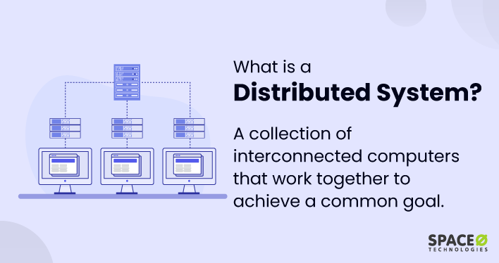

Slide 3
Distributed Computing??
Distributed computing is a model in which components of a software system are shared among multiple computers or nodes.
Even though the software components may be spread out across multiple computers in multiple locations, they're run as one system.
This is done to improve efficiency and performance.
The systems on different networked computers communicate and coordinate by sending messages back and forth to achieve a defined task

Slide 4
A distributed system is a collection of independent entities that cooperate to solve a problem that cannot be individually solved.
A distributed system can be characterized as a collection of mostly autonomous processors communicating over a communication network and having the following features:
No common physical clock: This is an important assumption because it introduces the element of “distribution” in the system and gives rise to the inherent asynchrony amongst the processors.
No shared memory: This is a key feature that requires message-passing for communication. This feature implies the absence of the common physical clock.

Slide 5
Geographical separation :The geographically wider apart that the processors are, the more representative is the system of a distributed system.
Autonomy and heterogeneity :The processors are “loosely coupled” in that they have different speeds and each can be running a different operating system. They are usually not part of a dedicated system, but cooperate with one another by offering services or solving a problem jointly.

Slide 6
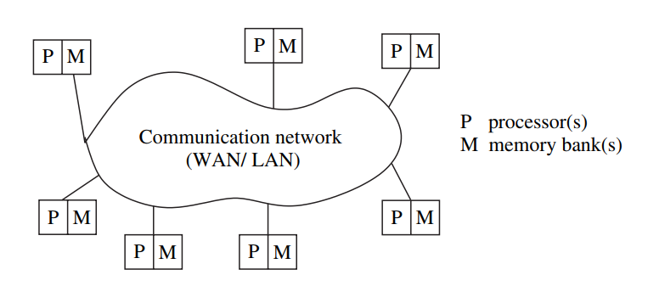
Relation to computer system components
A typical distributed system is shown in Figure .
Each computer has a memory processing unit and the computers are connected by a communication network.

Slide 7
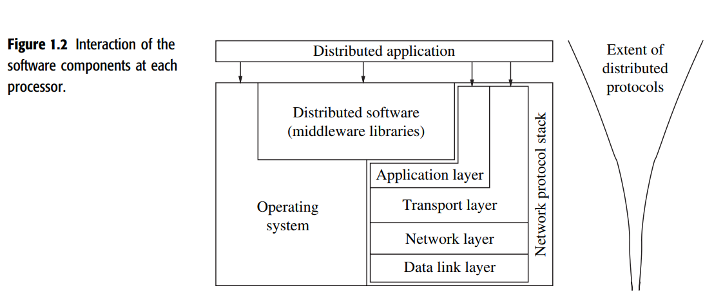
Figure shows the relationships of the software components that run on each of the computers and use the local operating system and network protocol stack for functioning.
The distributed software is also termed as middleware.

Slide 8
A distributed execution is the execution of processes across the distributed system to collaboratively achieve a common goal.
An execution is also sometimes termed a computation or a run.
The distributed system uses a layered architecture to break down the complexity of system design.

Slide 9
Middleware??
The middleware is the distributed software that drives the distributed system, while providing transparency of heterogeneity at the platform level.
Various primitives and calls to functions defined in various libraries of the middleware layer are embedded in the user program code.
There exist several libraries to choose from to invoke primitives for the more common functions such as reliable and ordered multicasting of the middleware layer.

Slide 10
Motivation
The motivation for using a distributed system is some or all of the following requirements:
Inherently distributed computations: In many applications such as money transfer in banking, or reaching consensus among parties that are geographically distant, the computation is inherently distributed.
Resource sharing :Resources such as peripherals, complete data sets in databases, special libraries, as well as data (variable/files) cannot be fully replicated at all the sites because it is often neither practical nor cost-effective. Further, they cannot be placed at a single site because access to that site might prove to be a bottleneck. Therefore, such resources are typically distributed across the system.

Slide 11
3. Access to geographically remote data and resources
In many scenarios, the data cannot be replicated at every site participating in the distributed execution because it may be too large or too sensitive to be replicated.
For example, payroll data within a multinational corporation is both too large and too sensitive to be replicated at every branch office/site.
It is therefore stored at a central server which can be queried by branch offices.
4. Enhanced reliability
A distributed system has the inherent potential to provide increased reliability because of the possibility of replicating resources and executions, as well as the reality that geographically distributed resources are not likely to crash/malfunction at the same time under normal circumstances.

Slide 12
Reliability entails several aspects:
availability, i.e., the resource should be accessible at all times;
integrity, i.e., the value/state of the resource should be correct, in the face of concurrent access from multiple processors, as per the semantics expected by the application;
fault-tolerance, i.e., the ability to recover from system failures, where such failures may be defined to occur in one of many failure models
5. Increased performance/cost ratio
Distributed system provides a better performance/cost ratio than using special parallel machines

Slide 13
6. Scalability
As the processors are usually connected by a wide-area network, adding more processors does not pose a direct bottleneck for the communication network.
7. Modularity and incremental expandability
Heterogeneous processors may be easily added into the system without affecting the performance, as long as those processors are running the same middleware algorithms. Similarly, existing processors may be easily replaced by other processors.

Slide 14
Primitives for distributed communication
Blocking/non-blocking, synchronous/asynchronous primitives
Message send and message receive communication primitives are denoted Send() and Receive(), respectively.
Send()
A Send primitive has at least two parameters
the destination
the buffer in the user space, containing the data to be sent.
Receive()
A Receive primitive has at least two parameters
The source from which the data is to be received
the user buffer into which the data is to be received.

Slide 15
There are two ways of sending data when the Send primitive is invoked – the buffered option and the unbuffered option.
The buffered option which is the standard option copies the data from the user buffer to the kernel buffer. The data later gets copied from the kernel buffer onto the network.
In the unbuffered option, the data gets copied directly from the user buffer onto the network.
For the Receive primitive, the buffered option is usually required because the data may already have arrived when the primitive is invoked, and needs a storage place in the kernel.

Slide 16
Synchronous primitives:
A Send or a Receive primitive is synchronous if both the Send() and Receive() handshake with each other.
The processing for the Send primitive completes only after the invoking processor learns that the other corresponding Receive primitive has also been invoked and that the receive operation has been completed.
The processing for the Receive primitive completes when the data to be received is copied into the receiver’s user buffer.
Asynchronous primitives
A Send primitive is said to be asynchronous if control returns back to the invoking process after the data item to be sent has been copied out of the user-specified buffer.
It does not make sense to define asynchronous Receive primitives

Slide 17
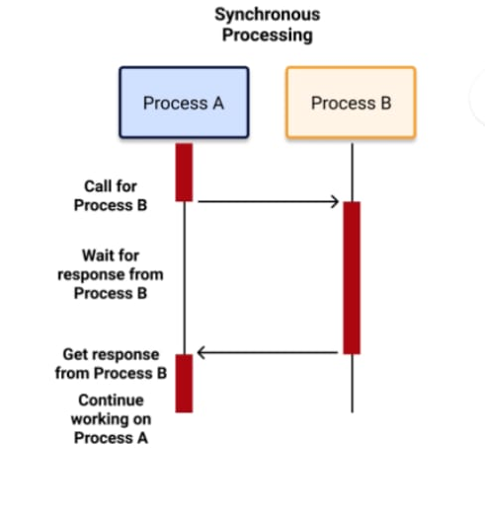
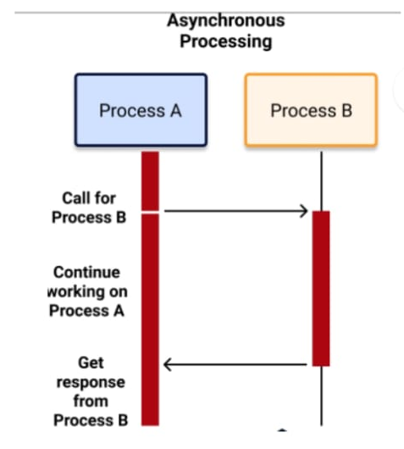

Slide 18
Blocking primitives
A primitive is blocking if control returns to the invoking process after the processing for the primitive (whether in synchronous or asynchronous mode) completes.
Non-blocking primitives
A primitive is non-blocking if control returns back to the invoking process immediately after invocation, even though the operation has not completed.
For a non-blocking Send, control returns to the process even before the data is copied out of the user buffer.
For a non-blocking Receive, control returns to the process even before the data may have arrived from the sender.

Slide 19
Processor synchrony
Processor synchrony indicates that all the processors execute in lock-step with their clocks synchronized.
As this synchrony is not attainable in a distributed system, what is more generally indicated is that for a large granularity of code, usually termed as a step, the processors are synchronized.
This abstraction is implemented using some form of barrier synchronization to ensure that no processor begins executing the next step of code until all the processors have completed executing the previous steps of code assigned to each of the processors.

Slide 20
Distributed systems challenges from a system perspective
Algorithmic challenges in distributed computing
Applications of distributed computing and newer challenges

