Slide 1
Module 1 Part_3
Prepared by
Jesna J S
Assistant Professor CSE, TKMCE

Slide 2
Contents
A model of distributed computations
A distributed program
A model of distributed executions
Models of communication networks
Global state of system
Cuts of system
Past and Future cones of an event.

Slide 3
Model of distributed Computations
A distributed system consists of a set of processors that are connected by a communication network.
The communication network provides the facility of information exchange among processors.
The communication delay is finite but unpredictable.
The processors do not share a common global memory and communicate solely by passing messages over the communication network.
There is no physical global clock in the system to which processes have instantaneous access.
.

Slide 4
The communication medium may deliver messages out of order, messages may be lost, garbled, or duplicated due to timeout and retransmission, processors may fail, and communication links may go down.
The system can be modeled as a directed graph in which vertices represent the processes and edges represent unidirectional communication channels
A distributed application runs as a collection of processes on a distributed system.

Slide 5
Distributed program
A distributed program is composed of a set of n asynchronous processes p1, p2, , pi, , pn that communicate by message passing over the communication network.
The processes do not share a global memory and communicate solely by passing messages.
Let Cij denote the channel from process pi to process pj and let mij denote a message sent by pi to pj .
Process execution and message transfer are asynchronous
A process may execute an action spontaneously and a process sending a message does not wait for the delivery of the message to be complete.

Slide 6
The global state of a distributed computation is composed of the states of the processes and the communication channels.
The state of a process is characterized by the state of its local memory and depends upon the context.
The state of a channel is characterized by the set of messages in transit in the channel.

Slide 7
A model of distributed executions
The execution of a process consists of a sequential execution of its actions.
The actions are atomic and the actions of a process are modeled as three types of events, namely, internal events, message send events, and message receive events.
Let e^{x}_{i} denote the xth event at process pi. Subscripts and/or superscripts will be dropped when they are irrelevant or are clear from the context.
For a message m, let send(m) and rec(m) denote its send and receive events, respectively.
The occurrence of events changes the states of respective processes and channels, thus causing transitions in the global system state.
An internal event changes the state of the process at which it occurs.
A send event (or a receive event) changes the state of the process that sends (or receives) the message and the state of the channel on which the message is sent (or received).
An internal event only affects the process at which it occurs.

Slide 8
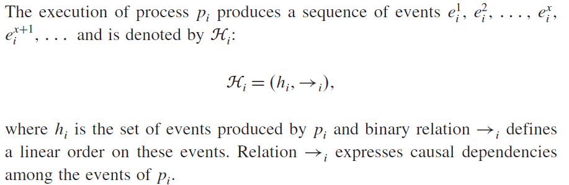
The events at a process are linearly ordered by their order of occurrence.

Slide 9

The send and the receive events signify the flow of information between processes and establish causal dependency from the sender process to the receiver process.
A relation →_{msg} that captures the causal dependency due to message exchange, is defined as follows.
For every message m that is exchanged between two processes, we have
Relation →_{msg} defines causal dependencies between the pairs of corresponding send and receive events.

Slide 10
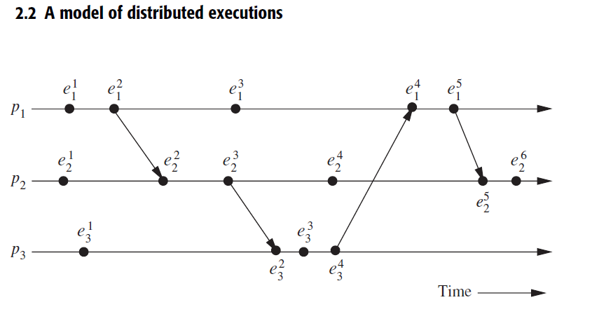
Evolution of a distributed execution is depicted by a space–time diagram.
A horizontal line represents the progress of the process.
A dot indicates an event.
A slant arrow indicates a message transfer.

Slide 11
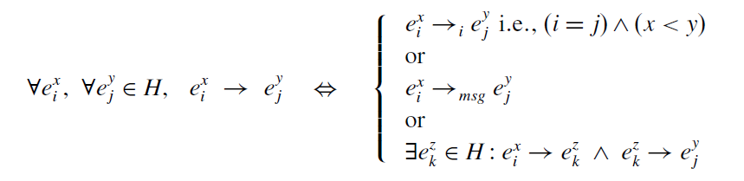
Causal precedence relation
The execution of a distributed application results in a set of distributed events produced by the processes.
Let H =∪_{i}h_{i} denote the set of events executed in a distributed computation. Causal dependencies b/w events in distributed execution: define a binary relation on the set H, denoted as →
The causal precedence relation induces an irreflexive partial order on the events of a distributed computation that is denoted as Ƕ =(H, →).

Slide 12
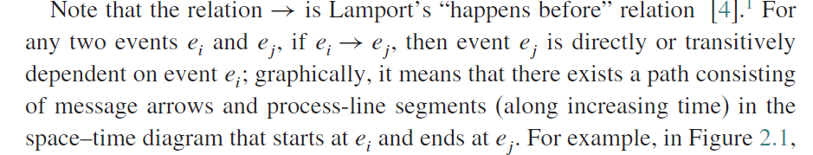

Slide 13
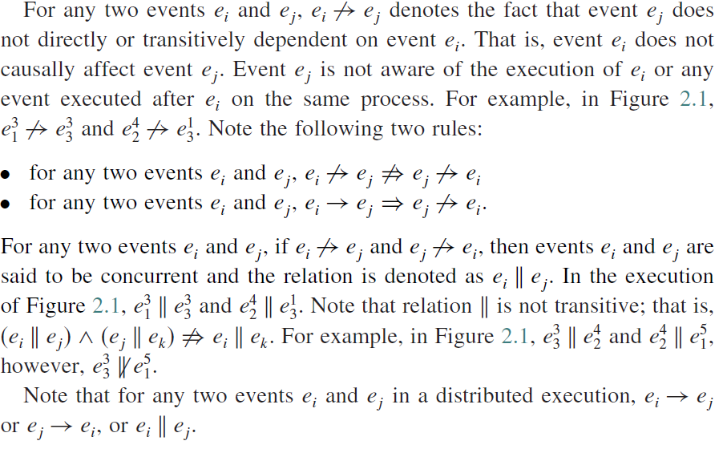



Slide 14
Logical vs. physical concurrency
In a distributed computation, two events are logically concurrent if and only if they do not causally affect each other.
Physical concurrency, on the other hand, has a connotation that the events occur at the same instant in physical time.
Note that two or more events may be logically concurrent even though they do not occur at the same instant in physical time.
However, if processor speed and message delays would have been different, the execution of these events could have very well coincided in physical time.
Whether a set of logically concurrent events coincide in the physical time or not, does not change the outcome of the computation.
Therefore, even though a set of logically concurrent events may not have occurred at the same instant in physical time, we can assume that these events occurred at the same instant in physical time.

Slide 15
Models of Communication Networks
Models of the service provided by communication networks are
FIFO (first-in, first-out)
Non-FIFO
Causal ordering.
FIFO
Each channel acts as a first-in first-out message queue and thus, message ordering is preserved by a channel.
Non-FIFO
The channel acts like a set in which the sender process adds messages and the receiver process removes messages from it in a random order.

Slide 16

3. Causal Ordering
It is based on Lamport’s “happens before” relation,
A system that supports the causal ordering model satisfies the following property:
This property ensures that causally related messages destined to the same destination are delivered in an order that is consistent with their causality relation.
Causally ordered delivery of messages implies FIFO message delivery.
CO ⊂ FIFO ⊂ Non-FIFO.
Causal ordering model is useful in developing distributed algorithms.
Generally, it considerably simplifies the design of distributed algorithms because it provides a built-in synchronization.

Slide 17
Global state of a distributed system
The global state of a distributed system is a collection of the local states of its components
Processes
Communication channels.
The state of a process at any time is defined by
The contents of processor registers, stacks, local memory, etc.
The local context of the distributed application.
The state of a channel is given by the set of messages in transit in the channel.

Slide 18
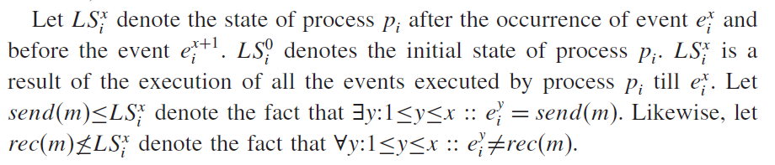


The occurrence of events changes the states of respective processes and channels, thus causing transitions in global system state.
An internal event changes the state of the process at which it occurs.
A send event (or a receive event) changes the state of the process that sends (or receives) the message and the state of the channel on which the message is sent (or received).

Slide 19

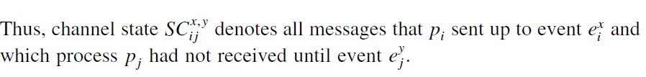
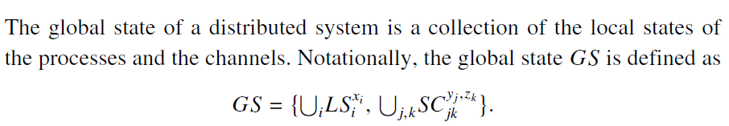






Send but not received

Slide 20
How the global state can be measured??
The states of all the components of the distributed system must be recorded at the same instant.
This will be possible by either
If the local clocks at processes were perfectly synchronized
Or there was a global system clock that could be instantaneously read by the processes.
However, both are impossible.

Slide 21
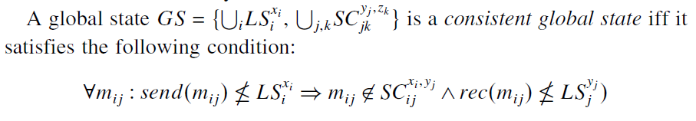

An effect should not be present without its cause
A state will be meaningful provided every message that is recorded as received is also recorded as sent.
Basic idea is that an effect should not be present without its cause.
A message cannot be received if it was not sent; that is, the state should not violate causality. Such states are called consistent global states and are meaningful global states.
A message should not receive without sending

Slide 22


Cuts of a distributed computation
In the space–time diagram of a distributed computation, a zigzag line joining one arbitrary point on each process line is termed a cut in the computation.
Such a line slices the space–time diagram, and thus the set of events in the distributed computation, into a PAST and a FUTURE.
The PAST contains all the events to the left of the cut and the FUTURE contains all the events to the right of the cut.
For a cut C, let PAST(C) and FUTURE(C) denote the set of events in the PAST and FUTURE of C, respectively.
Every cut corresponds to a global state and every global state can be graphically represented as a cut in the computation’s space–time diagram

Slide 23
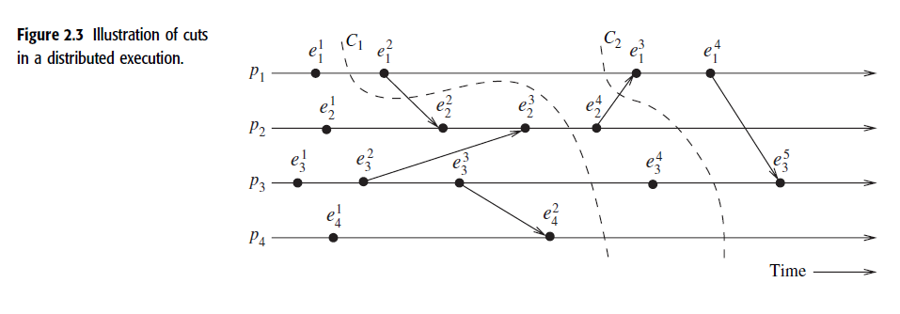

Slide 24
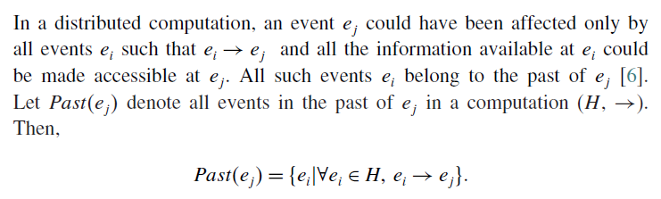
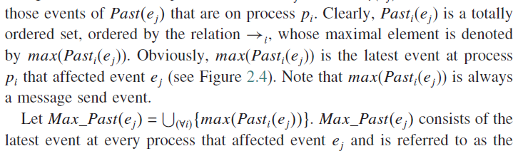


Past and future cones of an event

Slide 25
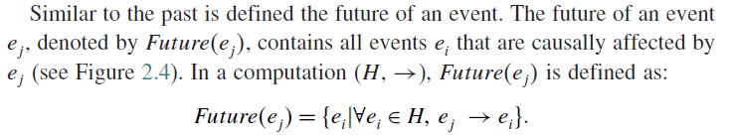
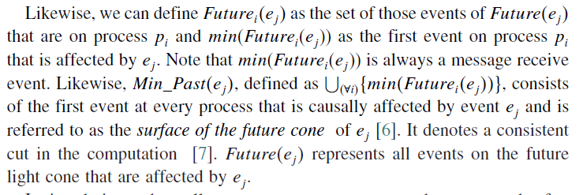






Slide 26
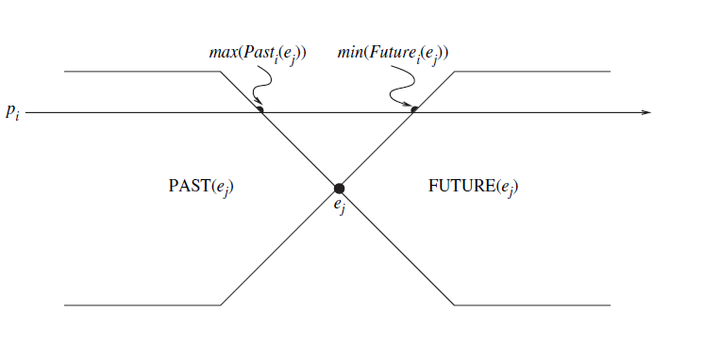


Illustration of past and future cones in a distributed computation

Slide 27
Models of process communications
There are two basic models of process communications
Synchronous
Asynchronous.
Synchronous Communication
The synchronous communication model is a blocking type where on a message send, the sender process blocks until the message has been received by the receiver process.
The sender process resumes execution only after it learns that the receiver process has accepted the message.
Thus, the sender and the receiver processes must synchronize to exchange a message.
Synchronous communication is simpler to handle and implement.
However, due to frequent blocking, it is likely to have poor performance and is likely to be more prone to deadlocks

Slide 28
Asynchronous Communication
It is a non-blocking type where the sender and the receiver do not synchronize to exchange a message.
After having sent a message, the sender process does not wait for the message to be delivered to the receiver process.
The message is buffered by the system and is delivered to the receiver process when it is ready to accept the message.
A buffer overflow may occur if a process sends a large number of messages in a burst to another process.
Asynchronous communication provides higher parallelism because the sender process can execute while the message is in transit to the receiver.
Asynchronous communication requires more complex buffer management.
In addition, due to higher degree of parallelism and non-determinism, it is much more difficult to design, verify, and implement distributed algorithms for asynchronous communications.

