Slide 1
Module 2 Part_01
Prepared by
Jesna J S
Assistant Professor

Slide 2
Logical Time
Causality is tracked using physical time.
However, in distributed systems, it is not possible to have global physical time; it is possible to realize only an approximation of it.
Logical time can be implemented in three ways
Scalar time
Vector time
Matrix time
The knowledge of the causal precedence relation among the events of processes helps solve a variety of problems in distributed systems, such as distributed algorithms design, tracking of dependent events, knowledge about the progress of a computation, and concurrency measures.

Slide 3
In distributed computing systems, the rate of occurrence of events is several magnitudes higher and the event execution time is several magnitudes smaller.
In a distributed computation, generally the progress is made in spurts and the interaction between processes occurs in spurts.
Consequently, it turns out that in a distributed computation, the causality relation between events produced by a program execution and its fundamental monotonicity property can be accurately captured by logical clocks.

Slide 4
In a system of logical clocks, every process has a logical clock that is advanced using a set of rules.
Every event is assigned a timestamp and the causality relation between events can be generally inferred from their timestamps .
The timestamps assigned to events obey the fundamental monotonicity property; that is, if an event “a” causally affects an event “b”, then the timestamp of “a” is smaller than the timestamp of “b”.

Slide 5
There are three ways to implement logical time in a distributed system.
In the first method, Lamport’s scalar clocks, the time is represented by non-negative integers.
In the second method, the time is represented by a vector of non-negative integers
In the third method, the time is represented as a matrix of non-negative integers.

Slide 6
A framework for a system of logical clocks
A system of logical clocks consists of a time domain T and a logical clock C .
Elements of T form a partially ordered set over a relation <.
This relation is usually called the happened before or causal precedence.

Slide 7
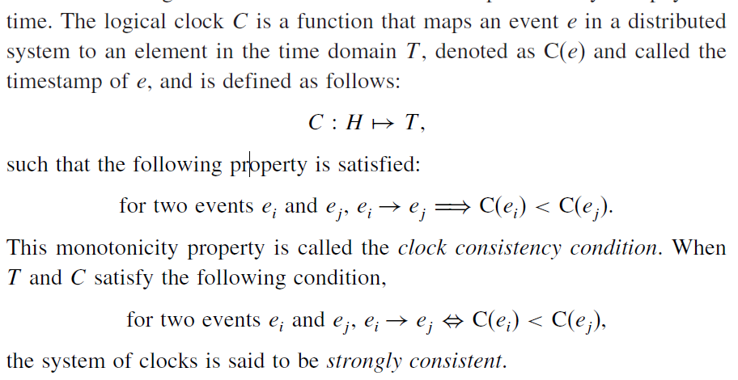





Slide 8
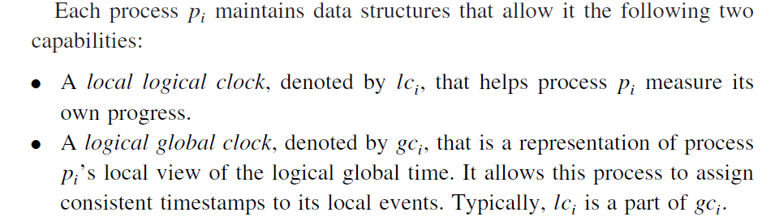

Implementing logical clocks

Slide 9
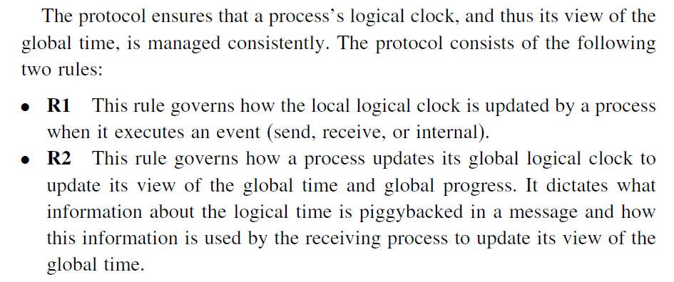


However all logical clock systems implement rules R1 and R2 and consequently ensure the fundamental monotonicity property associated with causality.

Slide 10
Scalar time
The scalar time representation was proposed by Lamport in 1978 as an attempt to totally order events in a distributed system.
Time domain in this representation is the set of non-negative integers.
The logical local clock of a process p_{i} and its local view of the global time are squashed into one integer variable Ci.

Slide 11
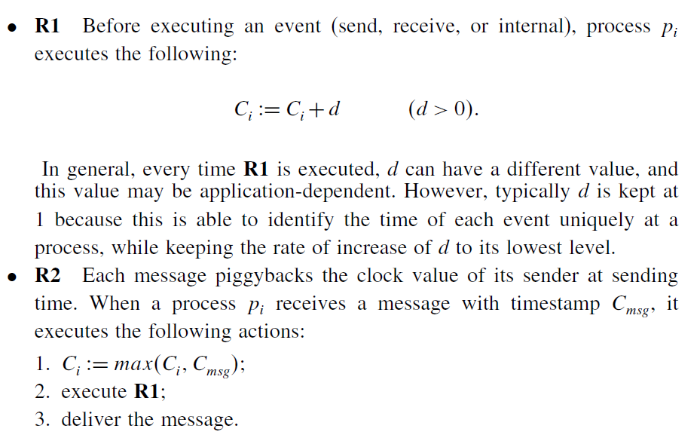
Rules R1 and R2 to update the clocks are as follows:

Slide 12
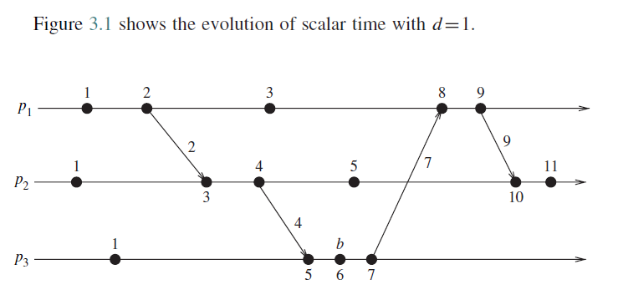

Slide 13
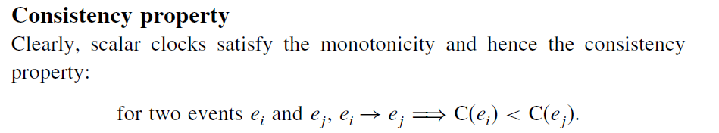
Basic properties
Total Ordering
Scalar clocks can be used to totally order events in a distributed system.
The main problem in totally ordering events is that two or more events at different processes may have identical timestamp.
For example in the above Figure, the third event of process P1 and the second event of process P2 have identical scalar timestamp.

Slide 14
A tie-breaking mechanism is needed to order such events.
A tie is broken as follows:
Process identifiers are linearly ordered and tie among events with identical scalar timestamp is broken on the basis of their process identifiers.
The lower the process identifier in the ranking, the higher the priority.
The timestamp of an event is denoted by a tuple (t, i) where “t” is its time of occurrence and “i ” is the identity of the process where it occurred.
The total order relation ≺ on two events x and y with timestamps (h,i) and (k,j), respectively, is defined as follows:

Slide 15

Since events that occur at the same logical scalar time are independent, they can be ordered using any arbitrary criterion without violating the causality relation →.
A total order is consistent with the causality relation “→”.
A total order is generally used to ensure liveness properties in distributed algorithms.
Requests are timestamped and served according to the total order based on these timestamps

Slide 16
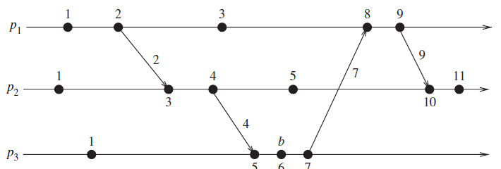
Event counting
If the increment value d is always 1, the scalar time has the following interesting property:
If event e has a timestamp h, then h−1 represents the minimum logical duration, counted in units of events, required before producing the event e ;
we call it the height of the event e.
In other words, h-1 events have been produced sequentially before the event e regardless of the processes that produced these events.
For example, five events precede event b on the longest causal path ending at b.

Slide 17

No strong consistency
The system of scalar clocks is not strongly consistent; that is, for two events ei and ej,
For example, in Figure, the third event of process P1 has smaller scalar timestamp than the third event of process P2.
However, the former did not happen before the latter.
The reason that scalar clocks are not strongly consistent is that the logical local clock and logical global clock of a process are squashed into one, resulting in the loss causal dependency information among events at different processes.

Slide 18
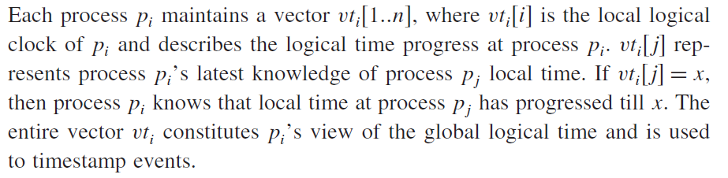
Vector time
The system of vector clocks was developed independently by Fidge, Mattern , and Schmuck .
In the system of vector clocks, the time domain is represented by a set of n-dimensional non-negative integer vectors.

Slide 19
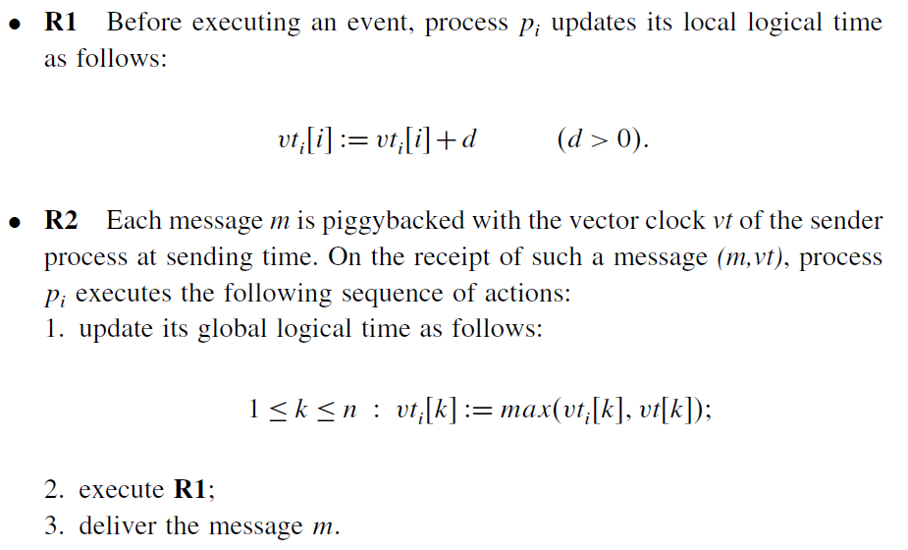
Process pi uses the following two rules R1 and R2 to update its clock:

Slide 20
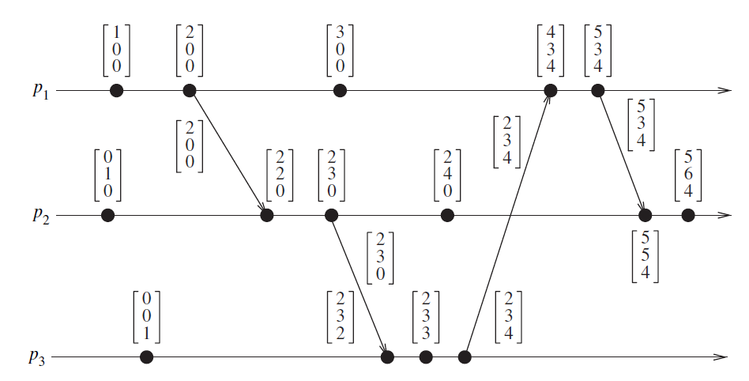
The timestamp associated with an event is the value of the vector clock of its process when the event is executed.
Figure shows an example of vector clocks progress with the increment value d = 1.
Initially, a vector clock is [0, 0, 0,…… 0].
Evolution of vector time

Slide 21
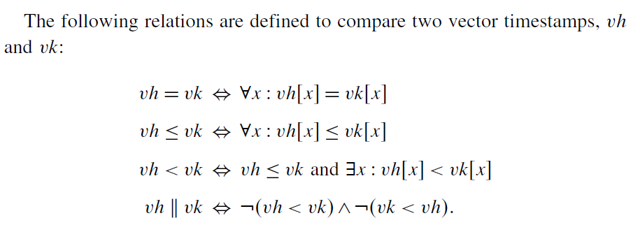

Slide 22
Basic Properties
Isomorphism
Strong Consistency
Event Counting

Slide 23

Isomorphism
If events in a distributed system are timestamped using a system of vector clocks, we have the following property.
If two events x and y have timestamps vh and vk, respectively, then
Thus, there is an isomorphism between the set of partially ordered events produced by a distributed computation and their vector timestamps.
This is a very powerful, useful, and interesting property of vector clocks.

Slide 24
Strong consistency
The system of vector clocks is strongly consistent; thus, by examining the vector timestamp of two events, we can determine if the events are causally related.
However, Charron–Bost showed that the dimension of vector clocks cannot be less than n, the total number of processes in the distributed computation, for this property to hold.

Slide 25
Event counting
If d is always 1 in rule R1, then the ith component of vector clock at process pi, vtii, denotes the number of events that have occurred at pi until that instant.
So, if an event e has timestamp vh, vhj denotes the number of events executed by process pj that causally precede e.
Clearly, vhj−1 represents the total number of events that causally precede e in the distributed computation.

