Slide 1
Module 2 Part_02
Prepared by
Jesna J S
Assistant Professor CSE, TKMCE

Slide 2
Why coordinator?
Distributed Algorithm is an algorithm that runs on a distributed system.
Distributed system is a collection of independent computers that do not share their memory. Each processor has its own memory and they communicate via communication networks. Communication in networks is implemented in a process on one machine communicating with a process on another machine.
Many algorithms used in the distributed system require a coordinator that performs functions needed by other processes in the system.

Slide 3
Election Algorithm
All the processes agree on such a common distinguished process called leader.
An algorithm for choosing a unique process to play a particular role (coordinator) is called an election algorithm.
Election algorithms are designed to choose a coordinator
It is essential that all the processes agree on the choice.
Afterwards, if the process that plays the role of server wishes to retire then another election is required to choose a replacement.

Slide 4
Election algorithms choose a process from a group of processors to act as a coordinator.
If the coordinator process crashes due to some reasons, then a new coordinator is elected on other processor.
Election algorithm basically determines where a new copy of the coordinator should be restarted.
Election algorithm assumes that every active process in the system has a unique priority number.
The process with highest priority will be chosen as a new coordinator.

Slide 5
We say that a process calls the election if it takes an action that initiates a particular run of the election algorithm.
At any point in time,
a process Pi is either a participant :: meaning that it is engaged in some run of the election algorithm
or a non-participant :: meaning that it is not currently engaged in any election.
Two algorithms,
A ring-based election algorithm
Bully algorithm

Slide 6
1. Ring-based election algorithm
The goal of this algorithm is to elect a single process called the coordinator.
The nodes are arranged in logical ring, and the nodes only communicate with their logical neighbors.
Each process p_{i} has a communication channel to the next process in the ring, p _{( i + 1)} mod N , all messages are sent clockwise around the ring.
Initially, every process is marked as a non-participant in an election.
Any process can begin an election.

Slide 7
Algorithm
When a node notice that the coordinator is crashed, then it will initiates the election by placing its identifier in an election message and sending it to its clockwise neighbour.
When a process receives an election message from its left, it compares the identifier in the message with its own
If the arrived identifier is smaller and the receiver is not a participant, then it substitutes its own identifier in the message and forwards it.
If the arrived identifies list contains its own identifier , then it will stop the election and the process with highest priority(Identifier) will be declared as the coordinator.
Initiator announces the new coordinator to all other nodes by sending messages.
[9,12,1]
1
[9,12,1,3]
12
3
[9,12]
[9,12,1,3,5]
9
5
[9]
[9,12,1,3,5,8]
8
[9,12,1,3,5,8]

Slide 8
The Bully Algorithm
This algorithm applies to system where every process can send a message to every other process in the system.
Process with highest id will be elected as the coordinator
There are three types of message in this algorithm:
An election message is sent to announce an election.
An answer message is sent in response to an election message
A coordinator message is sent to announce the identity of the elected process

Slide 9
Algorithm
If the coordinator does not respond to it within a time interval T, then it is assumed that coordinator has failed.
Now process P sends an election messages to every process with high priority number.
It waits for responses, if no one responds for time interval T then process P elects itself as a coordinator.
Then it sends a message to all lower priority number processes that it is elected as their new coordinator.
However, if an answer is received within time T from any other process Q,
Process P again waits for time interval T’ to receive another message from Q that it has been elected as coordinator.
If Q doesn’t responds within time interval T’ then it is assumed to have failed and algorithm is restarted.

Slide 10
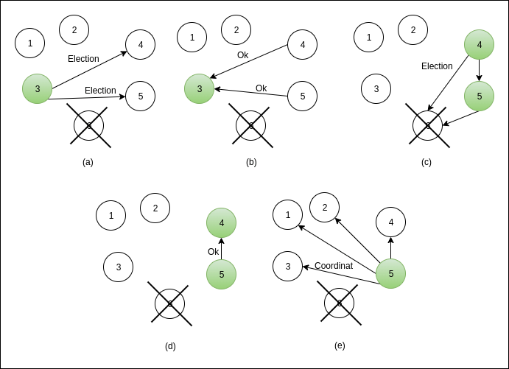

Slide 11
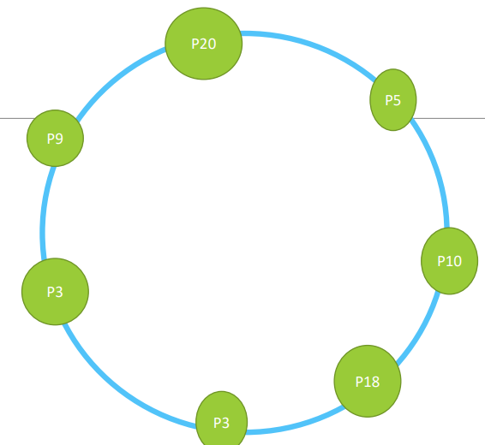
Problems?
In a ring topology 7 processes are connected with different ID’s as shown: P20->P5->P10->P18->P3->P16->P9 If process P10 initiates election after how many message passes will the coordinator be elected and known to all the processes. What modification will take place to the election message as it passes through all the process? Calculate total number of election messages and coordinator messages.

Slide 12
In the given process id’s 0,4,2,1,5,6,3,7, P7 was the initial coordinator and crashed.
Illustrate Bully algorithm, if P4 initiates the election.
Calculate total number of election messages and coordinator messages.

