Slide 1
Module 2 Part_04
Prepared by
Jesna J S
Assistant Professor CSE, TKMCE

Slide 2
Why termination of a process in a distributed computing is to be detected?
In distributed processing systems, a problem is typically solved in a distributed manner with the cooperation of a number of processes.
Also in some applications, the problem to be solved is divided into many subproblems, and the execution of a subproblem cannot begin until the execution of the previous subproblem is complete.
Hence, it is necessary to determine when the execution of a particular subproblem has ended so that the execution of the next subproblem may begin.
Therefore, a fundamental problem in distributed systems is to determine if a distributed computation has terminated.
The detection of the termination of a distributed computation is non-trivial since no process has complete knowledge of the global state, and global time does not exist.

Slide 3
Termination detection algorithms are used to detect the terminated process in a distributed system.
There are two distributed computations taking place in the distributed system
Underlying computation
Messages used in the underlying computation are called basic messages.
Termination detection algorithm.
Messages used for the purpose of termination detection (by a termination detection algorithm) are called control messages.

Slide 4
A termination detection (TD) algorithm must ensure the following:
Execution of a TD algorithm cannot indefinitely delay the underlying computation; that is, execution of the termination detection algorithm must not freeze the underlying computation.
The termination detection algorithm must not require addition of new communication channels between processes.

Slide 5
System model of a distributed computation
A distributed computation consists of a fixed set of processes that communicate solely by message passing. All messages are received correctly after an arbitrary but finite delay. Communication is asynchronous, i.e., a process never waits for the receiver to be ready before sending a message. Messages sent over the same communication channel may not obey the FIFO ordering.

Slide 6
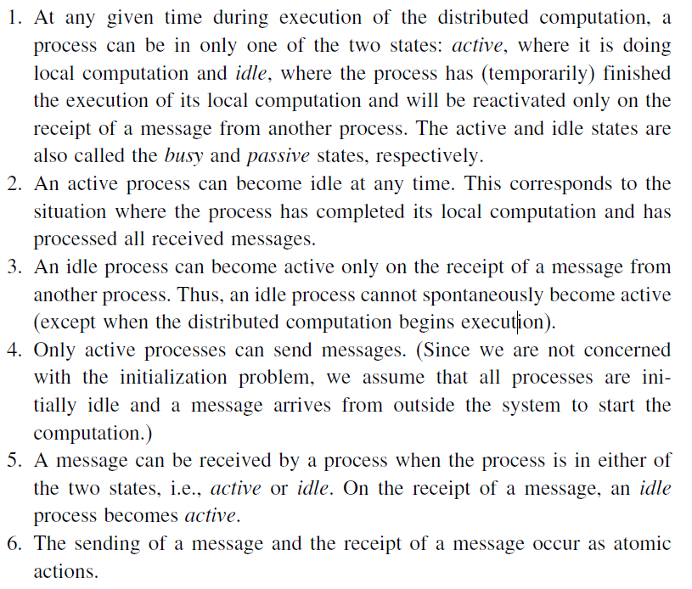




Characteristics of distributed computation

Slide 7





Slide 8
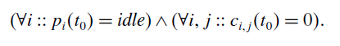


Definition of termination detection
Let pi(t) denote the state (active or idle) of process pi at instant t and c_{ij}(t) denote the number of messages in transit in the channel at instant t from process pi to process pj .
A distributed computation is said to be terminated at time instant t₀ iff:

Slide 9
Termination detection using distributed snapshots
The algorithm assumes that there is a logical bidirectional communication channel between every pair of processes.
Communication channels are reliable but non-FIFO.
Message delay is arbitrary but finite.

Slide 10
Informal description
The main idea behind the algorithm is as follows:
When a computation terminates, there must exist a unique process which became idle last.
When a process goes from active to idle, it issues a request to all other processes to take a local snapshot, and also requests itself to take a local snapshot.
When a process receives the request, if it agrees that the requester became idle before itself, it grants the request by taking a local snapshot for the request.
A request is said to be successful if all processes have taken a local snapshot for it.
The requester or any external agent may collect all the local snapshots of a request.
If a request is successful, a global snapshot of the request can thus be obtained and the recorded state will indicate termination of the computation, viz., in the recorded snapshot, all the processes are idle and there is no message in transit to any of the processes.

Slide 11
Formal description
The algorithm needs logical time to order the requests.
Each process i maintains an logical clock denoted by x, which is initialized to zero at the start of the computation.
A process increments its x by one each time it becomes idle.
A basic message sent by a process at its logical time x is of the form B(x).
A control message that requests processes to take local snapshot issued by process i at its logical time x is of the form R(x, i).
Besides logical clock x, a process maintains a variable k such that when the process is idle, (x,k) is the maximum of the values (x, k) on all messages R(x, k) ever received or sent by the process.

Slide 12
Logical time is compared as follows: (x, k) > (x, k’) iff (x > x’) or ((x = x’) and (k > k’)), i.e., a tie between x and x’ is broken by the process identification numbers k and k’.

Slide 13
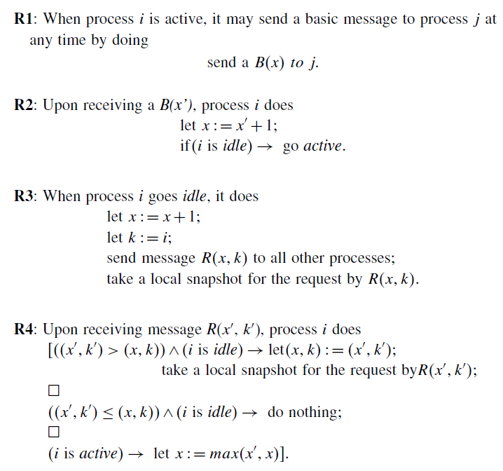
The algorithm is defined by the following four rules

Slide 14
Termination detection by weight throwing
A process called controlling agent monitors the computation in this algorithm.
A communication channel exists between each of the processes and the controlling agent and also between every pair of processes.

Slide 15
Algorithm
Initially, all processes are in the idle state.
The weight at each process is zero and the weight at the controlling agent is 1.
The computation starts when the controlling agent sends a basic message to one of the processes.
The process becomes active and the computation starts.
A non-zero weight W (0 <W ≤ 1) is assigned to each process in the active state and to each message in transit in the following manner:
When a process sends a message, it sends a part of its weight in the message.
When a process receives a message, it add the weight received in the message to its weight.
Thus, the sum of weights on all the processes and on all the messages in transit is always 1.

Slide 16
When a process becomes passive, it sends its weight to the controlling agent in a control message, which the controlling agent adds to its weight.
The controlling agent concludes termination if its weight becomes 1.

Slide 17
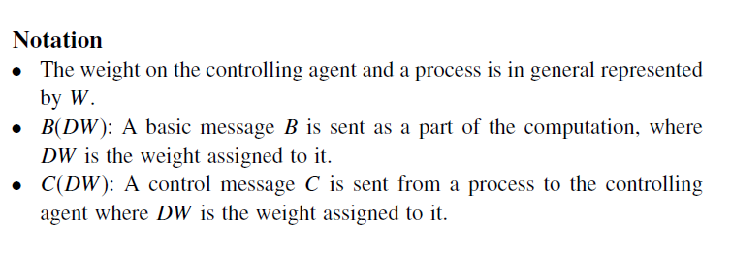

Slide 18
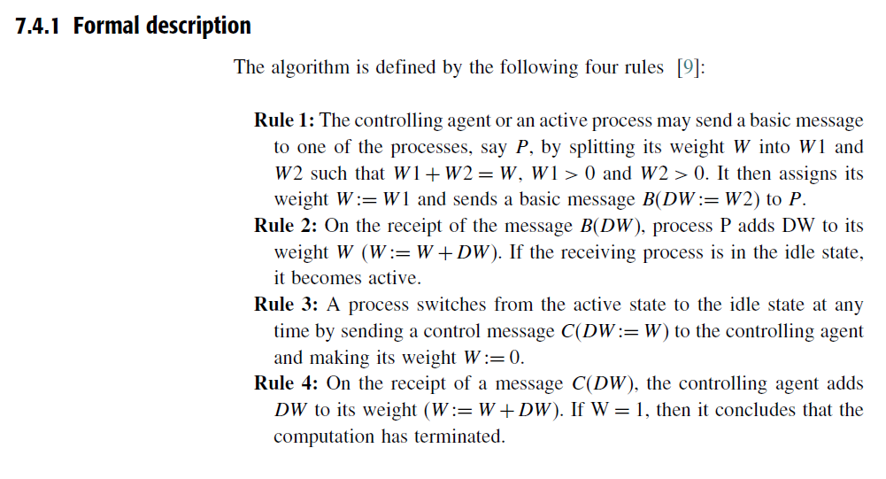

Slide 19
Spanning Tree based termination detection algorithm
The algorithm assumes there are N processes Pi, 0 ≤ i ≤ N, which are modeled as the nodes i, 0 ≤ i ≤ N, of a fixed connected undirected graph.
The edges of the graph represent the communication channels, through which a process sends messages to neighboring processes in the graph.
The algorithm uses a fixed spanning tree of the graph with process P0 at its root which is responsible for termination detection.
Process P0 communicates with other processes to determine their states and the messages used for this purpose are called signals.
All leaf nodes report to their parents, if they have terminated.
A parent node will similarly report to its parent when it has completed processing and all of its immediate children have terminated, and so on.
The root concludes that termination has occurred, if it has terminated and all of its immediate children have also terminated.

Slide 20
The termination detection algorithm generates two waves of signals moving inward and outward through the spanning tree.
Initially, a contracting wave of signals, called tokens, moves inward from leaves to the root.
If this token wave reaches the root without discovering that termination has occurred, the root initiates a second outward wave of repeat signals.
As this repeat wave reaches leaves, the token wave gradually forms and starts moving inward again.
This sequence of events is repeated until the termination is detected.

Slide 21
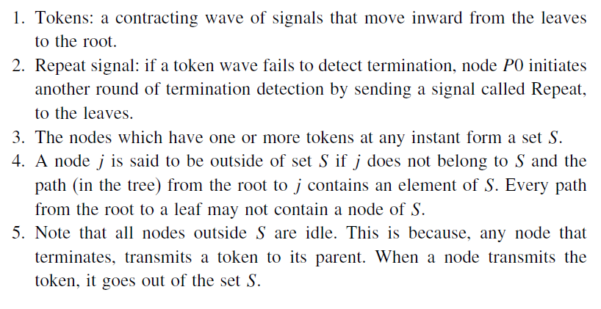





Definitions

Slide 22
A simple algorithm
Initially, each leaf process is given a token.
Each leaf process, after it has terminated, sends its token to its parent.
When a parent process terminates and after it has received a token from each of its children, it sends a token to its parent.
This way, each process indicates to its parent process that the subtree below it has become idle.
In a similar manner, the tokens get propagated to the root.
The root of the tree concludes that termination has occurred, after it has become idle and has received a token from each of its children

Slide 23
A problem with the algorithm
This simple algorithm fails under some circumstances.
After a process has sent its token to its parent, it should remain idle.
However, this is not the case.
The problem arises when a process after it has sent a token to its parent, receives a message from some other process. Note that this message could cause the process (that has already sent a token to its parent) to again become active.
Hence the simple algorithm fails since the process that indicated to its parent that it has become idle, is now active because of the message received from an active process.
Hence, the root node just because it received a token from a child, can’t conclude that all processes in the child’s subtree have terminated.
The algorithm has to be reworked to accommodate such message-passing scenarios.

Slide 24
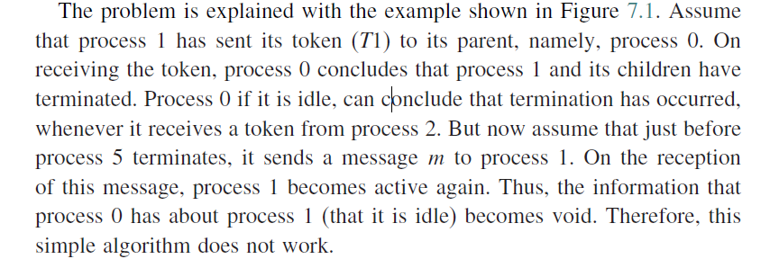
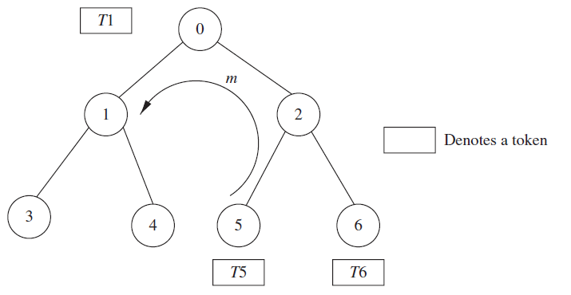

Slide 25
The correct algorithm
The correct algorithm was developed by Topor.
The main idea is to color the processes and tokens and change the color when such messages are involved.
In order to enable the root node to know that a node in its children’s subtree, that was assumed to be terminated, has become active due to a message, a coloring scheme for tokens and nodes is used.
The root can determine that an idle process has been activated by a message, based on the color of the token it receives from its children.

Slide 26
All tokens are initialized to white.
If a process had sent a message to some other process, it sends a black token to its parent on termination; otherwise, it sends a white token on termination.
Hence, the parent process on getting the black token knows that its child had sent a message to some other process.
The parent, when sending its token (on terminating) to its parent, sends a black token only if it received a black token from one of its children.
This way, the parent’s parent knows that one of the processes in its child’s subtree had sent a message to some other process.

Slide 27
This gets propagated and finally the root node knows that message-passing was involved when it receives a black token from one of its children.
In this case, the root asks all nodes in the system to restart the termination detection.
For this, the root sends a repeat signal to all other process.
After receiving the repeat signal, all leaves will restart the termination detection algorithm.

Slide 28
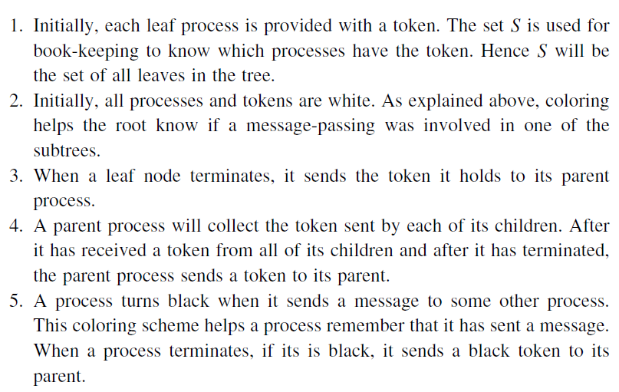


The algorithm description

Slide 29
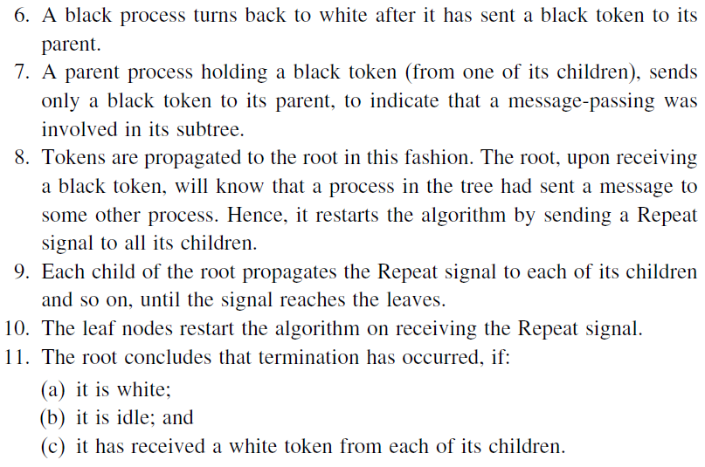



Slide 30
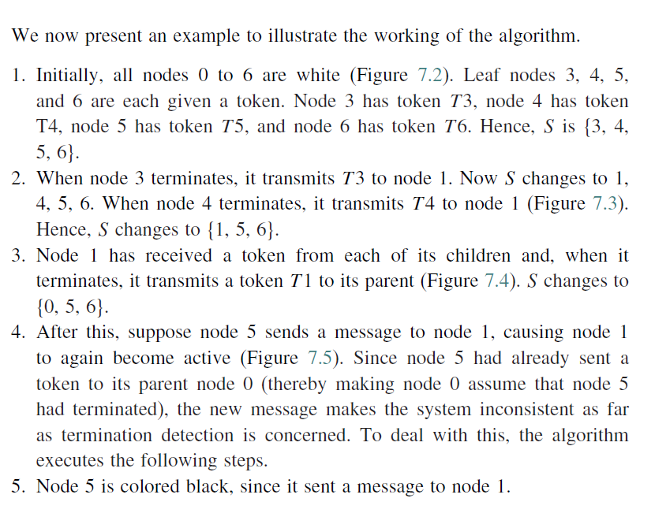
Example

Slide 31
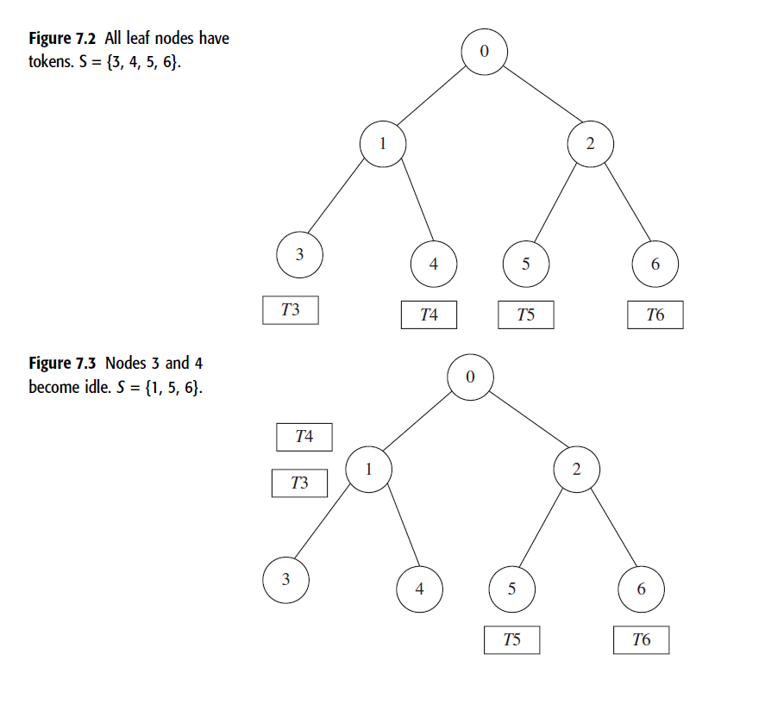

Slide 32
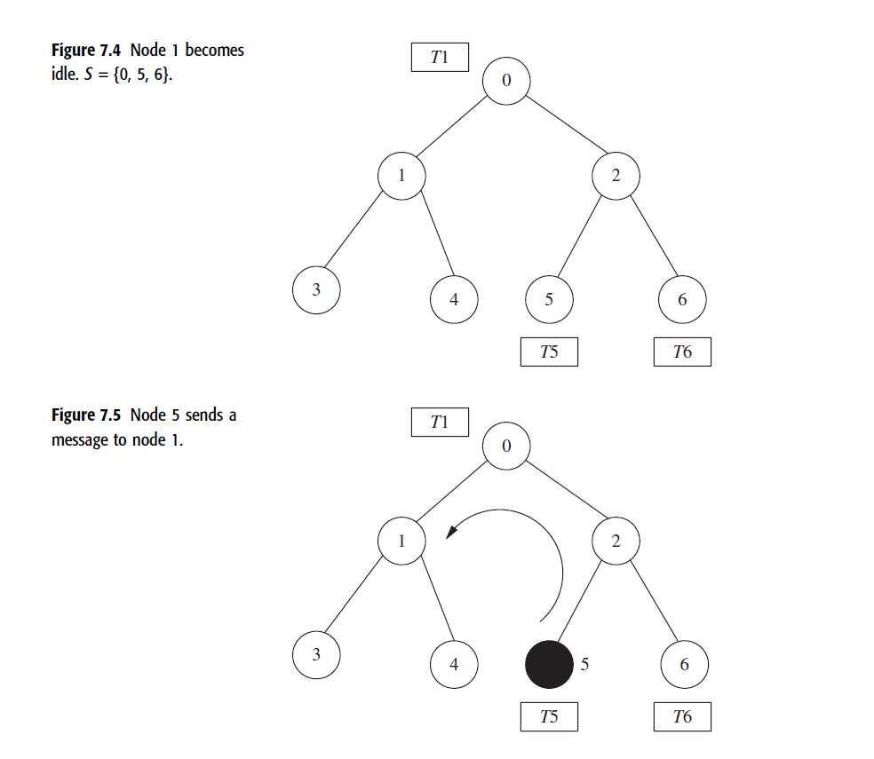

Slide 33
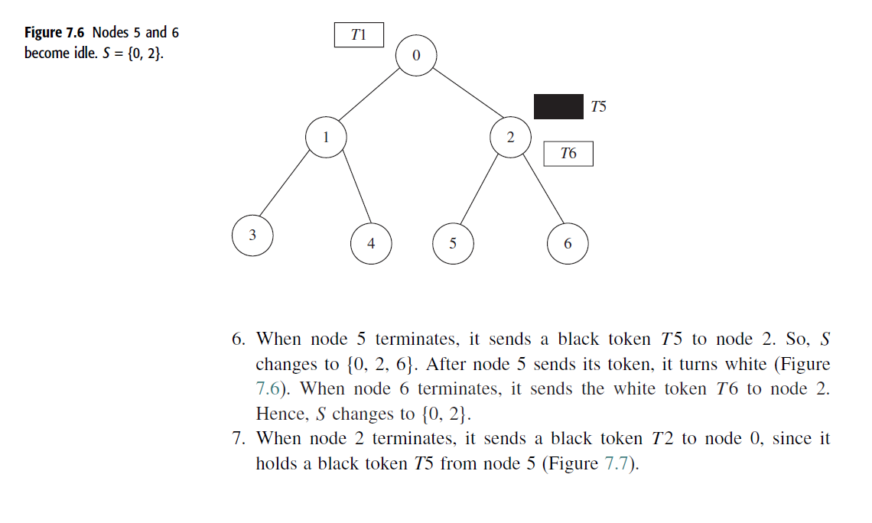

Slide 34
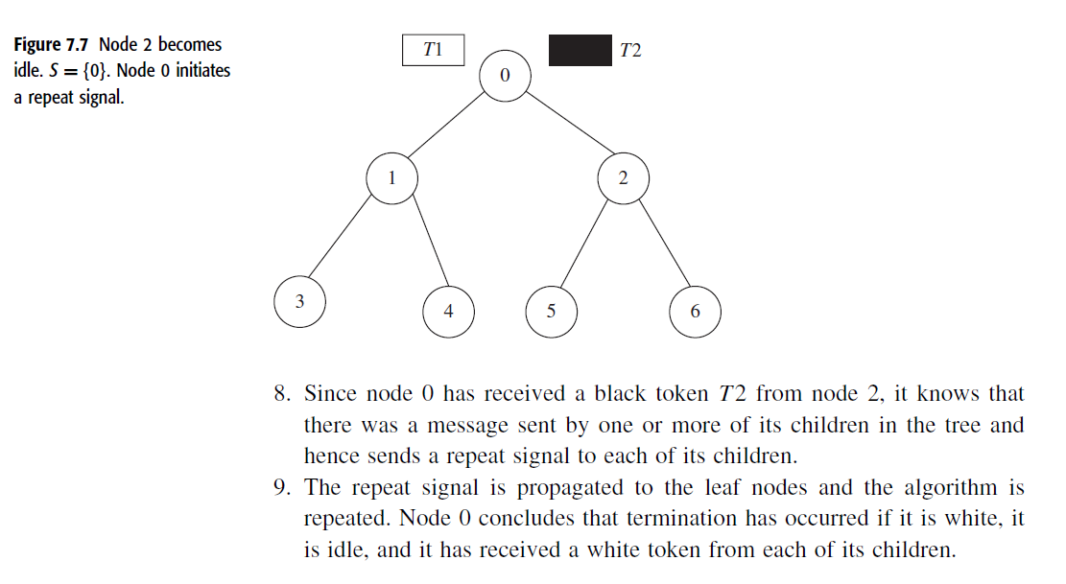

Slide 35
