Slide 1
Distributed mutual exclusion algorithms
Prepared by
Jesna J S
Assistant Professor CSE, TKMCE

Slide 2
Introduction
Mutual exclusion is a fundamental problem in distributed computing systems.
Mutual exclusion in a distributed system states that only one process is allowed to execute the critical section (CS) at any given time.
In a distributed system, shared variables (semaphores) or a local kernel cannot be used to implement mutual exclusion.
Message passing is the sole means for implementing distributed mutual exclusion.
The decision as to which process is allowed access to the CS next is arrived at by message passing, in which each process learns about the state of all other processes in some consistent way.
The design of distributed mutual exclusion algorithms is complex because these algorithms have to deal with unpredictable message delays and incomplete knowledge of the system state.

Slide 3
There are three basic approaches for implementing distributed mutual exclusion:
Token-based approach.
In the token-based approach, a unique token (also known as the PRIVILEGE message) is shared among the sites.
A site is allowed to enter its CS if it possesses the token and it continues to hold the token until the execution of the CS is over.
Mutual exclusion is ensured because the token is unique.
2. Non-token-based approach.
In the non-token-based approach, two or more successive rounds of messages are exchanged among the sites to determine which site will enter the CS next.
A site enters the critical section (CS) when an assertion, defined on its local variables, becomes true.
Mutual exclusion is enforced because the assertion becomes true only at one site at any given time.

Slide 4
3. Quorum-based approach.
In the quorum-based approach, each site requests permission to execute the CS from a subset of sites (called a quorum).
The quorums are formed in such a way that when two sites concurrently request access to the CS, at least one site receives both the requests and this site is responsible to make sure that only one request executes the CS at any time.

Slide 5
System Model
The system consists of N sites, S₁, S₂,….. S_{N} . Without loss of generality, we assume that a single process is running on each site.
The process at site S_{i} is denoted by p_{i}.
All these processes communicate asynchronously over an underlying communication network.
A process wishing to enter the CS requests all other or a subset of processes by sending REQUEST messages, and waits for appropriate replies before entering the CS.
While waiting the process is not allowed to make further requests to enter the CS.

Slide 6
A site can be in one of the following three states:
requesting the CS
executing the CS
neither requesting nor executing the CS (i.e., idle).
Following notations are used
N denotes the number of processes or sites involved in invoking the critical section
T denotes the average message delay
E denotes the average critical section execution time.

Slide 7
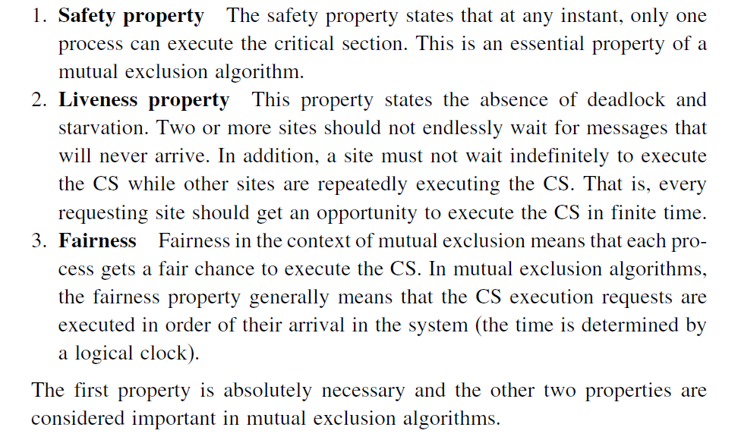







Requirements of mutual exclusion algorithms
A mutual exclusion algorithm should satisfy the following properties:

Slide 8
Lamport’s algorithm
Lamport developed a distributed mutual exclusion algorithm as an illustration of his clock synchronization scheme.
The algorithm is fair in the sense that a request for CS are executed in the order of their timestamps and time is determined by logical clocks.
When a site processes a request for the CS, it updates its local clock and assigns the request as timestamp.
The algorithm executes CS requests in the increasing order of timestamps.
Every site Si keeps a queue called request_queue _{i} which contains mutual exclusion requests ordered by their timestamps.
This algorithm requires communication channels to deliver messages in FIFO order

Slide 9
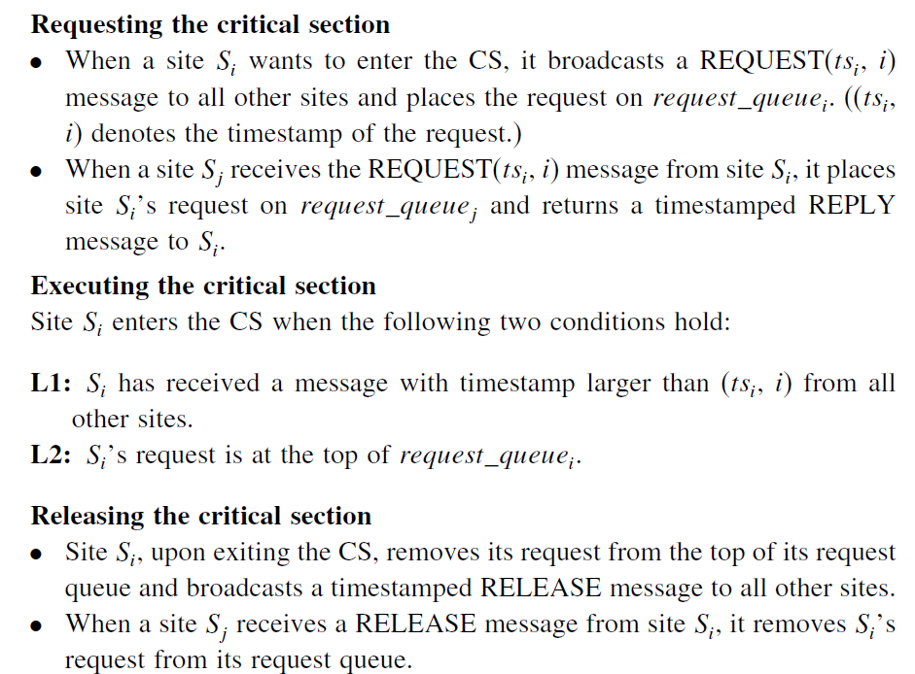

Slide 10
When a site removes a request from its request queue, its own request may come at the top of the queue, enabling it to enter the CS.
Clearly, when a site receives a REQUEST, REPLY, or RELEASE message, it updates its clock using the timestamp in the message.

Slide 11
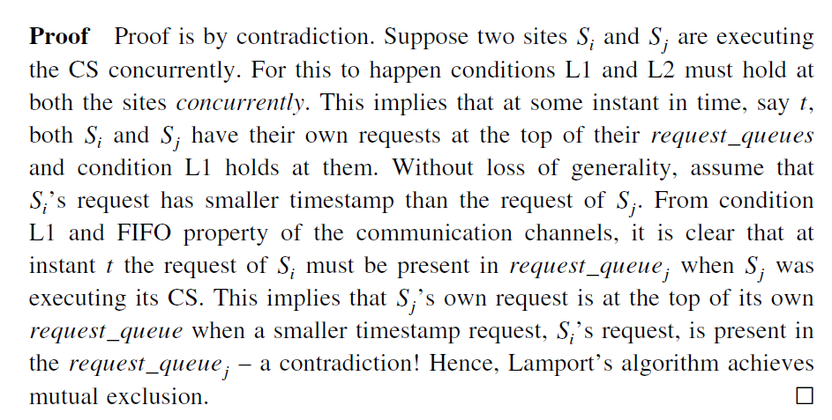
Correctness Theorem 1: Lamport’s algorithm achieves mutual exclusion.

Slide 12
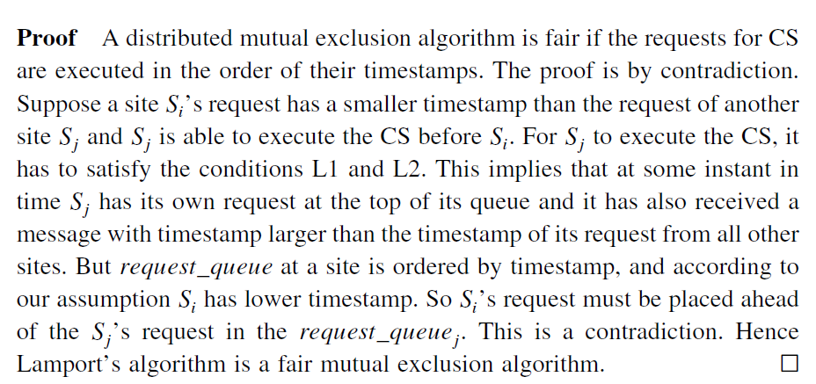
Theorem 2:Lamport’s algorithm is fair

