Slide 1
Module 3 Part_02
Prepared by
Jesna J S
Assistant Professor CSE, TKMCE

Slide 2
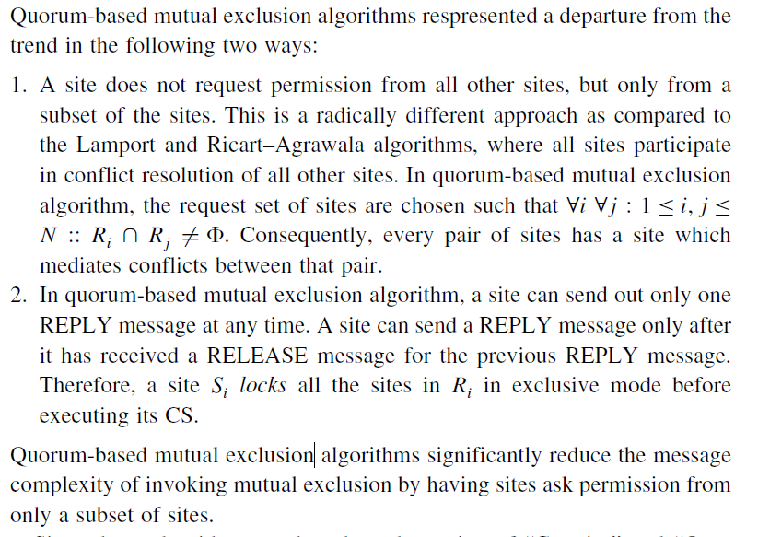






Quorum-based mutual exclusion algorithms

Slide 3
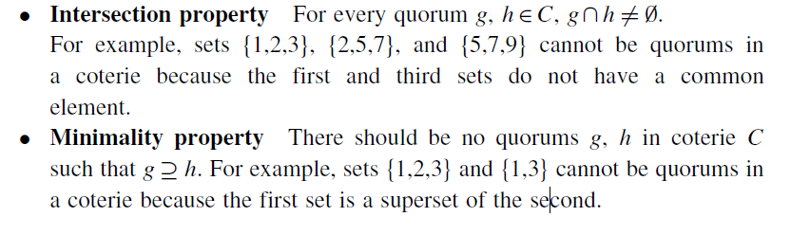





The algorithm is based on the notion of “Coteries” and “Quorums,” A coterie C is defined as a set of sets, where each set g ∈C is called a quorum.
The following properties hold for quorums in a coterie:

Slide 4
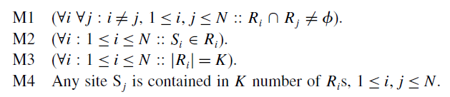
Maekawa’s algorithm
Maekawa’s algorithm was the first quorum-based mutual exclusion algorithm.
The request sets for sites (i.e., quorums) in Maekawa’s algorithm are constructed to satisfy the following conditions:

Slide 5
Since there is at least one common site between the request sets of any two sites (condition M1), every pair of sites has a common site which mediates conflicts between the pair.
A site can have only one outstanding REPLY message at any time; that is, it grants permission to an incoming request if it has not granted permission to some other site. Therefore, mutual exclusion is guaranteed.
This algorithm requires delivery of messages to be in the order they are sent between every pair of sites.
Conditions M1 and M2 are necessary for correctness; whereas conditions M3 and M4 provide other desirable features to the algorithm.
Condition M3 states that the size of the requests sets of all sites must be equal, which implies that all sites should have to do an equal amount of work to invoke mutual exclusion.
Condition M4 enforces that exactly the same number of sites should request permission from any site, which implies that all sites have “equal responsibility” in granting permission to other sites.

Slide 6
Three type of messages ( REQUEST, REPLY and RELEASE) are used.
A site send a REQUEST message to all other site in its request set or quorum to get their permission to enter critical section.
A site send a REPLY message to requesting site to give its permission to enter the critical section.
A site send a RELEASE message to all other site in its request set or quorum upon exiting the critical section.

Slide 7
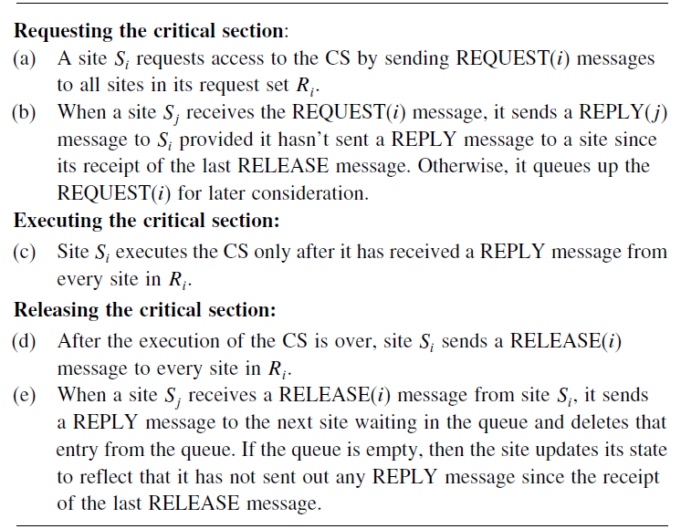

Algorithms

Slide 8
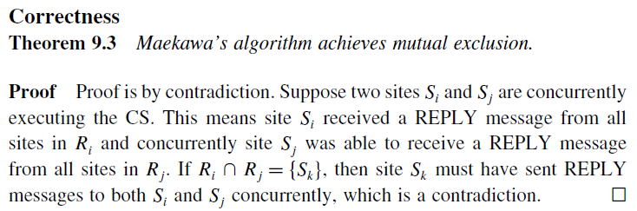



Slide 9
Message Complexity
Maekawa’s Algorithm requires invocation of 3√N messages per critical section execution as the size of a request set is √N.
These 3√N messages involves.
√N request messages
√N reply messages
√N release messages
Performance
The synchronization delay in this algorithm is 2T.
This is because after a site Si exits the CS, it first releases all the sites in Ri and then one of those sites sends a REPLY message to the next site that executes the CS.
Thus, two sequential message transfers are required between two successive CS executions.

Slide 10
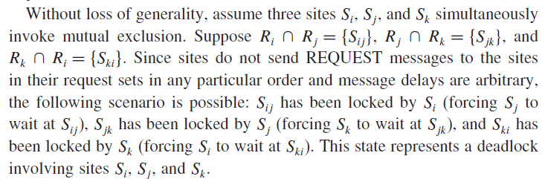
Problem of deadlocks in Maekawa’s algorithm
Maekawa’s algorithm can happen deadlock because a site is exclusively locked by other sites and requests are not prioritized by their timestamps.
Thus, a site may send a REPLY message to a site and later force a higher priority request from another site to wait.

Slide 11
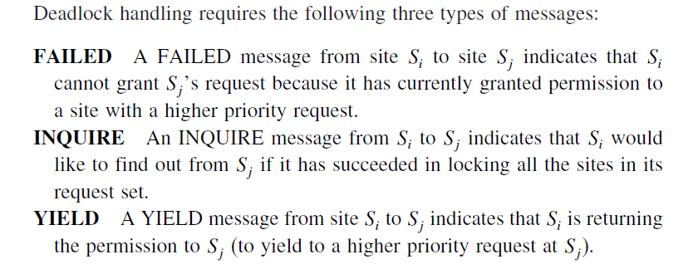



Handling deadlocks in Maekawa’s algorithm

Slide 12
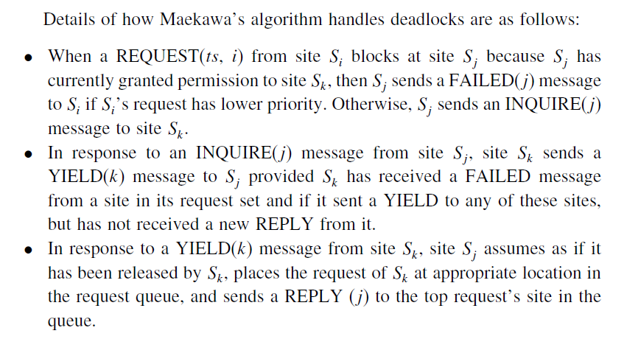




Slide 13
Thus, Maekawa-type algorithms require extra messages to handle deadlocks and may exchange these messages even though there is no deadlock.
The maximum number of messages required per CS execution in this case is 5√N.

