Slide 1
Module_3 Part_03
Prepared by
JESNA J S
Assistant Professor CSE, TKMCE

Slide 2
Token-based algorithms
A unique token is shared among the sites.
A site is allowed to enter its CS if it possesses the token.
A site holding the token can enter its CS repeatedly until it sends the token to some other site.
Depending upon the way a site carries out the search for the token, there are numerous token-based algorithms.
Token-based algorithms use sequence numbers instead of timestamps.
Every request for the token contains a sequence number and the sequence numbers of sites advance independently.
A site increments its sequence number counter every time it makes a request for the token.

Slide 3
The correctness proof of token-based algorithms, that they enforce mutual exclusion, is trivial because an algorithm guarantees mutual exclusion so long as a site holds the token during the execution of the CS.

Slide 4
Suzuki–Kasami’s broadcast algorithm
In Suzuki–Kasami’s algorithm, if a site that wants to enter the CS does not have the token, it broadcasts a REQUEST message for the token to all other sites.
A site that possesses the token sends it to the requesting site upon the receipt of its REQUEST message.
If a site receives a REQUEST message when it is executing the CS, it sends the token only after it has completed the execution of the CS.

Slide 5
Design Issues
How to distinguishing an outdated REQUEST message from a current REQUEST message.?
How to determine which site has an outstanding request for the CS?

Slide 6
ISSUE 1::How to distinguishing an outdated REQUEST message from a current REQUEST message
Due to variable message delays, a site may receive a token request message after the corresponding request has been satisfied.
If a site cannot determined if the request corresponding to a token request has been satisfied, it may dispatch the token to a site that does not need it.
This will not violate the correctness, however, but it may seriously degrade the performance by wasting messages and increasing the delay at sites that are genuinely requesting the token.
Therefore, appropriate mechanisms should implemented to determine if a token request message is outdated.

Slide 7
Outdated REQUEST messages are distinguished from current REQUEST messages in the following manner:
A REQUEST message of site S_{j} has the form REQUEST(j, n) where n (n = 1, 2,..) is a sequence number that indicates that site S_{j} is requesting its nth CS execution.
A site S_{i} keeps an array of integers RN_{i}[1, … ,N] where RN_{i}[j] denotes the largest sequence number received in a REQUEST message so far from site S_{j} .
When site S_{i} receives a REQUEST(j, n) message, it sets RN_{i}[j]=max(RN_{i}[j], n).
Thus, when a site Si receives a REQUEST(j, n) message, the request is outdated if RN_{i}[j]> n.

Slide 8
ISSUE 2: How to determine which site has an outstanding request for the CS
After a site has finished the execution of the CS, it must determine what sites have an outstanding request for the CS so that the token can be dispatched to one of them.
The problem is complicated because when a site S_{i} receives a token request message from a site S_{j} , site S_{j} may have an outstanding request for the CS.
However, after the corresponding request for the CS has been satisfied at S_{j} , an issue is how to inform site Si (and all other sites) efficiently about it.

Slide 9
Sites with outstanding requests for the CS are determined in the following manner:
The token consists of
A queue of requesting sites, Q,
An array of integers LN[1, … ,N], where LN[j] is the sequence number of the request which site S_{j} executed most recently.
After executing its CS, a site S_{i} updates LN[i] : = RN_{i}[i] to indicate that its request correspond
ing to sequence number RN_{i}[i] has been executed.
Token array LN[1, … ,N] permits a site to determine if a site has an outstanding request for the CS.
Note that at site S_{i} if RN_{i}[j]=LN[j]+1, then site S_{j} is currently requesting a token.
After executing the CS, a site checks this condition for all the j’s to determine all the sites that are requesting the token and places their i.d.’s in queue Q if these i.d.’s are not already present in Q.
Finally, the site sends the token to the site whose i.d. is at the head of Q.

Slide 10
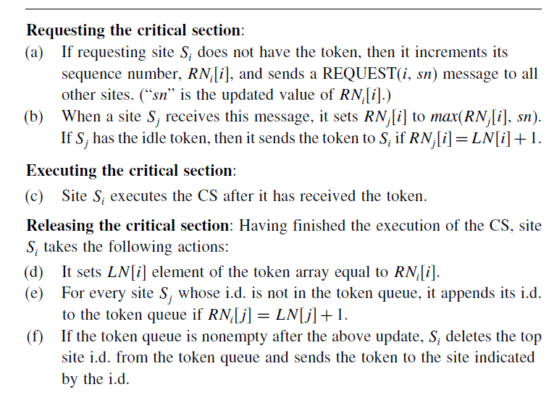
Algorithm

Slide 11
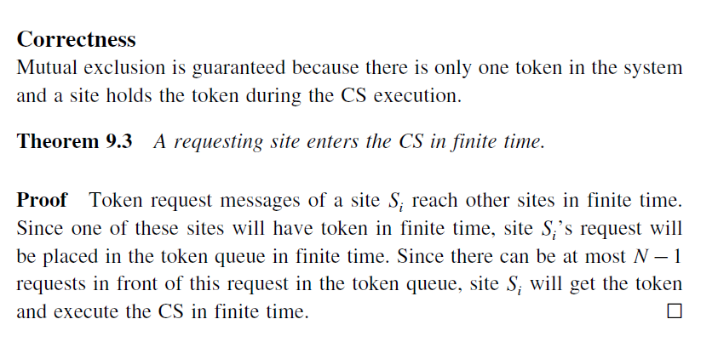

Slide 12
Performance
The beauty of the Suzuki–Kasami algorithm lies in its simplicity and efficiency.
No message is needed and the synchronization delay is zero if a site holds the idle token at the time of its request.
If a site does not hold the token when it makes a request, the algorithm requires N messages to obtain the token.
The synchronization delay in this algorithm is 0 or T.

