Slide 1
Module 4 Part_01
Prepared by
Jesna J S
Assistant Professor CSE, TKMCE

Slide 2
Distributed shared memory

Slide 3
Abstraction and advantages
Distributed shared memory (DSM) is an abstraction provided to the programmer of a distributed system.
It gives the impression of a single monolithic memory, as in traditional von Neumann architecture.
Programmers access the data across the network using only read and write primitives, as they would in a uniprocessor system.
Programmers do not have to deal with send and receive communication primitives and the ensuing complexity of dealing explicitly with synchronization and consistency in the message passing model.

Slide 4
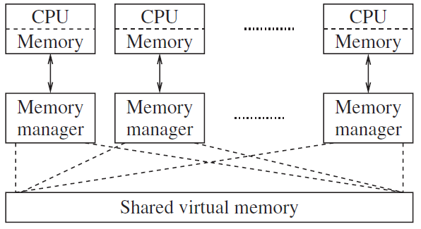
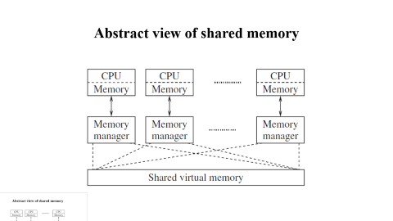
Abstract view of shared memory

Slide 5
DSM Advantages
Communication across the network is achieved by the read/write abstraction that simplifies the task of programmers.
A single address space is provided, thereby providing the possibility of avoiding data movement across multiple address spaces, and simplifying passing-by-reference and passing complex data structures containing pointers.
If a block of data needs to be moved, the system can exploit locality of reference to reduce the communication overhead.
DSM is often cheaper than using dedicated multiprocessor systems, because it uses simpler software interfaces and off-the-shelf hardware.
There is no bottleneck presented by a single memory access bus.

Slide 6
DSM effectively provides a large (virtual) main memory.
DSM provides portability of programs written using DSM. This portability arises due to a common DSM programming interface, which is independent of the operating system and other low-level system characteristics.

Slide 7
DSM Disadvantages
Programmers are not shielded from having to know about various replica consistency models and from coding their distributed applications according to the semantics of these models.
As DSM is implemented under the covers using asynchronous message passing, the overheads incurred are at least as high as those of a message passing implementation. As such, DSM implementations cannot be more efficient than asynchronous message-passing implementations.
By yielding control to the DSM memory management layer, programmers lose the ability to use their own message-passing solutions for accessing shared objects.

Slide 8
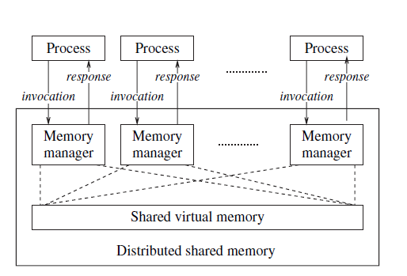
Detailed abstraction of DSM and interaction with application process

Slide 9
Design Issues of DSM
Determining what semantics to allow for concurrent access to shared objects.
The semantics needs to be clearly specified so that the programmer can code his program using an appropriate logic.
Determining the best way to implement the semantics of concurrent access to shared data.
One possibility is to use replication.
One decision to be made is the degree of replication –
Partial replication at some sites,
or Full replication at all the sites.
Another decision then is to decide on whether to use
Read-replication (replication for the read operations) or
Write-replication (replication for the write operations) or
Both.

Slide 10
3. Selecting the locations for replication (if full replication is not used), to optimize efficiency from the system’s viewpoint.
4. Determining the location of remote data that the application needs to access, if full replication is not used.
5. Reducing communication delays and the number of messages that are involved under the covers while implementing the semantics of concurrent access to shared data.

Slide 11
There are four broad dimensions along which DSM systems can be classified and implemented
Whether data is replicated or cached.
Whether remote access is by hardware or by software.
Whether the caching/replication is controlled by hardware or software.
Whether the DSM is controlled by the distributed memory managers, by the operating system, or by the language runtime system.

Slide 12
Shared memory mutual exclusion

Slide 13
Lamport’s bakery algorithm
Developed by Leslie Lamport that uses mutual exclusion to increase safety in the use of shared resources across several process.
The algorithm maintains the first-come, first-served principle(FCFS).
Lamport proposed the classical bakery algorithm for n-process mutual exclusion in shared memory systems.
The algorithm is so called because it mimics the actions that customers follow in a bakery store.

Slide 14
Analogy
a bakery with a numbering machine
each customer receives a unique number
numbers increase by one as customers enter
global counter displays the number of customers currently being served
all others wait inline
after the baker is finished serving the customer, the following number is displayed
served customer leaves

Slide 15
A process wanting to enter the critical section picks a token number that is one greater than the elements in the array choosing[1…n]
Processes enter the critical section in the increasing order of the token numbers.
In case of concurrent accesses to choosing by multiple processes, the processes may have the same token number.
In this case, a unique lexicographic order is defined on the tuple <token, pid> and this dictates the order in which processes enter the critical section.
The token number is first compared.
If they are the same, then process ID is compared next
ie, (a, b) < (c, d) if a < c or if a = c and b <d
The algorithm can be shown to satisfy the three requirements of the critical section problem:
(i) mutual exclusion, (ii) bounded waiting, and (iii) progress.

Slide 16
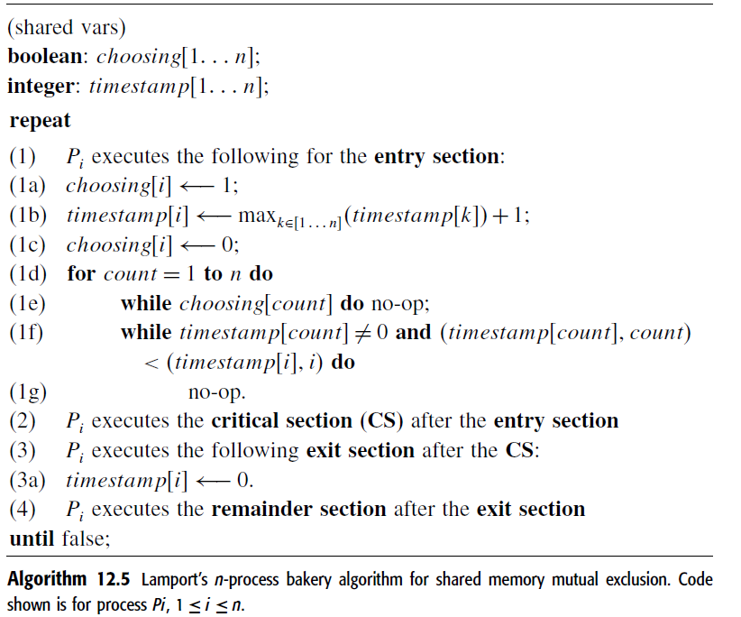

Slide 17
In the entry section, a process chooses a timestamp for itself, and resets it to 0 in the exit section.
In lines
1a–1c:: each process chooses a timestamp for itself, as the max of the latest timestamps of all processes, plus one.
These steps are non-atomic; thus multiple processes could be choosing timestamps in overlapping durations.
When process i reaches line 1d, it has to check the status of each other process j, to deal with the effects of any race conditions in selecting timestamps.
1d–1f::process i serially checks the status of each other process j.
i waits for j’s timestamp to stabilize, i.e., choosing[j]to be set to false.
Once j’s timestamp is stabilized,i moves from line 1e to line 1f.
Either j is not requesting (in which case j’s timestamp is 0) or j is requesting.
Line 1f determines the relative priority between i and j.

Slide 18
Mutual Exclusion
The process with a lexicographically lower timestamp has higher priority and enters the CS; the other process has to wait (line 1g). Hence, mutual exclusion is satisfied.
Bounded Wait
Bounded waiting is satisfied because each other process j can “overtake” process i at most once after i has completed choosing its timestamp.
The second time j chooses a timestamp, the value will necessarily be larger than i’s timestamp if i has not yet entered its CS.
Progress
It is guaranteed because the lexicographic order is a total order and the process with the lowest timestamp at any time in the loop (lines 1d–1g) is guaranteed to enter the CS.

