Slide 1
Module 4 Part_02
Prepared by
Jesna J S
Assistant Professor CSE, TKMCE

Slide 2
Checkpointing and rollback recovery
Rollback recovery treats a distributed system application as a collection of processes that communicate over a network.
It achieves fault tolerance by periodically saving the state of a process during the failure-free execution, enabling it to restart from a saved state upon a failure to reduce the amount of lost work.
The saved state is called a checkpoint, and the procedure of restarting from a previously checkpointed state is called rollback recovery.
A checkpoint can be saved on either the stable storage or the volatile storage depending on the failure scenarios to be tolerated.

Slide 3
In distributed systems, rollback recovery is complicated because messages induce inter-process dependencies during failure-free operation.
Upon a failure of one or more processes in a system, these dependencies may force some of the processes that did not fail to roll back, creating what is commonly called a rollback propagation.
To see why rollback propagation occurs, consider the situation where the sender of a message m rolls back to a state that precedes the sending of m. The receiver of m must also roll back to a state that precedes m’s receipt; otherwise, the states of the two processes would be inconsistent because they would show that message m was received without being sent, which is impossible in any correct ailure-free execution. This phenomenon of cascaded rollback is called the domino effect.

Slide 4
In a distributed system, if each participating process takes its checkpoints independently, then the system is susceptible to the domino effect. This approach is called independent or uncoordinated checkpointing.
Two techniques are used
Coordinated checkpointing
where processes coordinate their checkpoints to form a system-wide consistent state.
In case of a process failure, the system state can be restored to such a consistent set of checkpoints, preventing the rollback propagation.
Communication-induced checkpointing
It forces each process to take checkpoints based on information piggybacked on the application messages it receives from other processes.

Slide 5
System model
A distributed system consists of a fixed number of processes, P1, P2 ,…. PN , which communicate only through messages.
Processes cooperate to execute a distributed application and interact with the outside world by receiving and sending input and output messages, respectively.
A distributed system consists of a fixed number of processes, P1, P2 ,….. PN , which communicate only through messages.
Processes cooperate to execute a distributed application and interact with the outside world by receiving and sending input and output messages, respectively.

Slide 6
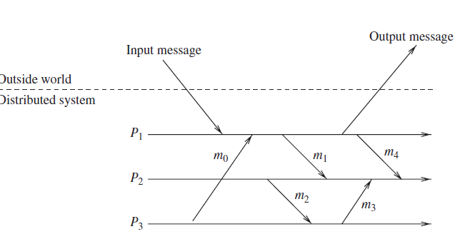

Slide 7
A generic correctness condition for rollback-recovery can be defined as follows : “a system recovers correctly if its internal state is consistent with the observable behavior of the system before the failure.”
Rollback-recovery protocols therefore must maintain information about the internal interactions among processes and also the external interactions with the outside world.

Slide 8
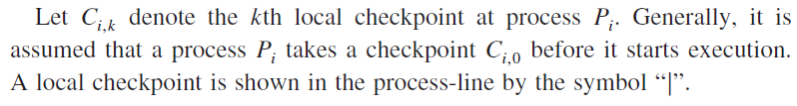
local checkpoint
In distributed systems, all processes save their local states at certain instants of time. This saved state is known as a local checkpoint.
A local checkpoint is a snapshot of the state of the process at a given instance
The event of recording the state of a process is called local checkpointing.
The contents of a checkpoint depend upon the application context and the checkpointing method being used.

