Slide 1
Module 4 Part_03
Prepared by
Jesna J S
Assistant Professor CSE, TKMCE

Slide 2
Log-based rollback recovery

Slide 3
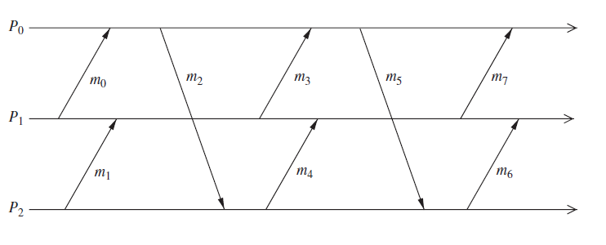
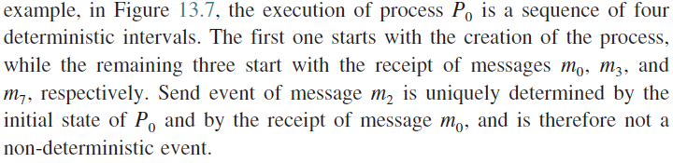
Deterministic and non-deterministic events
A non-deterministic event can be the receipt of a message from another process or an event internal to the process.
A message send event is a deterministic event.

Slide 4
Log-based rollback recovery
It exploits the fact that a process execution can be modeled as a sequence of deterministic state intervals, each starting with the execution of a non-deterministic event.
Log-based rollback recovery assumes that all non-deterministic events can be identified and their corresponding determinants can be logged into the stable storage.
During failure-free operation, each process logs the determinants of all non-deterministic events that it observes onto the stable storage.
Additionally, each process also takes checkpoints to reduce the extent of rollback during recovery.
After a failure occurs, the failed processes recover by using the checkpoints and logged determinants to replay the corresponding non-deterministic events precisely as they occurred during the pre-failure execution.

Slide 5
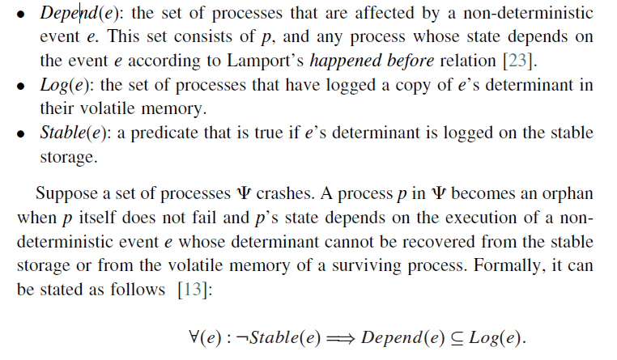
The no-orphans consistency condition
Let e be a non-deterministic event that occurs at process p. We define the following

Slide 6
The above property is called the always-no-orphans condition.
It states that if any surviving process depends on an event e, then either event e is logged on the stable storage, or the process has a copy of the determinant of event e. If neither condition is true, then the process is an orphan because it depends on an event e that cannot be generated during recovery since its determinant is lost.
Log-based rollback-recovery protocols guarantee that upon recovery of all failed processes, the system does not contain any orphan process, i.e., a process whose state depends on a non-deterministic event that cannot be reproduced during recovery.
Log-based rollback-recovery protocols are of three types:
Pessimistic logging,
Optimistic logging
Causal logging protocols

Slide 7

1. Pessimistic Logging
Pessimistic logging protocols assume that a failure can occur after any non-deterministic event in the computation.
This assumption is “pessimistic” since in reality failures are rare.
The determinant of each non-deterministic event before the event affects the computation will be logged to the stable storage.
Pessimistic protocols implement the property, synchronous logging, which is a stronger than the always-no-orphans condition.
If an event has not been logged on the stable storage, then no process can depend on it.
In addition to logging determinants, processes also take periodic checkpoints to minimize the amount of work that has to be repeated during recovery. When a process fails, the process is restarted from the most recent checkpoint and the logged determinants are used to recreate the prefailure execution.

Slide 8
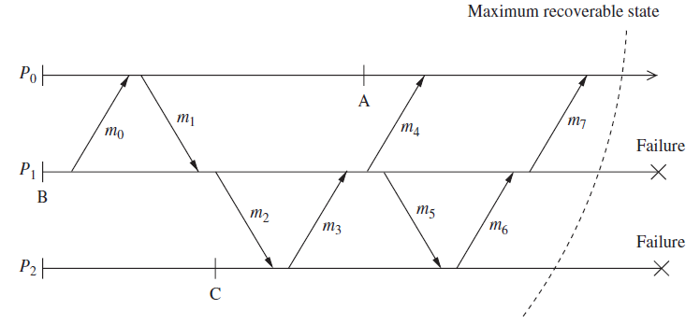
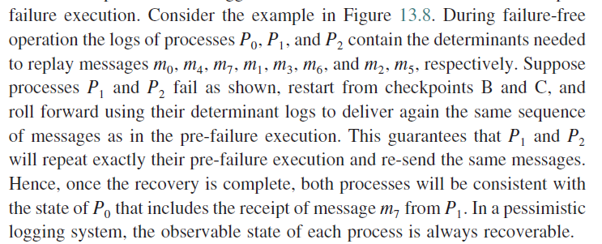

Slide 9
How to reduce the overhead
Implementations of pessimistic logging must use special techniques to reduce the effects of synchronous logging on the performance.
This overhead can be lowered using special hardware.
A fast non-volatile semiconductor memory can be used to implement the stable storage.
Another approach is to limit the number of failures that can be tolerated.
The overhead of pessimistic logging is reduced by delivering a message or executing an event and deferring its logging until the process communicates with another process or with the outside world.

Slide 10
Sender Based Message Logging(SBML)
Some pessimistic logging systems reduce the overhead of synchronous logging without relying on hardware.
The sender-based message logging (SBML) protocol keeps the determinants corresponding to the delivery of each message m in the volatile memory of its sender.
The determinant of m, which consists of its content and the order in which it was delivered, is logged in two steps.
First, before sending m, the sender logs its content in volatile memory.
Then, when the receiver of m responds with an acknowledgment that includes the order in which the message was delivered, the sender adds to the determinant the ordering information.
SBML avoids the overhead of accessing stable storage but tolerates only one failure and cannot handle non-deterministic events internal to a process.
Extensions to this technique can tolerate more than one failure in special network topologies.

Slide 11
2. Optimistic logging
In optimistic logging protocols, processes log determinants asynchronously to the stable storage .
These protocols optimistically assume that logging will be complete before a failure occurs.
Determinants are kept in a volatile log, and are periodically flushed to the stable storage.
Thus, optimistic logging does not require the application to block waiting for the determinants to be written to the stable storage, and therefore incurs much less overhead during failure-free execution.

Slide 12
If a process fails, the determinants in its volatile log are lost, and the state intervals that were started by the non-deterministic events corresponding to these determinants cannot be recovered.
Furthermore, if the failed process sent a message during any of the state intervals that cannot be recovered, the receiver of the message becomes an orphan process and must roll back to undo the effects of receiving the message.
Optimistic logging protocols do not implement the always-no-orphans condition
The always-no-orphans condition holds after the recovery is complete.
This is achieved by rolling back orphan processes until their states do not depend on any message whose determinant has been lost.

Slide 13
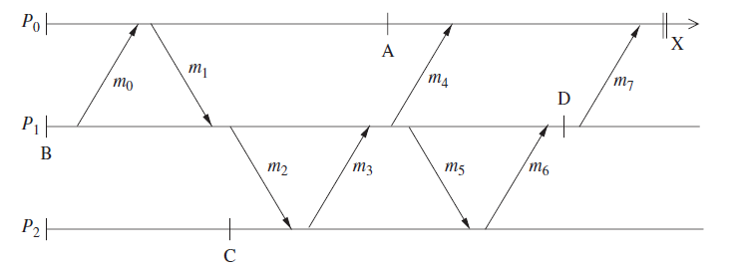
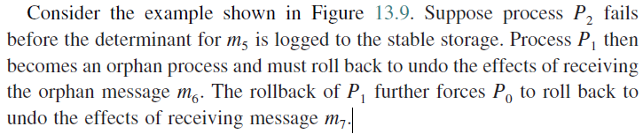

Slide 14
To perform rollbacks correctly, optimistic logging protocols track causal dependencies during failure free execution.
Upon a failure, the dependency information is used to calculate and recover the latest global state of the pre-failure execution in which no process is in an orphan.
Optimistic logging protocols require a non-trivial garbage collection scheme.
Also note that pessimistic protocols need only keep the most recent checkpoint of each process, whereas optimistic protocols may need to keep multiple checkpoints for each process.

Slide 15
3. Causal logging
Causal logging combines the advantages of both pessimistic and optimistic logging at the expense of a more complex recovery protocol.
Like optimistic logging, it does not require synchronous access to the stable storage except during output commit.
Like pessimistic logging, it allows each process to commit output independently and never creates orphans, thus isolating processes from the effects of failures at other processes.
Causal logging limits the rollback of any failed process to the most recent checkpoint on the stable storage, thus minimizing the storage overhead and the amount of lost work.

Slide 16
Causal logging protocols make sure that the always-no-orphans property holds by ensuring that the determinant of each non-deterministic event that causally precedes the state of a process is either stable or it is available locally to that process.

Slide 17
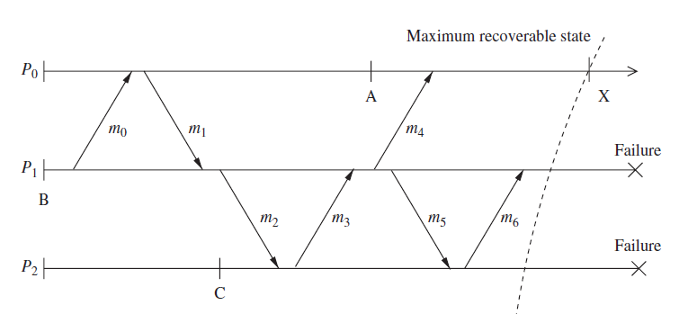

Slide 18
