Slide 1
MORPHOLOGICAL OPENING & CLOSING
AJAY SUSEEL R8B B22CSB06

Slide 2

OPENING
• Opening is a morphological operation consisting of two sequential steps: erosion followed by dilation.
• It is mainly used for removing noise, smoothing object boundaries, and separating touching objects.
• The operation removes small or thin structures while preserving the overall shape of larger objects.
• Opening simplifies the image by eliminating insignificant details.
• Opening of image A by structuring element B is expressed as
• First step - Erosion: removes small noise and thin protrusions from objects.
• Second step - Dilation: expands the remaining structures to approximately restore their original size.
• The process produces cleaner objects with smoother boundaries.

Slide 3
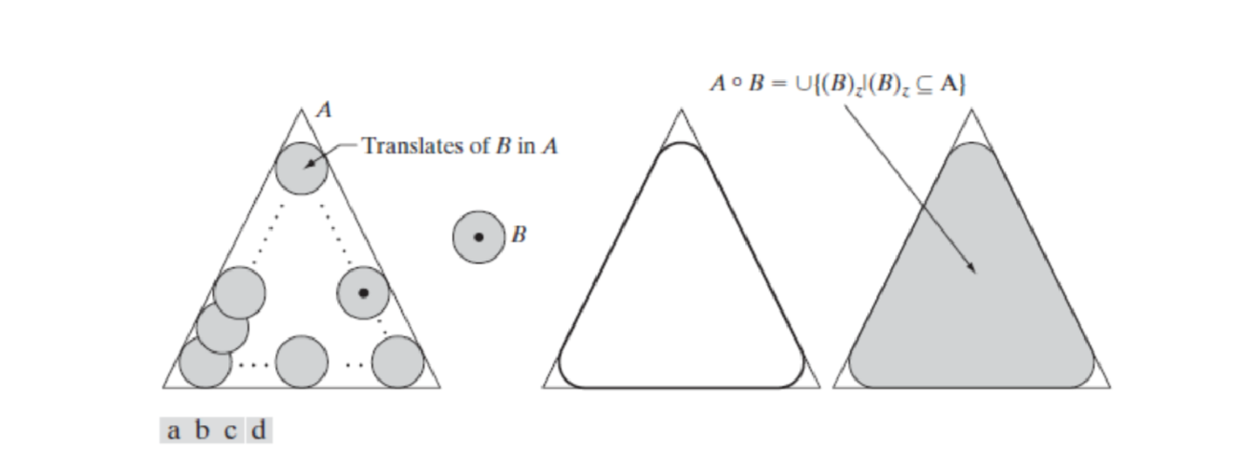
Geometric Interpretation and Applications
• The structuring element B can be imagined as a rolling ball moving inside the boundary of object A.
• Only the regions where the structuring element fits completely inside the object are retained.
• Opening can be interpreted as the union of all translations of B that fit within A.
Applications : • Noise removal • Separation of overlapping objects • Boundary smoothing • Background suppression

Slide 4

CLOSING
Closing is a morphological operation consisting of two steps: dilation followed by erosion. • It is mainly used for filling gaps, connecting broken contours, and closing small holes in objects. • The operation helps complete object boundaries and improve object continuity. • Small gaps or breaks in objects are eliminated.
• Closing of image A by structuring element B is expressed as
• First step – Dilation: expands objects and fills small holes or gaps. • Second step – Erosion: slightly shrinks the expanded region to restore object size. • The final result produces objects with filled holes and continuous boundaries.

Slide 5
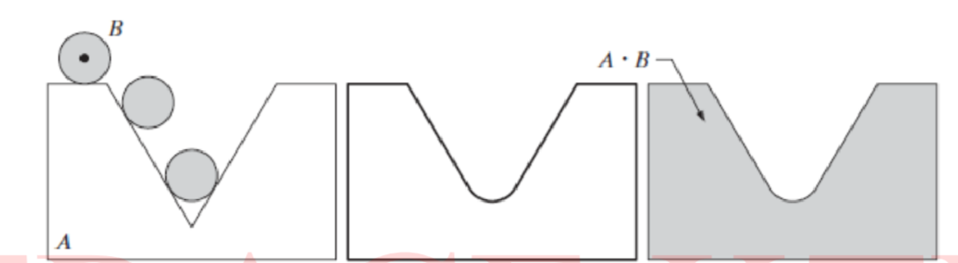
Geometric Interpretation and Applications
• The structuring element can be imagined as a rolling ball moving outside the object boundary. • A point belongs to the closing result if the translated structuring element intersects the object region. • Opening and closing are dual operations of each other in mathematical morphology.
Applications : • Filling holes in objects • Connecting broken lines or contours • Completing boundaries • Object reconstruction in images

Slide 6
