Slide 1
MODULE II
Image Transforms

Slide 2
Image transform
An image transform converts an image from the spatial domain into another domain (usually the frequency domain) to make image analysis, enhancement, compression, and filtering easier.

Slide 3
Purpose of Image Transforms:
To analyze frequency content of images
To compress images
To remove noise
To enhance important features (edges, textures)
To extract useful information

Slide 4
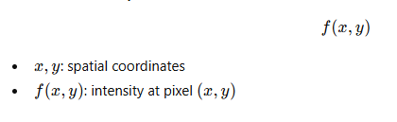
Spatial Domain
Spatial domain: The spatial domain refers to the image plane where an image is represented by its pixel intensity values, and processing is done directly on these pixels.
Mathematical Representation

Slide 5
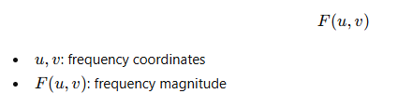
Frequency Domain
The frequency domain represents an image in terms of its frequency components, obtained by applying a transform such as the Fourier Transform.
Mathematical Representation

Slide 6
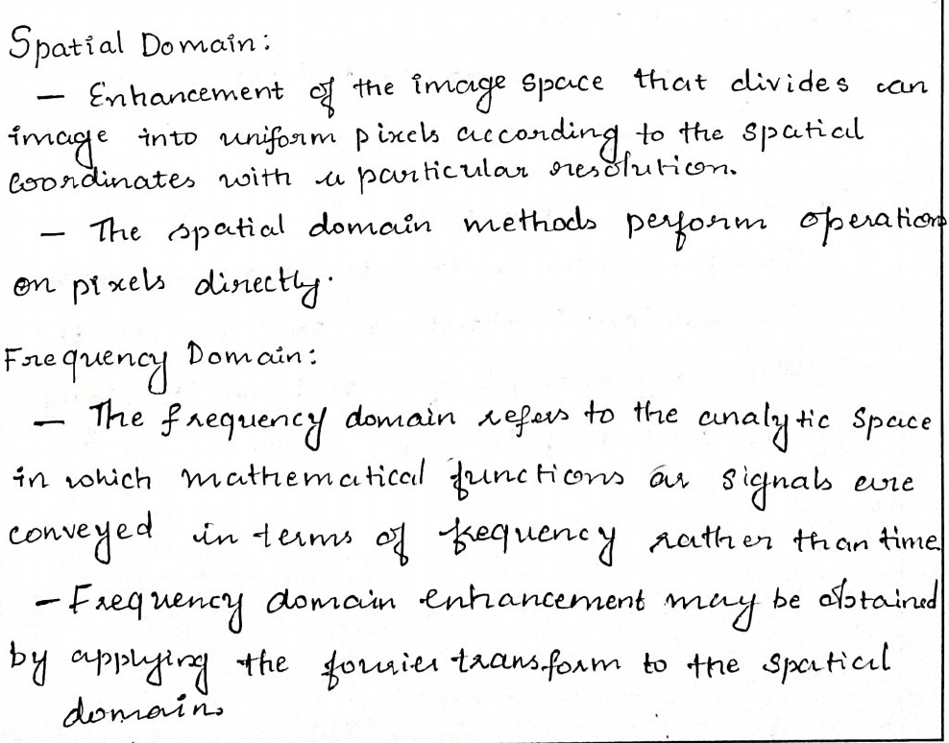

Slide 7
Spatial Domain vs Frequency Domain
Aspect | Spatial Domain | Frequency Domain
Representation | Pixel values | Frequency components
Domain | Image plane | Transform plane
Processing | Direct pixel manipulation | Frequency manipulation
Examples | Histogram equalization | Fourier filtering
Complexity | Low | Higher

Slide 8
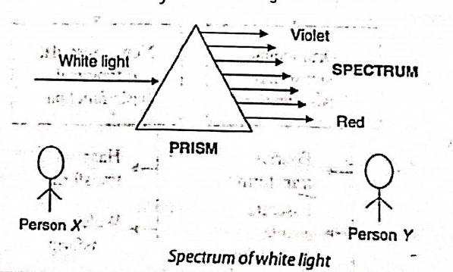

Slide 9
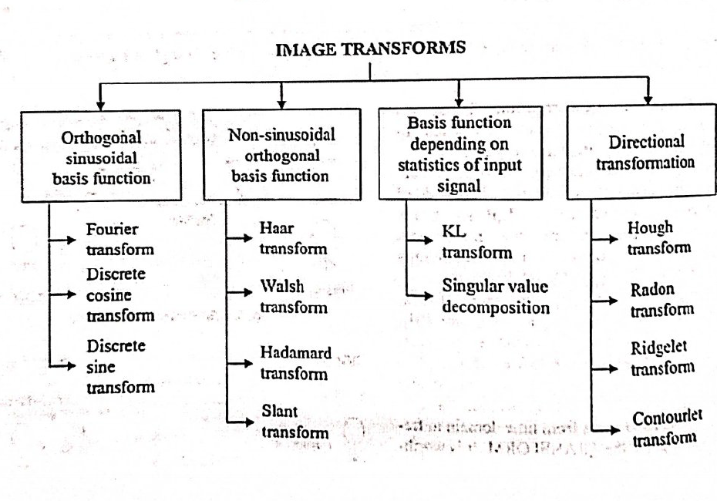

Slide 10
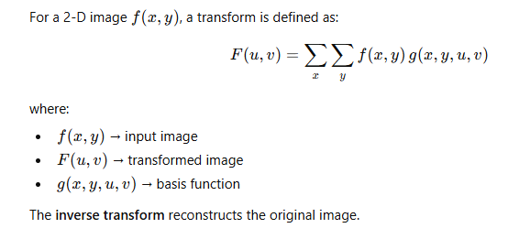
General Form of Image Transform

Slide 11
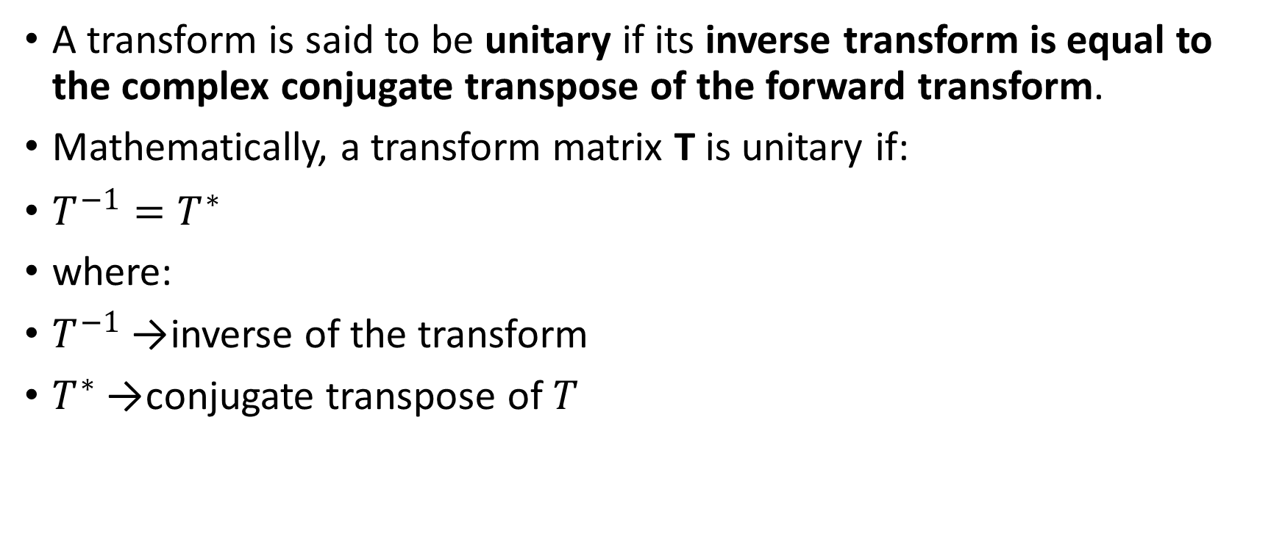
UNITARY TRANSFORM
A transform is said to be unitary if its inverse transform is equal to the complex conjugate transpose of the forward transform.
Mathematically, a transform matrix T is unitary if:
$T^{−1}=T^{∗}$
where:
$T^{−1}$→ inverse of the transform
$T^{∗}$→ conjugate transpose of $T$

Slide 12
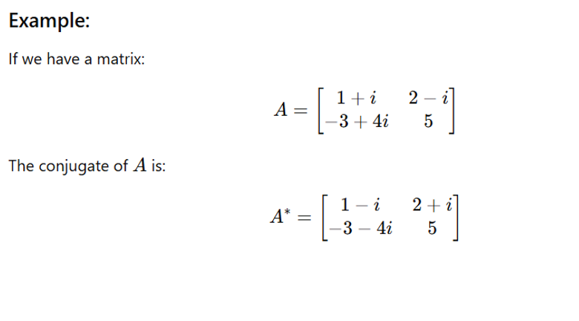

Slide 13
Importance of Unitary Property
Unitary transforms are important because they:
Preserve energy of the image
Do not amplify noise unnecessarily
Allow perfect reconstruction of the original image
Simplify mathematical analysis

Slide 14
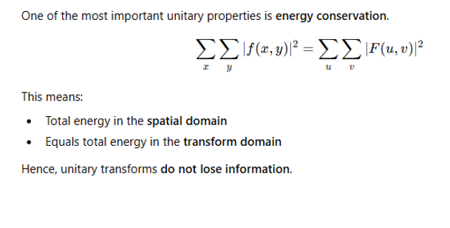
Basic properties of unitary transform.
1.Energy Preservation (Parseval’s Theorem)

Slide 15
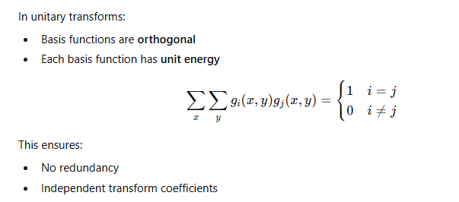
2. Orthonormal Basis Functions

Slide 16
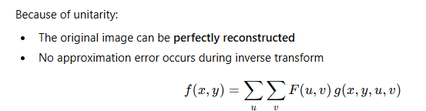
3.Perfect Reconstruction Property

Slide 17
4. Noise Stability
Unitary transforms:
Preserve noise statistics
White noise remains white after transformation
Noise energy remains unchanged
This property is crucial in image restoration and filtering.

Slide 18
Advantages of Unitary Transforms
Energy preserving
Numerically stable
Lossless transformation
Efficient for compression and restoration

Slide 19
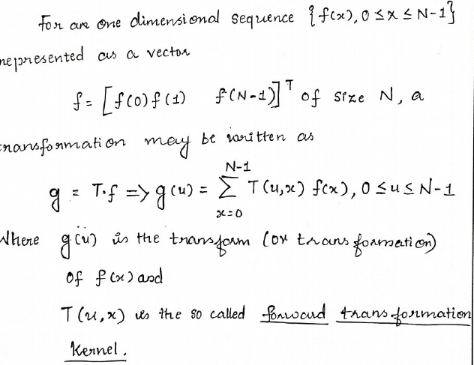
Unitary Transforms
1Dimensional signals

Slide 20
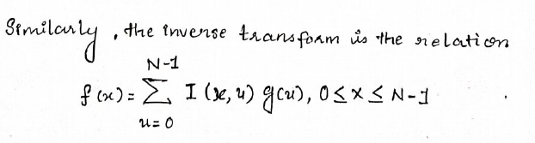
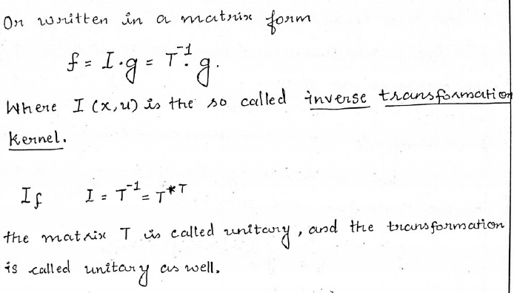

Slide 21
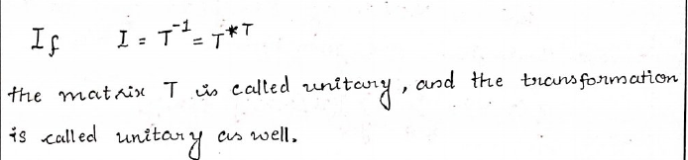
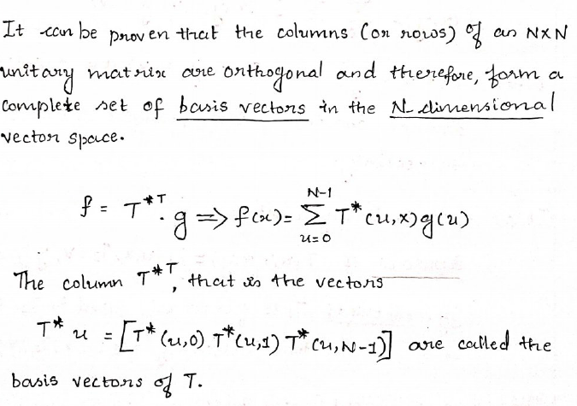

Slide 22
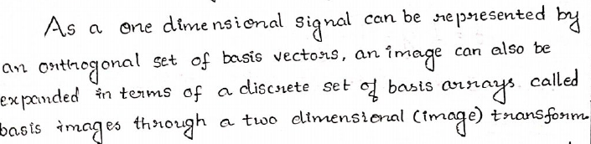
2 Dimensional signals

Slide 23
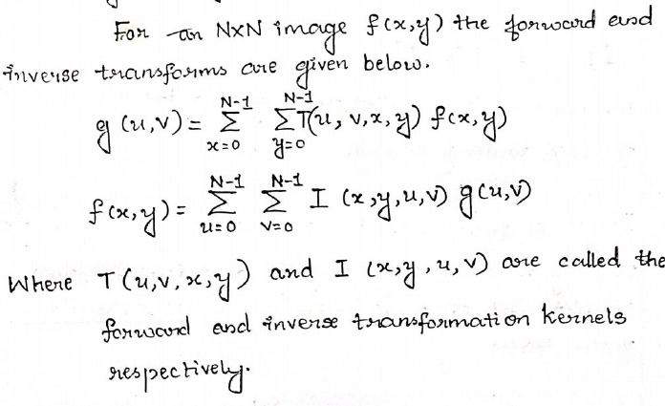

Slide 24
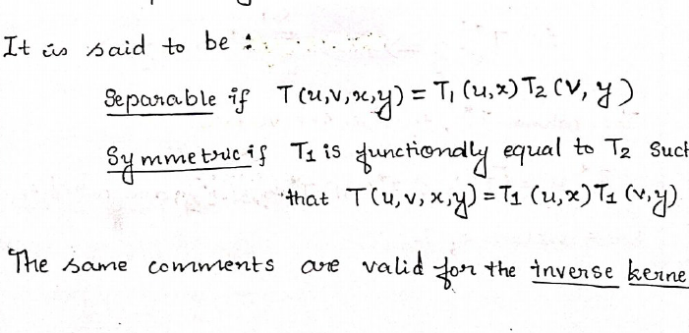

Slide 25
Discrete Fourier Transform (DFT)
In digital image processing, the Discrete Fourier Transform (DFT) is used to transform an image from the spatial domain into the frequency domain.
The frequency-domain representation describes the image in terms of its sinusoidal components, which is useful for filtering, enhancement, and analysis.

Slide 26



Final DFT equation
x(n)-the discrete-time input sequence,
$n$ is the time index,
$k$is the frequency index, and
$N$is the total number of samples
The DFT matrix is not unitary by default. However, the normalized DFT matrix
$$U=\frac{1}{\sqrt{N}}F$$
is unitary, because
$$UU^{H}=I$$
(where $H$denotes conjugate transpose).

Slide 27
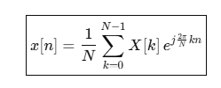
Inverse DFT (IDFT)

Slide 28
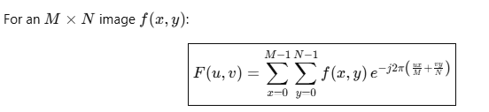
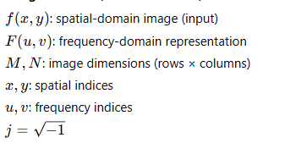
2-D DFT

Slide 29
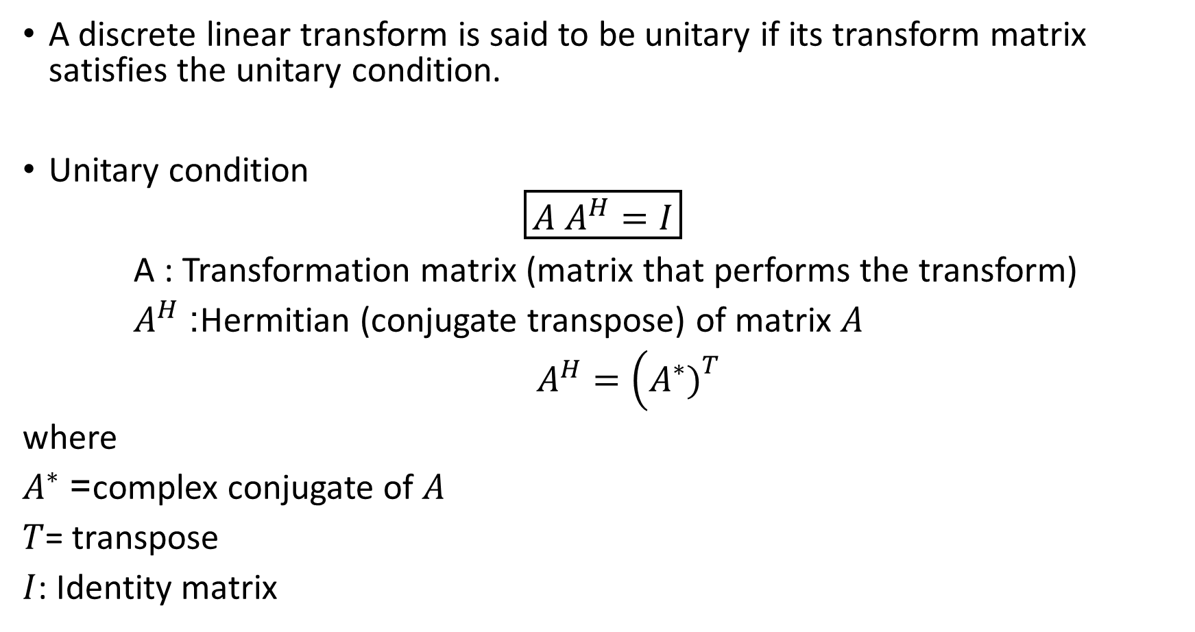
Unitary Transform
A discrete linear transform is said to be unitary if its transform matrix satisfies the unitary condition.
Unitary condition
$$\boxed{A A^{H}=I}$$
A : Transformation matrix (matrix that performs the transform)
$A^{H}$: Hermitian (conjugate transpose) of matrix $A$
$A^{H}=\left(A^{∗}{\left.)\right.}^{T}\right.$
where
$A^{∗}$= complex conjugate of $A$
$T$= transpose
$I$: Identity matrix

Slide 30

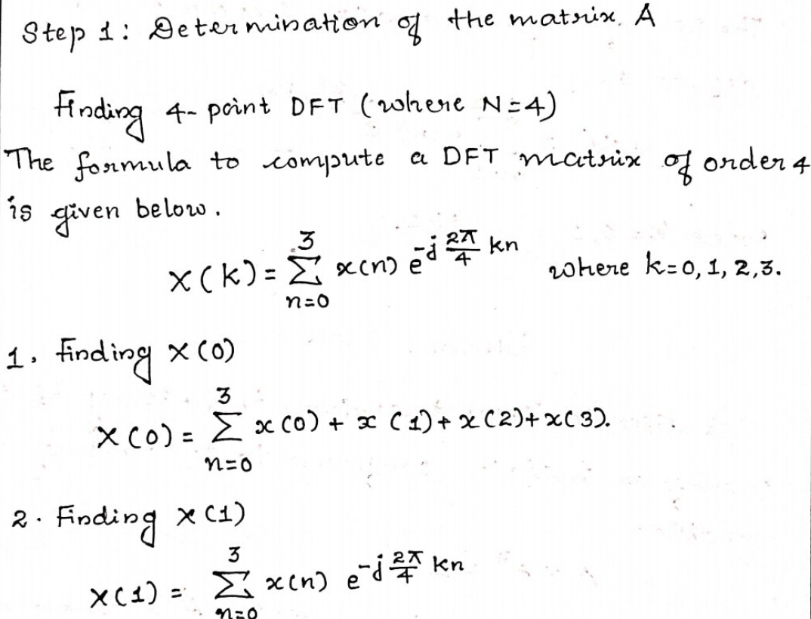

Slide 31
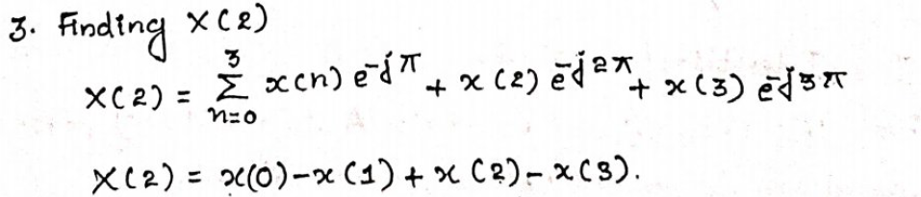
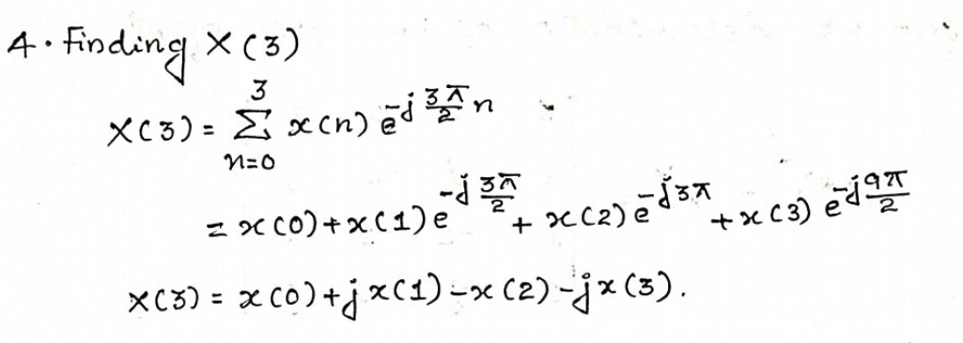

Slide 32
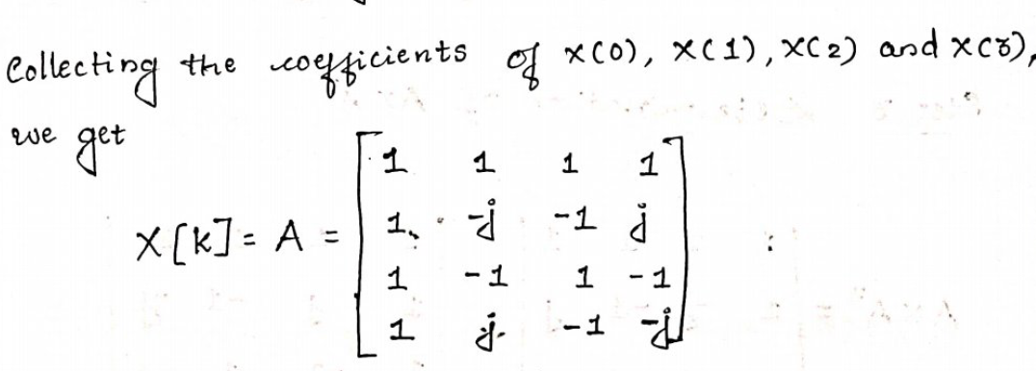

Slide 33
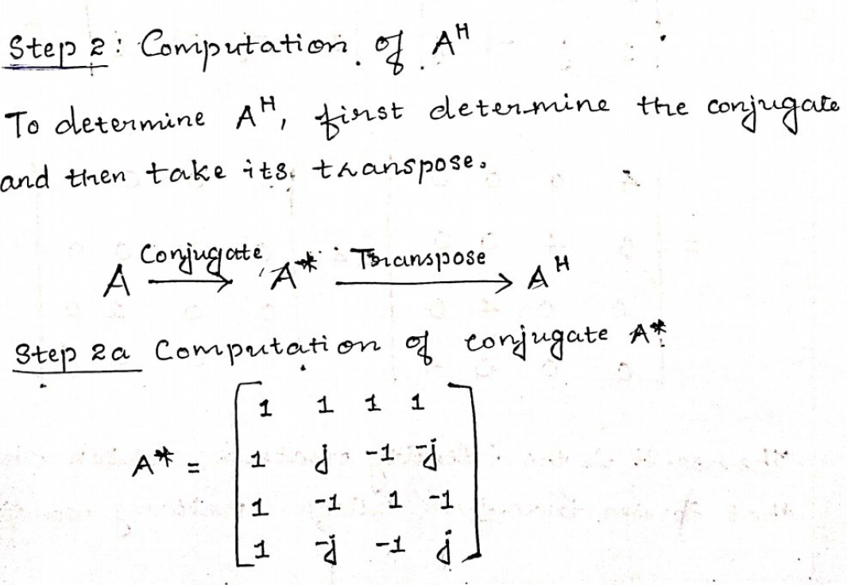

Slide 34
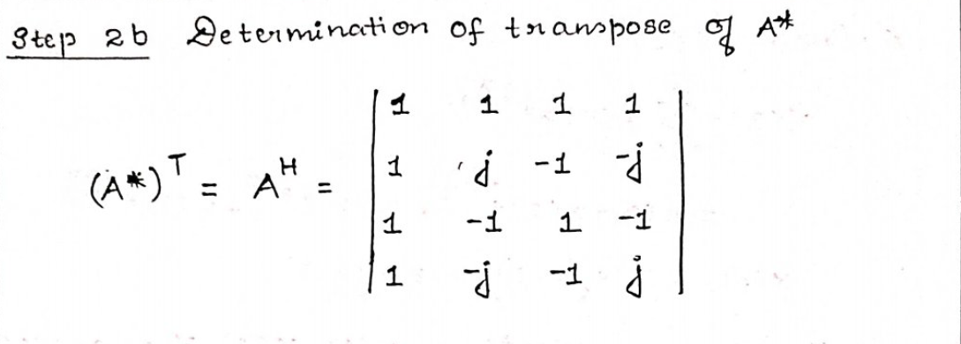

Slide 35
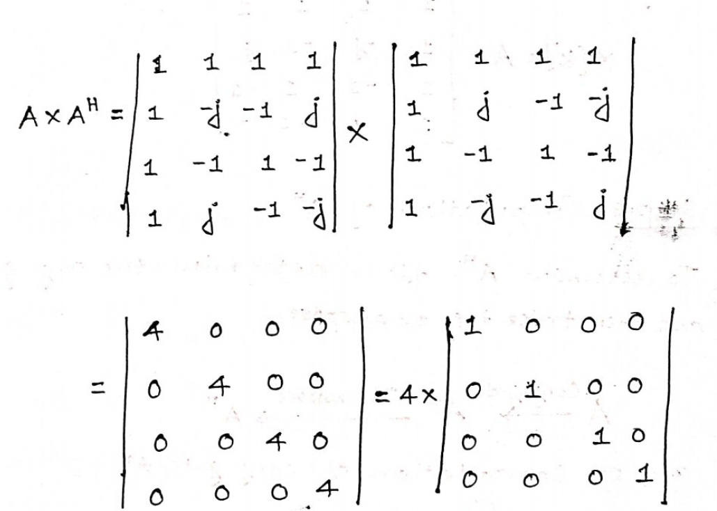
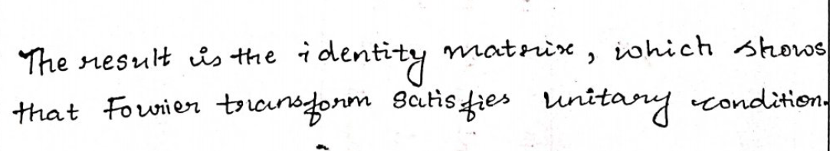

Slide 36
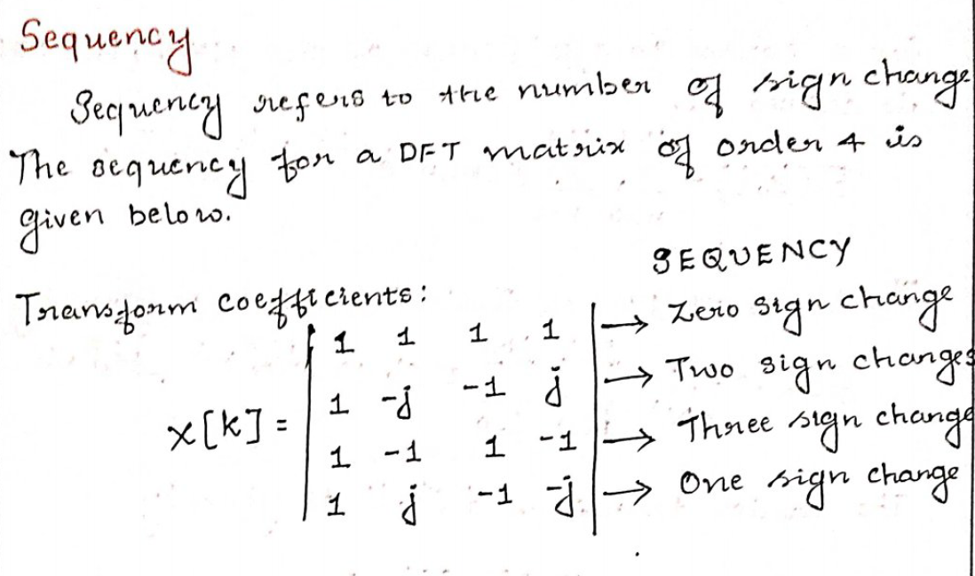

Slide 37
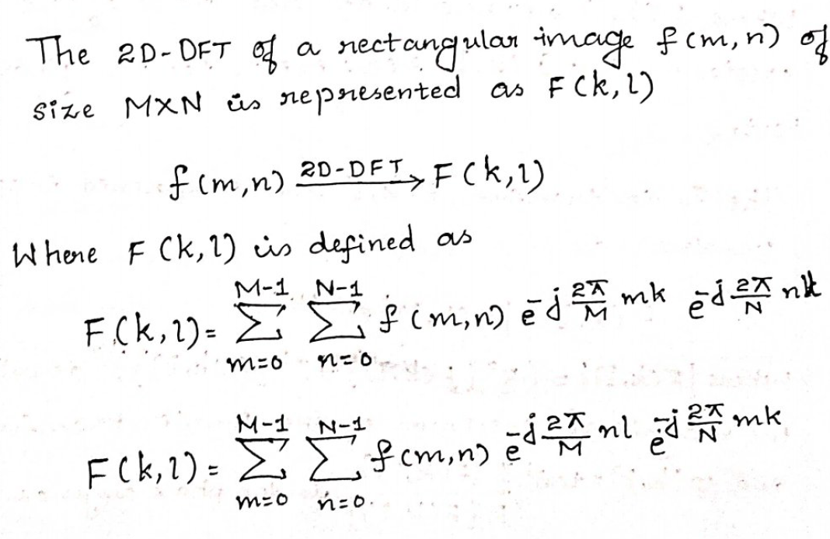
2DFT

Slide 38
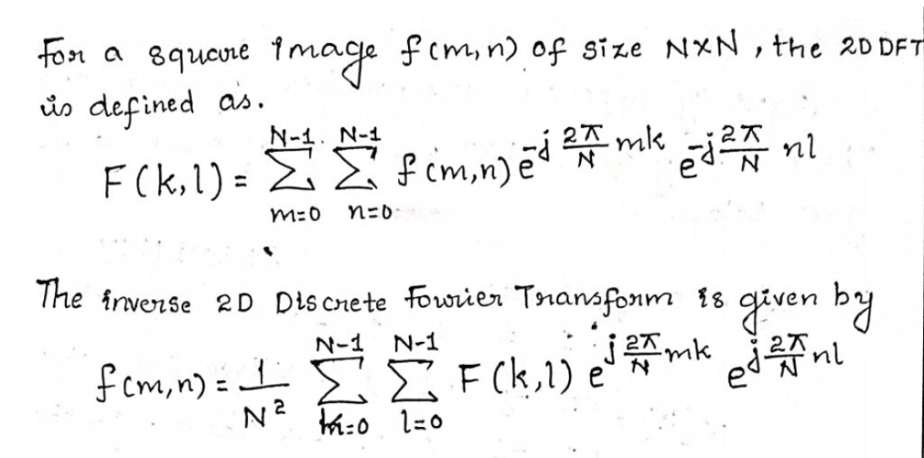

Slide 39
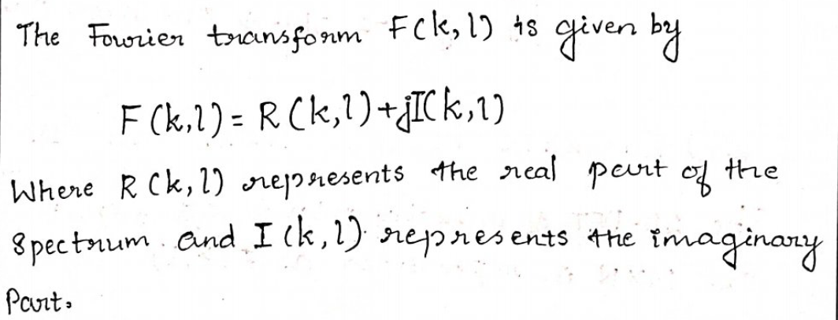

Slide 40
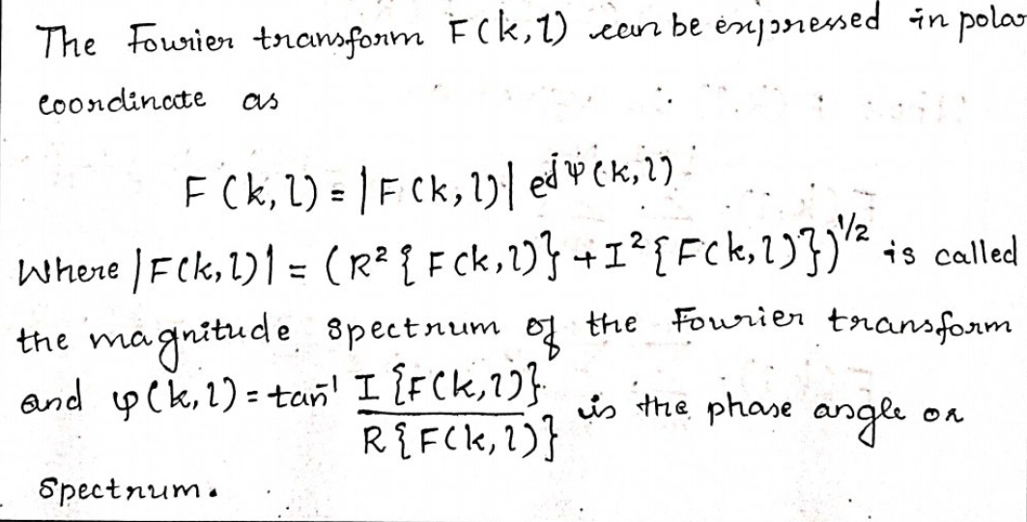

Slide 41

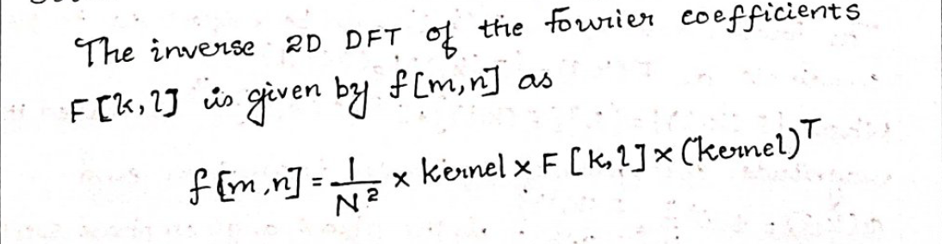

Slide 42
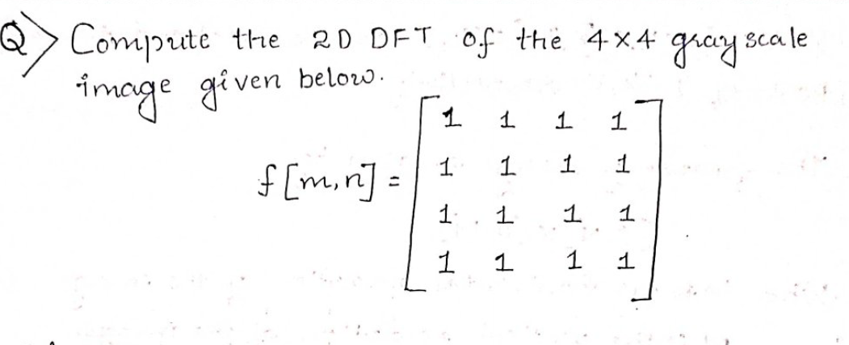

Slide 43
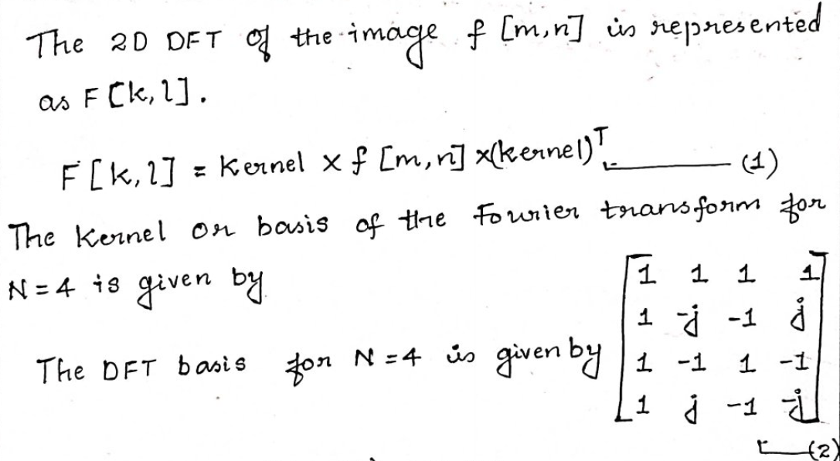

Slide 44
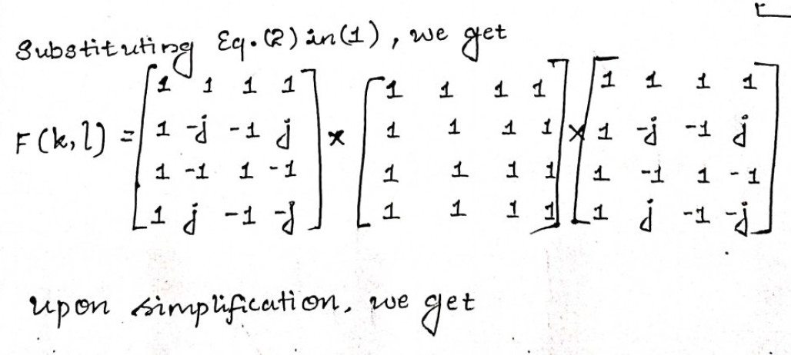

Slide 45
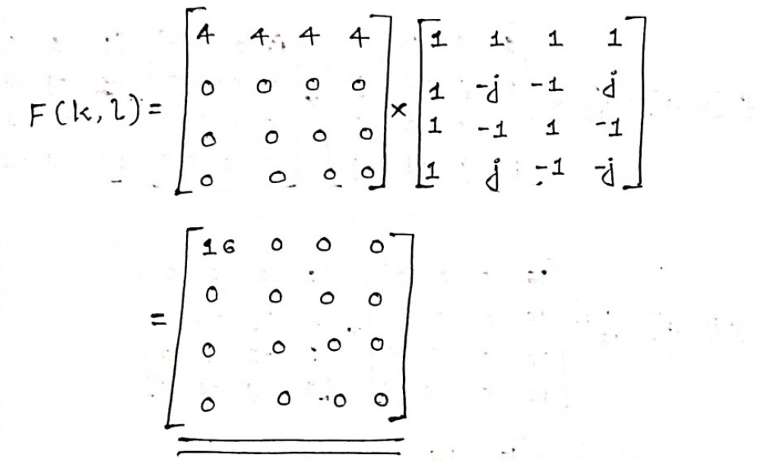

Slide 46
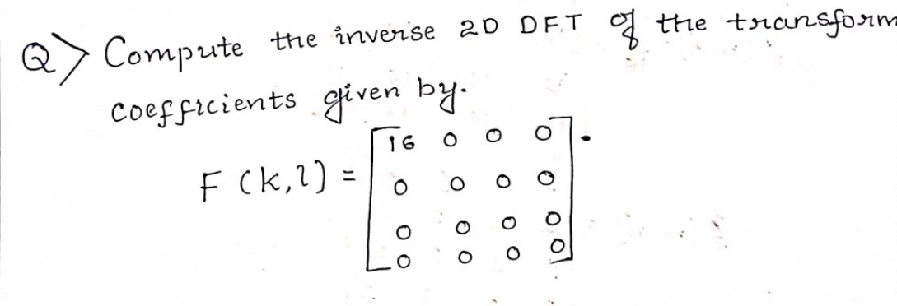

Slide 47
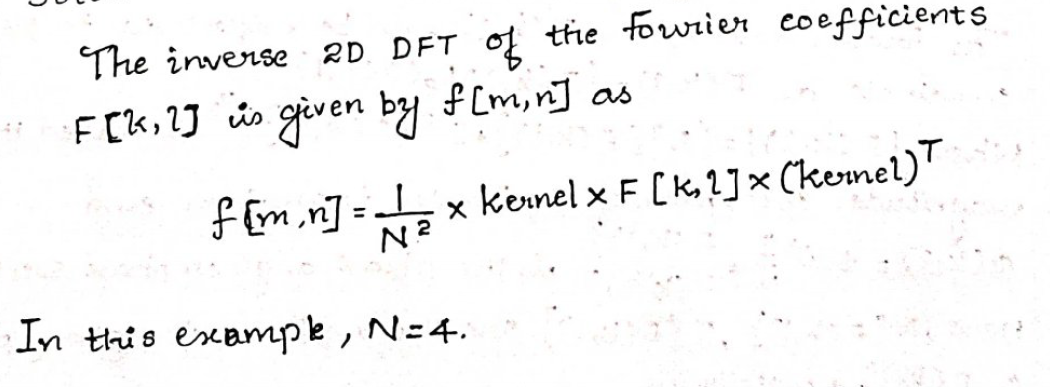

Slide 48
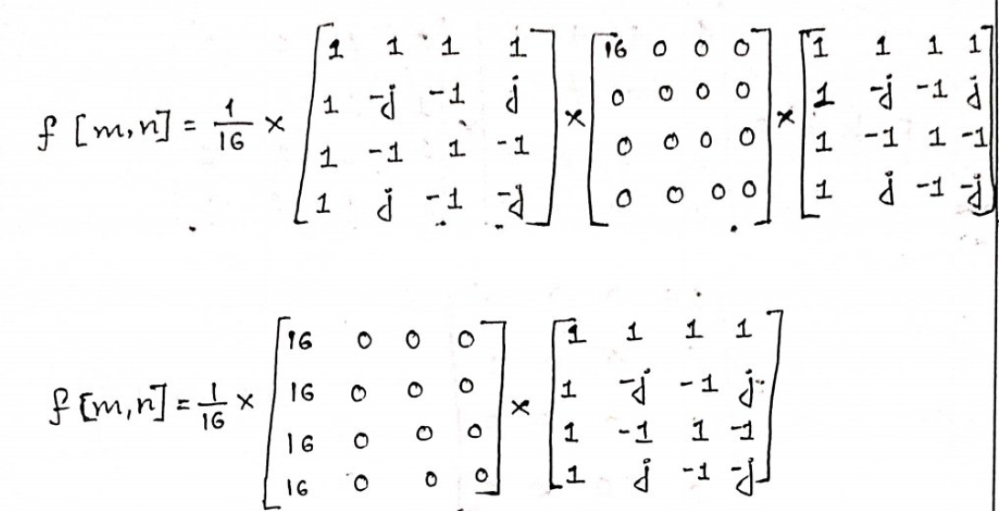

Slide 49
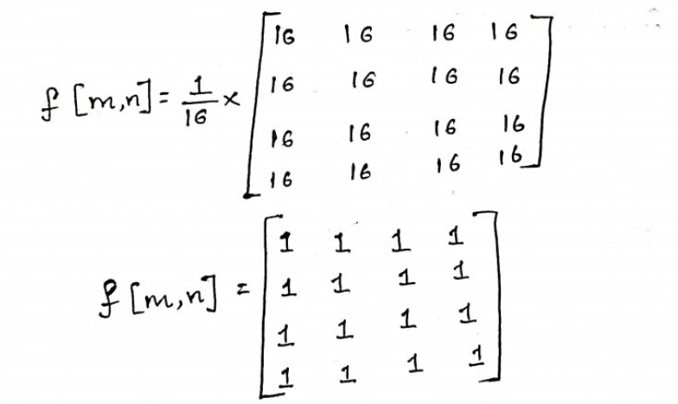

Slide 50
DCT – Discrete Cosine Transform
The Discrete Cosine Transform (DCT) is a real, separable, linear transform closely related to the Discrete Fourier Transform (DFT).
It represents an image as a sum of cosine functions oscillating at different frequencies.
It has excellent energy compaction
It uses real-valued basis functions
It is the foundation of JPEG image compression

Slide 51
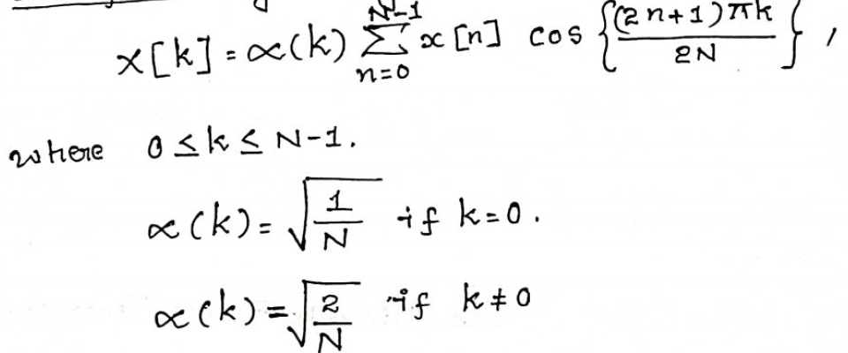
1D Discrete Cosine Transform

Slide 52
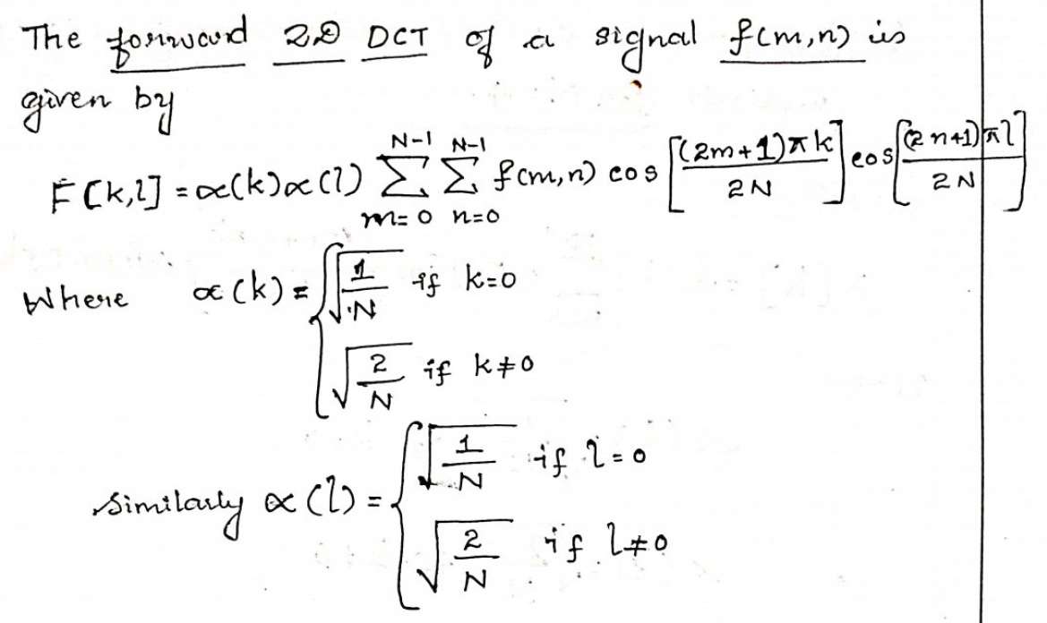
2D Discrete Cosine Transform

Slide 53
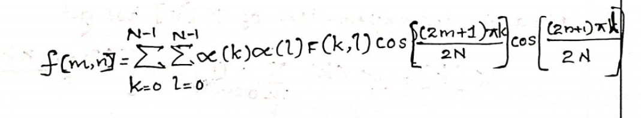
2D Inverse DCT

Slide 54
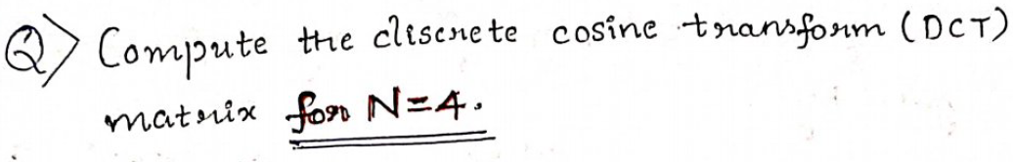


Slide 55




Slide 56


Slide 57



Slide 58


Slide 59


Slide 60


Slide 61


Slide 62
Hadamard Transform
The Hadamard Transform (HT) is a non-sinusoidal, orthogonal image transform used to convert an image from the spatial domain into the transform (frequency) domain using only +1 and −1 basis functions.

Slide 63

Hadamard Matrix
A Hadamard matrix is a square matrix whose elements are only +1 and −1, and whose rows (and columns) are mutually orthogonal.

Slide 64


Construction of Hadamard Matrix
Hadamard matrices are defined only for sizes that are powers of 2.
Order 2
Recursive Construction
$$H_{2N}=\left[\begin{matrix}H_{N} & H_{N} \\ H_{N} & −H_{N}\end{matrix}\right]$$

Slide 65


Order 8

Slide 66


Slide 67


Slide 68


Slide 69


Slide 70


