Slide 1
SEGMENTATION
Image Segmentation is the process of dividing a digital image into smaller groups so that processing and analyzing the larger images becomes easier and simpler.
Region and Edge-based segmentation are different types of Image Segmentation.

Slide 2
Region-based segmentation
This process involves dividing the image into smaller segments that have a certain set of rules.
This technique employs an algorithm that divides the image into several components with common pixels.
Small segments can include similar pixels from neighboring pixels and subsequently grow in size.
They are two types:
Region growing
Region splitting and merging

Slide 3
Region Growing
As its name implies, region growing is a procedure that groups pixels or subregions into larger regions based on predefined criteria for growth.
The basic approach is to start with a set of “seed” points and from these grow regions by appending to each seed those neighboring pixels that have predefined properties similar to the seed (such as specific ranges of intensity or color).
In Region growing method, we start with a random pixel as the seed pixel and then check the adjacent pixels.
If the adjacent pixels satisfy the predefined rules, then that pixel is added to the region of the seed pixel.
Region is grown from the seed pixel by adding in neighboring pixels that are similar, increasing the size of the region.
When the growth of one region stops, we simply choose another seed pixel which does not yet belong to any region and start again.

Slide 4
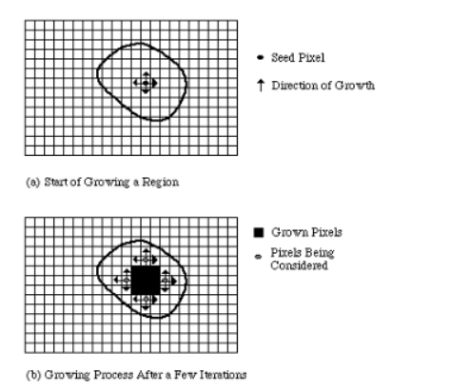
Drawback:
o Current region dominates the growth process
o Different choices of seeds may give different segmentation results.
A basic region-growing algorithm based on 8-connectivity may be stated as follows

Slide 5
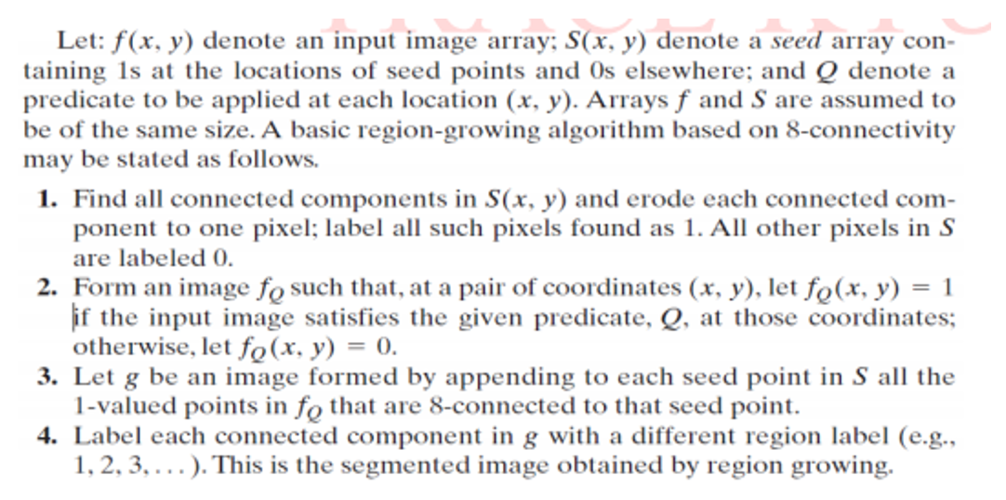

Slide 6
Region splitting and merging
In this method, the whole image is considered a single region.
Now to divide the region into segments it checks for pixels included in the initial region if they follow the predefined set of criteria.
If they follow similar rules they are taken into one segment.

Slide 7
Let R represents the entire image region and select Q the predicate.
One approach for segmentation is to subdivide it successively into smaller and smaller quadrants so that for any region Ri, Q(Ri) = TRUE.
We start with the entire region. When Q(Ri) = FALSE, we divide the image segments into quadrants.
If Q is false for any quadrant, we subdivide that quadrant into sub – quadrants and so on.
This particular splitting technique has a convenient representation in the form of so called, quad trees,i.e. trees with exactly four descendants.
The root of the tree corresponds to the entire image, and that each
node corresponds to the subdivision of a node into four descendant nodes.

Slide 8
In this case, only R4 was subdivided further.
If only splitting is used, the final partition normally contains adjacent regions with identical properties.
This drawback can be remedied by allowing merging as well as splitting.
Satisfying the constraints of segmentation requires merging only adjacent regions whose combined pixels satisfy the predicate Q
That is, two adjacent regions Rj and Rk are merged only if
Q (Rj ∪ Rk)=TRUE.

Slide 9
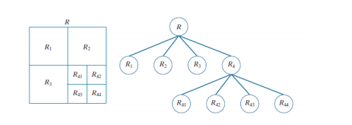
The preceding discussion can be summarized by the following procedure in which, at any step, we
Split into four disjoint quadrants any region Ri for which Q (Ri) = FALSE.
2. When no further splitting is possible, merge any adjacent regions Rj and Rk for which Q (Rj ∪ Rk) =
TRUE.
Partitioned image
Corresponding quadtree.

Slide 10
