Slide 1
THRESHOLDING

Slide 2
Thresholding
Thresholding is the simplest method of image segmentation.
Intensity thresholding is an image processing technique used to separate objects of interest from the background in an image.
The basic idea behind thresholding is to convert an image into a binary image by setting all pixel values above a certain threshold to one and all values below the threshold to zero.
The threshold value is typically chosen based on the intensity histogram of the image.
The histogram shows the distribution of pixel intensities in the image, and the threshold can be selected at a point were there is a significant difference in the distribution between the objects of interest and the background.

Slide 3
There are different types of thresholding methods,
Global thresholding
Local thresholding
Adaptive thresholding
Global thresholding sets a fixed threshold value for the entire image.
Local thresholding sets different threshold values for different regions of the image
based on their local characteristics.
Adaptive thresholding adjusts the threshold value dynamically based on the
local image characteristics and is particularly useful for images with non-uniform
lighting or background.

Slide 4
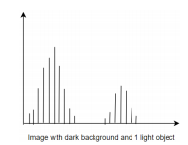
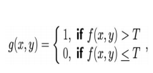
Single value (Binary) thresholding
Simplest thresholding method is binary thresholding.
Here all pixel values those are greater than the specific threshold value is assign a standard value.
Example: If the pixel value is smaller than the threshold, it is set to 0, otherwise, it is set to a maximum value (generally 255).
This threshold value which can be changed arbitrarily.
The application of this algorithms is when we have to separate foreground with background.
The drawback of this algorithm is that it will always segment the image in to two categories.

Slide 5
Multi value thresholding
In bi-level thresholding, image is segmented into two different regions.
The pixels with gray values greater than a certain value T are classified as object pixels, and the others with gray values lesser than T are classified as background pixels.
Multilevel thresholding is a process that segments a gray level image into several distinct regions.
This technique determines more than one threshold for the given image and segments the image into certain brightness regions, which correspond to one background and several objects.
The method works very well for objects with colored or complex backgrounds, on which bi-level thresholding fails to produce satisfactory results.

Slide 6
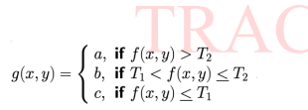
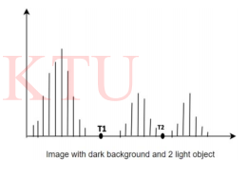

Slide 7
BASIC GLOBAL THRESHOLDING
A global thresholding technique is the one which makes use of a single threshold value for the whole image.
They are Histogram based thresholding techniques.
The simplest of all thresholding techniques is to partition the image histogram by using a single global threshold, T.
Creates a binary image after thresholding.
Segmentation is then accomplished by scanning the image pixel by pixel and labeling each pixel as object or back-ground, depending on whether the gray level of that pixel is greater or less than the value of T.
The success of this method depends entirely on how well the histogram can be partitioned.

Slide 8
The objects of interest in this case are darker than the background, so any pixel with a gray level ≤ T was labelled black (0), and any pixel with a gray level ≥ T was labeled white (255).
The key objective is to generate a binary image.
The type of global thresholding just described can be expected to be successful in highly controlled environments.
One of the areas in which this often is possible is in industrial inspection applications, where control of the illumination usually is feasible

Slide 9
How to select the threshold T in global thresholding?
The following algorithm can be used to obtain T automatically.
1. Select an initial estimate of T
2. Segment the image using T. This will produce two groups of pixels: G1 consisting of all pixels with gray level values >T and G2 consisting of pixels with values <= T
3. Compute the average gray level values µ1 and µ2 for the pixels in regions G1and G2
4. Compute the new threshold value 𝑇 =1/2( 𝜇1 + 𝜇2 )
5. Repeat steps 2 through 4 until the difference in T in successive iterations is smaller than a pre-defined parameter ∆T which is initialized as zero. The average intensity is the good choice for initial T value.

Slide 10
This simple algorithm works well in situations where there is a reasonably clear valley between the modes of the histogram related to objects and background.
Parameter ∆𝑇 is used to control the number of iterations in situations where speed is an important issue.
In general, the larger ∆𝑇 is, the fewer iterations the algorithm will perform.
The initial threshold must be chosen greater than the minimum and less than maximum intensity level in the image.
The average intensity of the image is a good initial choice for T

Slide 11
OPTIMUM GLOBAL THRESHOLDING USING OTSU METHOD
The method is optimum in the sense that it maximizes the between-class variance, a well-known measure used in statistical discriminant analysis.
The basic idea is that well- thresholded classes should be distinct with respect to the intensity values of their pixels and, conversely, that a threshold giving the best separation between classes in terms of their intensity values would be the best (optimum) threshold.
In addition to its optimality, Otsu’s method has the important property that it is based entirely on computations performed on the histogram of an image, an easily obtainable 1-D array
The algorithm assumes that the image contains two classes of pixels: object and background.
The goal is to find a threshold value that maximizes the between-class variance, which is defined as the sum of the variances of the two classes weighted by their probabilities.

Slide 12
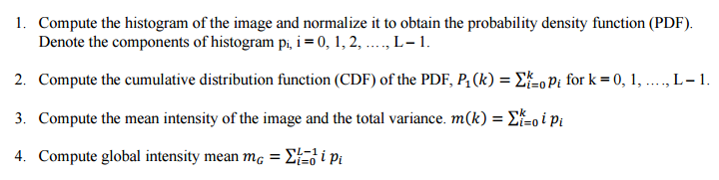
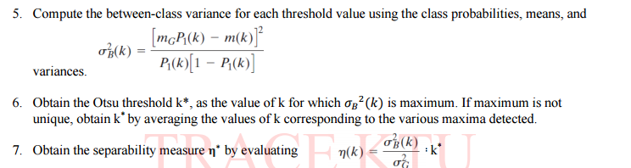
The steps involved in Otsu's method are as follows:

Slide 13
Applications:
Object Detection and Recognition: Otsu’s method can effectively segment images into foreground and background regions, which makes it useful for detecting and recognizing objects in images
Medical Imaging: Otsu’s method is extensively used in medical imaging applications for segmenting images of organs and tissues. Since it can assist in identifying abnormalities or anomalies in the images and help in the diagnosis
Document Analysis: Otsu’s method finds its application in segmenting handwritten or printed text in document images, which can aid in optical character recognition (OCR) and document analysis.
Quality Control and Inspection: Otsu’s method can be used in quality control and inspection applications to detect defects or anomalies in images of manufactured products.

Slide 14
Advantages of Otsu's method:
1. It is a simple and computationally efficient method that can be easily implemented.
2. It is an automatic thresholding method that does not require manual input or user intervention.
3. It is a widely used and well-established method that has been shown to produce good results in many applications.
4. It can handle a wide range of image types, including grayscale and color images.
5. It is a global thresholding method that can be applied to the entire image or a subset of the image.

Slide 15
Disadvantages of Otsu's method:
1. It assumes that the image histogram is bimodal, which may not be the case for all images. In cases where the histogram is not bimodal, Otsu's method may not produce optimal results.
2. It may not work well for images with high levels of noise or low contrast.
3. It may not be suitable for images with complex or irregular backgrounds.
4. It does not take into account spatial information or texture information, which may be important for some applications

