Slide 1
STRUCTURING ELEMENT
Presented by
AJINA A
B22CSA11

Slide 2
WHAT IS STRUCTURING ELEMENT?
A structuring element is a small shape or template that defines the neighborhood around each pixel in the image.
It defines the size, shape, and configuration of the local area used for the operation.
It is typically a binary matrix or a binary image, where the foreground pixels (usually represented as 1s) define the shape of the element.
The background pixels (usually represented as 0s) indicate the area outside the shape.

Slide 3
Square: It has equal dimensions in both the horizontal and vertical directions. It defines a square neighborhood around each pixel.
Rectangle: It has different dimensions in the horizontal and vertical directions, allowing for elongated or rectangular neighborhoods.
Disk: It defines a circular neighborhood around each pixel. It is useful for capturing circular or rounded structures in the image.
Line: It consists of a single row or column of foreground pixels. It is used for morphological operations along specific directions, such as detecting lines or thin structures.
Custom Shape: Structuring elements can be designed to match specific shapes or structures of interest. They can be created manually or generated automatically based on specific criteria.

Slide 4
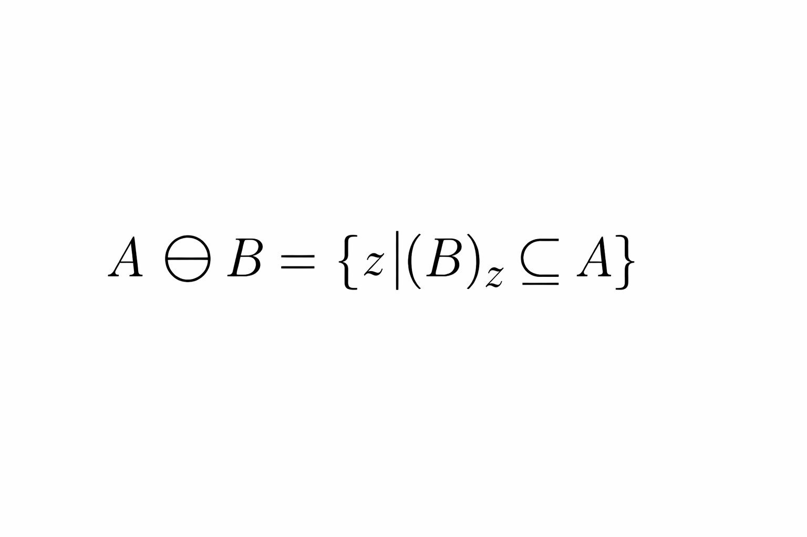
EROSION
Erosion is a fundamental morphological operation used in digital image processing to remove small or thin features and to shrink or simplify the boundaries of objects.
The erosion operation uses a structuring element to scan the image and replaces each pixel with the minimum pixel value within the structuring element.
With A and B as sets in Z2 , the erosion of A by B, denoted by A ⊖ B is given

Slide 5
Applications:
noise removal
Segmentation
object detection
pattern recognition
It is often used in conjunction with other morphological operations, such as dilation, opening, and closing, to achieve specific tasks.
The choice of structuring element determines the specific characteristics of the erosion operation and its impact on the image.
A larger structuring element results in more significant erosion, while a smaller structuring element produces more refined details.

Slide 6
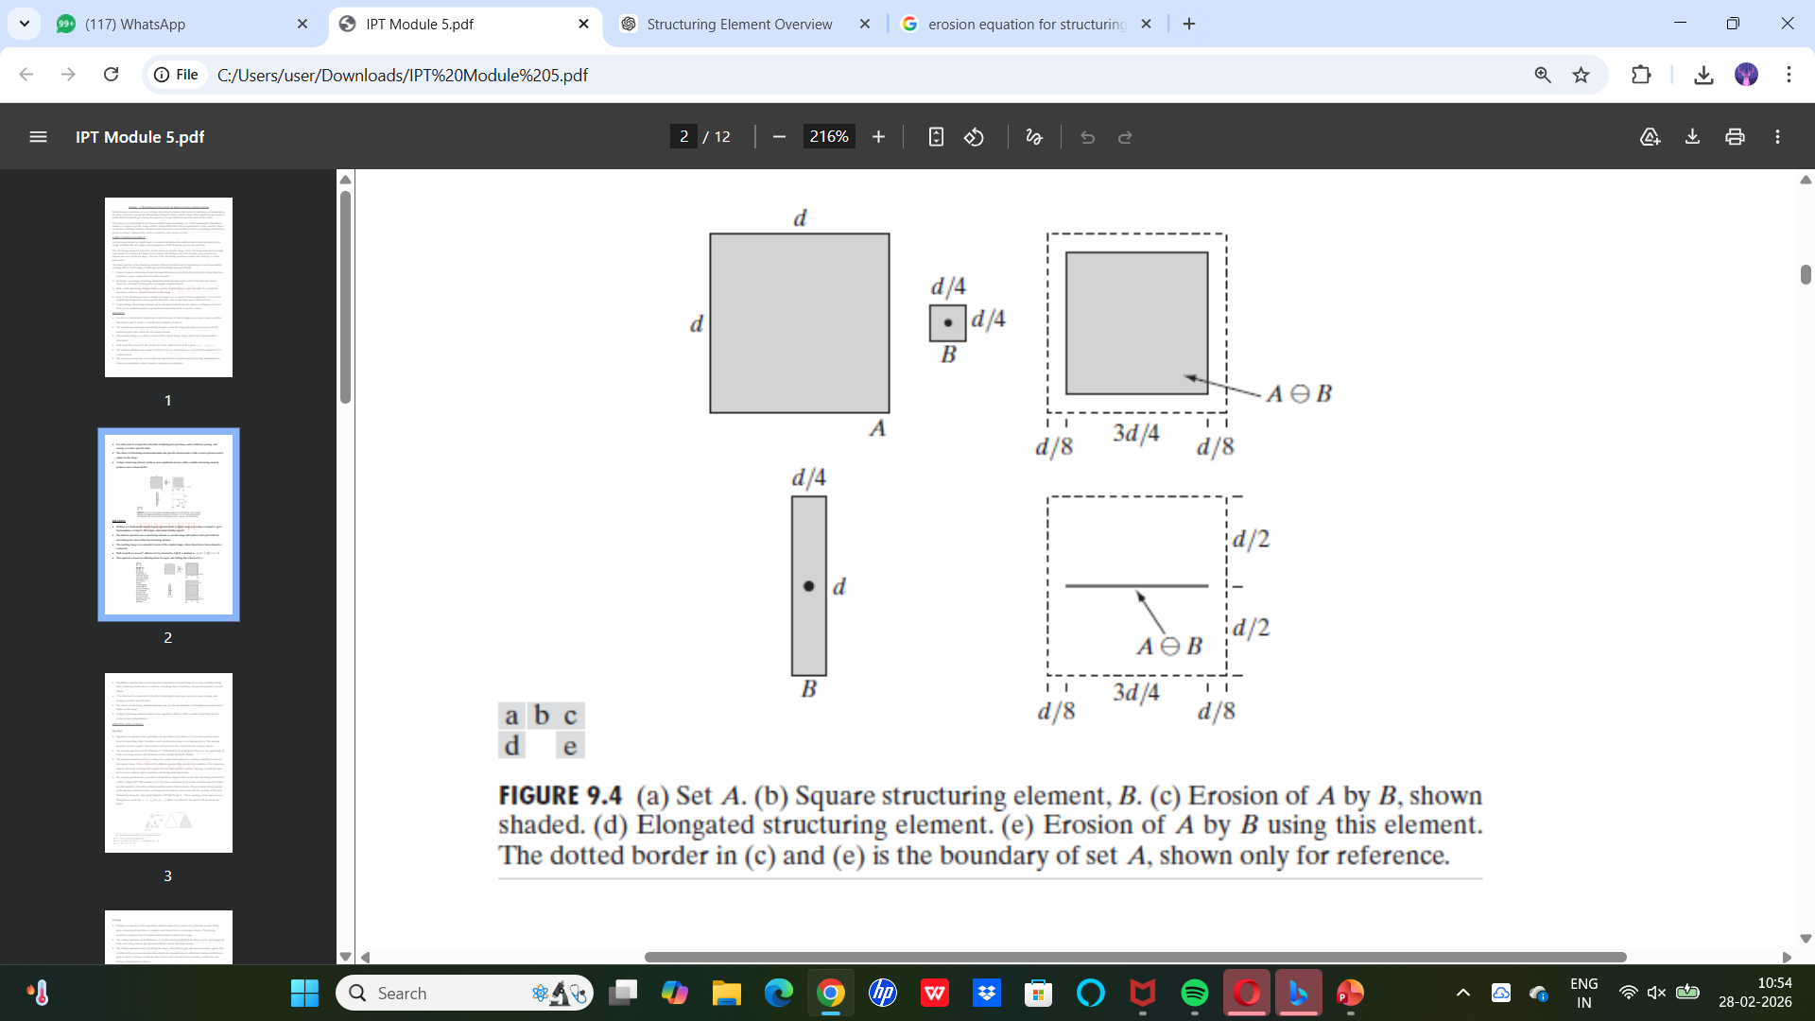

Slide 7
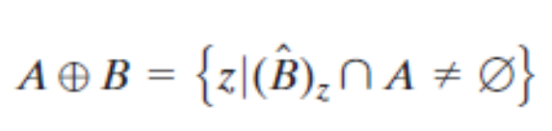
DILATION
Dilation is a fundamental morphological operation used in digital image processing to expand or grow the boundaries of objects, fill in gaps, and connect nearby regions.
The dilation operation uses a structuring element to scan the image and replaces each pixel with the maximum pixel value within the structuring element.
With A and B as sets in Z2 , dilation of A by denoted by A ⊕ B
This equation is based on reflecting about its origin, and shifting this reflection by z.

Slide 8
Dilation is used to fill small gaps, connect broken edges, smooth boundaries, and enhance object regions in an image.
It is commonly combined with other morphological operations like erosion, opening, and closing for better image processing results.
The structuring element controls how dilation affects the image (shape and size matter).
A larger structuring element causes stronger expansion, while a smaller one preserves finer details.

Slide 9
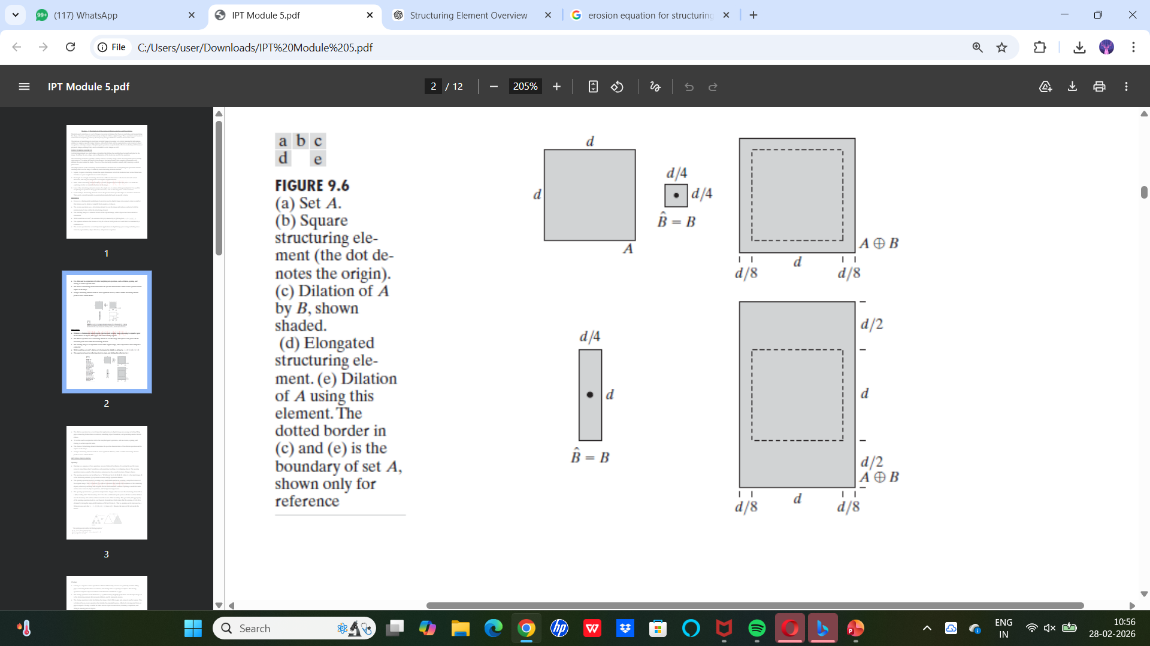

Slide 10
THANK YOU

