Slide 1
Linear Regression

Slide 2
Example 1:
Suppose you run a social networking site that charges a monthly subscription fee of $25, and that this is your only source of revenue.
Each month you collect data and count your number of users and total revenue.
Done this daily over the course of two years, recording it all in a spreadsheet.
Express this data as a series of points. Here are the first four:
S={(x,y)=(1,25),(10,250),(100,2500),(200,5000)}

Slide 3
Equation to represent the relationship of x and y
x | y
1 | 25
10 | 250
100 | 2500
200 | 5000
𝑦=25𝑥

Slide 4
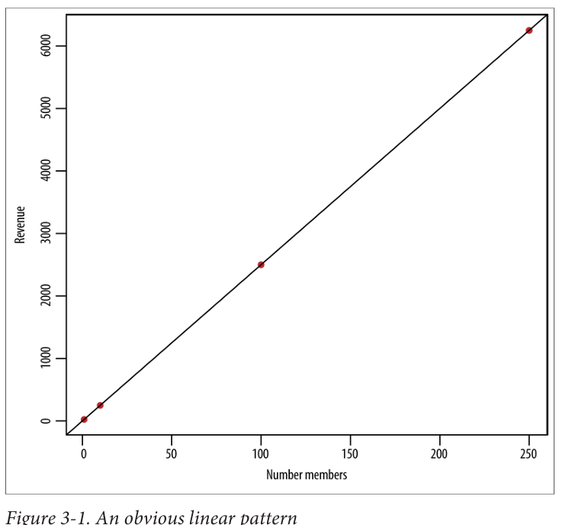
Deduce this mentally and identify the following:
There’s a linear pattern.
The coefficient relating 𝑥 and 𝑦 is 25.
The relationship seems deterministic.

Slide 5
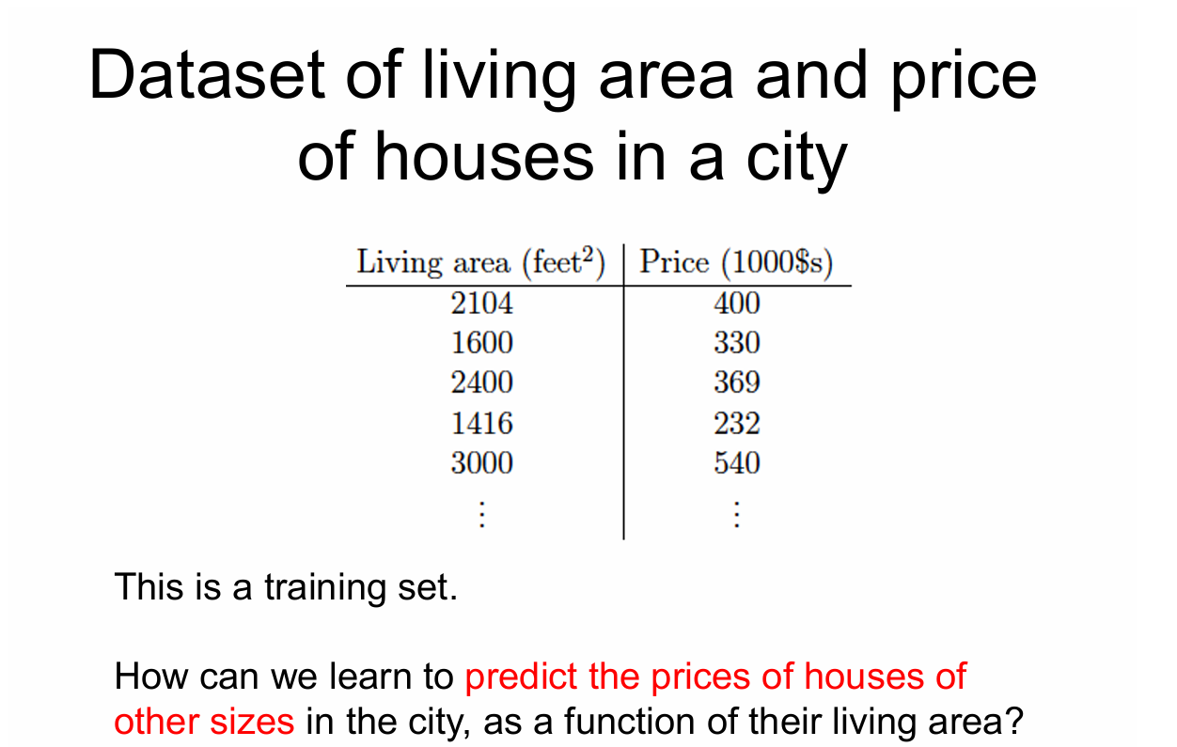
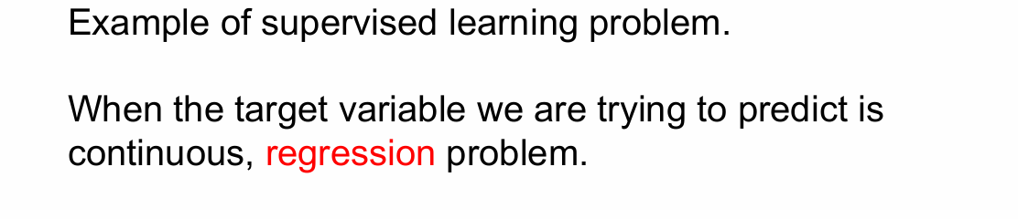

Slide 6
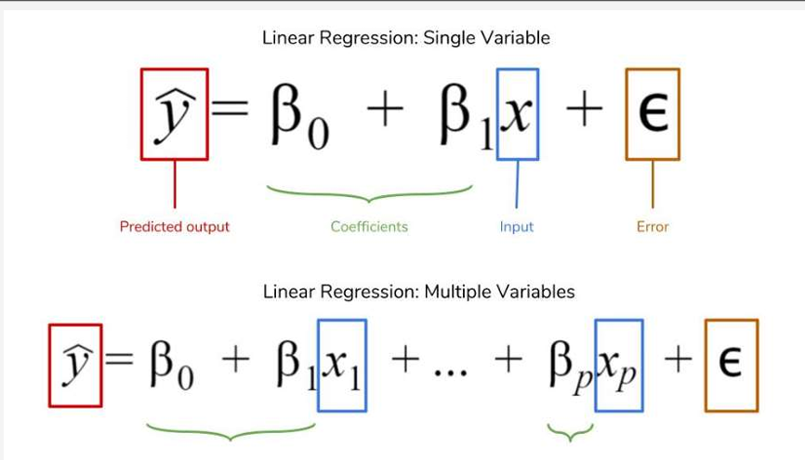
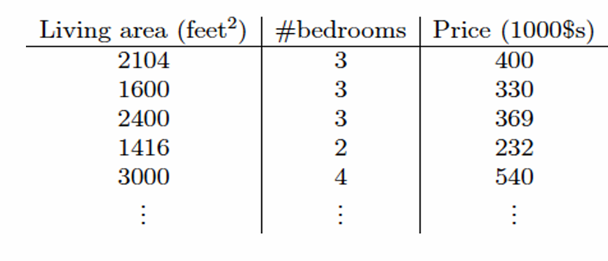
What is Linear Regression?
A linear regression is a data plot that graphs the linear relationship and a dependent variable(s).

Slide 7
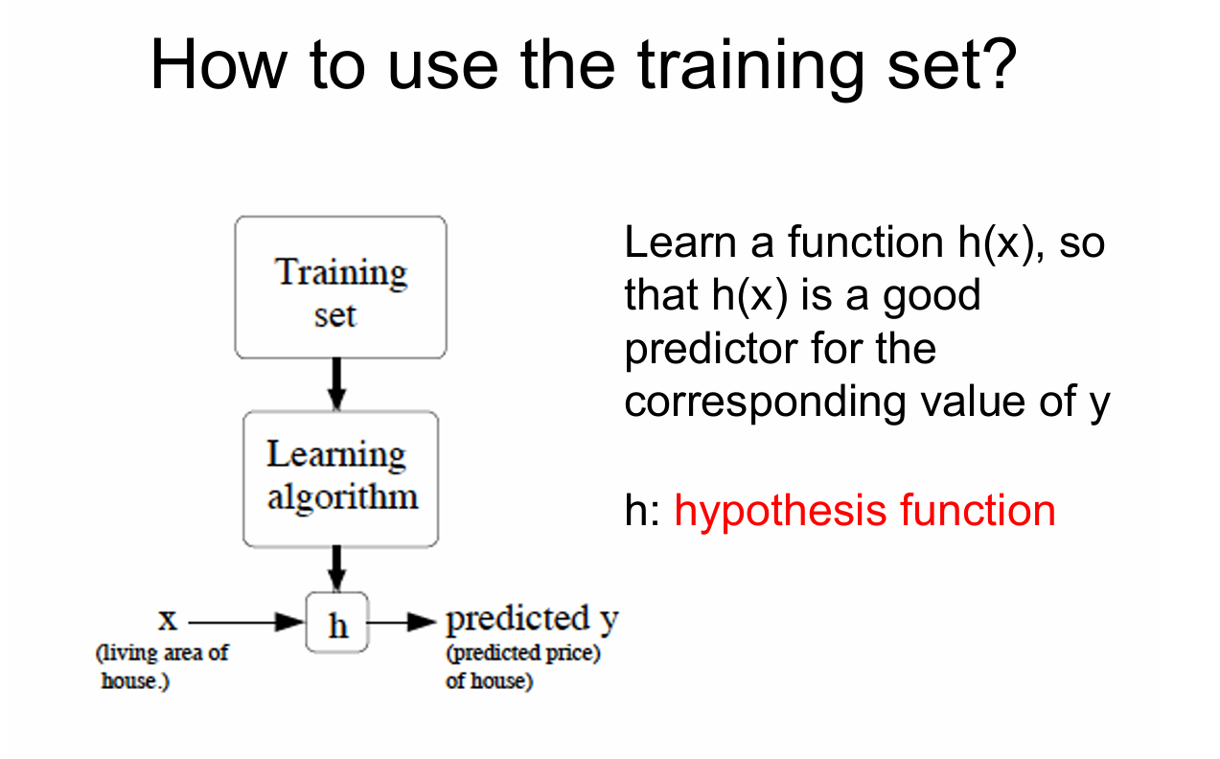

Slide 8
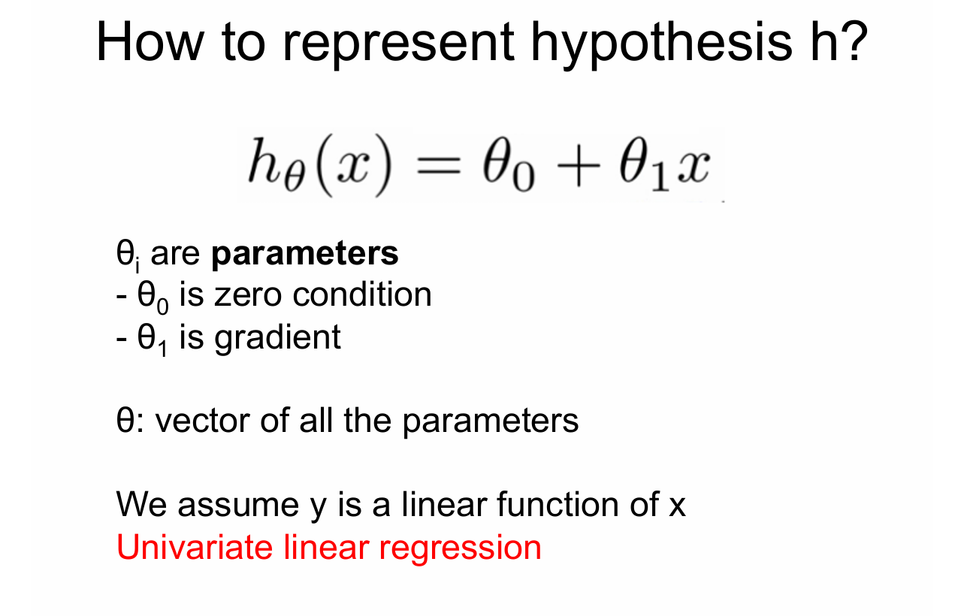

Slide 9
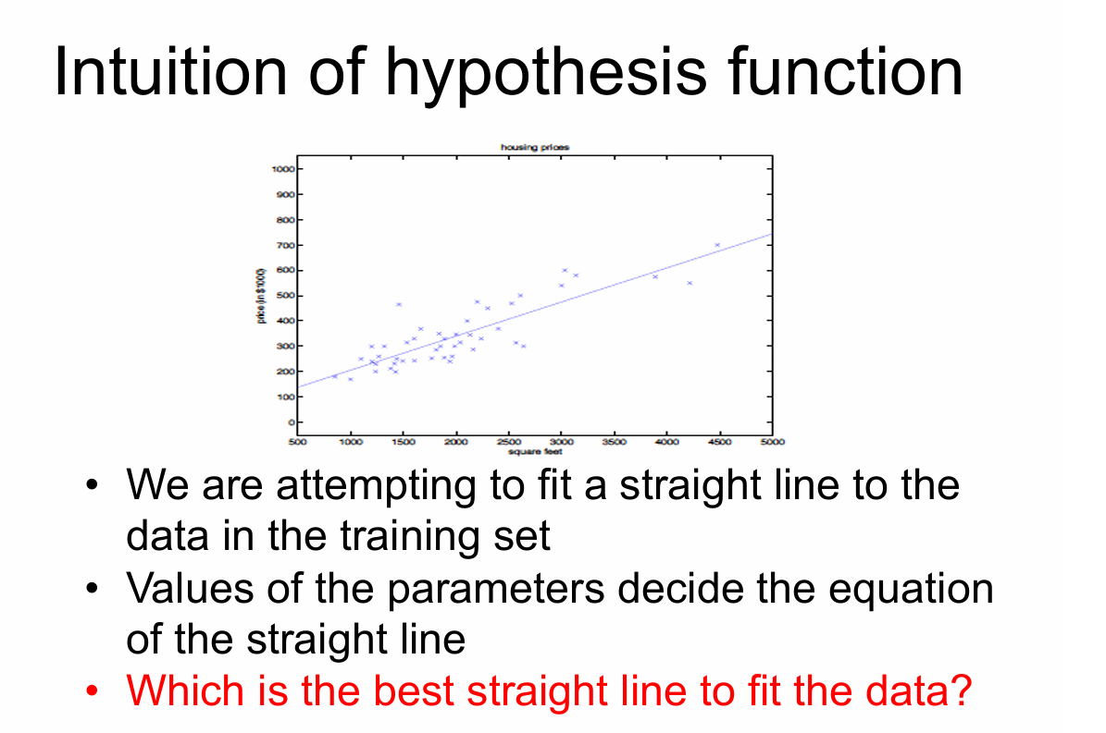

Slide 10
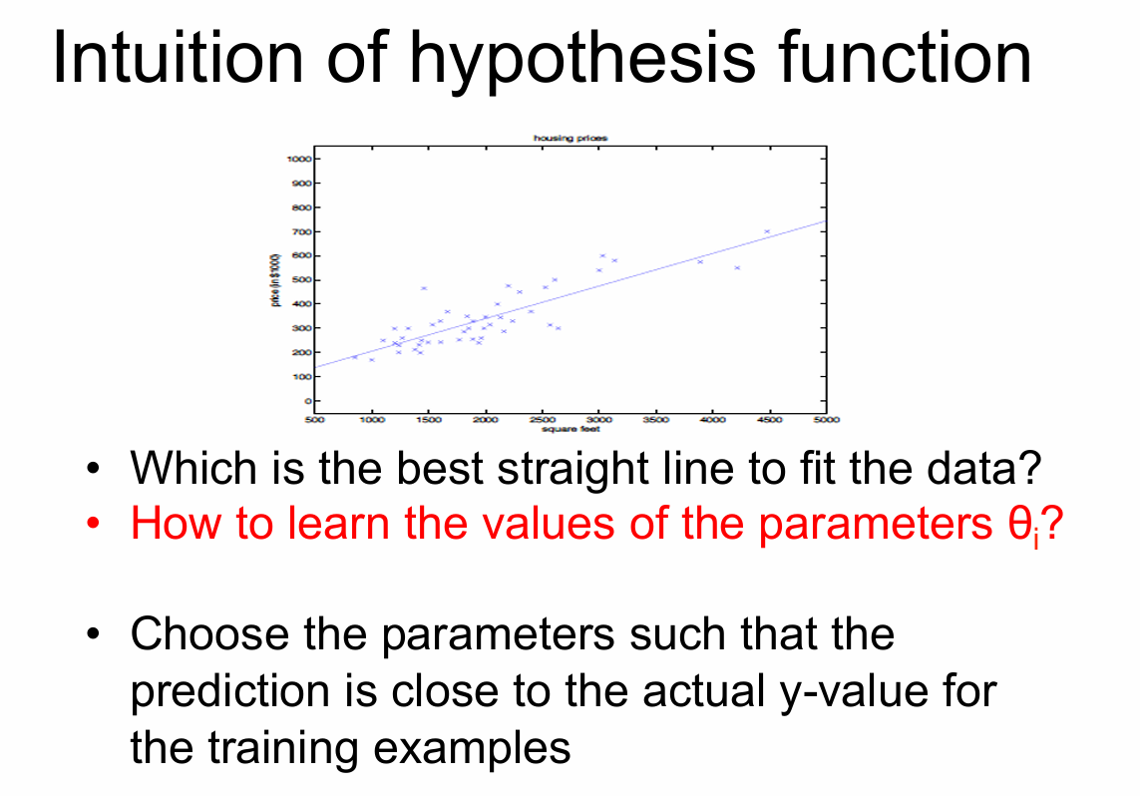

Slide 11
Assumed Linear Regression Model
Estimating the regression parameters
Objective: Minimize the difference between the observation and its prediction according to the line.

Slide 12
Regression => least squares estimation
We want the line which is best for all points. This is done by finding the values of β₀ and β₁ which minimizes some sum of errors. There are a number of ways of doing this. Consider these two:
Sum of squared residuals
Referred to as least squares estimates.

Slide 13
Normal Equations
Calculus is used to find the least squares estimates.
Solve this system of two equations in two unknowns.
Note: The parameter estimates will be functions of the data,
hence they will be statistics.

Slide 14
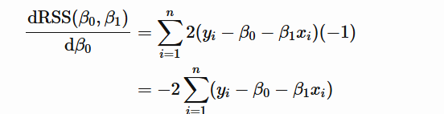



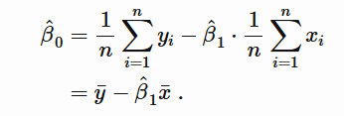

Slide 15
