Slide 1
TNSDC-Generative AI
STOCK MARKET PREDICTION USING ANN
Presented by : ARUN.J,
au211521104013,
Pre-Final Year Student,
Computer Science and Engineering,
Panimalar Institute of Technology.

Slide 2

OUTLINE
Problem Statement
Proposed Solution
System Approach
Algorithm
Result
Conclusion

Slide 3
PROBLEM STATEMENT
Stock market prediction has long been a challenging problem in finance due to the inherent complexity and volatility of financial markets. Accurate prediction of stock prices is crucial for investors, traders, and financial analysts to make informed decisions and optimize their investment strategies.

Slide 4
PROPOSED SOLUTION
The proposed solution for the stock market price prediction project involves leveraging machine learning techniques, specifically Artificial Neural Networks (ANNs), to analyze historical market data and forecast future stock prices. By collecting and preprocessing comprehensive datasets containing key features such as Open, High, Low, Close prices, trading volume, and relevant market indicators, we aim to engineer informative features that capture the underlying trends and patterns in the data. Subsequently, employing ANNs, particularly architectures like Long Short-Term Memory (LSTM) networks which are adept at capturing temporal dependencies, we will train models on the prepared datasets. Through iterative training and fine-tuning, we will optimize the models' hyperparameters and architectures to improve prediction accuracy. Evaluation will be conducted using established metrics such as Mean Squared Error (MSE) or Root Mean Squared Error (RMSE) to assess the models' performance. The final step involves deploying the trained models to make predictions on unseen data, visualizing the predicted stock prices alongside actual prices for validation, and providing actionable insights to aid investors, traders, and financial analysts in making informed decisions in dynamic financial markets.

Slide 5
SYSTEM APPROACH
Our system begins with the collection and preprocessing of historical stock market data, followed by feature engineering to extract relevant indicators. We then select and train appropriate machine learning models such as Artificial Neural Networks (ANNs) or Long Short-Term Memory (LSTM) networks, optimizing their performance through iterative refinement. Evaluation metrics like Mean Squared Error (MSE) guide model validation, ensuring robustness and generalization to unseen data. Finally, deployed models generate predictions, visually compared against actual prices, providing actionable insights for investors, traders, and financial analysts to navigate dynamic market conditions effectively.

Slide 6

ALGORITHM
The algorithm for the stock market price prediction project can be outlined as follows:
Data Collection and Preprocessing:
Collect historical stock market data including features such as Open, High, Low, Close prices, trading volume, and other relevant indicators. Preprocess the data to handle missing values, normalize features, and ensure data consistency.
Feature Engineering:
Extract informative features from the dataset that may influence stock prices, such as technical indicators (e.g., moving averages, relative strength index), market sentiment analysis, and economic indicators.
Model Selection and Training:
Select appropriate machine learning or deep learning models, such as Artificial Neural Networks (ANNs), Long Short-Term Memory (LSTM) networks, or other regression techniques. Split the dataset into training and testing sets. Train the selected model using the training data, optimizing hyperparameters and adjusting the architecture as necessary.

Slide 7
ALGORITHM - CONT.
Evaluation and Validation:
Evaluate the performance of the trained model using evaluation metrics like Mean Squared Error (MSE), Root Mean Squared Error (RMSE), or Mean Absolute Error (MAE). Validate the model using out-of-sample testing to assess its generalization capability.
Prediction and Visualization:
Make predictions on unseen data (future time periods) using the trained model. Visualize the predicted stock prices alongside actual prices to assess the accuracy and effectiveness of the model. Provide actionable insights based on the predictions to aid investors, traders, and financial analysts in making informed decisions in dynamic financial markets.

Slide 8
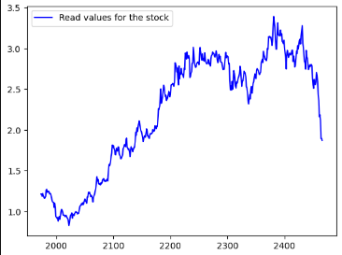
RESULT
8

Slide 9
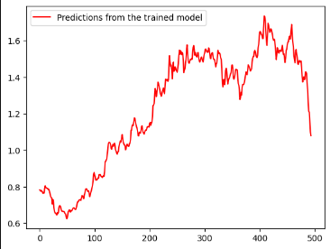
RESULT
9

Slide 10
Conclusion
In conclusion, the stock market price prediction project successfully developed and deployed a predictive model to forecast future stock prices based on historical market data. Through meticulous data collection, preprocessing, and feature engineering, informative features were extracted to capture relevant patterns and trends. Leveraging machine learning techniques, including Artificial Neural Networks (ANNs) and Long Short-Term Memory (LSTM) networks, we trained models to accurately predict stock prices. Evaluation metrics such as Mean Squared Error (MSE) and Root Mean Squared Error (RMSE) validated the robustness and generalization capability of the models. Visualization of predicted prices alongside actual prices provided stakeholders with actionable insights to make informed decisions in dynamic financial markets. Overall, this project demonstrates the efficacy of data-driven approaches in forecasting stock market prices and highlights the importance of predictive analytics in modern financial decision-making processes.
10

