Slide 1
Clustering Algorithm Practice

Slide 2
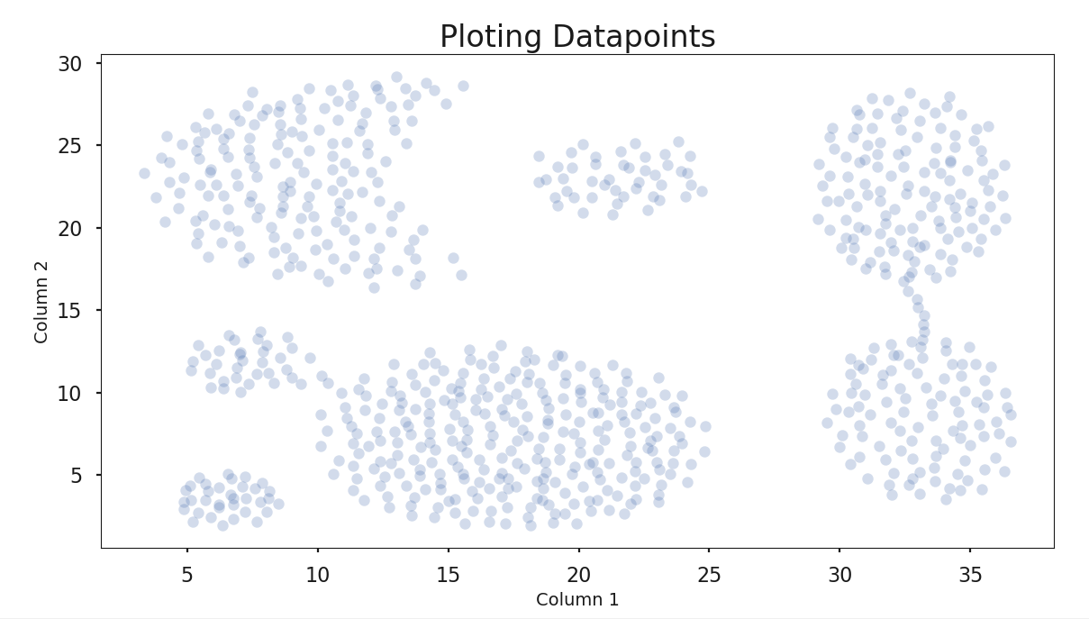
Used Data Set 1

Slide 3
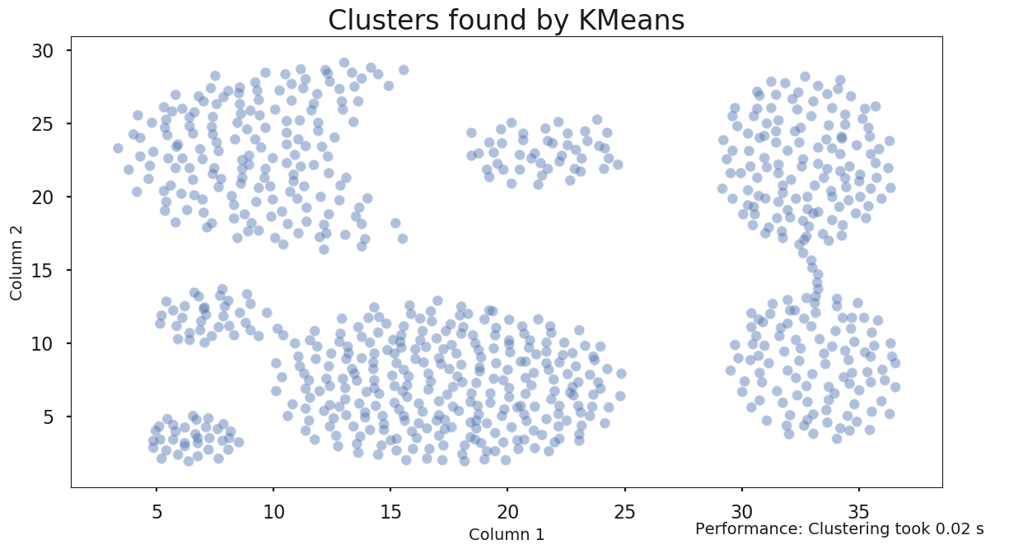
Kmeans
Data Set 1
#Cluster 1

Slide 4
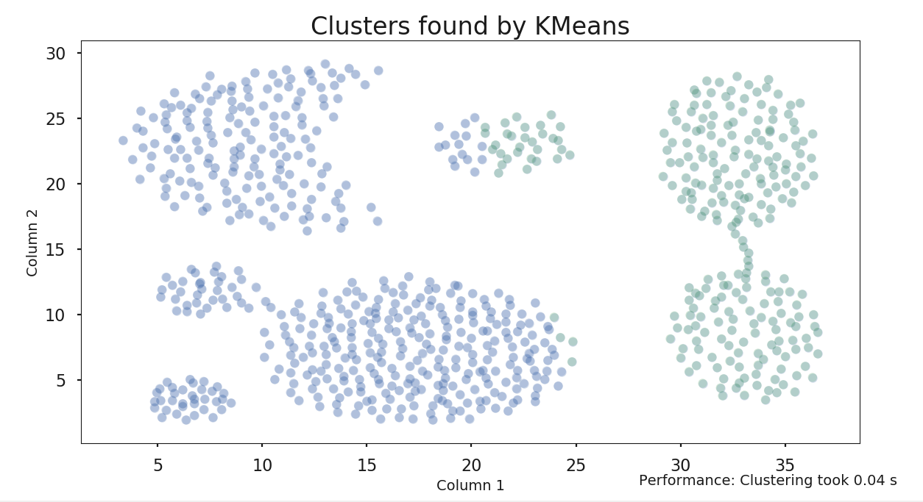
Kmeans
Data Set 1
#Cluster 2

Slide 5
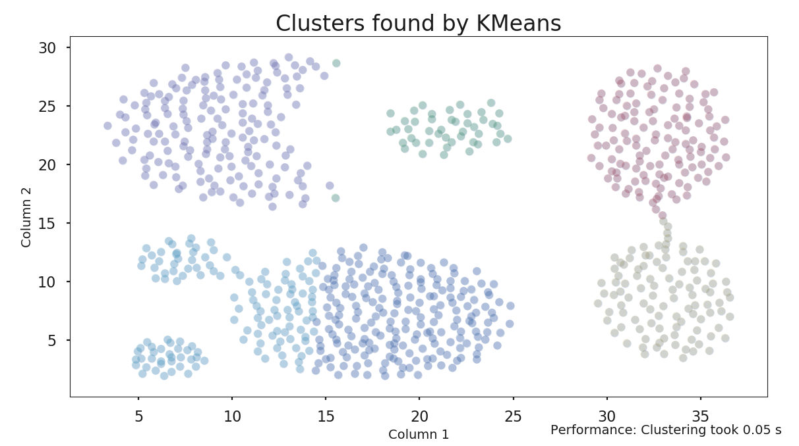
Kmeans
Data Set 1
#Cluster 6

Slide 6
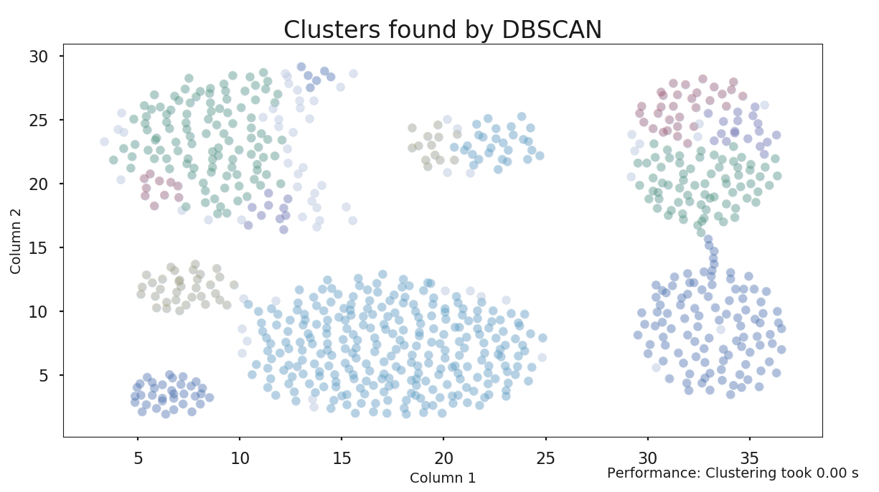
DBSCAN
Data Set 1
EPS = 1

Slide 7
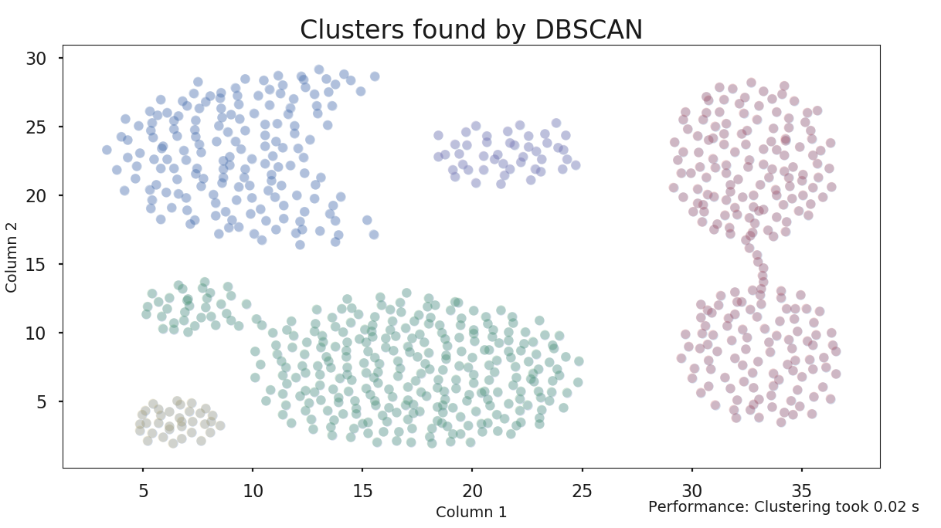
DBSCAN
Data Set 1
EPS = 2

Slide 8
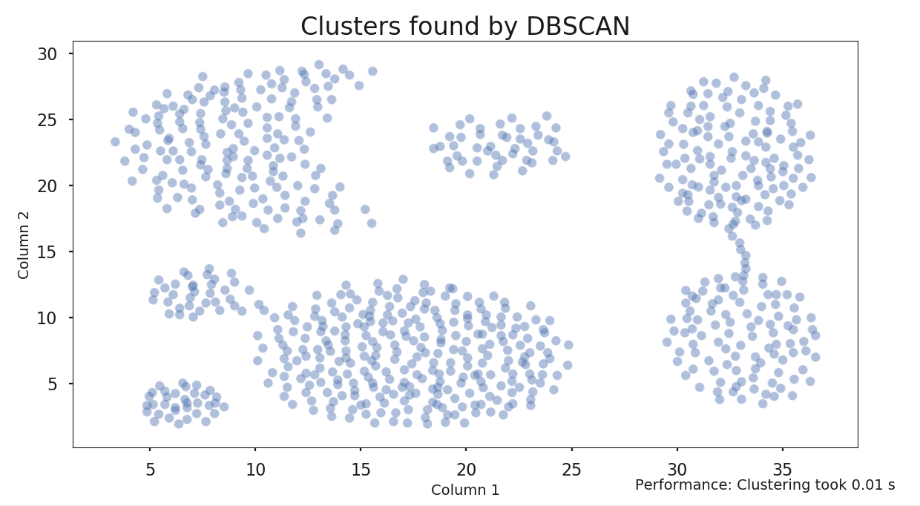
DBSCAN
Data Set 1
EPS = 10

Slide 9
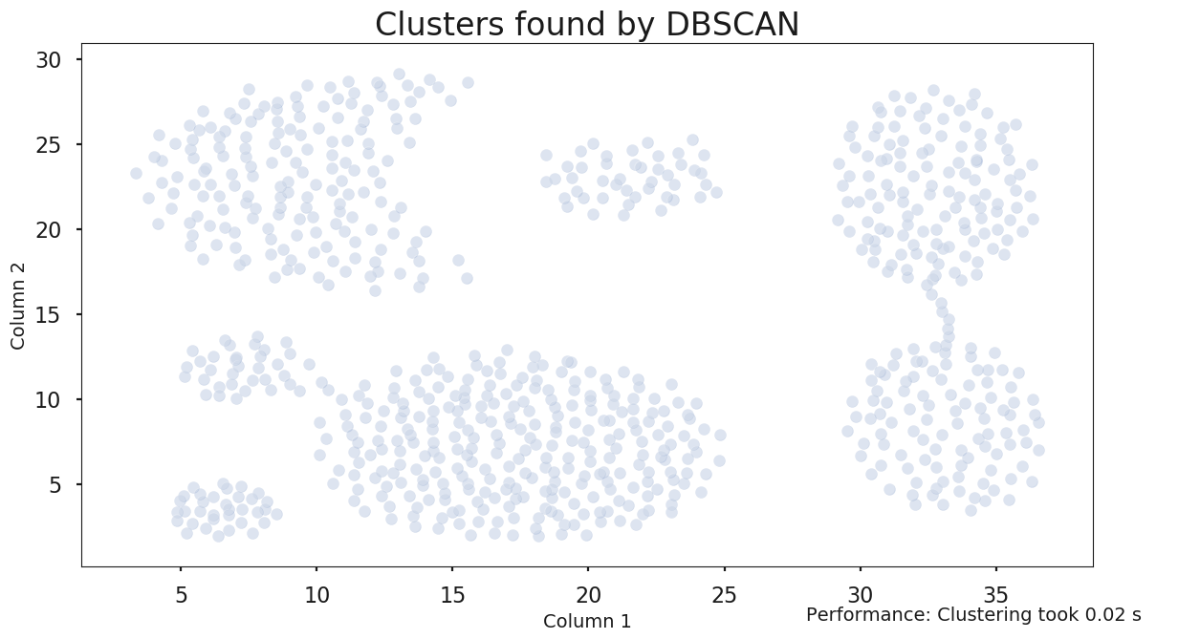
DBSCAN
Data Set 1
EPS = .1

Slide 10
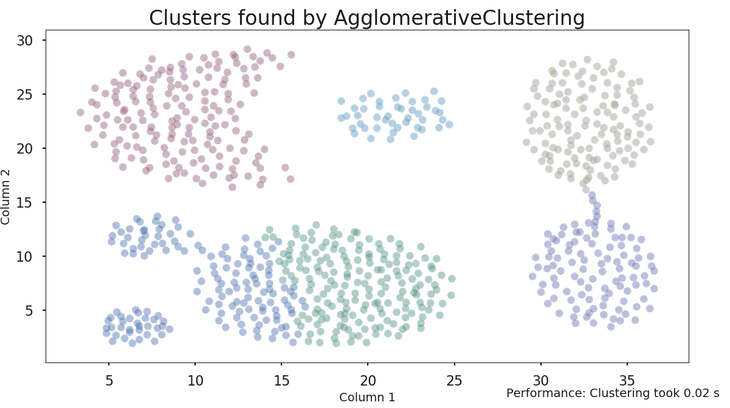
Hierarchical Clustering
Data Set 1
Linkage=complete
#Cluster=6

Slide 11
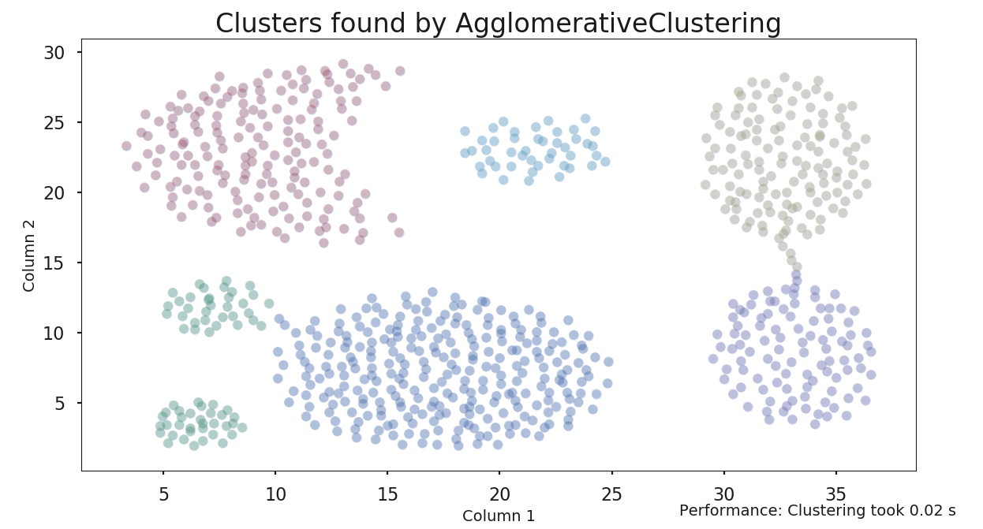
Hierarchical Clustering
Data Set 1
Linkage=Ward
#Cluster=6

Slide 12
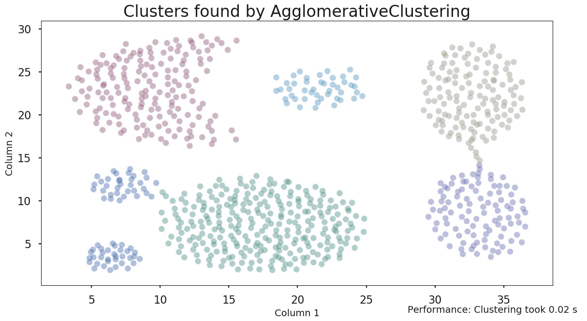
Hierarchical Clustering
Data Set 1
Linkage=Average
#Cluster=6

Slide 13
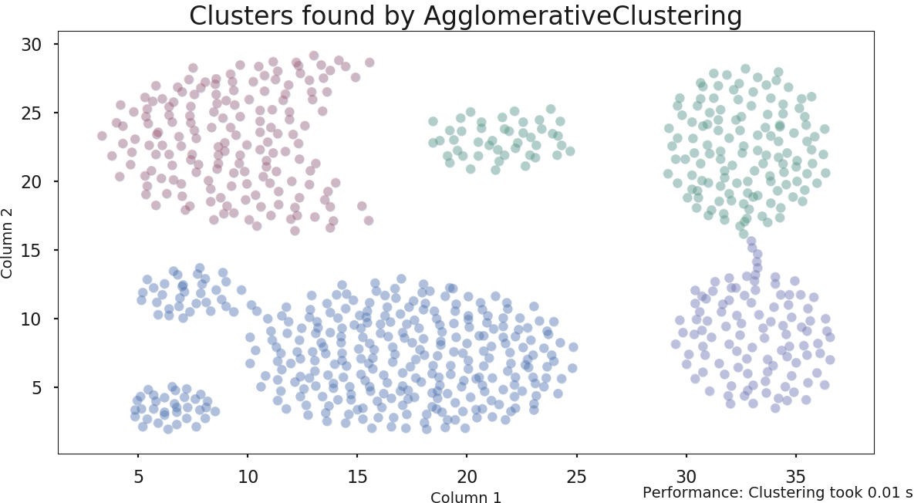
Hierarchical Clustering
Data Set 1
Linkage=complete
#Cluster=4

Slide 14

Hierarchical Clustering
Data Set 1
Linkage=Average
#Cluster=4

Slide 15
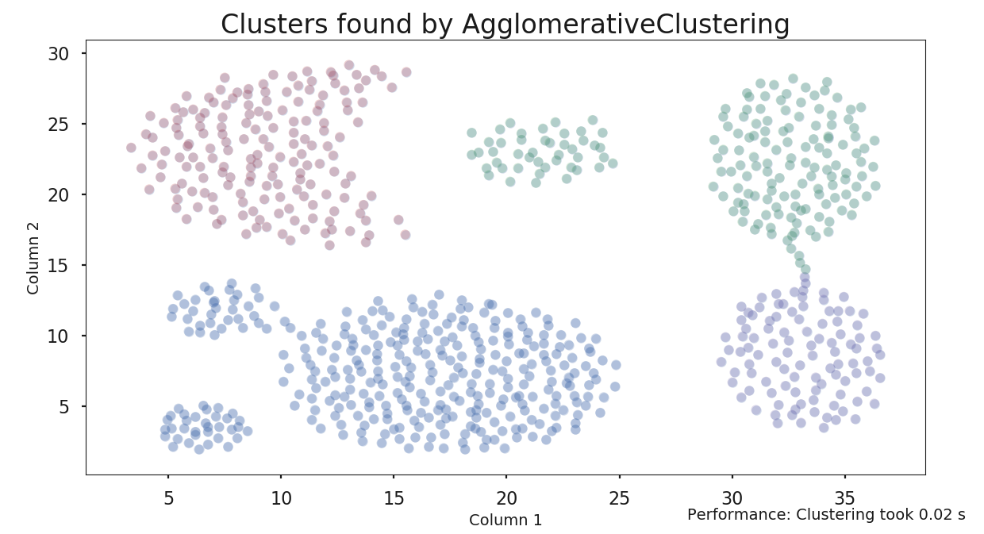
Hierarchical Clustering
Data Set 1
Linkage=Ward
#Cluster=4

Slide 16
Performance comparison

