Slide 1
Welcome
To
Wishcart

Slide 2


HOME GROCERIES MEDICINE SPORTS STATIONARY SKINCARE
Search
Login/Signup
Welcome to Wishcart where you can find all the products do you want. We provides Groceries, medicine, sports, stationary, skincare products which is necessary for your day to day life.

Slide 3

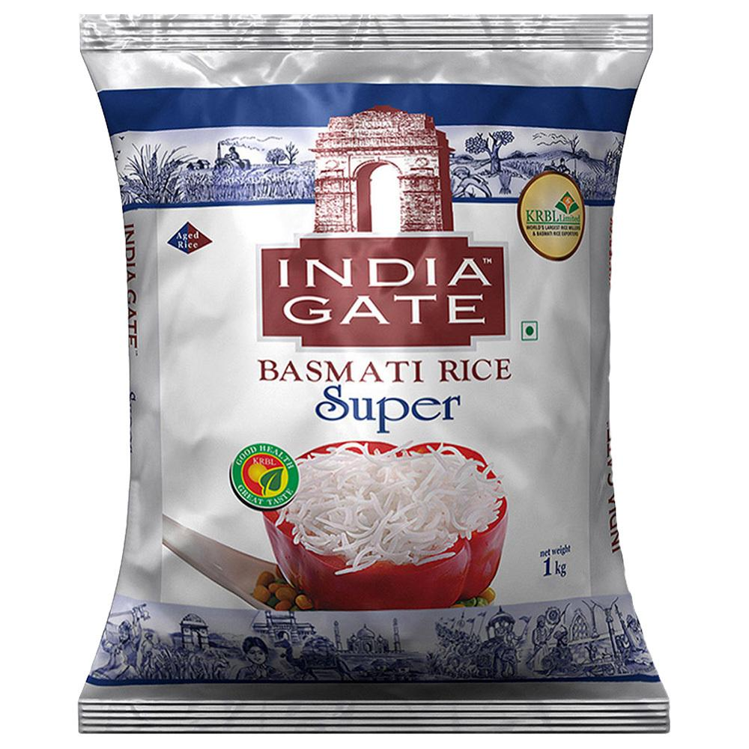






HOME GROCERIES MEDICINE SPORTS STATIONARY SKINCARE
Search
Login/Signup
Aashirvaad Atta-5Kg
Rs 286
India Gate Basmati Rice, 1kg
Rs 132
Catch Jeera, 200gm
RS 115
Tata Salt, 1kg
Rs 28
Moong Dal, 1kg
RS180
Chana Dal,1kg
Rs 90
Fortune Mustard Oil,1Litre
Rs 180
Fortune Refined Oil, 1L
Rs 170

Slide 4





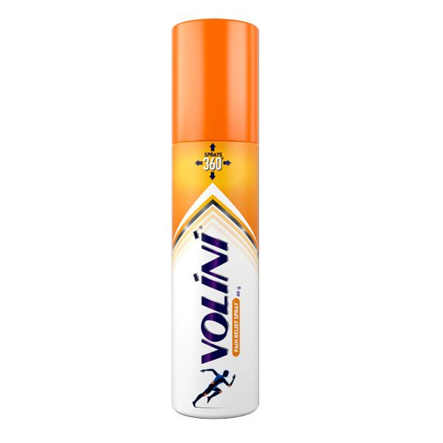
HOME GROCERIES MEDICINE SPORTS STATIONARY SKINCARE
Search
Login/Signup

Slide 5

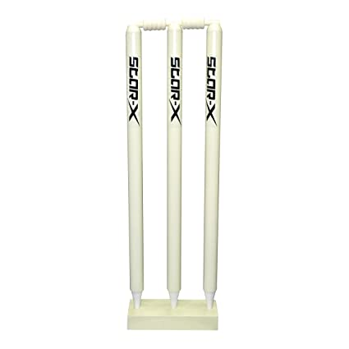

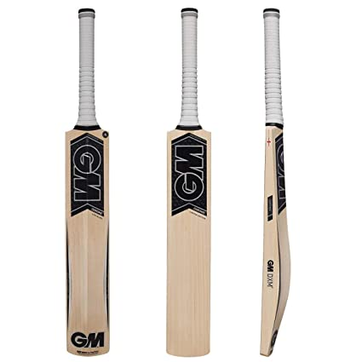
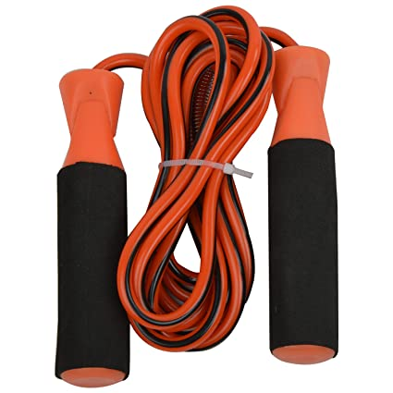
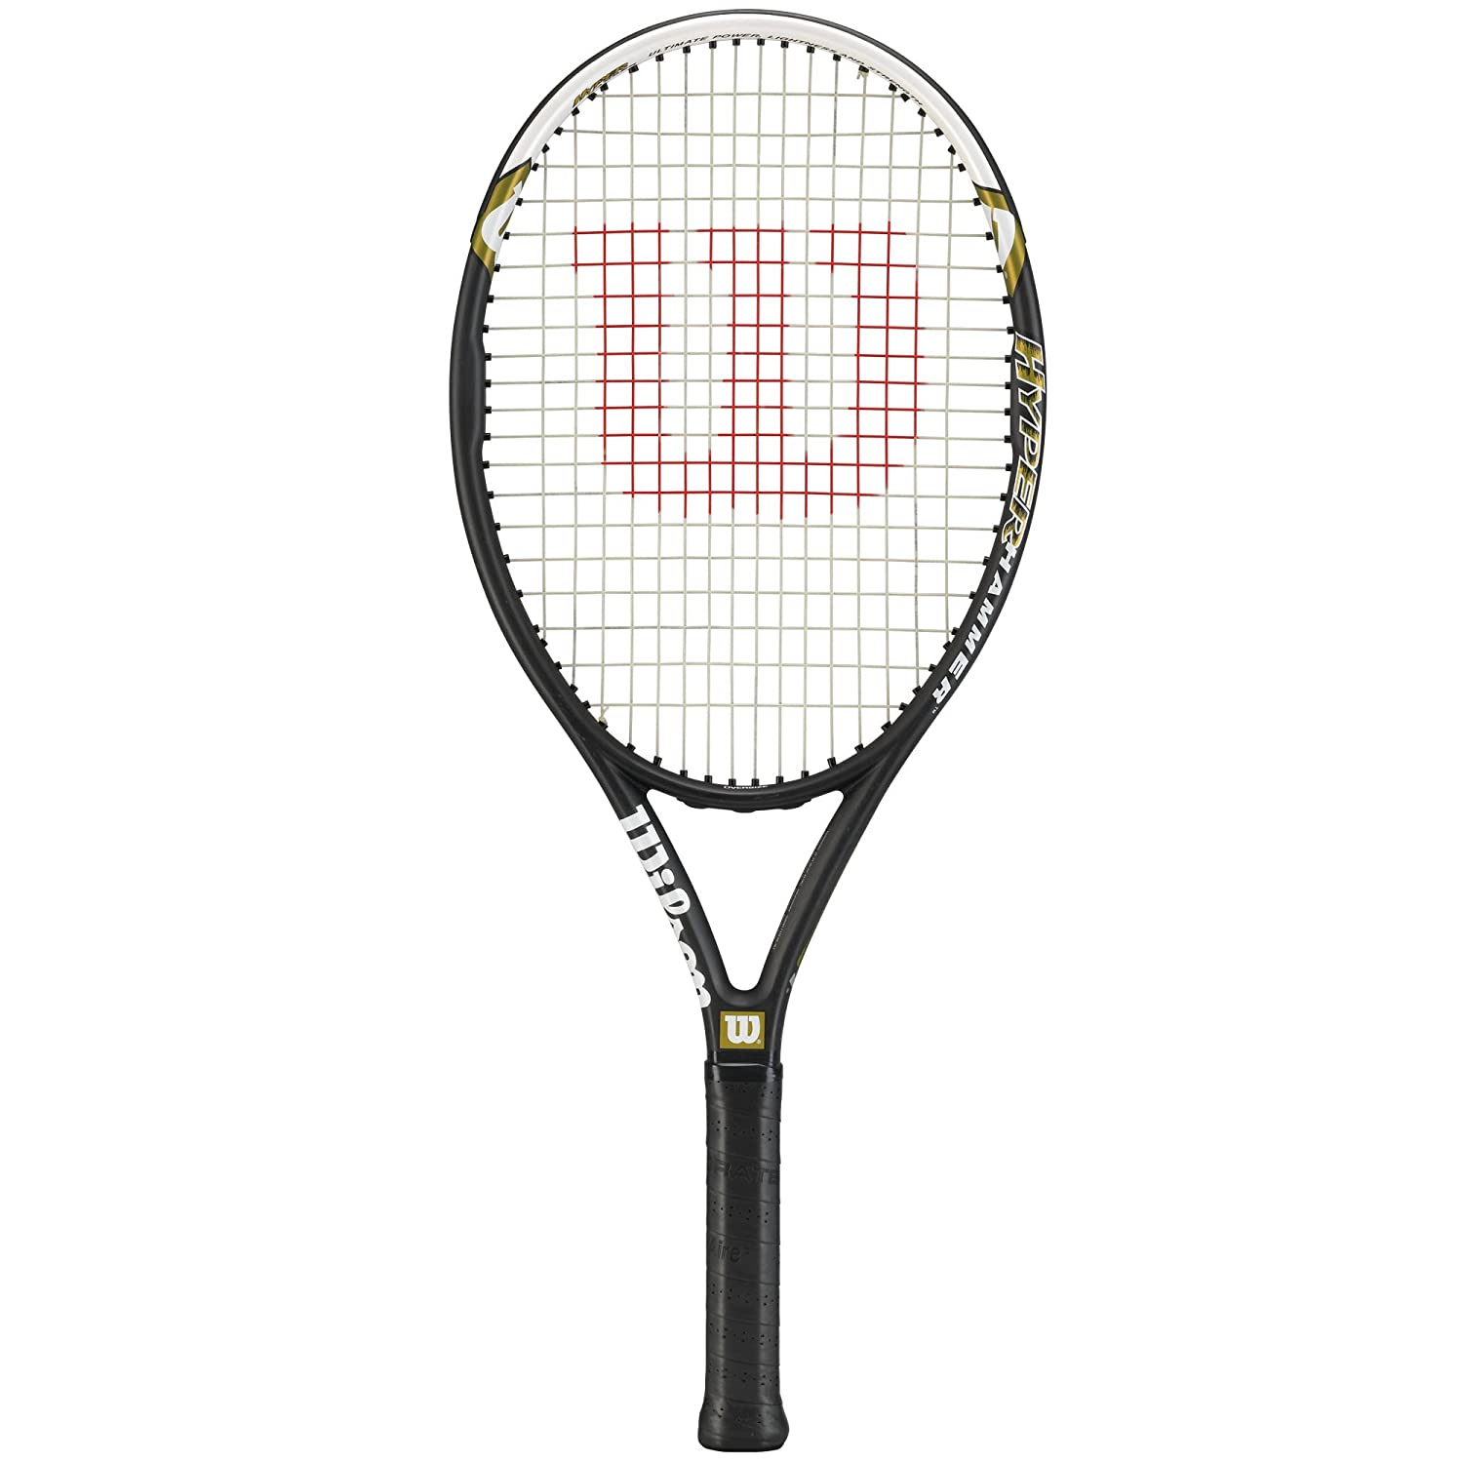

HOME GROCERIES MEDICINE SPORTS STATIONARY SKINCARE
Search
Login/Signup

Slide 6

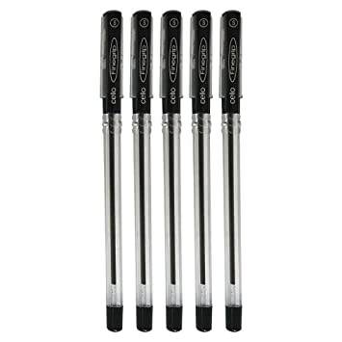


HOME GROCERIES MEDICINE SPORTS STATIONARY SKINCARE
Search
Login/Signup

Slide 7




HOME GROCERIES MEDICINE SPORTS STATIONARY SKINCARE
Search
Login/signup

Slide 8
HOME GROCERIES MEDICINE SPORTS STATIONARY SKINCARE
Search
Login/Signup
Log in to Wishcart
Email or phone number
Password
Log in

Slide 9
HOME GROCERIES MEDICINE SPORTS STATIONARY SKINCARE
Search
Login/Signup
Sign up to Wishcart
Name
Mobile no.
Email
Password
Create Account

