Slide 1

Hotel performance dashboard Overall
Powered By

Slide 2
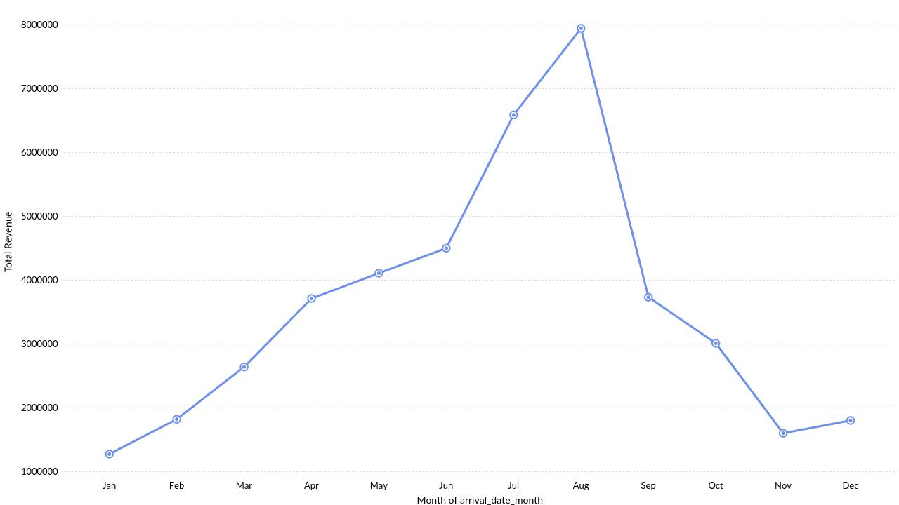
Monthly Revenue Trend
Powered By

Slide 3
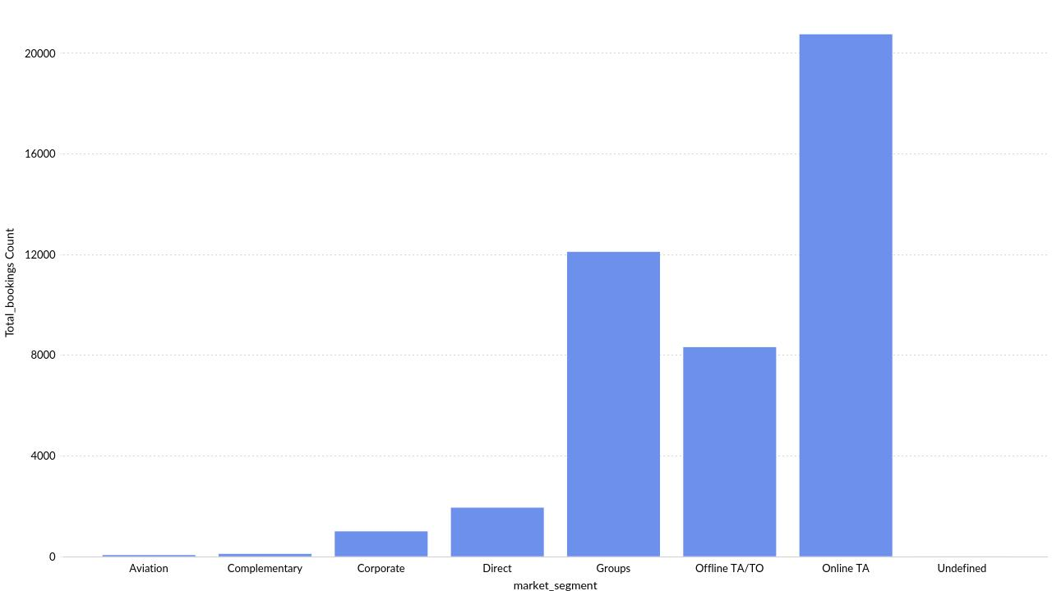
Market Segment Cancellation Analysis
Powered By

Slide 4
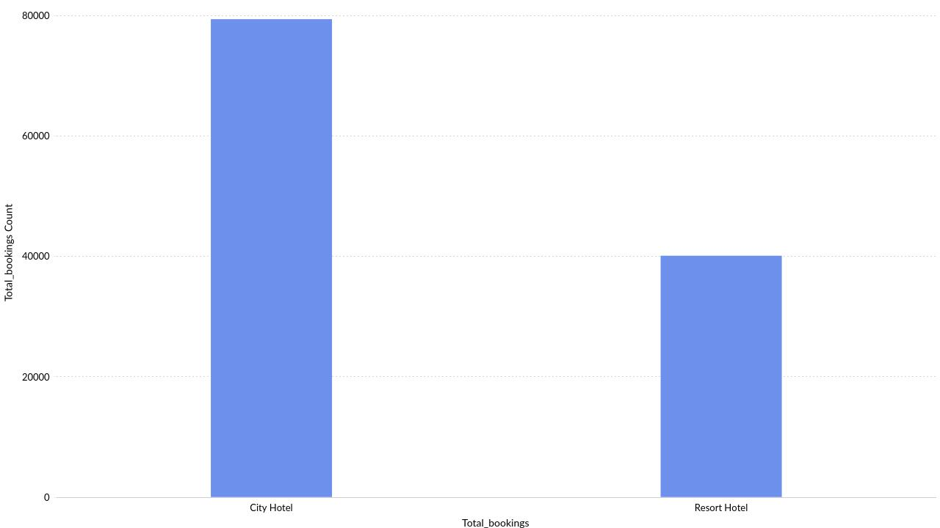
booking volume comparison
Powered By

Slide 5
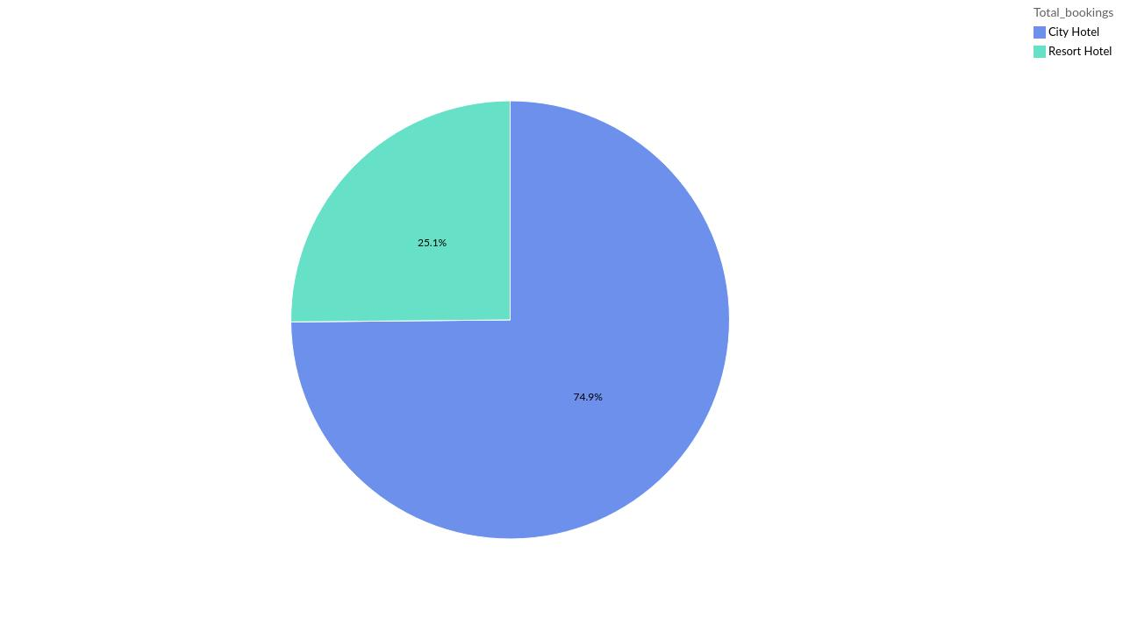
Hotel cancellation analysis
Powered By

Slide 6
Market Segment Cancellation Analysis
Powered By

Slide 7
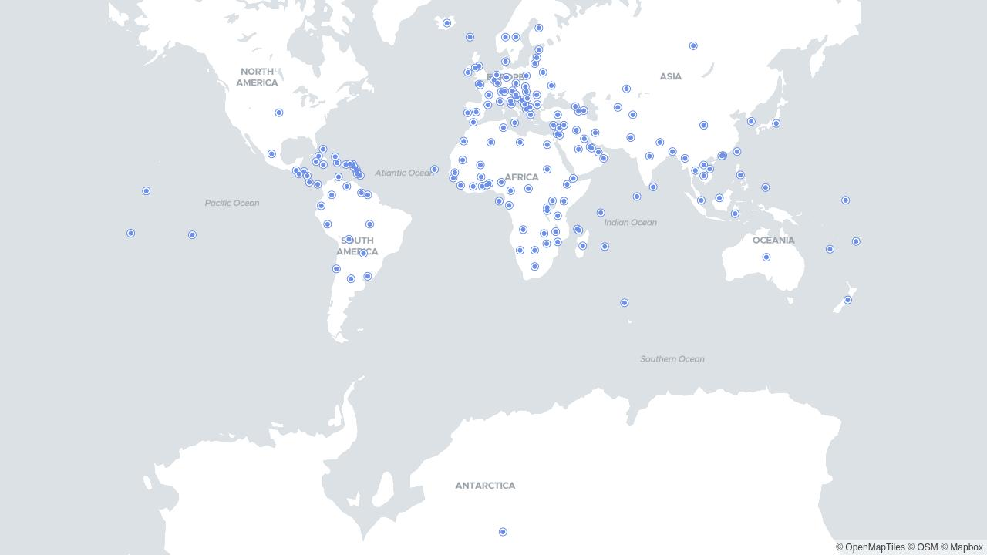
Overall Global Bookings
Powered By

