Slide 1

CoCo CLI HACKATHON • GCC EDITION • PROTOTYPE SUBMISSION
Risk, Fraud & Regulatory Intelligence Copilot
Banking / NBFC compliance — ask in English, get verified SQL + cited law + draft SAR, every step logged
Team Name : [Your Team Name] Problem Statement : [PS-ID / Title] Team Leader : [Name] Team Size : [N]

Slide 2

1 • PROBLEM BRIEF
Analysts drown in alerts. SARs take hours.
▸ Real problem: alert triage + rulebook lookup + SAR drafting is manual, slow, and citation-free — audit gaps risk fines (penalties).
▸ Users: compliance analyst (triage) and compliance officer (approver) at banks / NBFCs.
▸ Pain now: hand-written SQL, PDF rulebooks, copy-paste SARs, zero proof trail.
▸ Fix: one chat: English question → safe SQL evidence + top-3 law cites + draft SAR in minutes, fully logged.

Slide 3
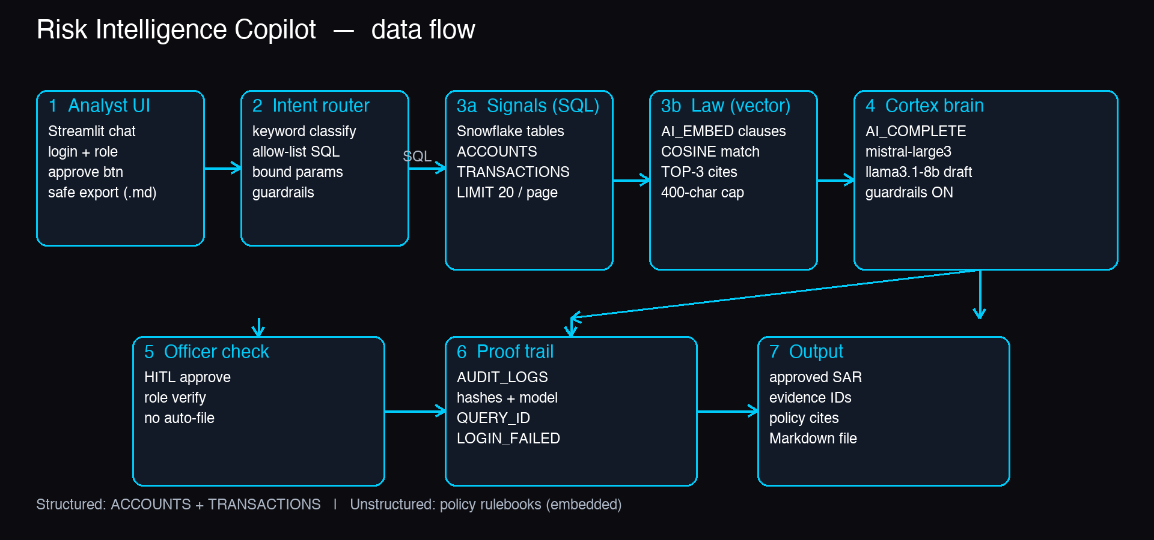
2 • ARCHITECTURE
Signal → Evidence → Report, all inside Snowflake
CoCo CLI skills (modular agents): Researcher-Coder builds • Component Scout upgrades parts • Brutal Critic audits till SHIP | Sources: structured (ACCOUNTS, TRANSACTIONS) + unstructured (policy rulebooks, embedded)

Slide 4
3 • HOW IT WORKS
Three steps. Guarded. Human-approved.
▸ Step 1 — Router: keyword intent + allow-list SQL templates with bound params (safe inputs); blocked words rejected.
▸ Step 2 — Evidence + Law: Snowflake SQL signals plus AI_EMBED vector search (TOP-3 clauses, cosine match).
▸ Step 3 — Report: AI_COMPLETE (mistral-large3, llama3.1-8b drafts) writes short SAR; officer MUST approve before save.
▸ Trust built-in: row locks + name masking, rate limits, prompt/result hashes (proof prints), QUERY_ID, denied-login audit.

Slide 5
4 • IMPACT
Faster triage. Cited claims. Full audit.
▸ Measurable: triage hours → minutes; every SAR line backed by evidence IDs + policy cites; 100% drafts logged with model + hashes.
▸ Scale: any Snowflake bank schema — add tables, re-embed rulebooks, same 3-step flow; SiS-native deploy, no data leaves Snowflake.
▸ Beyond demo: real-time screening queue, multi-regulator packs (RBI / FINCEN / Basel), auto Task cleanup, SSO + key-pair auth in prod.

Slide 6
5 • STACK & REPO
Free-tier 2026 parts. Live code.
▸ Snowflake Trial: AI_EMBED (arctic-embed-m-v1.5) + AI_COMPLETE + VECTOR search — $400 free credit, ~$0 for demo.
▸ Models: mistral-large3 (256K) primary, llama3.1-8b cheap drafts; Streamlit UI + Python connector + pooled sessions.
▸ GitHub: github.com/Arunkumar06-cmd/risk-intelligence-copilot
▸ Run: pip install -r requirements.txt → run sql/01_setup.sql → streamlit run streamlit_app.py • tests: 9 passed.

Slide 7

THANK YOU
Risk, Fraud & Regulatory Intelligence Copilot • [Your Team Name]
github.com/Arunkumar06-cmd/risk-intelligence-copilot

