Slide 1

CoCo CLI HACKATHON • GCC EDITION • PROTOTYPE SUBMISSION
Risk, Fraud & Regulatory Intelligence Copilot
Banking / NBFC compliance — ask in English, get verified SQL + cited law + draft SAR; officer approves, every approval logged
Team Name : Behelit Problem Statement : [PS-ID / Title] Team Leader : Arun Kumar Team Size : 1 (solo)

Slide 2

1 • PROBLEM BRIEF
Analysts drown in alerts. SARs take hours.
▸ Real problem: alert triage + rulebook lookup + SAR drafting is manual, slow, and citation-free — audit gaps risk fines (penalties).
▸ Users: compliance analyst (triage) and compliance officer (approver) at banks / NBFCs.
▸ Pain now: hand-written SQL, PDF rulebooks, copy-paste SARs, zero proof trail.
▸ Fix: one chat: English question → safe SQL evidence + top-3 law cites + draft SAR; every approval (and denied try) logged.

Slide 3
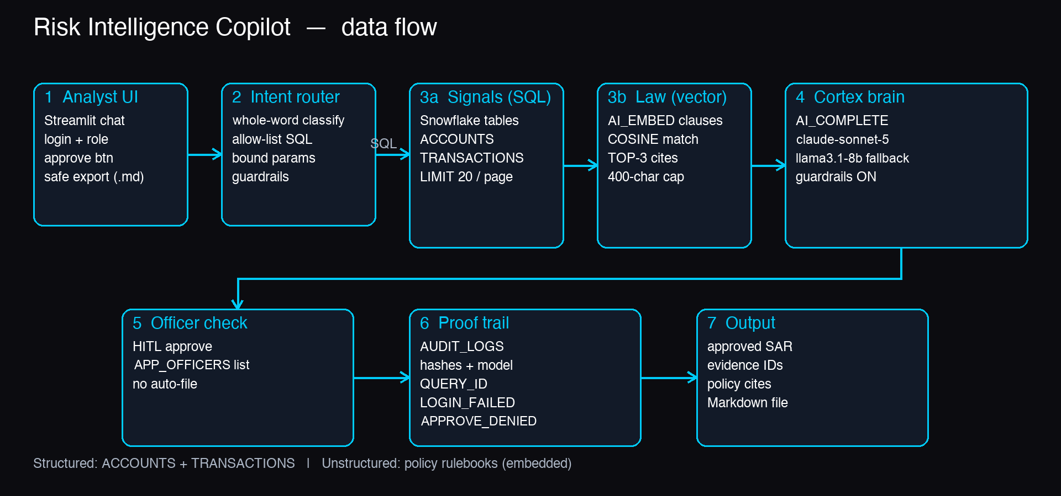
2 • ARCHITECTURE
Signal → Evidence → Report, all inside Snowflake
Data: structured (ACCOUNTS, TRANSACTIONS) + unstructured (policy rulebooks, embedded)

Slide 4
3 • HOW IT WORKS
Three steps. Guarded. Human-approved.
▸ Step 1 — Router: whole-word intent match + allow-list SQL templates with bound params (safe inputs); blocked words rejected.
▸ Step 2 — Evidence + Law: Snowflake SQL signals plus AI_EMBED vector search (TOP-3 clauses, cosine match).
▸ Step 3 — Report: AI_COMPLETE (claude-sonnet-5 primary, llama3.1-8b fallback, guardrails ON) writes a short SAR; officer MUST approve before save.
▸ Trust built-in: officer allow-list (APP_OFFICERS), row locks + name masking, rate limits, prompt/result hashes (proof prints), QUERY_ID, denied-login + denied-approval audit.

Slide 5
4 • IMPACT
Faster triage. Cited claims. Full audit.
▸ Measurable: goal: triage hours → minutes; every SAR line backed by evidence IDs + policy cites; every approved SAR logged with model + hashes.
▸ Scale: any Snowflake bank schema — add tables, re-embed rulebooks, same 3-step flow; SiS-ready (container runtime, per-viewer officer check); not yet live-tested.
▸ Beyond demo: real-time screening queue, multi-regulator packs (RBI / FinCEN / Basel), live Snowflake test run, SSO for local mode.

Slide 6
5 • STACK & REPO
Snowflake trial parts. Open code.
▸ Snowflake Trial: AI_EMBED (arctic-embed-m-v1.5) + AI_COMPLETE + VECTOR search. Self-service trial: AI features stay off until a credit card is added.
▸ Models: claude-sonnet-5 primary, llama3.1-8b fallback, guardrails ON; Streamlit UI + Python connector locally, Snowflake's own session in SiS.
▸ GitHub + live demo: github.com/Arunkumar06-cmd/risk-intelligence-copilot • arunkumar06-cmd.github.io/risk-intelligence-copilot (demo mode: sample data, runs in the browser)
▸ Run: pip install -r requirements.txt -r requirements-dev.txt → secrets.toml → sql/01 + sql/03 → streamlit run streamlit_app.py • tests: 102 passed.

Slide 7

Risk, Fraud & Regulatory Intelligence Copilot • Behelit
github.com/Arunkumar06-cmd/risk-intelligence-copilot
Live demo: arunkumar06-cmd.github.io/risk-intelligence-copilot

