Slide 1
ABSTRACT CLASS AND INTERFACE

Slide 2
CONTENTS
Introduction
Abstraction
What is Abstract Class
Example for abstract class.
What is Interface.
Example for Interface.
Abstract class vs Interface.

Slide 3
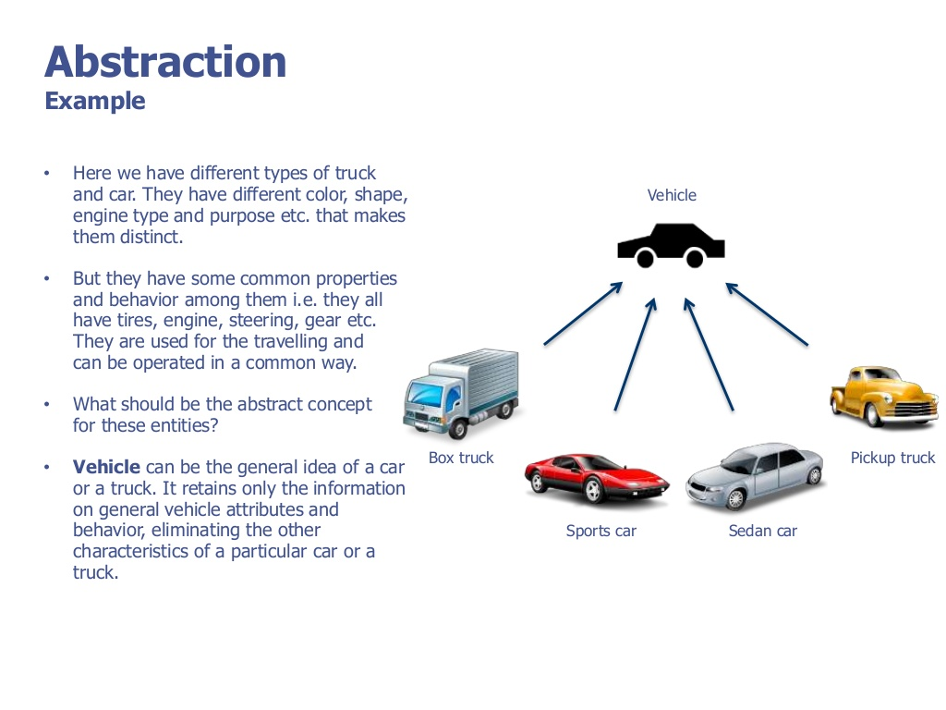

Slide 4
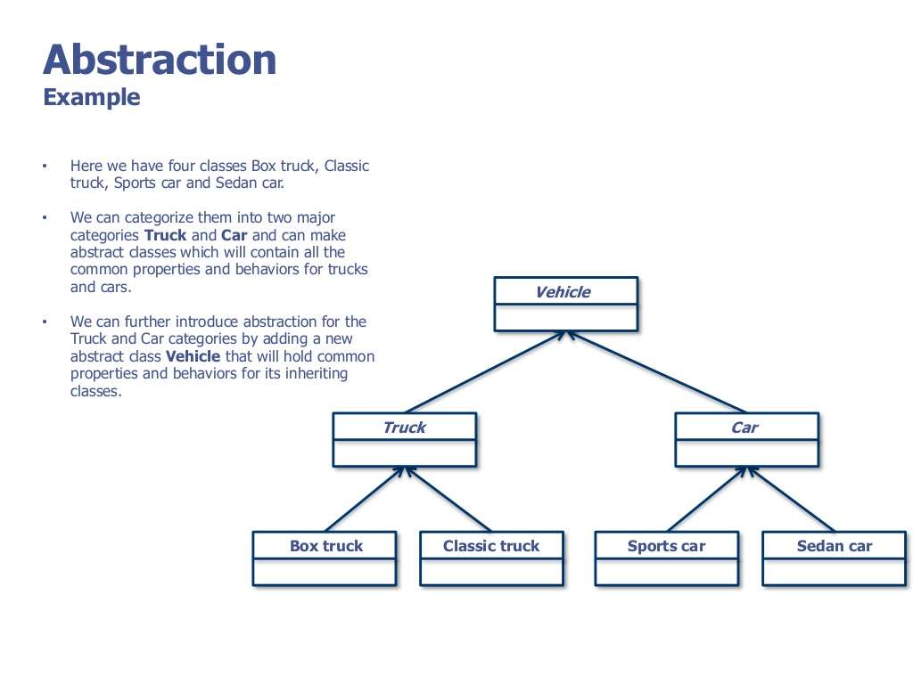

Slide 5
Abstract Class
Abstract class is just like other classes but it marks with abstract keyword.
Classes that contain one or more abstract methods.
An abstract method is that which is declared but contains no implementation.
A method can be made abstract if we add the keyword “abstract” to it.
Abstract classes may not be instantiated, and require subclasses to provide implementations for the abstract methods.
These subclasses are also known as child class or derived class.
here is a simple program of an abstract class.

Slide 6
Example program
abstract class AA {
abstract void m1();
void m2(){
System.out.println("concrete method");
}
}
class BB extends AA{
@Override
void m1() {
// TODO Auto-generated method stub
System.out.println("method m1 override in class BB");
}
}

Slide 7
Example Program
public class demo {
public static void main(String[] args) {
BB b = new BB();
b.m2();
b.m1();
}
}

Slide 8
Interfaces
Interfaces are similar to abstract classes, but differ in their functionality.
Interfaces defines methods without body.
Using interface we can achieve total abstraction which means methods in interfaces are abstract by default.
It can contain final variables,which must be initialized with values.
Once it is defined ,any number of classes can implement an interface.
If we are implementing an interface in a class we must implement all the methods defined in the interface.

Slide 9
Example Program
interface Vehicle {
// all are the abstract methods.
void changeGear(int a);
void speedUp(int a);
void applyBrakes(int a);
}
class Bicycle implements Vehicle{
int speed;
int gear;
// to change gear
@Override
public void changeGear(int newGear){
gear = newGear;
}
// to increase speed
@Override
public void speedUp(int increment){
speed = speed + increment;
}
// to decrease speed
@Override
public void applyBrakes(int decrement){
speed = speed - decrement;
}
public void printStates() {
System.out.println("speed: " + speed
+ " gear: " + gear);
}
}

Slide 10
class Bike implements Vehicle {
int speed;
int gear;
// to change gear
@Override
public void changeGear(int newGear){
gear = newGear;
}
// to increase speed
@Override
public void speedUp(int increment){
speed = speed + increment;
}
// to decrease speed
@Override
public void applyBrakes(int decrement){
speed = speed - decrement;
}
public void printStates() {
System.out.println("speed: " + speed
+ " gear: " + gear);
}
}

Slide 11
public class demo1 {
public static void main (String[] args) {
// creating an inatance of Bicycle
// doing some operations
Bicycle bicycle = new Bicycle();
bicycle.changeGear(2);
bicycle.speedUp(3);
bicycle.applyBrakes(1);
System.out.println("Bicycle present state :");
bicycle.printStates();
// creating instance of bike.
Bike bike = new Bike();
bike.changeGear(1);
bike.speedUp(4);
bike.applyBrakes(3);
System.out.println("Bike present state :");
bike.printStates();
}
}

Slide 12
Abstract class vs Interface
Type of methods: Interface can have only abstract methods. Abstract class can have abstract and non-abstract methods.
Type of variables: Abstract class can have final, non-final, static and non-static variables. Interface has only static and final variables.
Implementation: Abstract class can provide the implementation of interface. Interface can’t provide the implementation of abstract class.
Inheritance vs Abstraction: A Java interface can be implemented using keyword “implements” and abstract class can be extended using keyword “extends”.

Slide 13
Abstract class vs Interface
Multiple implementation: An interface can extend another Java interface only, an abstract class can extend another Java class and implement multiple Java interfaces.
Accessibility of Data Members: Members of a Java interface are public by default. A Java abstract class can have class members like private, protected, etc.

Slide 14
THANK YOU

