Slide 1

ELECTRICITY BILLING SYSTEM By using STACK
SRM INSTITUTE OF SCIENCE AND TECHNOLOGY
FACULTY OF ENGINEERING AND TECHNOLOGY
DEPARTMENT OF DATA SCIENCE AND BUSINESS SYSTEMS
21CSC201J Data Structures and Algorithms
REAL WORLD PROBLEM
By,
RA2311056010053 ARUNKUMAR S

Slide 2
Table of contents
INTRODUCTION
STACK
IMPLEMENTATION OF ELECTRICITY BILLING SYSTEM IN STACK
SAMPLE CODE
USAGE
CONCLUSION

Slide 3
INTRODUCTION
Our project “ Electricity Billing System” aims to display consumed units and payable amounts. The aim of our project is to develop a system that computerized the paper work performed in the electricity authority office

Slide 4
STACK
A stack is a linear data structure that follows the Last-In-First-Out (LIFO) principle, which means that the last item added to the stack is the first one to be removed. Think of it as a collection of items, much like a stack of plates, where you can only add or remove items from the top.
They are two types :
1) Fixed size stack, 2) Dynamic size stack

Slide 5
IMPLEMENTATION OF ELECTRICITY BILLING SYSTEM IN STACK
An electricity billing system's structure can be complex, involving various components and subsystems to ensure accurate billing, Customer management, and efficient operations.
Add and maintain records of energy used by customers.
Provides a convenient solution of billing pattern.
Add and maintain customers details

Slide 6
USAGE
Compile the Program
Run the Program
Interact with the Application : Add a New Bill, Generate a Bill (Pop from Stack), Display Bills, Exit the Program.
Repeat and Test
Exit the Program

Slide 7
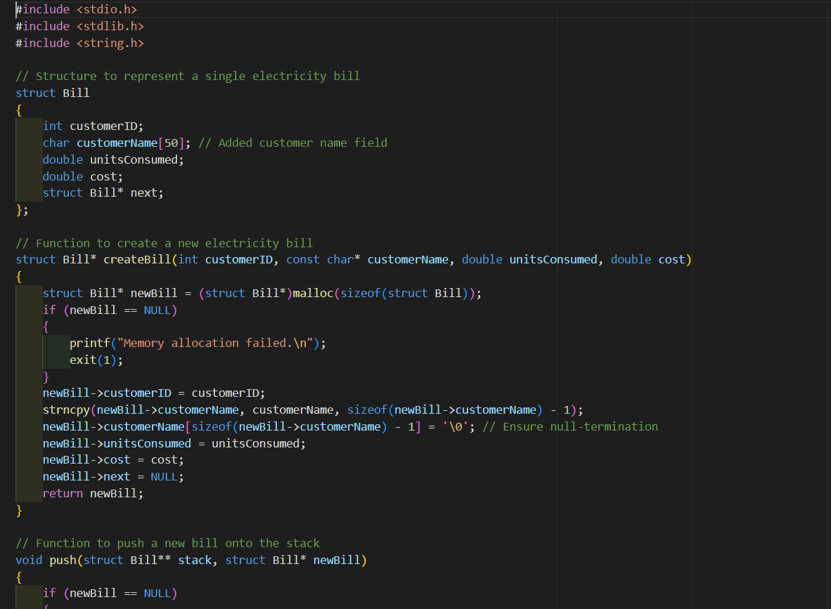
SAMPLE CODE

Slide 8
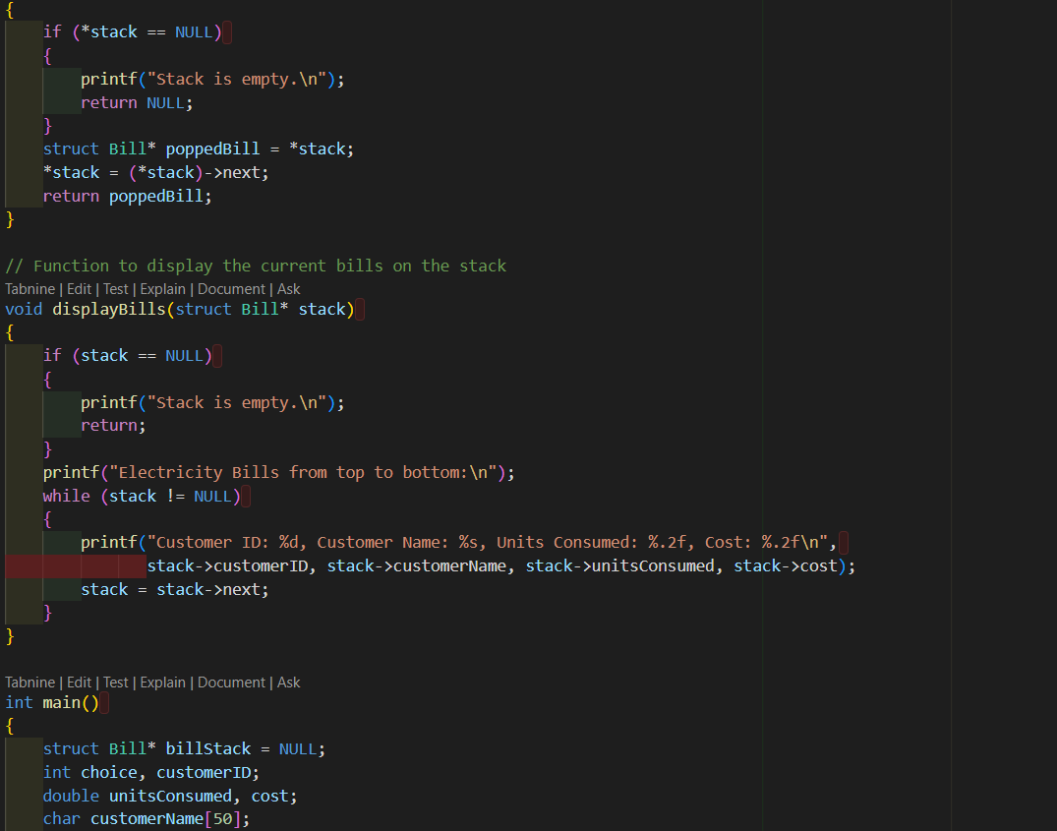

Slide 9
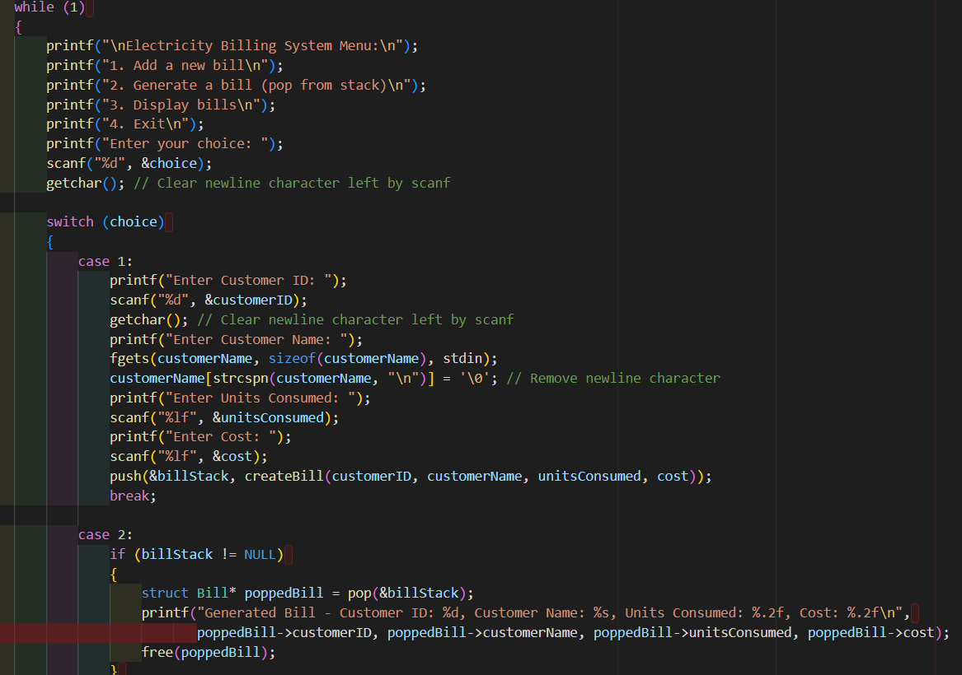

Slide 10
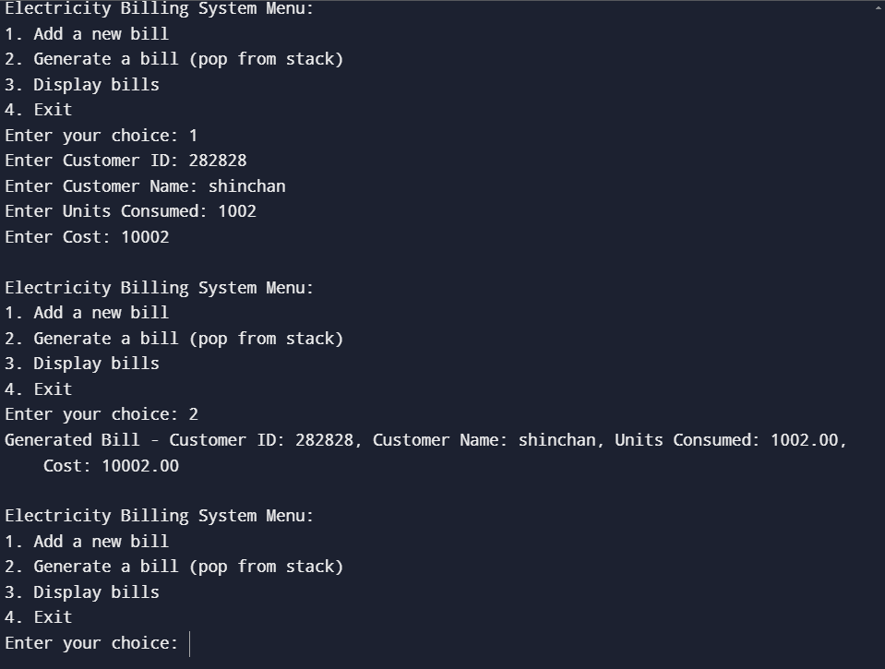
OUTPUT

Slide 11
CONCLUSION
In conclusion, the electricity billing system implemented in C using a stack data structure provides an illustrative example of how a stack can be employed in a context that may not be its most natural application. While stacks are commonly used for last-in, first-out (LIFO) data processing, this project showcases their adaptability and the importance of understanding fundamental data structures.
Key takeaways from this implementation include:
Stack Data Structure
Push and Pop Operations
User Interaction
Memory Management
Educational Value

Slide 12
Thanks

