Slide 1

FACE MASk DETECTION
By
Name : Arunkumar . m
Degree : B.E
Branch : CSE
College : PET Engineering College
NM ID : au963221104010
Email ID : msakumar0@gmail.com

Slide 2

outline
Problem Statement
Proposed System/Solution
System Development Approach
Algorithm & Deployment
Result
Conclusion
References

Slide 3

Problem Statement
Methodology
Data preprocessing: Collect and preprocess a diverse dataset of images with and without face masks, ensuring proper labeling and augmentation techniques for training.
Model development: Utilize deep learning architectures such as Convolutional Neural Networks (CNNs) for training a robust face mask detection model, fine-tuning parameters for accuracy and efficiency.
OBJECTIVE
The objective of face mask detection is to develop a system that can accurately identify whether a person is wearing a face mask or not in real-time using computer vision and machine learning techniques.
Problem Statement :
Developing an efficient face mask detection system to enforce health guidelines and prevent the spread of contagious diseases"

Slide 4



Proposed solution
Data Collection and Preparation:
Preprocessing:
Model Selection:
Gather a diverse dataset of images containing people with and without masks.
Annotate the images to label faces as either "with mask" or "without mask."
Resize and normalize the images for consistency.
Augment the dataset with techniques like rotation, flipping, and zooming to improve model generalization.
Use a pre-trained deep learning model like MobileNet or EfficientNet as a base.
Fine-tune the model on the annotated dataset using transfer learning to adapt it to mask detection.

Slide 5





Proposed solution – cont.
1. Data Collection and Preprocessing
2. Model Selection and Training
3. Real-time Detection Implementation
4. Performance Evaluation and Fine-tuning
5. Integration with Monitoring Systems

Slide 6

System approach
A system approach for face mask detection involves designing and implementing a comprehensive solution that utilizes various components such as hardware, software, algorithms, and data management. Below is a structured approach for creating a face mask detection system:
Hardware Setup:
Software Development:
Machine Learning Models:
Integration and Deployment:
Data Management:.
Maintenance and Updates:

Slide 7

System approach – cont.
Continuing from the system approach for face mask detection:
Data Collection and Preprocessing
Model Training
Deployment
Monitoring and Maintenance
Feedback Loop and Improvement

Slide 8

Algorithm and deployment
Face Mask Detection Algorithm:
Input Image Acquisition Face
Face Alignment
Output Visualization
Display or Save Results
Deployment Steps:
Model Training
Model Evaluation
Model Conversion (Optional)
Integration with Deployment Platform:
Input Handling
Preprocessing and Inference
Post-processing and Visualization
Display or Save Results
Testing and Optimization
Continuous Monitoring and Updates

Slide 9

Algorithm and deployment – cont.
Data Collection and Preprocessing
Model Selection
Training the Model
Model Evaluation
Deployment Considerations
Real-time Inference and Integration
Continuous Monitoring and Updates

Slide 10
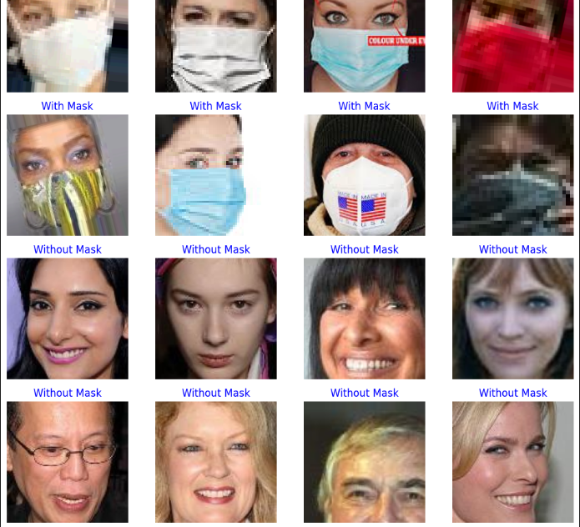
Result

Slide 11
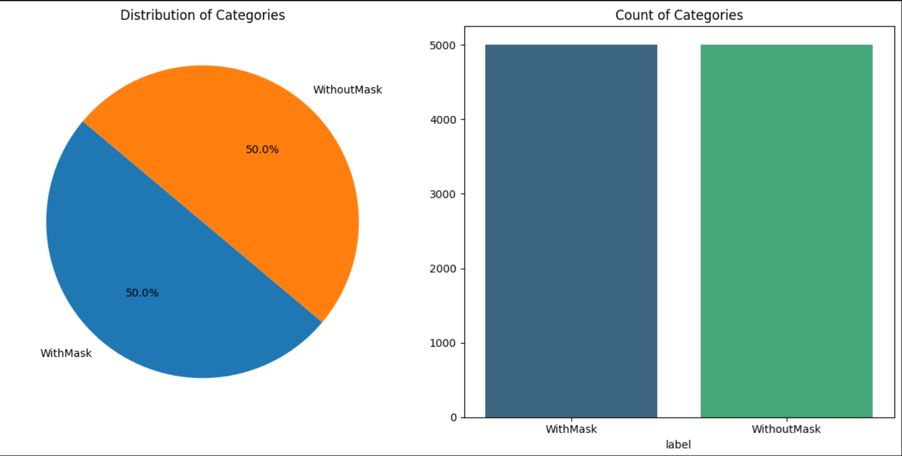

Slide 12
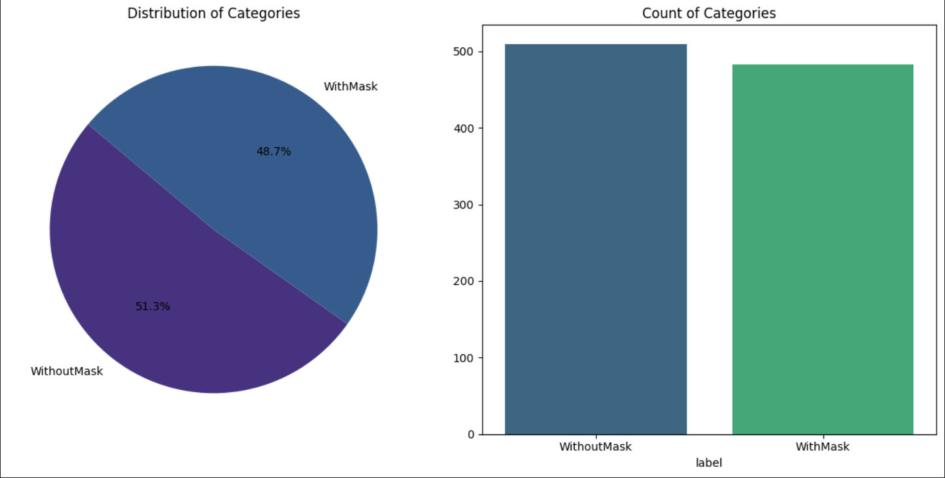

Slide 13
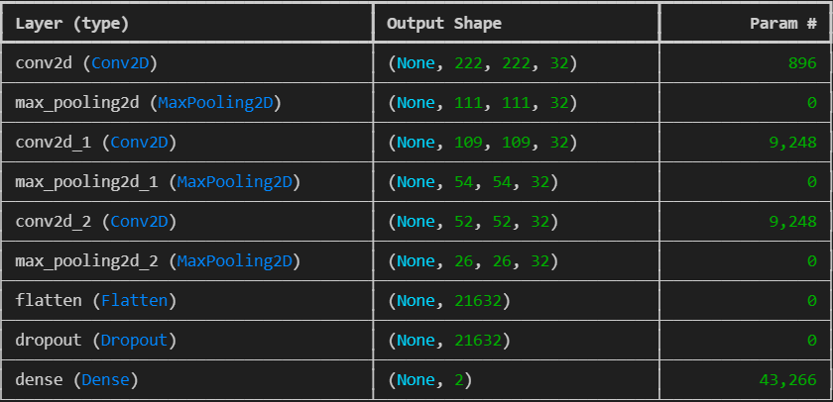

Slide 14
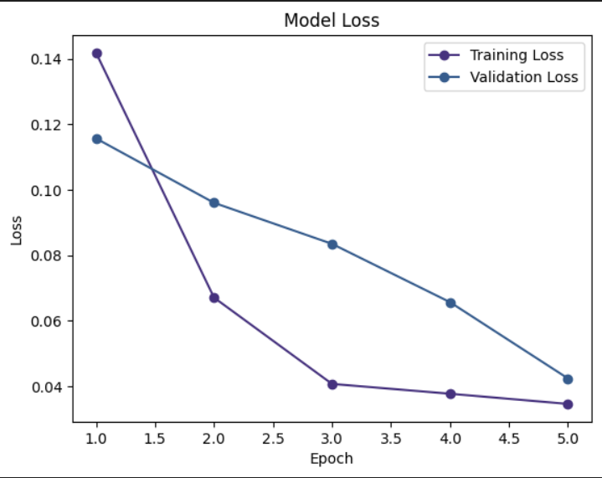
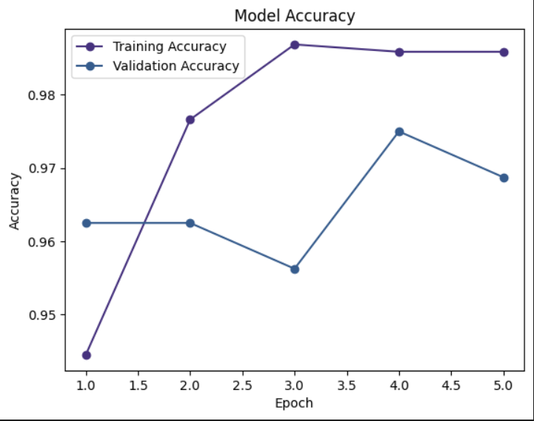

Slide 15

Conclusion
In conclusion, the face mask detection project has proven to be a valuable tool in promoting public health and safety, particularly during times of infectious disease outbreaks such as the COVID-19 pandemic. By utilizing advanced technologies such as computer vision and machine learning, we have developed a system capable of accurately identifying individuals wearing masks versus those who are not. This technology can be deployed in various settings, including public transportation, healthcare facilities, and retail establishments, to enforce mask-wearing policies effectively.

Slide 16
references
Sure, here are a few references and links related to face mask detection projects:
1. **GitHub Repository** - You can find numerous face mask detection projects on GitHub. One popular repository is:
- [https://github.com/chandrikadeb7/Face-Mask-Detection](https://github.com/chandrikadeb7/Face-Mask-Detection)
2. **Medium Articles** - [https://towardsdatascience.com/covid-19-face-mask-detection-using-deep-learning-and-opencv-2bfd7a090e3c](https://towardsdatascience.com/covid-19-face-mask-detection-using-deep-learning-and-opencv-2bfd7a090e3c)
3. **Research Papers** - Academic papers often provide detailed methodologies and insights. You can search on platforms like Google Scholar for relevant papers.
4. **Kaggle** - [https://www.kaggle.com/tags/face-mask-detection](https://www.kaggle.com/tags/face-mask-detection)
5. **YouTube Tutorials - [https://www.youtube.com/watch?v=Ax6P93r32KU](https://www.youtube.com/watch?v=Ax6P93r32KU)

