Slide 1

VOTE INDIA SECURE
A Secure E-Voting Platform for Shareholders
Making shareholder voting simple, transparent, and tamper-proof.
TEAM MEMBERS
Arunkumar K – 24BCS031
Athithya A – 24BCS040
Mugilan M – 24BCS176

Slide 2
Problem Statement
Voting in company annual meetings is often difficult for regular shareholders due to slow postal ballots and complicated legacy portals. At the same time, companies and meeting scrutinizers struggle with manual counting, delayed reports, and risks of vote tampering.
There is a need for a centralized, user-friendly digital platform that enables shareholders to vote securely from any device and provides secure OTP login, duplicate-proof voting, and instant transparent results.
Domain:
Web Application & Secure E-Governance

Slide 3
Solution Proposed: Working Process
Vote India Secure connects companies and shareholders through a simple, step-by-step verified voting workflow.
1 Company Registers
2 Register Shareholders
3 Create Meeting
Company creates an account on the platform with its corporate details and admin credentials.
Company uploads its shareholder roster with Folio/DP ID, email, mobile, and shareholding count.
Company sets up AGM/EGM agenda, voting resolutions, start/end dates, and dispatches notice alerts.
4 Shareholder Login
5 Cast Weighted Vote
6 Scrutiny & Results
Shareholders enter their registered ID and authenticate quickly with a 6-digit OTP code.
Shareholder votes FOR, AGAINST, or ABSTAIN; vote weight is calculated based on their share count.
Meeting scrutinizer unlocks votes after deadline; system generates final verified tally reports.

Slide 4
Technologies Used
Frontend
Backend
Database
React.js
Bootstrap
Vite
Node.js, Express.js
Supabase Edge Functions
REST APIs
MySQL
Supabase
Security
Tools
Deployment
OTP 2-Factor Login
SHA-256 Vote Hashing
Git and GitHub
Vercel

Slide 5
Impacted Users
Retail Shareholders
Institutional Investors
Company Secretaries
Vote easily from phone or laptop with simple OTP login
Cast weighted votes according to total shareholdings
Set up meeting agendas and track voter attendance live
Scrutinizers
Registrars & RTAs
Company Management
Count and verify all votes with complete transparency
Upload and manage shareholder records effortlessly
Get clear, fair, and trustworthy general meeting outcomes
Regulators & Auditors
Proxy Advisors
Platform Administrators
Access clear audit trails and verify voting compliance
Review meeting resolutions and accurate voting data
Manage user permissions and keep the platform secure

Slide 6
Impacted Users
Retail Shareholders
Institutional Investors
Company Secretaries
Vote easily from phone or laptop with simple OTP login
Cast weighted votes according to total shareholdings
Set up meeting agendas and track voter attendance live
Scrutinizers
Registrars & RTAs
Company Management
Count and verify all votes with complete transparency
Upload and manage shareholder records effortlessly
Get clear, fair, and trustworthy general meeting outcomes
Regulators & Auditors
Proxy Advisors
Platform Administrators
Access clear audit trails and verify voting compliance
Review meeting resolutions and accurate voting data
Manage user permissions and keep the platform secure

Slide 7
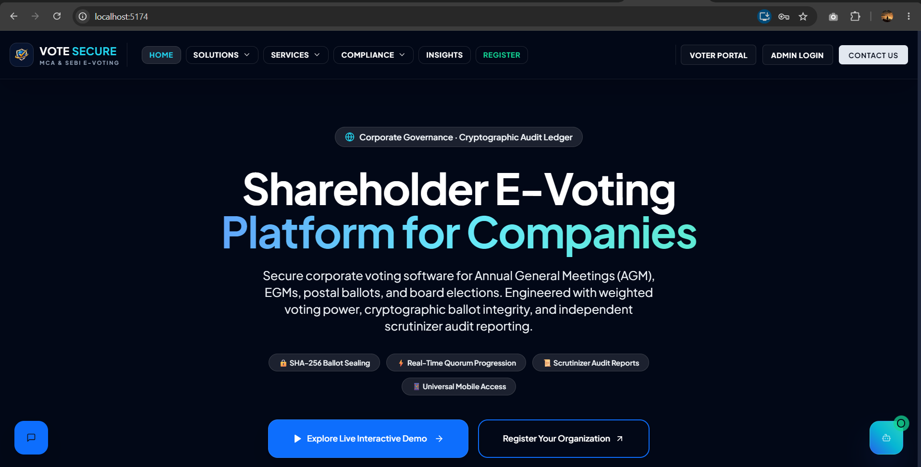
Landing Page

Slide 8
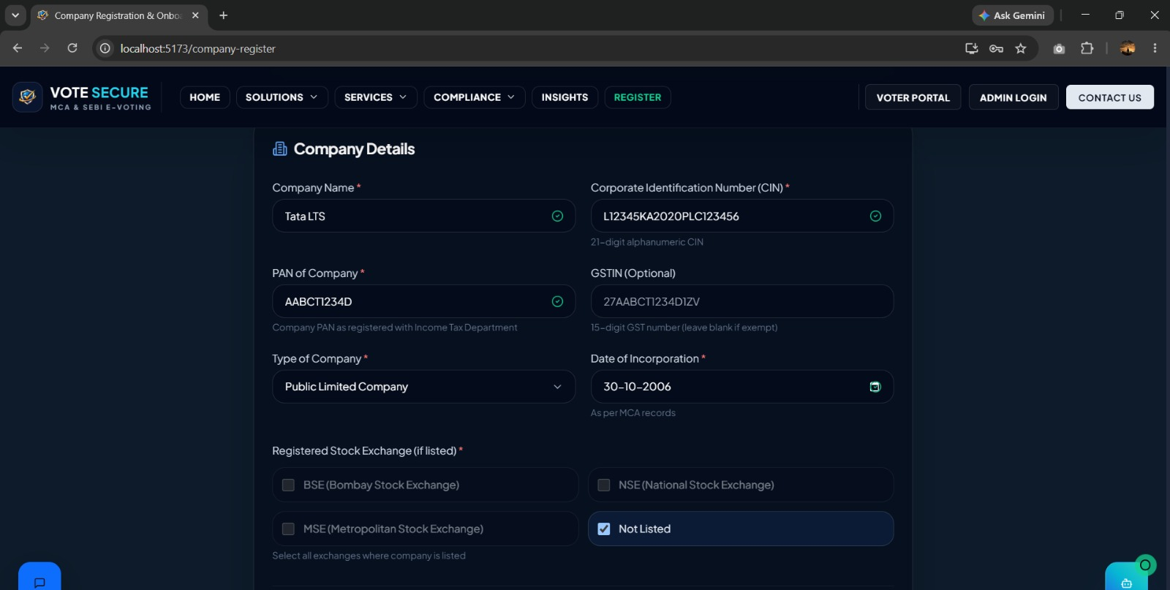
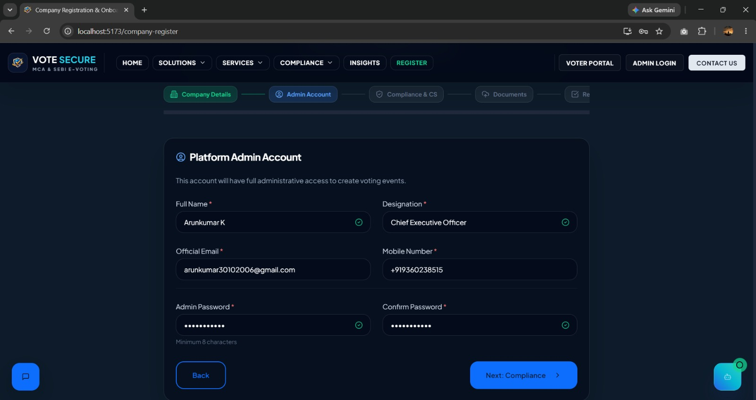
Prototype:
Company Registation Page:

Slide 9
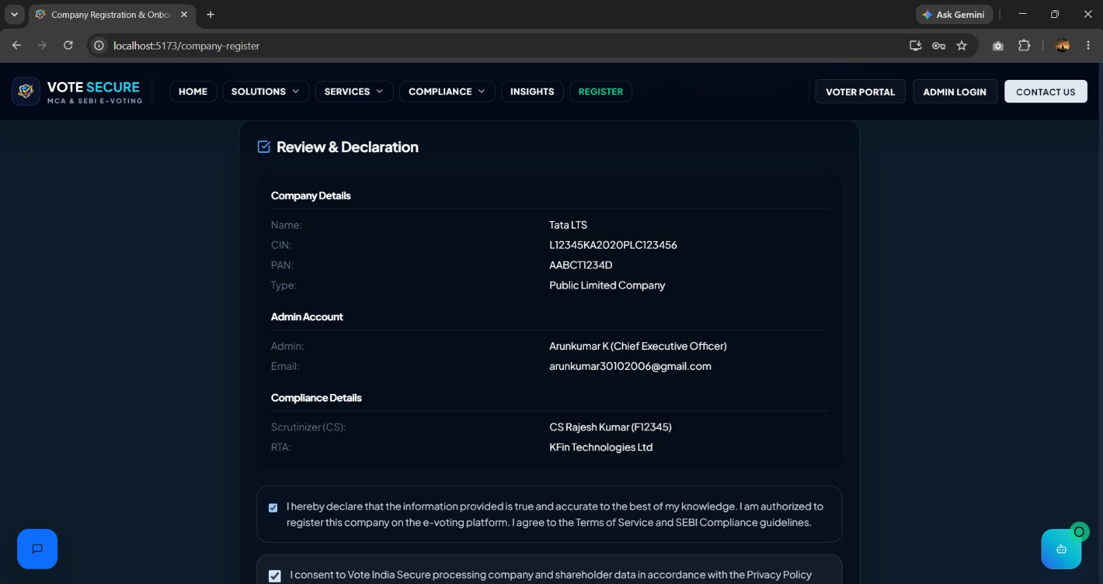
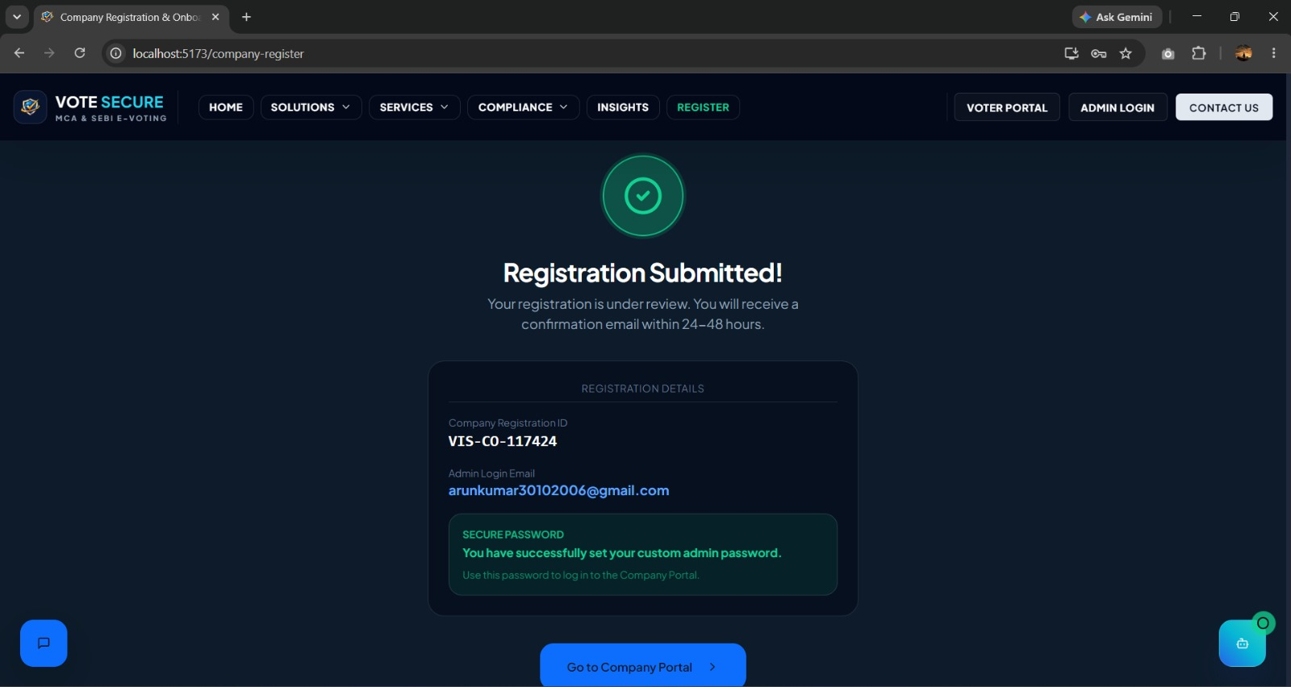
Prototype:
Company Registation Page:

Slide 10
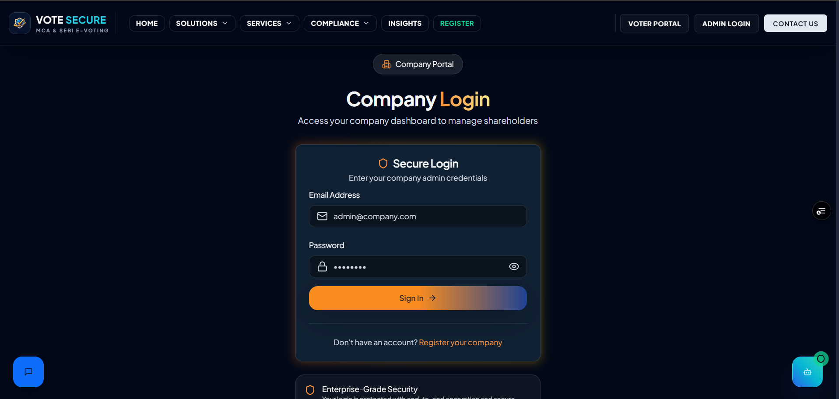
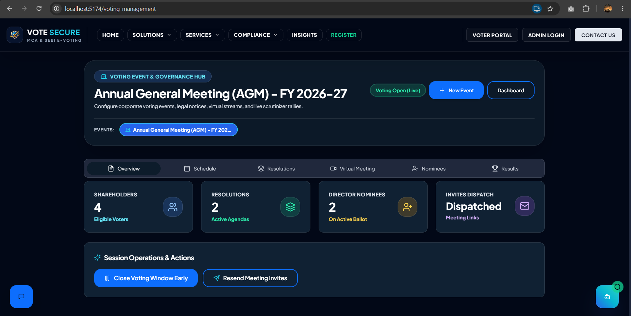
Prototype:
Company Dashboard Page:

Slide 11
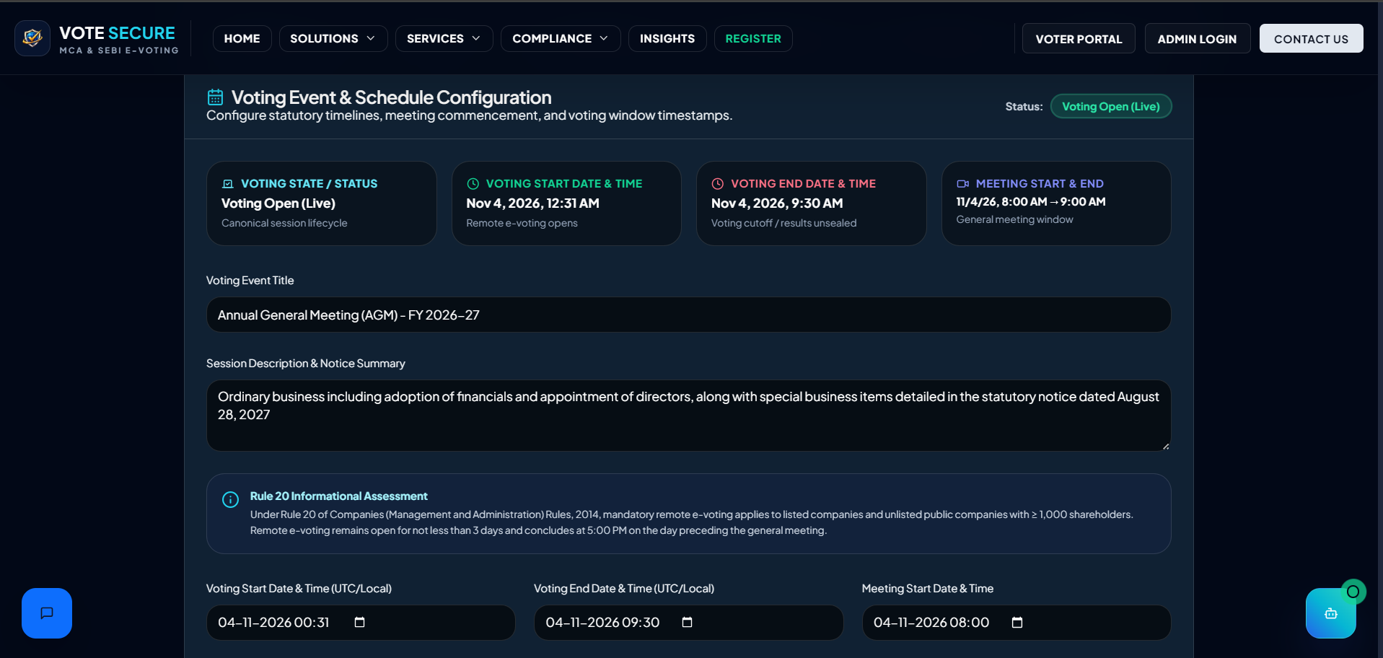
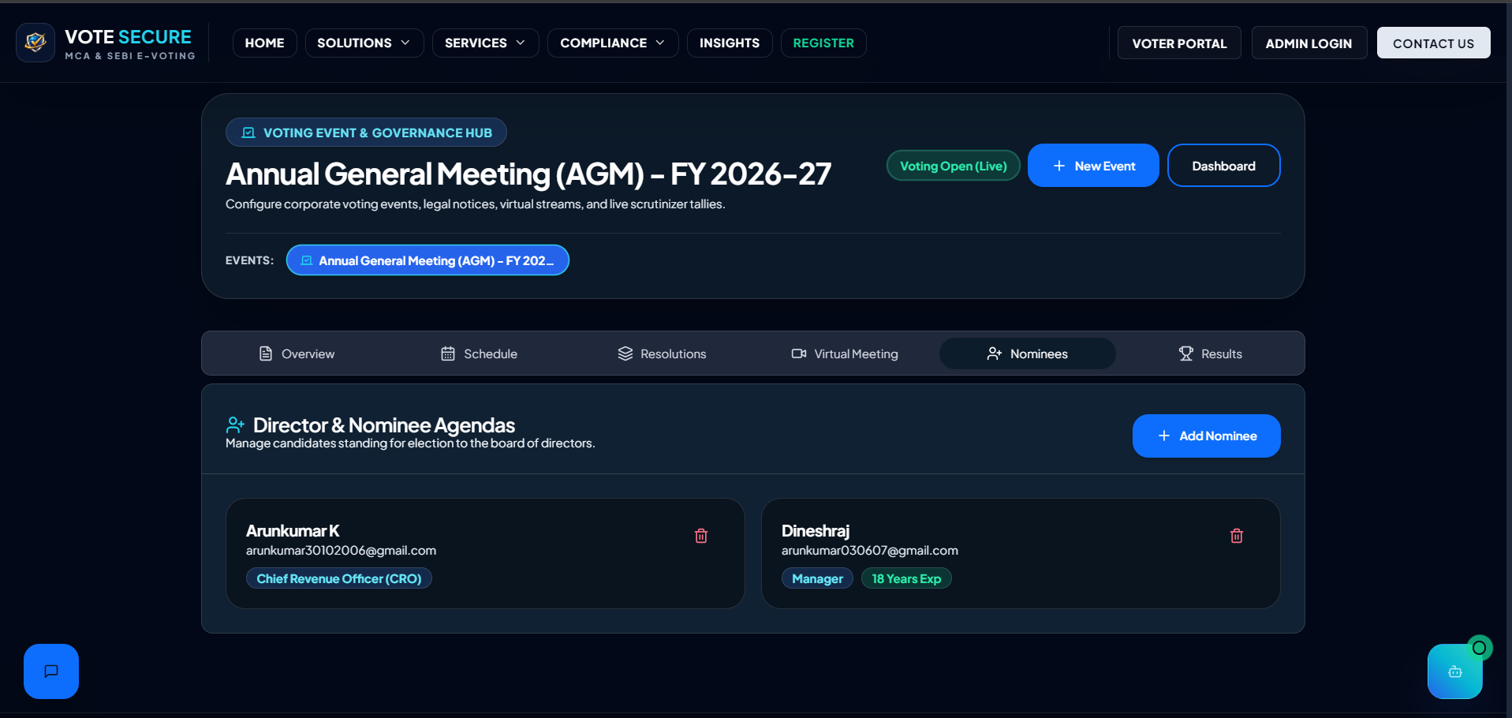
Prototype:
Company Dashboard Page:

Slide 12
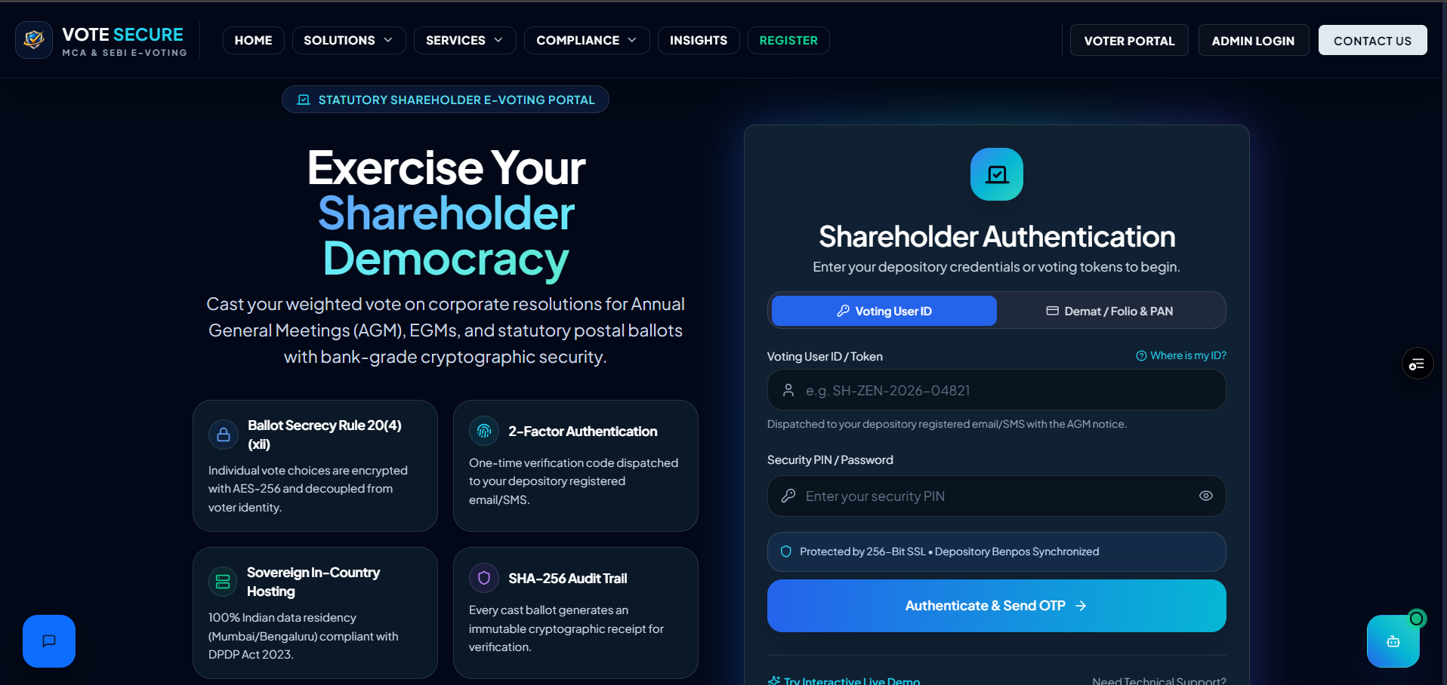
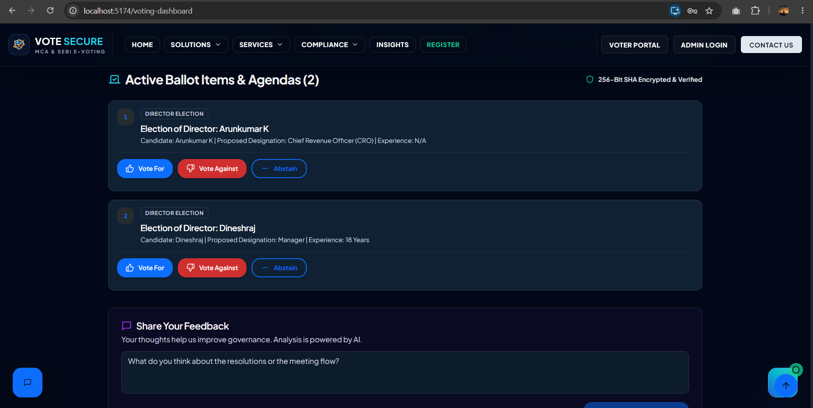
Prototype:
Shareholder Voting page:

Slide 13
THANK YOU!!
Vote India Secure: Simple, Secure & Transparent Shareholder Voting.

