Slide 1
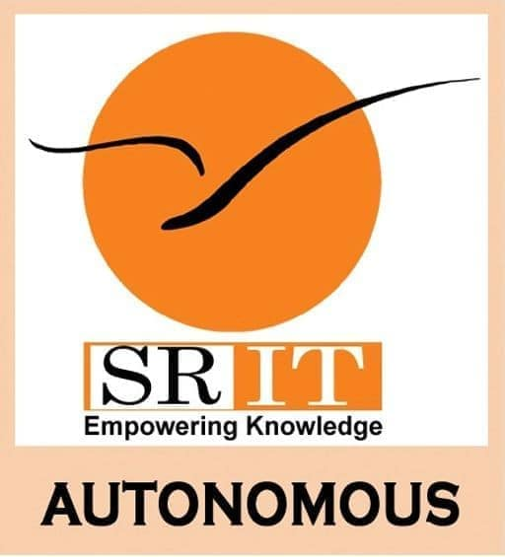
Smart College Bus Tracking System Using Hybrid GPS and AI Chatbot
by
R.ARUN KUMAR NAIK
Roll No. 224G1A0507
P. Md. MANSOOR
Roll No. 224G1A0545
G. SRAVANI
Roll No. 224G5A05A3
Under the guidance of
Dr. S. Ravi Kumar, M.C.A., Ph.D.
Associate Professor
Department of Computer Science and Engineering
Srinivasa Ramanujan Institute of Technology
(Affiliated to JNTUA & Approved by AICTE) (Accredited by NAAC with ‘A’ Grade & Accredited by NBA (EEE, ECE & CSE) Rotarypuram Village, B K Samudram Mandal, Ananthapuramu – 515701.
2025-2026
A25
DEPT. OF COMPUTER SCIENCE AND ENGINEERING
01
SRINIVASA RAMANUJAN INSTITUTE OF TECHNOLOGY

Slide 2
Smart College Bus Tracking System Using Hybrid GPS and AI Chatbot
Contents
Abstract
Introduction
Literature Survey
Existing System
Proposed System
Planning
Design
Implementation
Research Paper
References
GitHub Link
A25
DEPT. OF COMPUTER SCIENCE AND ENGINEERING
03
SRINIVASA RAMANUJAN INSTITUTE OF TECHNOLOGY

Slide 3
Smart College Bus Tracking System Using Hybrid GPS and AI Chatbot
Abstract
This project presents a Smart College Bus Tracking System designed to provide reliable real-time bus location information using a hybrid GPS approach and AI-based communication. Traditional bus tracking systems either rely on costly GPS hardware or manual communication methods, which often lead to interruptions and inconvenience. To overcome these limitations, the proposed system combines mobile-based GPS tracking with a dedicated GPS tracking device, ensuring uninterrupted and accurate bus location updates.
The system is developed with three main modules: Admin, Driver, and Student. The Admin module allows administrators to manage buses, drivers, students, routes, and complaints through a centralized platform. The Driver module enables drivers to update live bus locations using a mobile application, while the GPS device acts as a backup source for continuous tracking. The Student module provides real-time bus tracking, estimated arrival time (ETA), stop-based alerts, route details, and complaint submission through a web or mobile interface.
To enhance communication, an AI chatbot is integrated into the system, enabling students to instantly query bus location, arrival time, and other transportation-related information without manual intervention. This reduces dependency on phone calls or messaging applications and improves response time.
Overall, the proposed system improves transportation reliability, reduces waiting time, enhances user convenience, and ensures effective communication. By using cloud computing, hybrid GPS tracking, and AI-based interaction, the system offers a smart, scalable, and cost-effective solution for college transportation management.
A25
DEPT. OF COMPUTER SCIENCE AND ENGINEERING
04
SRINIVASA RAMANUJAN INSTITUTE OF TECHNOLOGY

Slide 4
Smart College Bus Tracking System Using Hybrid GPS and AI Chatbot
Introduction
The Smart College Bus Tracking System using Hybrid GPS & AI Chatbot is a web-based and IoT-integrated platform designed to manage and monitor college transportation digitally. It allows administrators to manage buses, drivers, and routes, monitor real-time bus locations, and handle complaints, while students can track buses live, view estimated arrival times, and receive updates. Drivers can update trip status and share live location through the connected GPS device. The system ensures better coordination, transparency, and efficient transportation management.
This project addresses common transportation problems such as lack of real-time tracking, uncertainty in bus arrival times, poor communication between students and drivers, and difficulty in managing routes manually. Traditional methods often lead to confusion, delays, and inconvenience for students and administrators.
This project is chosen to solve the challenges faced in managing college bus systems using manual methods such as phone calls, notice boards, or unorganized tracking. Without a centralized system, monitoring buses, handling complaints, and providing live updates becomes inefficient. Our system provides a smart, centralized, and technology-driven solution.
A25
DEPT. OF COMPUTER SCIENCE AND ENGINEERING
05
SRINIVASA RAMANUJAN INSTITUTE OF TECHNOLOGY

Slide 5
Smart College Bus Tracking System Using Hybrid GPS and AI Chatbot
Literature Survey
Objective : To implement real-time bus tracking using mobile GPS and live map visualization
Real-time vehicle tracking has been widely explored using GPS hardware and mapping APIs such as Google Maps and OpenStreetMap. Studies show that mobile GPS-based tracking can provide accurate location updates when combined with map visualization tools. Techniques such as real-time data streaming and geolocation services help users track movement and estimate arrival time.
Limitation:
Most existing systems rely on dedicated GPS hardware installed in buses, making deployment costly for institutions. Many solutions also lack additional features like ETA prediction, stop-based alerts, and role-based access control.
Example:
Rao et al. (2022) implemented a GPS-based school bus monitoring system, but required expensive tracking hardware.
Singh & Patel (2021) used a mobile phone for location tracking, but the system lacked ETA and student notification features.
Gap:
There is a lack of mobile-based, cost-effective college bus tracking systems that provide:
Live map tracking
ETA calculations
Stop alerts
Complaint handling
Multi-role access (Admin, Driver, Student)
This project bridges the gap by using smartphone GPS and cloud-based real-time location streaming to create an efficient and scalable bus tracking solution.
A25
DEPT. OF COMPUTER SCIENCE AND ENGINEERING
06
SRINIVASA RAMANUJAN INSTITUTE OF TECHNOLOGY

Slide 6
Smart College Bus Tracking System Using Hybrid GPS and AI Chatbot
Existing System
Bus transportation management in many colleges is handled using manual methods such as printed timetables, notice boards, and phone calls to share route and timing information.
Bus schedules, driver details, and routes are usually stored in registers or spreadsheets across different departments, making management difficult.
Since there is no real-time tracking or automated notifications, students cannot know the exact bus location or arrival time, leading to delays and communication issues.
Key Features of Existing System
Manual bus schedule management using printed timetables or notice boards.
Communication through phone calls or messaging apps.
Bus route and driver details maintained in registers or spreadsheets.
Limited coordination between administrators, drivers, and students.
Basic transportation management without integrated digital platforms.
A25
DEPT. OF COMPUTER SCIENCE AND ENGINEERING
07
SRINIVASA RAMANUJAN INSTITUTE OF TECHNOLOGY

Slide 7
Smart College Bus Tracking System Using Hybrid GPS and AI Chatbot
Existing System
Limitations of Existing System
No centralized digital system for managing transport data.
Lack of real-time bus tracking and location updates.
Students cannot know exact arrival time (ETA) of buses.
No automated alerts or notification system.
Data stored in multiple places causing confusion and inconsistencies.
High administrative workload due to manual coordination.
Poor communication between students, drivers, and administrators.
No structured system for complaints or feedback.
A25
DEPT. OF COMPUTER SCIENCE AND ENGINEERING
08
SRINIVASA RAMANUJAN INSTITUTE OF TECHNOLOGY

Slide 8
Smart College Bus Tracking System Using Hybrid GPS and AI Chatbot
Proposed System
The proposed system is a web-based and mobile-friendly platform designed to manage college bus transportation in an organized and digital way.
Key Features of Proposed System
Hybrid GPS tracking using mobile GPS and bus-installed GPS device for accurate location tracking .
Real-time bus location displayed on an interactive map.
Estimated Time of Arrival (ETA) calculation for each bus stop.
Stop-based notifications to alert students before the bus arrives.AI-powered chatbot to answer queries about routes, timings, and bus location.
Centralized cloud system for storing and managing transportation data.
Complaint submission and tracking system for students.
A25
DEPT. OF COMPUTER SCIENCE AND ENGINEERING
09
SRINIVASA RAMANUJAN INSTITUTE OF TECHNOLOGY

Slide 9
Smart College Bus Tracking System Using Hybrid GPS and AI Chatbot
Proposed System
Role-Based Access System
The system provides access to three main users:
Administrator
Manage buses, routes, drivers, and student registrations.
Monitor live bus tracking through dashboard.
View and respond to complaints.
Driver
Login to update real-time bus location using mobile GPS.
Share updates about delays or route changes.
Student
Login securely to track bus location in real-time.
View route details and estimated arrival time.
Submit complaints or queries through the system.
Notification Allerts
A25
DEPT. OF COMPUTER SCIENCE AND ENGINEERING
10
SRINIVASA RAMANUJAN INSTITUTE OF TECHNOLOGY

Slide 10
Smart College Bus Tracking System Using Hybrid GPS and AI Chatbot
Planning
The planning phase of the Smart College Bus Tracking System focused on identifying the issues in traditional college transportation management and proposing a smart solution using GPS tracking and digital communication.
During this stage, requirement analysis was conducted to understand the needs of administrators, drivers, and students for efficient bus tracking and management.*
The system workflow was designed using role-based access, clearly defining how administrators, drivers, and students interact with the system.
Data organization and route management planning were considered to ensure that bus details, driver information, routes, and student records are maintained in a centralized system.
In addition, real-time tracking and notification planning were included to provide live bus location, estimated arrival time (ETA), and stop-based alerts to students.
These planning steps helped create a structured framework for developing an efficient, reliable, and smart transportation management system for college campuses.
A25
DEPT. OF COMPUTER SCIENCE AND ENGINEERING
11
SRINIVASA RAMANUJAN INSTITUTE OF TECHNOLOGY

Slide 11
Smart College Bus Tracking System Using Hybrid GPS and AI Chatbot
Design
System Architecture
The system is designed using a web-based and mobile-compatible architecture that allows secure access and real-time monitoring.
It follows a role-based structure with three main users:
Administrator
Driver
Student
The Frontend layer provides user interfaces for registration, login, bus tracking, route viewing, notifications, and complaint submission.
The Backend layer processes requests, manages authentication, and controls role-based access.
A centralized database stores information such as bus details, driver data, routes, student registrations, and tracking records.
The system integrates Hybrid GPS tracking and AI chatbot support for accurate tracking and instant query responses.
A25
DEPT. OF COMPUTER SCIENCE AND ENGINEERING
12
SRINIVASA RAMANUJAN INSTITUTE OF TECHNOLOGY

Slide 12
Smart College Bus Tracking System Using Hybrid GPS and AI Chatbot
Design
User Management Module
User Management and Authentication
Manages user registration, login, and authentication.
Supports three user roles:
Administrator
Driver
Student
Key features include:
Profile management
Secure login verification
Role-based permission control
The administrator can manage users, buses, and driver details through a dashboard.
Ensures that each user can access only authorized features of the system.
A25
DEPT. OF COMPUTER SCIENCE AND ENGINEERING
13
SRINIVASA RAMANUJAN INSTITUTE OF TECHNOLOGY

Slide 13
Smart College Bus Tracking System Using Hybrid GPS and AI Chatbot
Design
Tracking, Route, Notification & AI Modules
Bus Tracking Module
Tracks bus location in real time using Hybrid GPS technology.
Combines driver mobile GPS and bus GPS device for accurate tracking.
Displays live location on an interactive map.
Route Management
ModuleManages bus routes, stops, and estimated arrival times.
Notification & Complaint Module
Sends alerts for bus arrival and route changes.
Allows students to submit complaints to the administrator.
AI Chatbot Module
Provides instant responses to queries about bus routes, timings, and system usage.
Improves user convenience and communication efficiency.
A25
DEPT. OF COMPUTER SCIENCE AND ENGINEERING
14
SRINIVASA RAMANUJAN INSTITUTE OF TECHNOLOGY

Slide 14
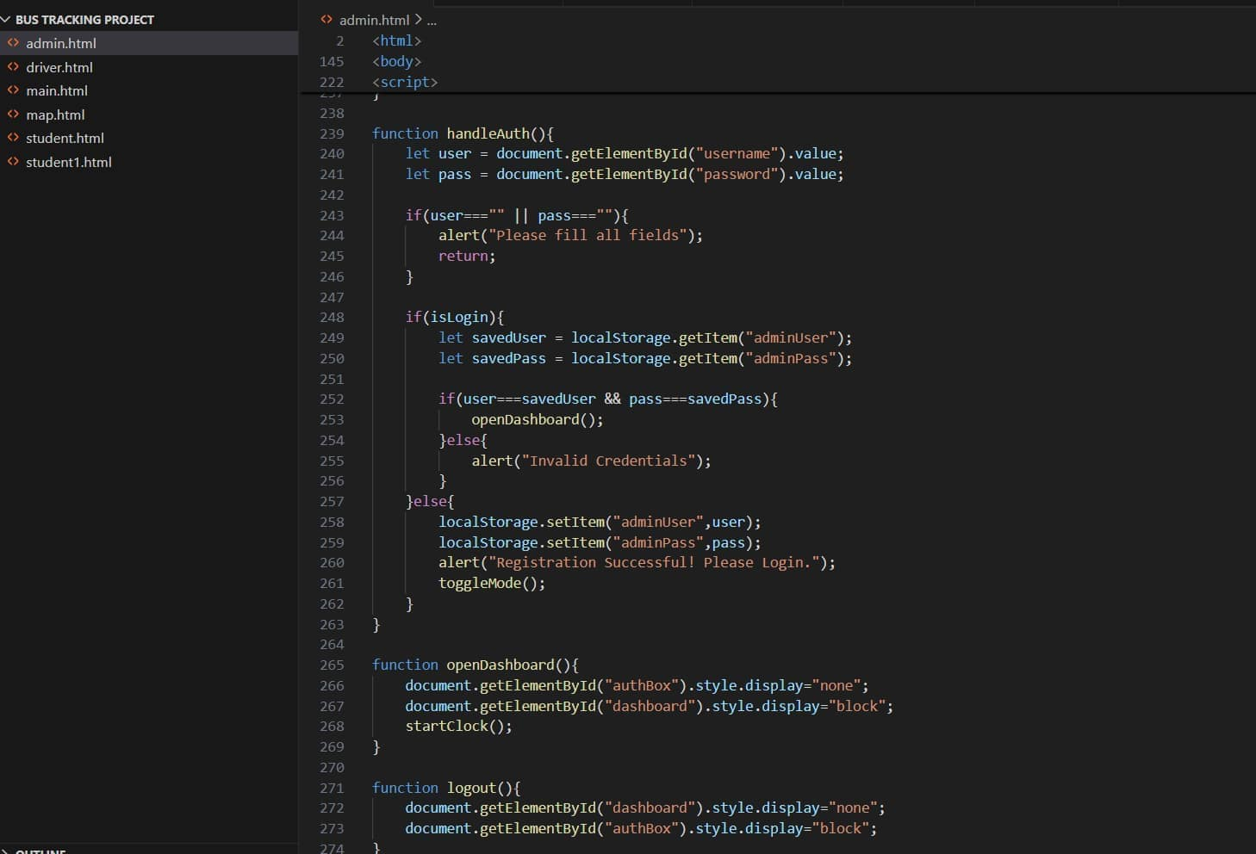
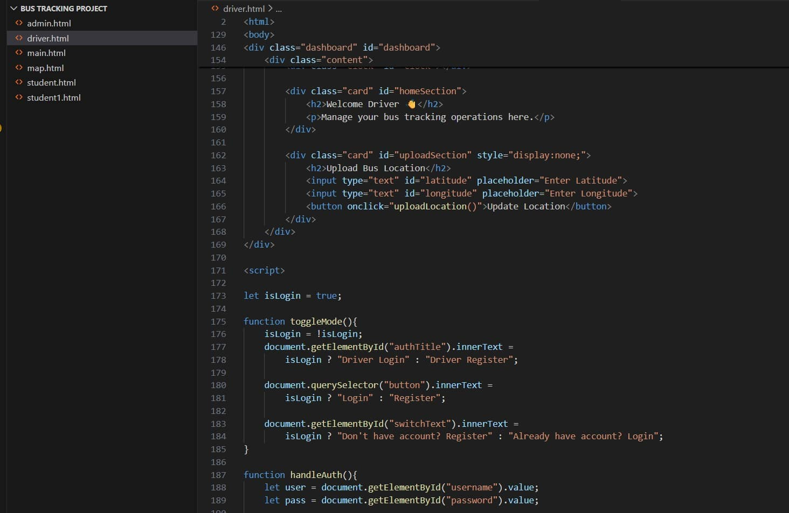
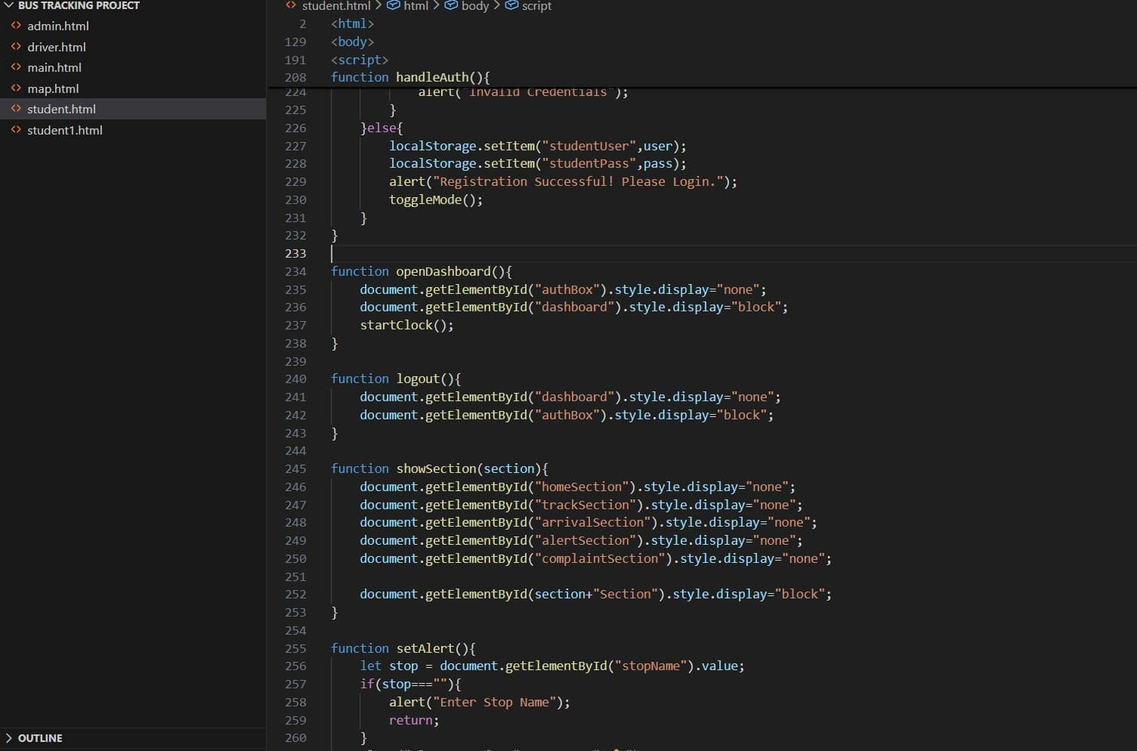
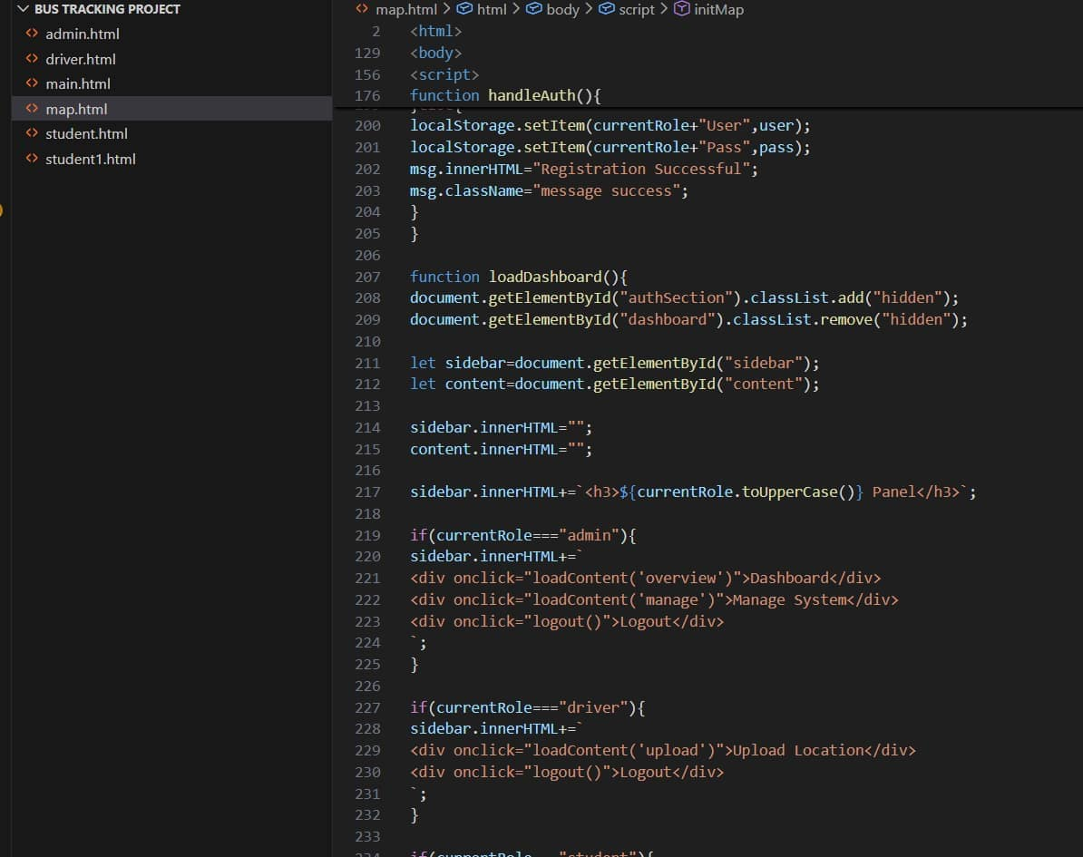
Smart College Bus Tracking System Using Hybrid GPS and AI Chatbot
Implementation
A25
DEPT. OF COMPUTER SCIENCE AND ENGINEERING
15
SRINIVASA RAMANUJAN INSTITUTE OF TECHNOLOGY

Slide 15
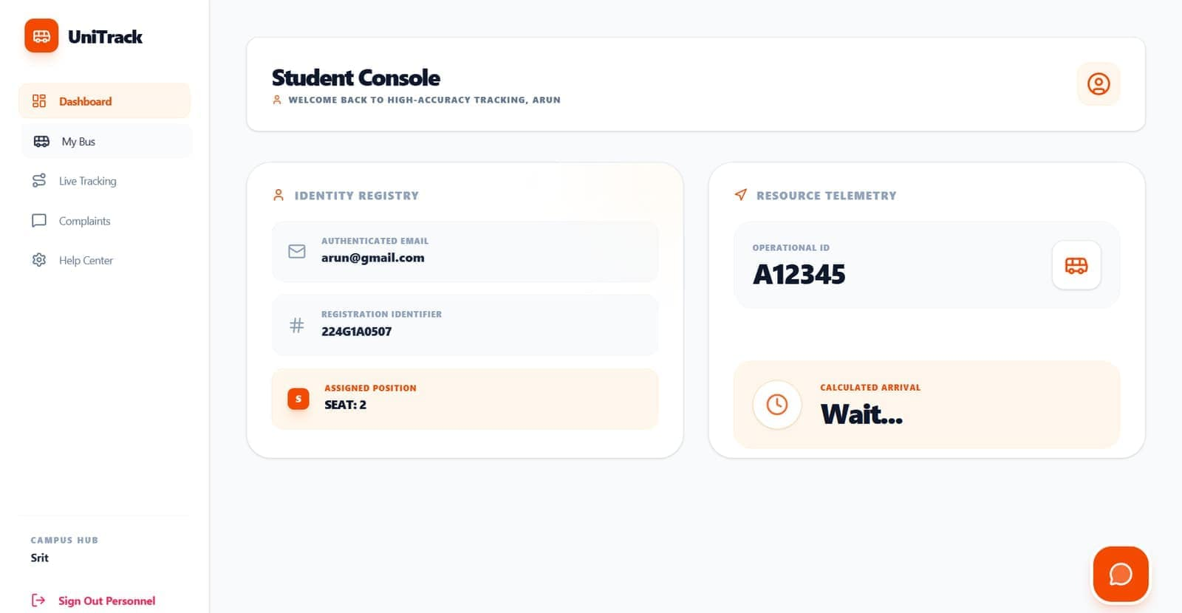
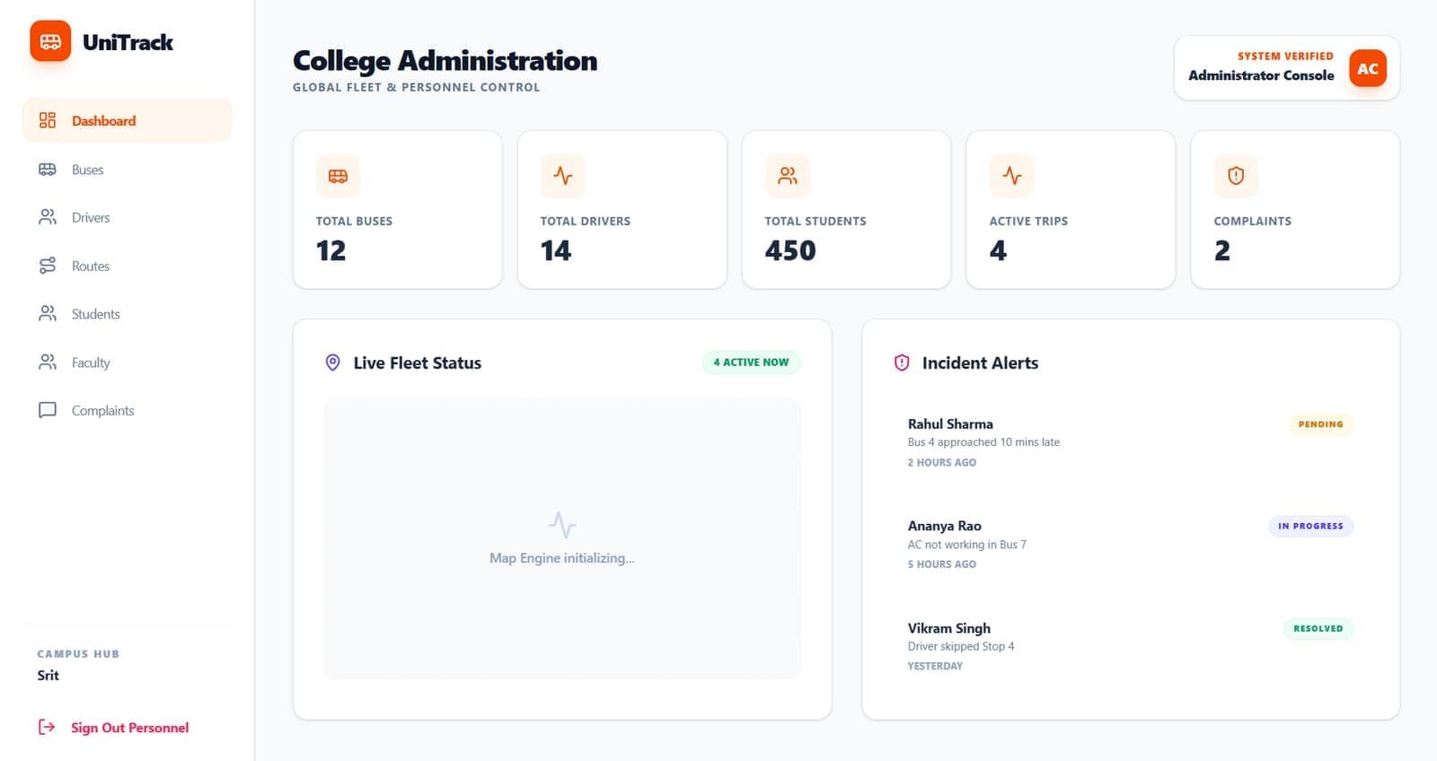
Smart College Bus Tracking System Using Hybrid GPS and AI Chatbot
Output
A25
DEPT. OF COMPUTER SCIENCE AND ENGINEERING
16
SRINIVASA RAMANUJAN INSTITUTE OF TECHNOLOGY

Slide 16
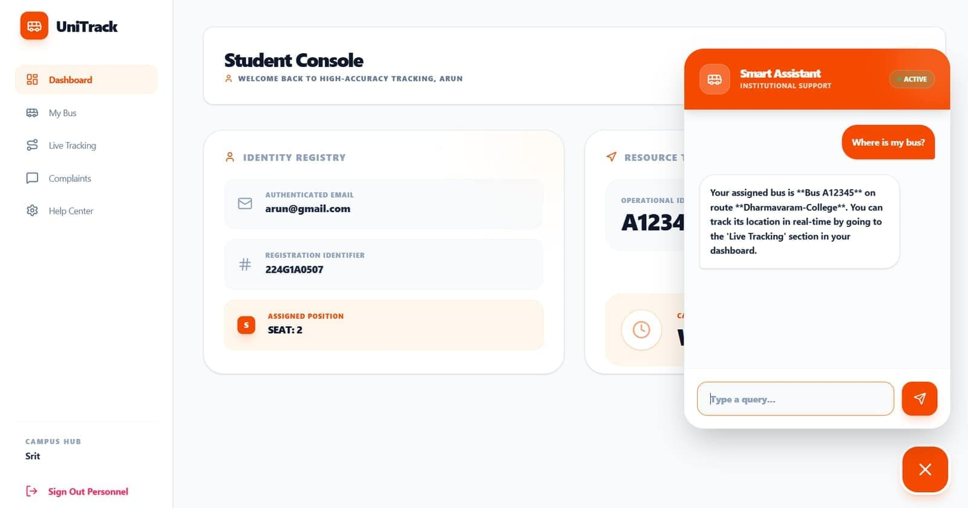
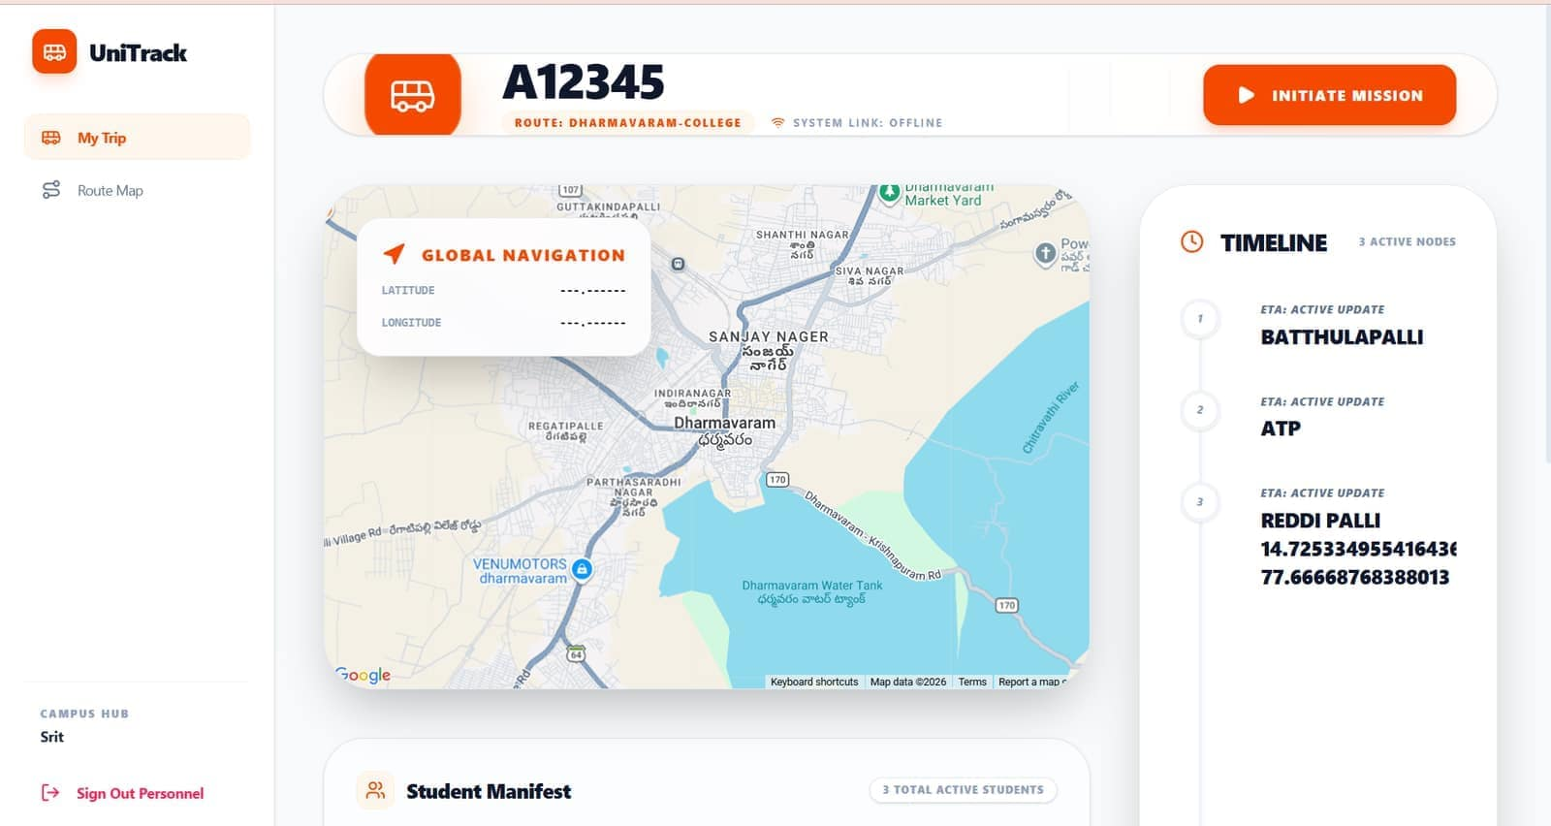
Smart College Bus Tracking System Using Hybrid GPS and AI Chatbot
Output
A25
DEPT. OF COMPUTER SCIENCE AND ENGINEERING
17
SRINIVASA RAMANUJAN INSTITUTE OF TECHNOLOGY

Slide 17
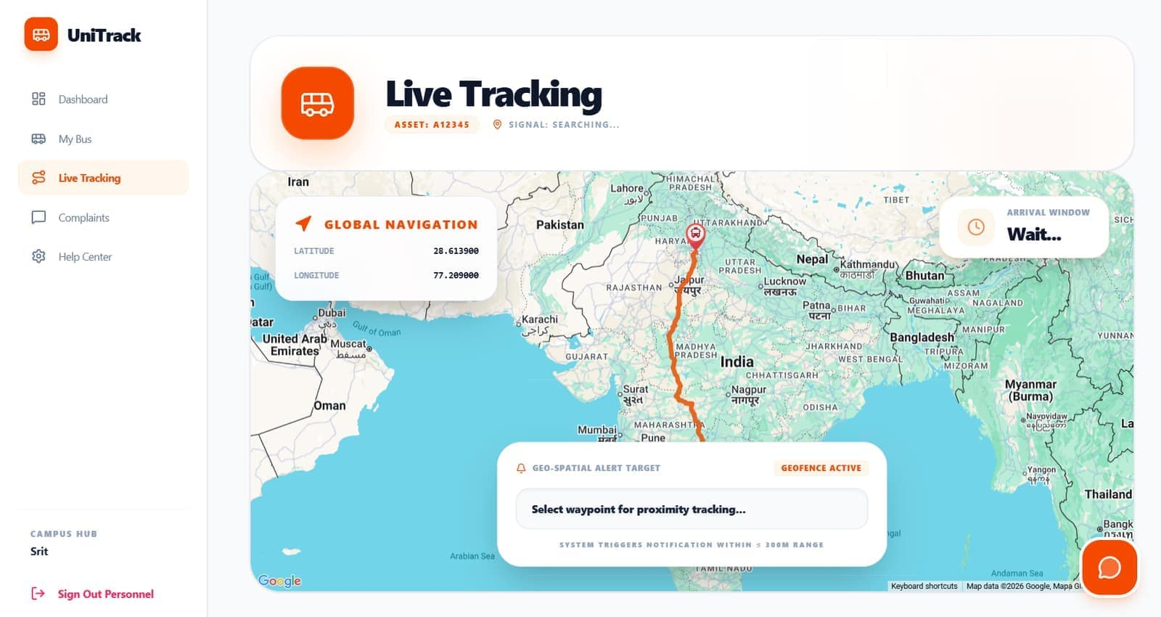
Smart College Bus Tracking System Using Hybrid GPS and AI Chatbot
Output
A25
DEPT. OF COMPUTER SCIENCE AND ENGINEERING
18
SRINIVASA RAMANUJAN INSTITUTE OF TECHNOLOGY

Slide 18
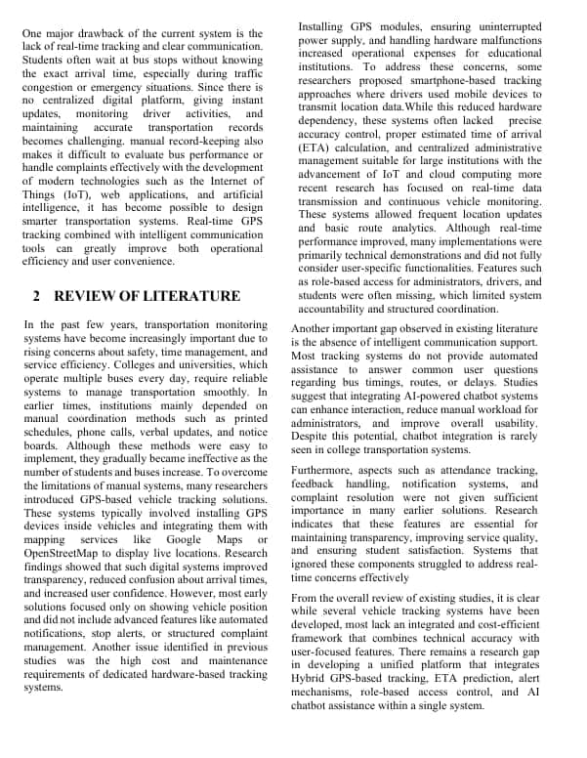
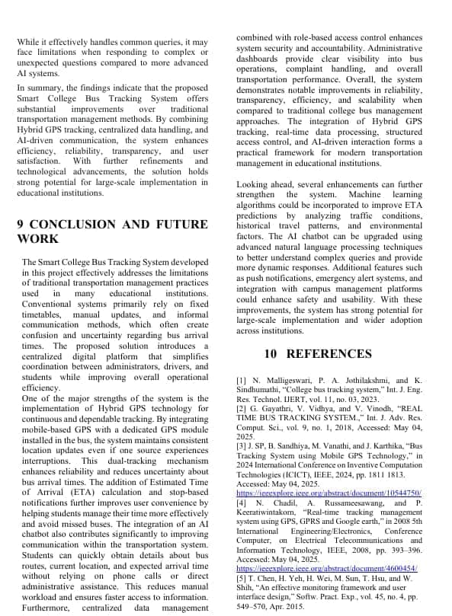
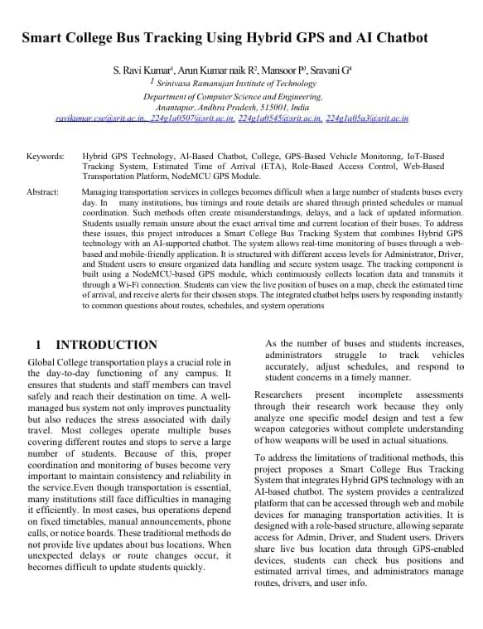
Smart College Bus Tracking System Using Hybrid GPS and AI Chatbot
Research Paper
A25
DEPT. OF COMPUTER SCIENCE AND ENGINEERING
19
SRINIVASA RAMANUJAN INSTITUTE OF TECHNOLOGY

Slide 19
Smart College Bus Tracking System Using Hybrid GPS and AI Chatbot
References
[1] N. Malligeswari, P. A. Jothilakshmi, and K. Sindhumathi, “College bus tracking system,” Int. J. Eng. Res. Technol. IJERT, vol. 11, no. 03, 2023.
[2] G. Gayathri, V. Vidhya, and V. Vinodh, “REAL TIME BUS TRACKING SYSTEM.,” Int. J. Adv. Res. Comput. Sci., vol. 9, no. 1, 2018, Accessed: May 04, 2025. [Online].
[3] J. SP, B. Sandhiya, M. Vanathi, and J. Karthika, “Bus Tracking System using Mobile GPS Technology,” in 2024 International Conference on Inventive Computation Technologies (ICICT), IEEE, 2024, pp. 1811 1813.
Accessed: May 04, 2025. [Online].
Available: https://ieeexplore.ieee.org/abstract/document/10544750/
[4] N. Chadil, A. Russameesawang, and P. Keeratiwintakorn, “Real-time tracking management system using GPS, GPRS and Google earth,” in 2008 5th International Engineering/Electronics, Conference Computer, on Electrical Telecommunications and Information Technology, IEEE, 2008, pp. 393–396. Accessed: May 04, 2025.
[Online]. https://ieeexplore.ieee.org/abstract/document/4600454/
[5] T. Chen, H. Yeh, H. Wei, M. Sun, T. Hsu, and W. Shih, “An effective monitoring framework and user interface design,” Softw. Pract. Exp., vol. 45, no. 4, pp. 549–570, Apr. 2015
A25
DEPT. OF COMPUTER SCIENCE AND ENGINEERING
20
SRINIVASA RAMANUJAN INSTITUTE OF TECHNOLOGY

Slide 20
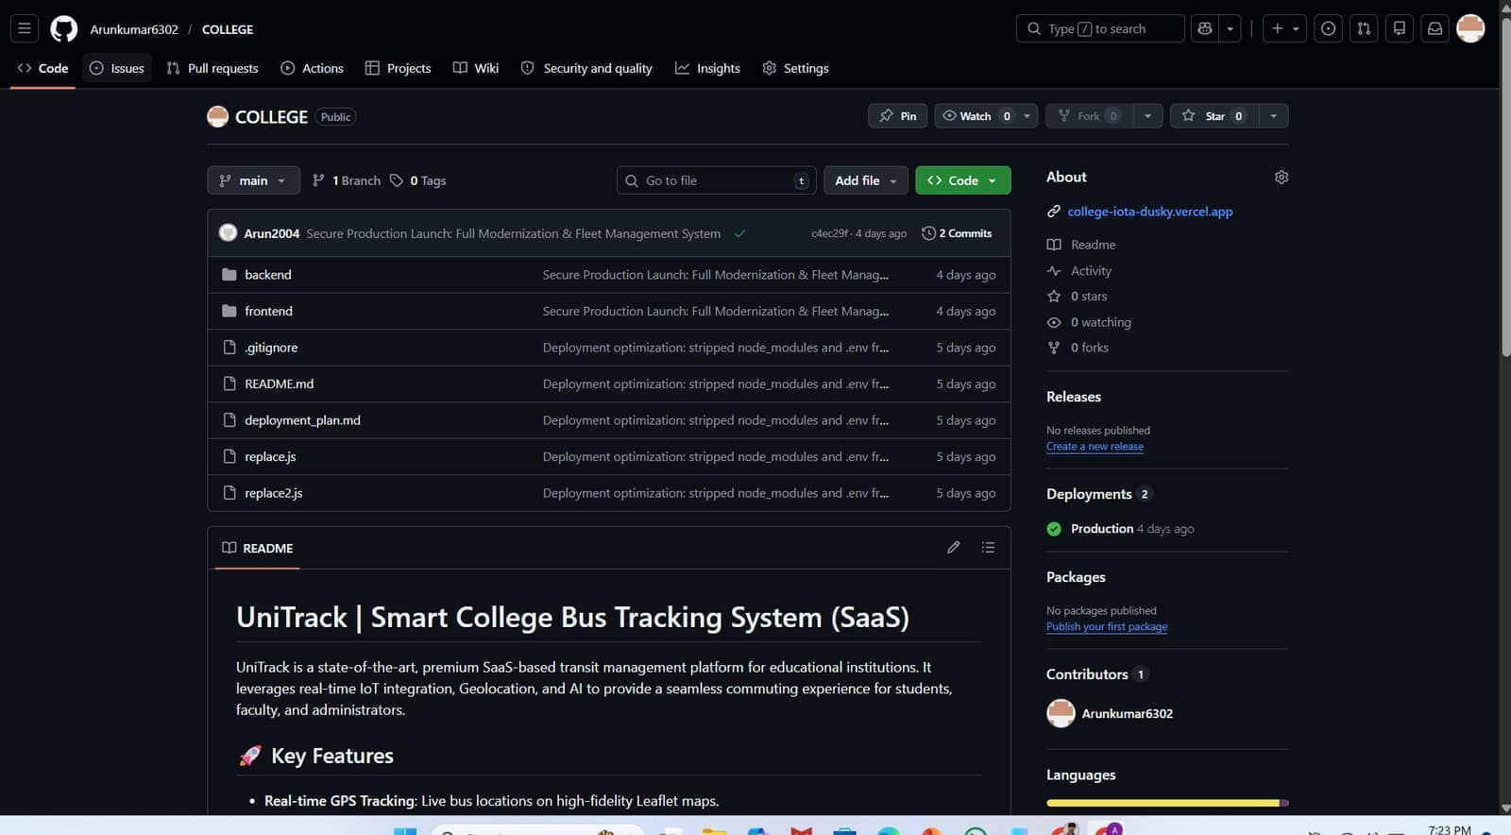
Smart College Bus Tracking System Using Hybrid GPS and AI Chatbot
Git Hub
Git-Hub : https://github.com/Arunkumar6302/COLLEGE.git
A25
DEPT. OF COMPUTER SCIENCE AND ENGINEERING
21
SRINIVASA RAMANUJAN INSTITUTE OF TECHNOLOGY

Slide 21
Smart College Bus Tracking System Using Hybrid GPS and AI Chatbot
THANK YOU
A25
DEPT. OF COMPUTER SCIENCE AND ENGINEERING
22
SRINIVASA RAMANUJAN INSTITUTE OF TECHNOLOGY

Slide 22
Smart College Bus Tracking System Using Hybrid GPS and AI Chatbot
ANY QUERIES?
A25
DEPT. OF COMPUTER SCIENCE AND ENGINEERING
23
SRINIVASA RAMANUJAN INSTITUTE OF TECHNOLOGY

