Slide 1


Project Name - P599 Bank Analytics
Group no. - 006
Group Member’s
MR. Kasani Siva Tarun Kumar
MR. Dobariya Ankur
MR. Aditya R. Pawar
MR. Aakash Manoj Barua
MR. Boya Arun Kumar
MR. Sheshank Naik
MR. Muhammad Jaseem

Slide 2
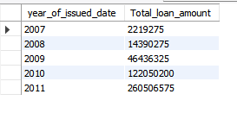
1. Year Wise Loan Amount Stats
SQL QUERY -
select year(issue_d) as year_of_issued_date,
sum(loan_amnt) as Total_loan_amount from finance_1
group by year_of_issued_date
order by year_of_issued_date asc ;
OUTPUT:-

Slide 3
1. Year Wise Loan Amount Stats
Years | Loan Amount
2007 | 2219275
2008 | 14390275
2009 | 46436325
2010 | 122050200
2011 | 260506575
Grand Total | 445602650

Slide 4
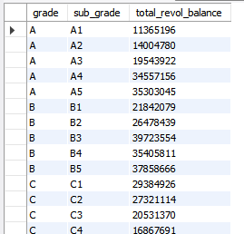
2. Grade and sub grade wise revol_bal
SQL QUERY
select grade, sub_grade, sum(revol_bal) as total_revol_balance
from finance_1 inner join finance_2
on(finance_1.id = finance_2.id)
group by grade, sub_grade
order by grade, sub_grade;
OUTPUT:-

Slide 5
2. Grade and sub grade wise revol_bal

Slide 6

3. Total Payment for Verified Status Vs Total Payment for Non Verified Status
SQL QUERY
select verification_status,
round(sum(total_pymnt)) as total_payment from
finance_1 inner join finance_2
on(finance_1.id = finance_2.id)
group by verification_status;
OUTPUT:-

Slide 7
3. Total Payment for Verified Status Vs Total Payment for Non Verified Status
Loan Status | Loan Amount
Not Verified | 153541418
Verified | 329162976
Grand Total | 482704394

Slide 8
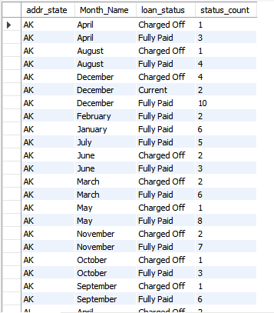
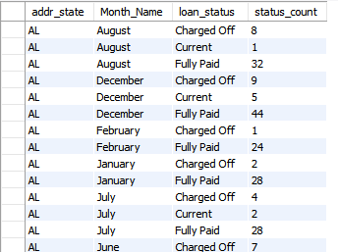
4. State wise and month wise loan status
select addr_state, monthname(issue_d) as Month_Name, loan_status,
count(*) As status_count
from finance_1
group by addr_state, monthname(issue_d),loan_status
order by addr_state, monthname(issue_d),loan_status;
SQL QUERY
OUTPUT:-

Slide 9
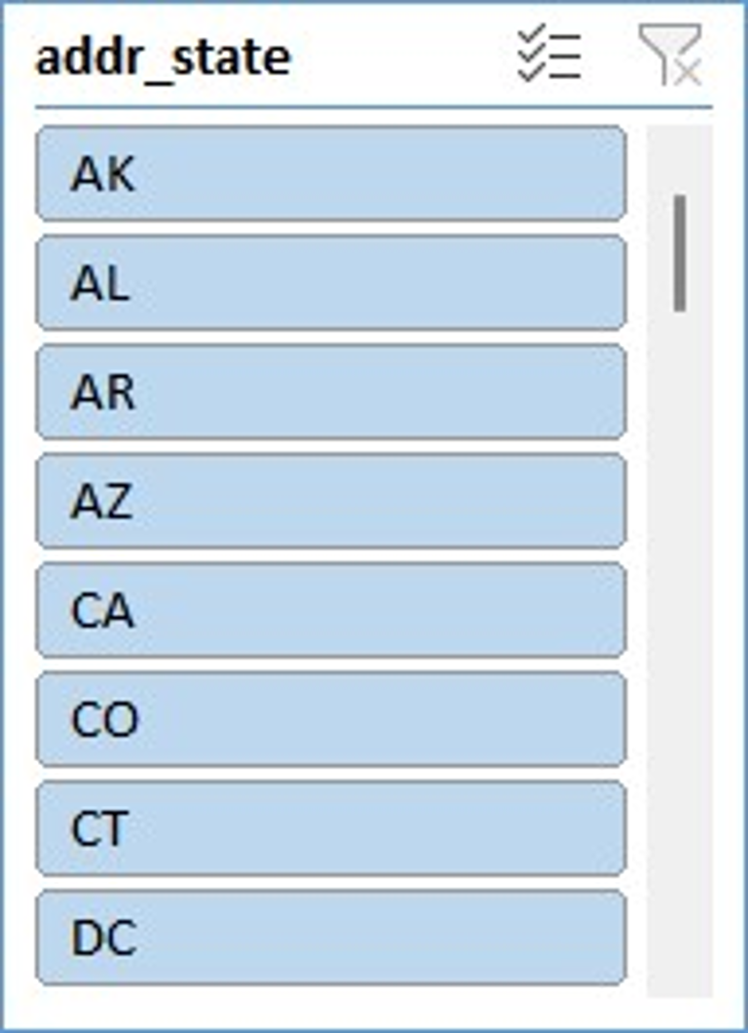
4. State wise and month wise loan status
Count of loan_status | Column Labels
Row Labels | Charged Off | Current | Fully Paid | Grand Total
Jan | 321 |  | 2058 | 2379
Feb | 290 |  | 2068 | 2358
Mar | 347 | 1 | 2344 | 2692
Apr | 370 | 3 | 2461 | 2834
May | 466 | 80 | 2453 | 2999
Jun | 483 | 99 | 2697 | 3279
Jul | 479 | 125 | 2872 | 3476
Aug | 468 | 130 | 2920 | 3518
Sep | 547 | 150 | 2951 | 3648
Oct | 580 | 173 | 3181 | 3934
Nov | 598 | 161 | 3408 | 4167
Dec | 678 | 218 | 3537 | 4433
Grand Total | 5627 | 1140 | 32950 | 39717

Slide 10
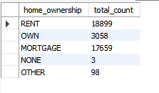
5. Home ownership Vs last payment date stats
select home_ownership,
count(issue_d) as total_count
from finance_1 inner join finance_2
on(finance_1.id = finance_2.id)
group by home_ownership;
SQL QUERY
OUTPUT:-

Slide 11
5. Home ownership Vs last payment date stats
Home Ownership | Count of Last Payment Date
NONE | 3
OTHER | 98
OWN | 3053
MORTGAGE | 17645
RENT | 18847
Grand Total | 39646

Slide 12
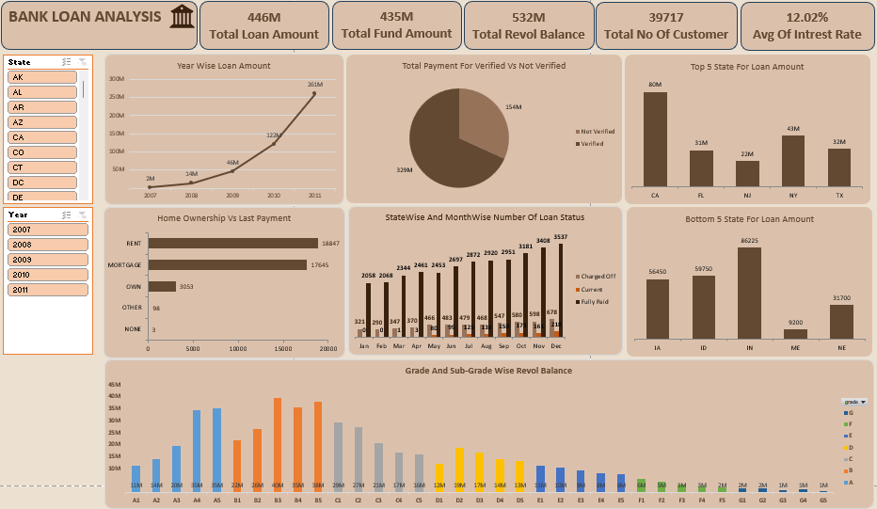
DASHBOARD

Slide 13
THANK YOU

