Slide 1
Version Control Softwares

Slide 2
Version Control Software
Project Contains multiple developers.
How to integerate all the developers at working from different locations.
How to monitor or trac code change
Who
When
What
why

Slide 3
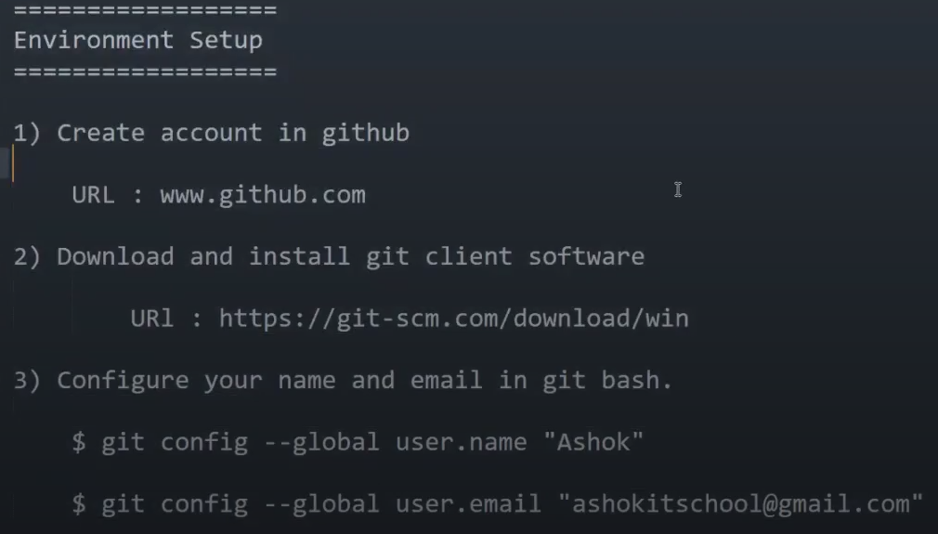

Slide 4
Git Architecture
Working Tree
Staging Area
Local Repository
Central Repository
1.
2.
3.For the first time git push it will ask you for user credential
github
gitinit
gitadd
git
commit
Working Tree
Staging Area
Local Repo
git push
Central Repo
git status
git log
Central Repo
Laptop

Slide 5
Git Repo Practical
Create git repo (public)
Ex: https://github.com
Copy Script from git repo and execute it in git bash
Note : Git bash is a client to perform git operations with github repo
Note : When we execute git push for first it will ask for git account credentials/token.
Note : It will save our git account credentials in “Windows Credential Manager”. If we want to connect with diff github account then remove those credentials.

Slide 6
Git Bash commands
Git init : To Initialize working tree.
Git status : To check the staging area.
Git add : To add files to the staging area.
Git commit : Send files from the staging area to the local repository.
Git log : To check the commit history.
Git push : To send files from local repo to central repo.

Slide 7
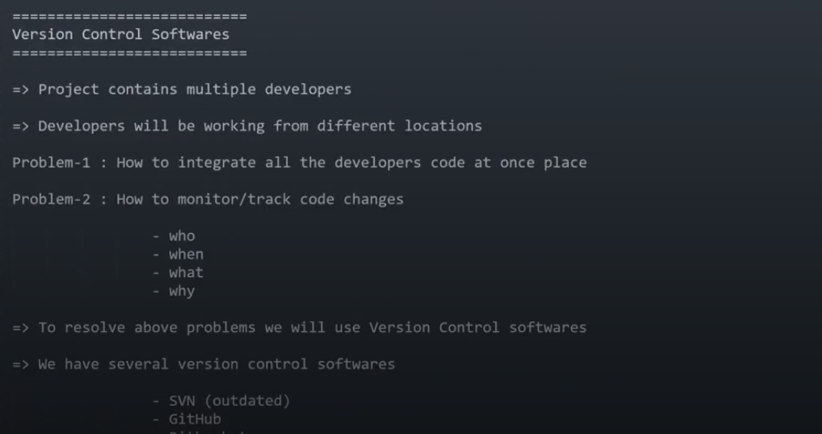

Slide 8
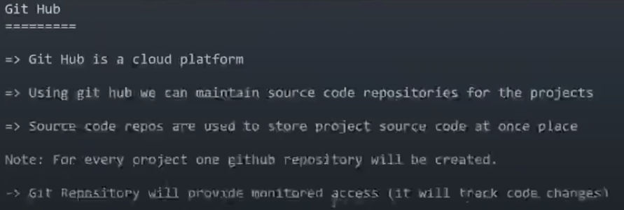

Slide 9
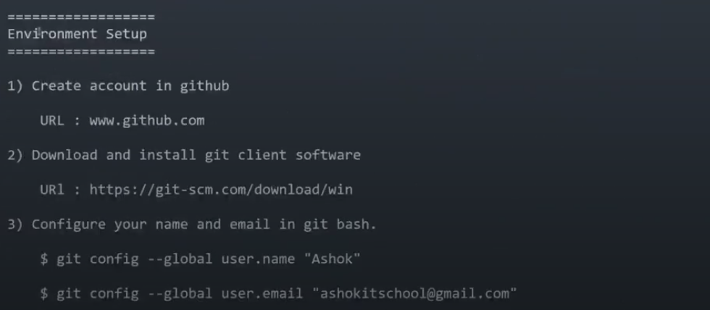

Slide 10
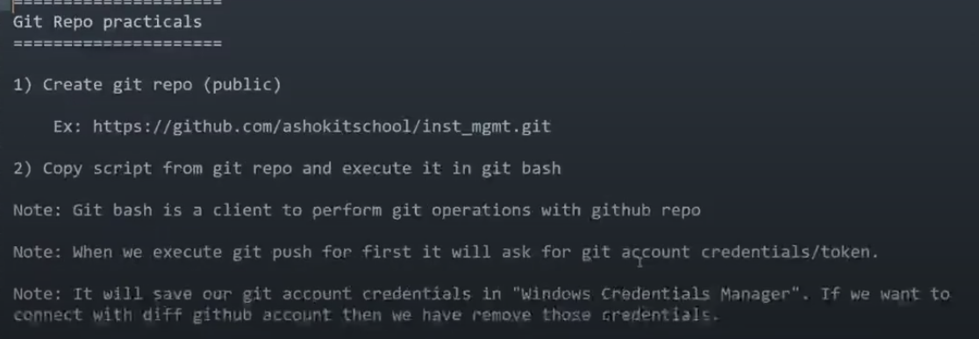

Slide 11
