Slide 1
Agro-Mentor: AI-powered Platform for Agricultural Management and Real-Time Support
CSE7101- Capstone Project
Review-1
Batch Number: CSG_42
Under the Supervision of,
Guide: Mr.Francis Vijayakumar Annareddy
Reviewer: Mr. Himansu Shekar Rout
School of Computer Science and Engineering
Presidency University
NAME | ROLL_NO
NAVEEN M | 20221CSG0153
KURUBA ARUN KUMAR | 20221LCG0005
AVINASH N | 20221LCG0004
Name of the Program: CSG(Computer Science and Technology)
Name of the HoD: Dr. Anandaraj S.P
Name of the Program Project Coordinator: Dr. Sharmasth Vali
Name of the School Project Coordinators: Dr. Sampath A K , Dr. Geetha Arjunan

Slide 2
Problem Statement Number: PSCS_150
Problem Statement Number: PSCS_150
Organization: AICTE,MIC-STUDENT INNOVATION
Category: Software
Problem Description:
Despite advances in technology, many rural farmers in India are still unable to leverage modern tools for disease management, crop monitoring, and marketplace connections. Fragmented information sources and lack of expert support make it challenging for farmers to make informed decisions. An integrated application using artificial intelligence, real-time data, and peer networking can bridge this gap, enabling improved productivity and sustainable growth in the agricultural sector.

Slide 3
OBJECTIVE
Mobile-First Design: Develop an intuitive, user-friendly mobile application to maximize accessibility and ease of use for farmers.
Localized Customization: Adapt the platform to address the specific agricultural challenges and needs of select regions or farming communities—starting with Karnataka.
Expert Connectivity: Enable farmers to interact directly with local agronomy professionals and experts for personalized support and real-time advice.
Multi-Language Support: Provide the app interface in multiple regional languages, such as Kannada and English, to cater to a diverse user base.

Slide 4
OBJECTIVE (cont..)
Real time AI Assistant support: Integrate an intelligent AI assistant to deliver instant, personalized responses to farming questions, expert advice, and agricultural recommendations at any time.
Integrated Disease Detection: Use AI-powered image analysis to detect crop diseases and deliver accurate recommendations, enhancing farmer decision-making.
Market and Resource Linkages: Offer features for contract farming, vertical farming, and digital marketplace connections, helping farmers access new opportunities and improve profitability.
Live News and Market Prices: Provide farmers with up-to-date agricultural news and live market price information to empower better decision-making and keep them informed about the latest trends.

Slide 5
Background and Related work for title Selection
Examining Popular Agriculture Apps and Their Capabilities Applications such as Plantix, AgriApp, and IFFCO Kisan offer services including crop disease identification, weather updates, and expert advisory support.
Reviewing Literature on AI Applications in Agriculture Research highlights the use of AI in areas like diagnosing crop diseases, predicting yields, and monitoring soil health.
Identifying Limitations of Current Digital Solutions for Farmers Many existing platforms face challenges such as poor internet availability, limited local language options, and high usage costs.
Exploring Ongoing Government Programs Supporting Digital Agriculture Schemes such as Pradhan Mantri Kisan Samman Nidhi (PM-KISAN) and the National Agriculture Market (e-NAM) are designed to provide financial support and improved market access to farmers.

Slide 6
Proposed Methodology
Proposed Methodology:
Our methodology is a multi-layered process designed to empower farmers with AI-driven insights, community support, and marketplace access. The core of this workflow is an AI-powered disease detection pipeline integrated with a Progressive Web App (PWA).
Workflow Steps:
User Access – Farmers access the Agro mentor PWA via mobile or desktop, with support for English and Kannada.
Image Input – Farmers upload or capture crop images through the app.
Preprocessing & Analysis – Images undergo quality checks, resizing, and enhancement before AI analysis.
AI Disease Detection – Image processing and CNN models classify crop diseases, provide severity levels, and generate confidence scores.
Expert & Community Support – Recommendations, expert consultation, and peer knowledge sharing are delivered through the platform.
Marketplace & Updates – Farmers access direct marketplaces, contract farming options, and real-time news/market prices.

Slide 7
Software requirements
Web Application: ReactJS with TailwindCSS: Framework for building the frontend interface, ensuring a modern, responsive, and user-friendly experience.
Backend Server: Node.js/Python: Handles server-side logic, API requests, and application functionality.
Database: MongoDB / Cloud Storage: NoSQL database or cloud platform for securely storing user data and application records.
AI Model: CNN Models & Image Processing: Utilized for computer vision tasks and intelligent decision-making.
Cloud Infrastructure:
Netlify: A cloud-based platform for deploying and hosting web applications.
GitHub Actions: For CI/CD (Continuous Integration and

Slide 8
Innovation & Contribution
What Makes DigiFarmer Stand Out:
Bilingual Smart Interface: "While most farm apps are English-only, DigiFarmer seamlessly switches between English and Kannada with intelligent translation, making advanced farming tech accessible to local farmers.“
All-in-One Agricultural Ecosystem: "Combines disease detection + expert chat + marketplace + contract farming in one platform—competitors like AgriApp only focus on single features, forcing farmers to juggle multiple apps.“
Real-Time Installation & Updates: "Progressive Web App technology means instant installation from any browser without app store delays, plus automatic updates—no waiting for Play Store approvals like traditional farming apps.“
Open Architecture for Customization: "Built with modern React/TypeScript stack and fully documented on GitHub—unlike closed-source competitors, it can be adapted for any crop, region, or language by developers worldwide
“DigiFarmer isn't just a project—it's a digital farming assistant that could genuinely help thousands of farmers make better crop decisions”

Slide 9

Github Link
Access the project’s source code and documentation
via the GitHub repository:
https://github.com/ArunkumarK572/Agro-Mentor

Slide 10
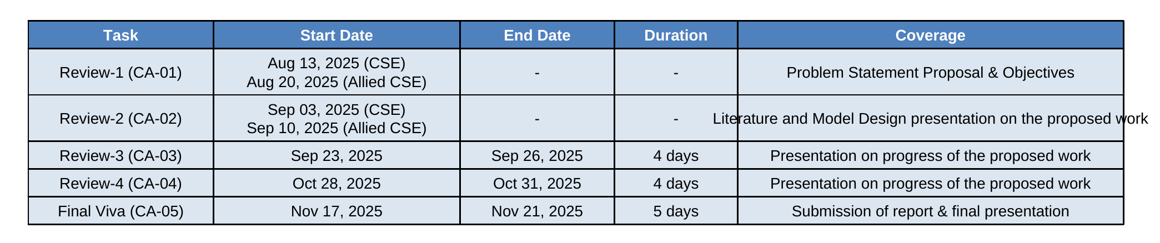
Timeline of the Project

Slide 11
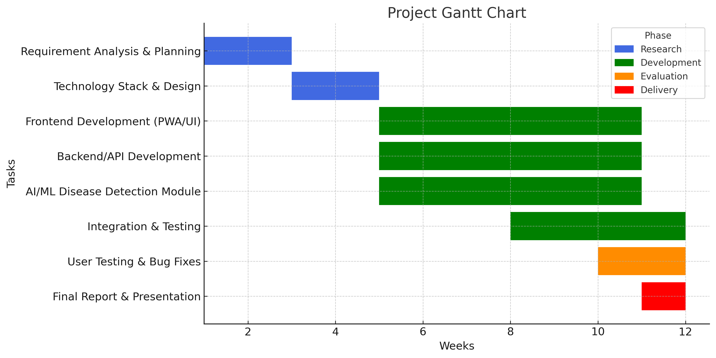
Timeline of the Project in Gantt Chart

Slide 12
References
[1]. J. Kamilaris and F. X. Prenafeta-Boldú, "Deep learning in agriculture: A survey," Computers and Electronics in Agriculture, vol. 147, pp. 70–90, Apr. 2018.
[2]. S. Sladojevic, M. Arsenovic, A. Anderla, D. Culibrk, and D. Stefanovic, "Deep neural networks based recognition of plant diseases by leaf image classification," Computational Intelligence and Neuroscience, vol. 2016, Article ID 3289801, 2016.
[3]. D. Singh, V. Jain, and S. K. Jain, "Plant Disease Detection Using Convolutional Neural Network," in Procedia Computer Science, vol. 167, pp. 376–381, 2020.

Slide 13


