Slide 1
Agro-Mentor: AI-powered Platform for Agricultural Management and Real-Time Support
CSE7101- Capstone Project
Review-2
Batch Number: CSG_42
Under the Supervision of,
Guide: Mr.Francis Vijayakumar Annareddy
Reviewer: Mr. Himansu Shekar Rout
School of Computer Science and Engineering
Presidency University
NAME | ROLL_NO
NAVEEN M | 20221CSG0153
KURUBA ARUN KUMAR | 20221LCG0005
AVINASH N | 20221LCG0004
Name of the Program: CSG(Computer Science and Technology)
Name of the HoD: Dr. Anandaraj S.P
Name of the Program Project Coordinator: Dr. Sharmasth Vali
Name of the School Project Coordinators: Dr. Sampath A K , Dr. Geetha Arjunan

Slide 2
Abstruct
Agro-Mentor is an AI-powered, bilingual platform that enables Indian farmers to instantly diagnose crop diseases using advanced image analysis, receive expert recommendations, and access real-time market information through a single, easy-to-use mobile app.
The platform integrates artificial intelligence for automatic disease detection, while also providing local language (Kannada/English) support to ensure accessibility and relevance for rural users.
By combining AI-driven insights, seamless expert advice, and live marketplace updates, Agro-Mentor aims to boost farm productivity, increase profitability, and drive sustainable growth in rural agriculture.

Slide 3
Literature Survey
Kamilaris & Prenafeta-Boldú (2018): Deep learning enables smart diagnostics, yield prediction, and precision management in agriculture.
Sladojevic et al. (2016): CNN models achieve high accuracy in automated plant leaf disease detection from images.
Singh, Jain & Jain (2020): Convolutional neural networks provide rapid identification of crop diseases from digital pictures.
Ferentinos (2018): Neural networks successfully diagnose multiple crop diseases in varied field environments.
Ramcharan et al. (2019): Smartphone-based AI systems accurately detect cassava diseases for smallholders.
Meshram et al. (2021): Surveys current ML technologies improving pre, during, and post-harvest processes in agriculture.
Zheng et al. (2019): Staged CNNs provide robust, real-world rice disease detection from field-captured images.
Linares & Parra (2025): IoT and AI fusion supports advanced crop and grassland management with decision support in smart farming.
Mzoughi & Yahiaoui (2023): Ensemble deep learning and multispectral imagery help detect plant diseases earlier and more reliably.
Nature Communications (2023): Three-stage deep learning boosts field-accuracy for crop disease recognition in real farm settings.

Slide 4
OBJECTIVE
Mobile-First Design: Develop an intuitive, user-friendly mobile application to maximize accessibility and ease of use for farmers.
Localized Customization: Adapt the platform to address the specific agricultural challenges and needs of select regions or farming communities—starting with Karnataka.
Expert Connectivity: Enable farmers to interact directly with local agronomy professionals and experts for personalized support and real-time advice.
Multi-Language Support: Provide the app interface in multiple regional languages, such as Kannada and English, to cater to a diverse user base.

Slide 5
OBJECTIVE (cont..)
Real time AI Assistant support: Integrate an intelligent AI assistant to deliver instant, personalized responses to farming questions, expert advice, and agricultural recommendations at any time.
Integrated Disease Detection: Use AI-powered image analysis to detect crop diseases and deliver accurate recommendations, enhancing farmer decision-making.
Market and Resource Linkages: Offer features for contract farming, vertical farming, and digital marketplace connections, helping farmers access new opportunities and improve profitability.
Live News and Market Prices: Provide farmers with up-to-date agricultural news and live market price information to empower better decision-making and keep them informed about the latest trends.

Slide 6
Existing Methods and Drawbacks
Multiple Apps, Fragmented Functions: Farmers must use separate apps for disease detection, market information, and expert advice, leading to inconvenience and inefficiency.
Limited Language Support: Most platforms are English-only, making them inaccessible for many local language farmers in regions like Karnataka.
High Data and Internet Dependence: Apps require stable connectivity and consume significant data, which is often not feasible in rural areas.
Cost Barriers: Some features or updates may require payment, limiting usage for low-income farmers.
No Unified Ecosystem: There is no single app that combines AI disease diagnosis, real-time expert chat, marketplace, and regional customization in one solution.

Slide 7
Proposed Methodology
Workflow Steps:
User Access – Farmers access the Agro mentor PWA via mobile or desktop, with support for English and Kannada.
Image Input – Farmers upload or capture crop images through the app.
Preprocessing & Analysis – Images undergo quality checks, resizing, and enhancement before AI analysis.
AI Disease Detection – Image processing and CNN models classify crop diseases, provide severity levels, and generate confidence scores.
Expert & Community Support – Recommendations, expert consultation, and peer knowledge sharing are delivered through the platform.
Marketplace & Updates – Farmers access direct marketplaces, contract farming options, and real-time news/market prices.
Feasibility—Technology, Cost, Resources:
Technology: Uses open-source PWA (React, TypeScript), scalable Python-based CNNs, and cloud/backend integration—enabling easy upgrades and modular deployment.
Cost: PWA avoids app store fees, supports affordable rollout, and uses widely available smartphones/IT infrastructure.
Resources: Leverages digital literacy programs, existing mobile penetration, and a modular stack so developers can localize or extend the system for different crops or regions.

Slide 8
Modules
User Portal: Bilingual web app for easy farmer access and navigation.
AI Disease Detection: Crop images analyzed instantly by advanced AI models.
AI + Expert Chat: Instant AI responses and live expert support through an interactive chat.
Marketplace: Access to contract farming, trading, and real-time news/prices.
Community: Peer-to-peer farmer support and knowledge sharing platform.

Slide 9
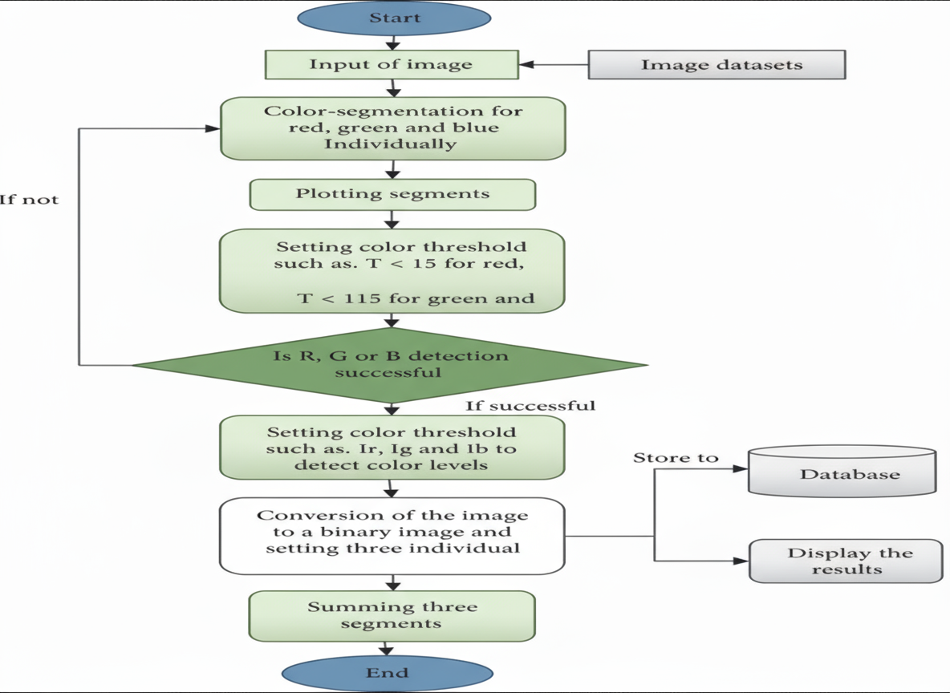
Architecture Diagram

Slide 10
Software requirements
Web Application: ReactJS with TailwindCSS: Framework for building the frontend interface, ensuring a modern, responsive, and user-friendly experience.
Backend Server: Node.js/Python: Handles server-side logic, API requests, and application functionality.
Database: MongoDB / Cloud Storage: NoSQL database or cloud platform for securely storing user data and application records.
AI Model: CNN Models & Image Processing: Utilized for computer vision tasks and intelligent decision-making.
Cloud Infrastructure:
Netlify: A cloud-based platform for deploying and hosting web applications.
GitHub Actions: For CI/CD

Slide 11
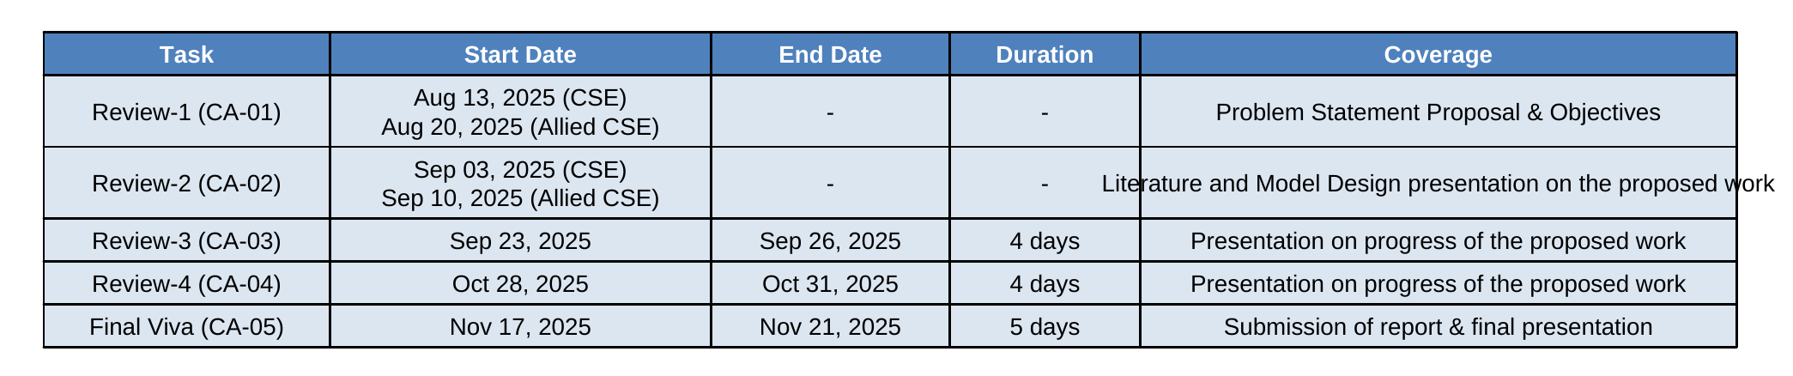
Timeline of the Project

Slide 12
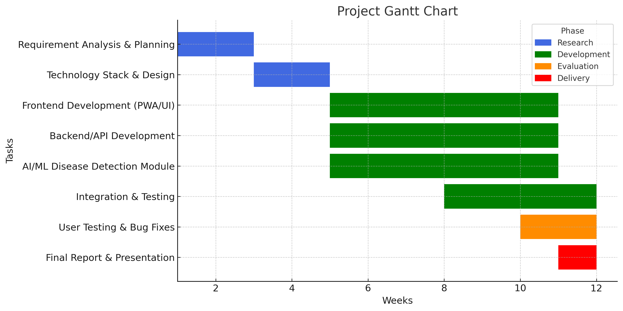
Timeline of the Project in Gantt Chart

Slide 13
References
[1]. J. Kamilaris and F. X. Prenafeta-Boldú, "Deep learning in agriculture: A survey," Computers and Electronics in Agriculture, vol. 147, pp. 70–90, Apr. 2018.
[2]. S. Sladojevic, M. Arsenovic, A. Anderla, D. Culibrk, and D. Stefanovic, "Deep neural networks based recognition of plant diseases by leaf image classification," Computational Intelligence and Neuroscience, vol. 2016, Article ID 3289801, 2016.
[3]. D. Singh, V. Jain, and S. K. Jain, "Plant Disease Detection Using Convolutional Neural Network," in Procedia Computer Science, vol. 167, pp. 376–381, 2020.

Slide 14

Github Link
Access the project’s source code and documentation
via the GitHub repository:
https://github.com/ArunkumarK572/Agro-Mentor

Slide 15


