Slide 1
Employee Data Analysis using Excel
STUDENT NAME REGISTER NO DEPARTMENT COLLEGE
:K.ARUN KUMAR
:122202746,asunm1437122202746
:B.com (CORPORATE SCRETARYSHIP)
:MAR GREGORIOS COLLEGE OF ARTS AND SCIENCE

Slide 2
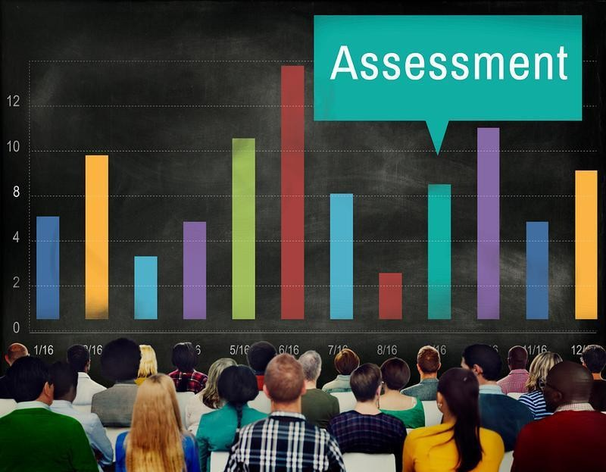
PROJECT TITLE
Employee performance Analysis using Excel

Slide 3


AGENDA
1.Problem Statement 2.Project Overview 3.End Users
4.Our Solution and Proposition 5.Dataset Description 6.Modelling Approach 7.Results and Discussion 8.Conclusion
3/21/2024 Annual Review

Slide 4

PROBLEM STATEMENT
Our current system suffers from significant performance issues, including slow response times and frequent downtime. These problems lead to decreased user satisfaction, lower productivity, and increased operational costs. The lack of detailed performance analysis makes it difficult to pinpoint the root causes of these inefficiencies and implement effective solutions.
Therefore, a comprehensive performance analysis is needed to identify and address the specific factors contributing to these performance issues, ultimately improving system reliability and user experience.

Slide 5

PROJECT OVERVIEW
The project aims to enhance system performance by conducting a thorough performance analysis. This analysis will focus on identifying bottlenecks, inefficiencies, and failure points within the system. By leveraging advanced monitoring tools and performance metrics, we will pinpoint the root causes of current issues and implement targeted optimizations. The goal is to improve response times, increase system reliability, and boost overall user satisfaction. This initiative will ensure that the system operates efficiently, scales effectively, and meets user expectations.

Slide 6



WHO ARE THE END USERS?
System Administrators:
They need performance analysis to monitor system health, troubleshoot issues, and ensure smooth operations.
Developers:
They require insights from performance analysis to identify and fix code inefficiencies and optimize application performance.
Business Analysts:
They use performance data to assess system impact on business processes and make informed decisions for improvements.
EMPLOYEE
EMPLOYER

Slide 7

OUR SOLUTION AND ITS VALUE PROPOSITION
Enhanced Efficiency:
Provides actionable insights to streamline operations and improve system responsiveness.
Increased Reliability:
Identifies and mitigates potential issues before they impact users, ensuring consistent performance.
Cost Savings:
Optimizes resource allocation, reducing operational costs and improving ROI.
Improved User Experience:
Delivers faster, more reliable performance,
leading to higher user satisfaction and engagement.

Slide 8
Dataset Description
EMPLOYEE = KAGGLE 26- FEATURES
9- FEATURESEMPLOYEE – ID – NUMERICAL VALUES.
NAME – TEXT
EMPLOYEE TYPE PERFORMANCE LEVEL GENDER – MALE , FEMALE
EMPLOYEE RATING – NUMERICAL VALUES

Slide 9

THE "WOW" IN OUR SOLUTION
PERFORMANCE LEVEL=IF(Z8>=5, "VERY HIGH", IF(Z8>=4, "HIGH", IF(Z8>=3, "MEDIUM", "LOW")))
3/21/2024 Annual Review

Slide 10
MODELLING
DATACOLLECTION
Downloaded theemployeedata performance fromEDUNET DASHBOARD
DATACLEANING
Identifiedthemissing values.
Filteredthemissing values.
PERFORM ANCE LEVEL SUMMARY PIVOTTABLE
PIE CHART
VISUALIZATION
GRAPH

Slide 11
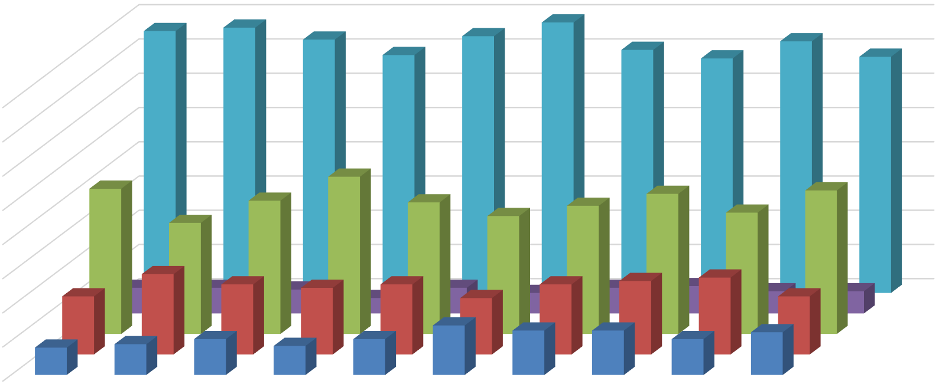
RESULTS
EMPLOYEE PERFORMANCE
160
140
120
100
80
60
HIGH
LOW MEDIUM
(blank)
VERY HIGH MEDIUM
LOW HIGH
VERY HIGH
(blank)
40
20
0
BPC
CCDR
EW
MSC
NEL
PL
PYZ
SVG
TNS
WBL

Slide 12
conclusion
The performance analysis reveals critical insights into the system’s efficiency and reliability. By examining key metrics such as response times, throughput, and resource utilization, we identified several bottlenecks and areas for improvement. Our findings indicate that optimizing resource allocation and addressing specific performance issues will significantly enhance system responsiveness and stability. Implementing these improvements will lead to a more reliable system, reduced operational costs, and a better overall user experience.

