Slide 1
Mutual Fund Analytics Platform
Capstone Project Report
Submitted By
Arunmozhi M
Data Analyst Intern
Bluestock™
July 2026

Slide 2
Project Overview
--The Mutual Fund Analytics Platform is a comprehensive data analytics project developed to analyze Indian mutual fund datasets using Python, SQLite, and Power BI.
--The project automates the complete ETL process, performs extensive exploratory data analysis, calculates key financial performance metrics, and provides interactive dashboards for investment analysis.
--The primary objective is to help investors and analysts understand mutual fund performance, evaluate investment risks, and make informed financial decisions through data-driven insights.

Slide 3
Project Objectives
• Build an automated ETL pipeline for multiple mutual fund datasets.
• Clean, transform, and integrate the datasets into SQLite.
• Perform Exploratory Data Analysis (EDA).
• Calculate financial performance metrics such as CAGR, Sharpe Ratio, Sortino Ratio, Alpha, Beta, Maximum Drawdown, and Value at Risk (VaR).
• Develop an interactive Power BI dashboard.
• Perform advanced analytics to support investment decision-making.

Slide 4
Technology Stack
Programming Language
• Python
Libraries
• Pandas
• NumPy
• Matplotlib
• Plotly
• SQLite3
Database
• SQLite
Visualization
• Power BI
Development Tools
• VS Code
• Jupyter Notebook
• Git & GitHub

Slide 5
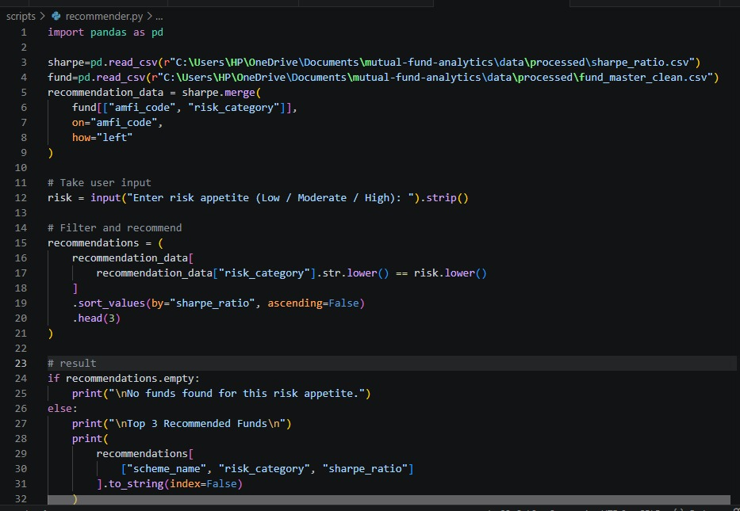
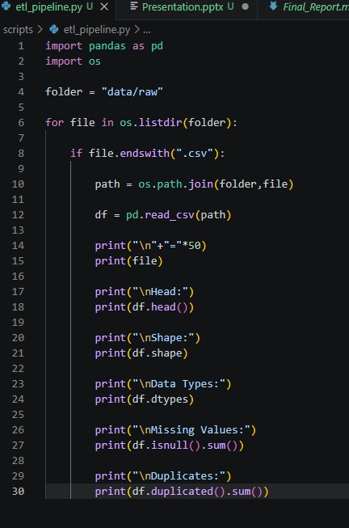
ETL Pipeline
The ETL pipeline automates the complete data processing workflow.
Extract
• Read multiple mutual fund datasets.
Transform
• Remove duplicate records.
• Handle missing values.
• Standardize column names.
• Convert date formats.
• Clean inconsistent data.
Load
• Store processed datasets into SQLite.
• Export cleaned CSV files for analysis.

Slide 6
Dataset Overview
├── reports/ │ ├── Final_Report.pdf │ └── Presentation.pptx
Content
The Mutual Fund Analytics project uses 14 cleaned datasets containing information about mutual fund schemes, NAV history, fund performance, investor transactions, SIP trends, AUM, benchmark indices, and risk metrics. The data was transformed through an ETL pipeline to ensure consistency, accuracy, and reliability before analysis.
Key Datasets
Fund Master
NAV History
Scheme Performance
Investor Transactions
Fund Scorecard
Benchmark Indices
SIP Monthly Data
AUM by Fund House
Footer Clean and structured data provides the foundation for accurate analytics and reporting.

Slide 7
Data Cleaning & Feature Engineering
Content
The datasets were cleaned by removing duplicate records, handling missing values, correcting inconsistent formats, and standardizing column names. Feature engineering was performed to generate important financial performance metrics that improve investment analysis and decision-making.
Data Cleaning
Removed duplicate records
Handled missing values
Standardized date formats
Corrected inconsistent column names
Removed invalid records
Feature Engineering
CAGR
Sharpe Ratio
Sortino Ratio
Alpha
Beta
Maximum Drawdown
Tracking Error
Footer Feature engineering enhances analytical insights and investment performance evaluation

Slide 8
SQL Analysis & Key Performance Indicators
Content
SQL queries were used to analyze the cleaned datasets and calculate key business metrics. These analyses provided insights into mutual fund performance, fund house distribution, investor activity, and overall market trends.
SQL Analysis
Total Mutual Fund Schemes
Fund House Analysis
Category-wise Performance
Monthly SIP Trends
Investor Transaction Summary
Assets Under Management (AUM)
Key Performance Indicators
Total Schemes
Total Fund Houses
Average CAGR
Average Sharpe Ratio
Total AUM
Footer SQL-based analysis transforms raw data into meaningful business insights.

Slide 9
Power BI Dashboard
Content
Interactive dashboards were developed in Power BI to visualize mutual fund performance and provide meaningful insights through dynamic charts, KPI cards, filters, and drill-through functionality.
Dashboard Features
Executive Summary
Scheme Performance Analysis
Risk & Return Analysis
Assets Under Management (AUM)
SIP Trend Analysis
Benchmark Comparison
Interactive Filters
Drill-through Navigation
Footer Power BI dashboards enable interactive, data-driven investment analysis and reporting.

Slide 10
Key Insights
Content
The analysis revealed valuable insights into mutual fund performance and investment trends. Risk-adjusted metrics such as the Sharpe Ratio, Sortino Ratio, Alpha, and Beta helped identify well-performing schemes. Interactive dashboards enabled users to compare fund performance, analyze Assets Under Management (AUM), monitor SIP trends, and evaluate benchmark performance for informed investment decisions.
Key Highlights
Identified top-performing mutual fund schemes
Compared risk and return across categories
Analyzed AUM and SIP growth trends
Evaluated benchmark performance
Enabled interactive filtering and drill-through analysis
Footer Data-driven insights support smarter investment decisions.

Slide 11
Conclusion
Content
The Mutual Fund Analytics project successfully demonstrates an end-to-end data analytics workflow using ETL, SQL, SQLite, Python, and Power BI. Cleaned and transformed datasets were analyzed to generate meaningful financial insights, while interactive dashboards made complex information easy to understand. This project showcases practical skills in data engineering, business intelligence, and data visualization.
Project Outcomes
Automated ETL pipeline
Structured SQLite database
SQL-based analytical queries
Interactive Power BI dashboards
Actionable investment insights
Footer Transforming financial data into actionable business intelligence.

Slide 12
Thank You
Content
Thank You!
Mutual Fund Analytics Project
Prepared by: Arunmozhi M
Technologies Used
Python
SQL
SQLite
Power BI
Git & GitHub
Thank You for Your Time and Attention

