Slide 1


GOVERNMENT ARTS AND SCIENCE COLLEGE, NEMMELI
FINAL YEAR PROJECT PRESENTATION
PROJECT GUIDE
Mrs. K. THANGAMARI MCA., M.Phil.,
TEAM MEMBERS
ARUN N | GOKULAKANNAN R | HARIHARAN G

Slide 2
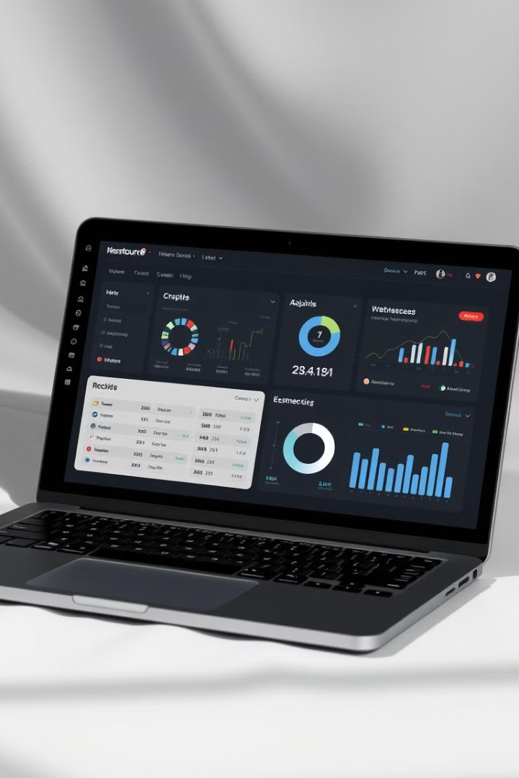
EXPENSE MANAGEMENT SYSTEM
your ultimate solution for effortless expense tracking.
With just a few clicks, take control of your finances like never before. Whether you're planning monthly expenses or keeping an eye on daily spending, our system ensures a smooth and organized experience.

Slide 3

Abstract: Streamlining Expense Management
The Expense Management System streamlines expense tracking using PHP and MySQL.
Key Features
Secure authentication and personalized dashboards.
Comprehensive expense tracking and dynamic reporting.
Benefits
Better financial control and informed decisions.
Identification of cost-cutting areas.

Slide 4
System Overview & Key Features
A PHP-based web application designed for efficient expense tracking.
Key Features
Benefits
Expense tracking
Improved financial planning.
Budgeting and planning
Better savings and financial security.
Detailed reports (tabular and graphical)
Secure data storage

Slide 5

System Objectives & Specifications
The system aims to provide a simple, powerful expense tracking tool.
Objectives
Simplified Financial Management
Convenience and Accessibility
Expense Categorization and Budgeting
Benefits
Accuracy and Data Security
Financial Planning
Continuous Improvement

Slide 6




Requirements & System Design
Functional and non-functional requirements for the Expense Management System.
User Registration
Secure login.
Expense Entry
Add, edit, delete.
Budget Management
Set monthly budget.

Slide 7



Security Considerations
Data security is a crucial aspect of the expense management system.
Data Encryption
Ensuring secure communication and storage.
Secure Authentication
Preventing unauthorized access.

Slide 8

PROJECT STACK
The expense management system consists of a frontend, backend, and database.
Frontend Tools - HTML / CSS / JAVASCRIPT
Backend Tools - PHP
Database - MySQL

Slide 9
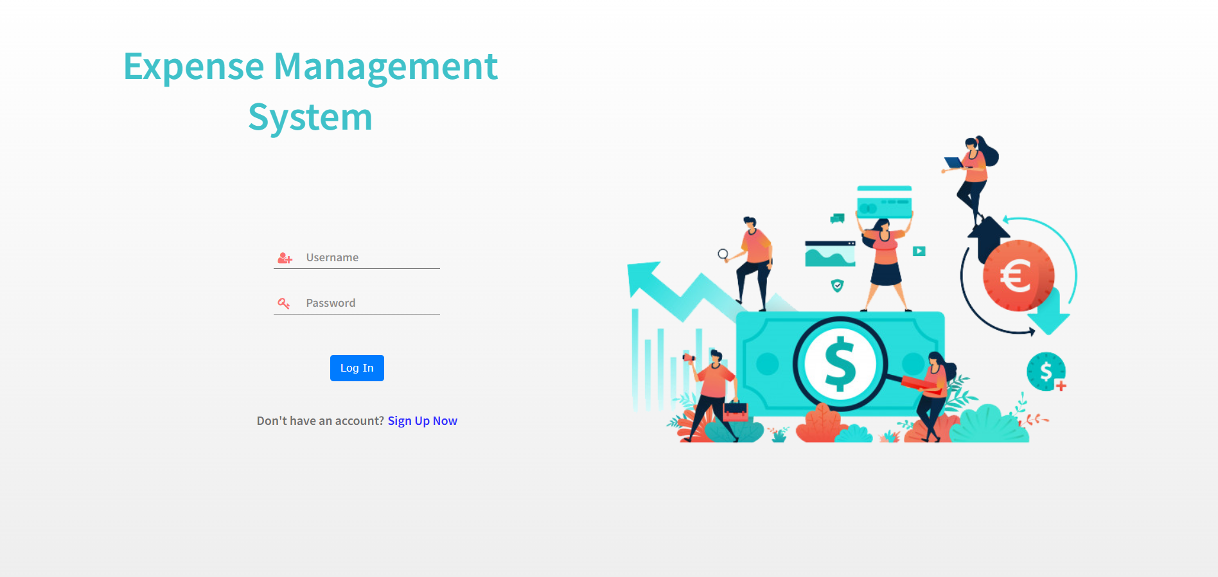
USER LOGIN

Slide 10
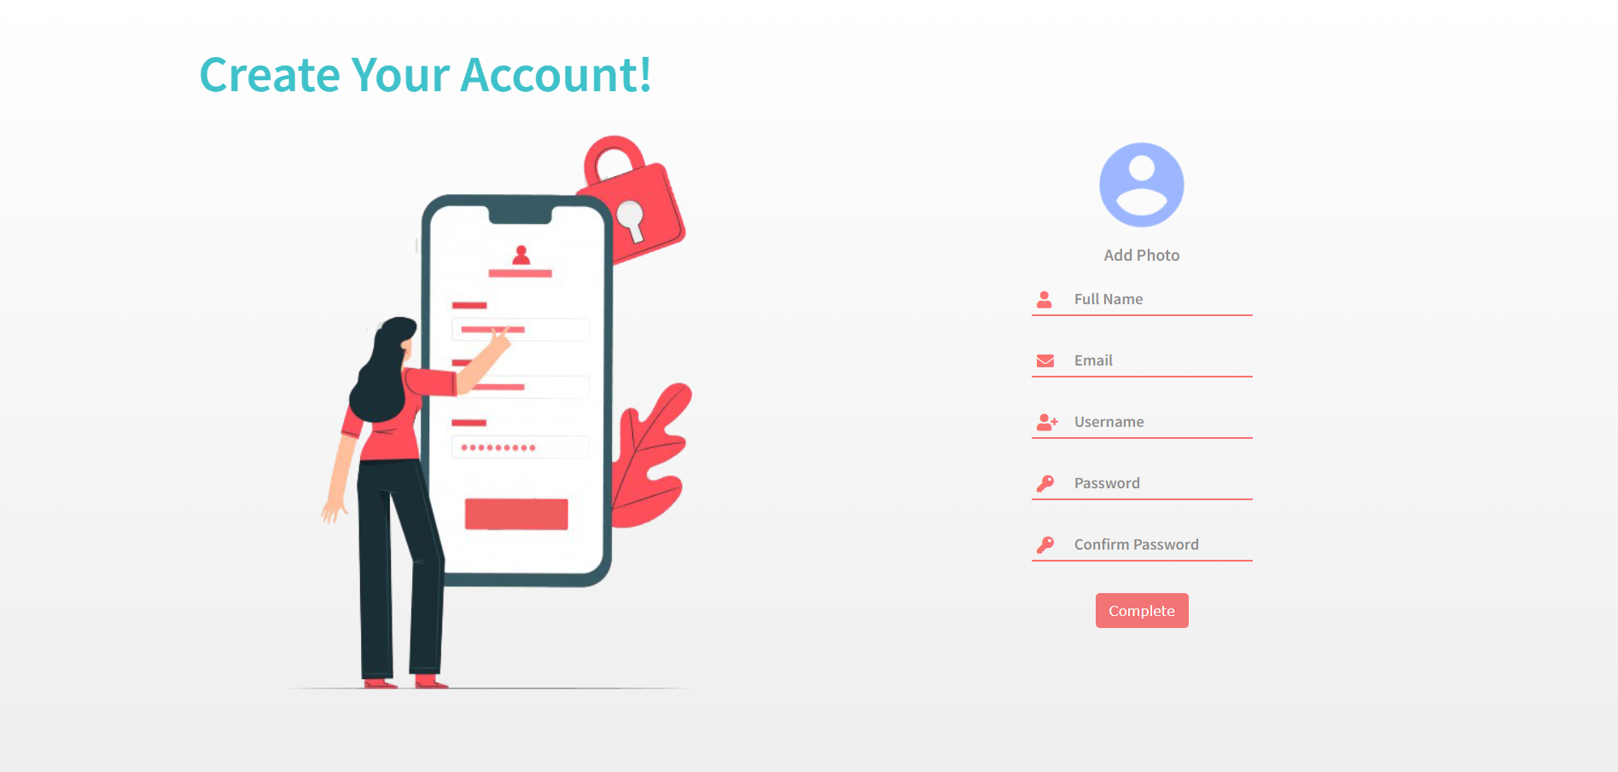
USER REGISTRATION

Slide 11
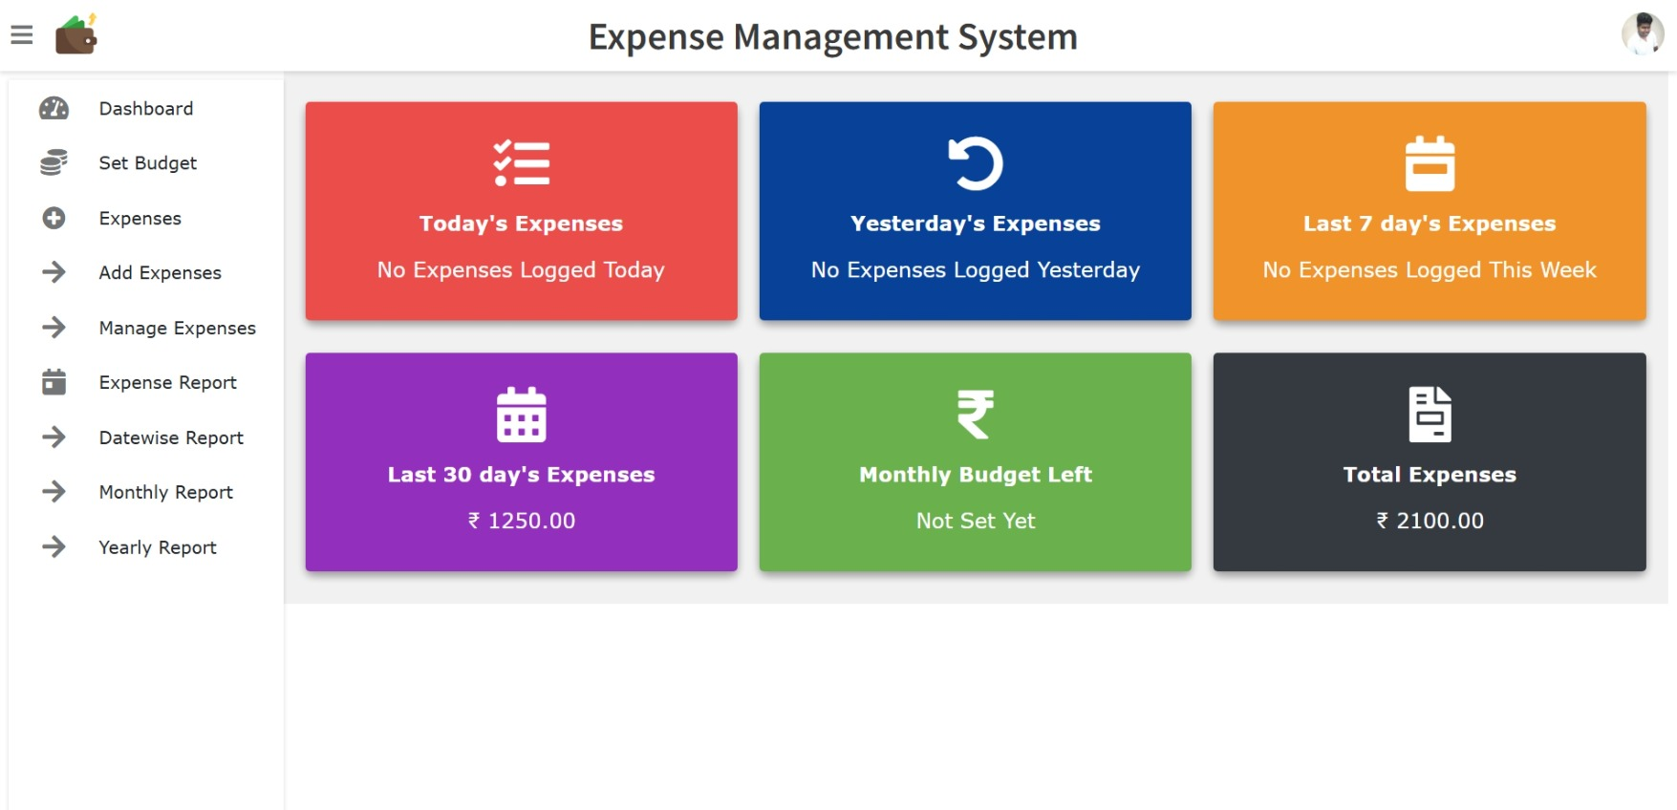
DASHBOARD

Slide 12
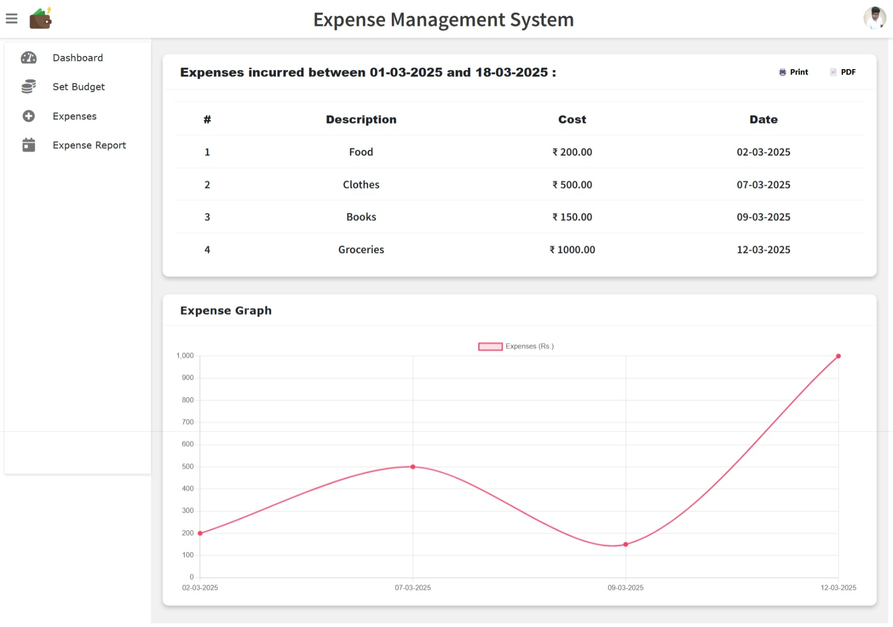
EXPENSE REPORT

Slide 13




LIVE PROJECT
Expense Management
Performance
Infrastructure
Security

Slide 14

Conclusion
The Expense Management System is a valuable tool for financial awareness.
It provides a reliable, secure, and efficient platform for tracking and managing expenses.
Thank you.

