Slide 1
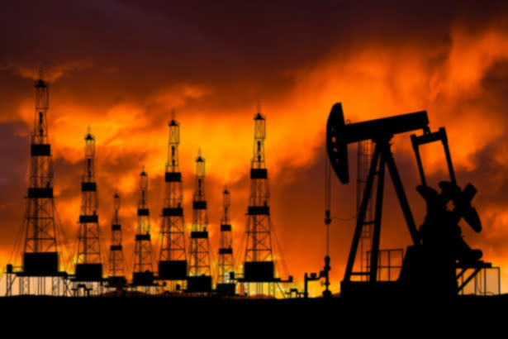
Crude Oil Price Forecasting

Slide 2

Objective
Develop a model that would predict the Crude Oil Price for the next year.

Slide 3

Data Cleaning steps
Renamed the Column Name
Handled the missing values using KNN Imputer
Converted negative values to positive
Found the outliers

Slide 4

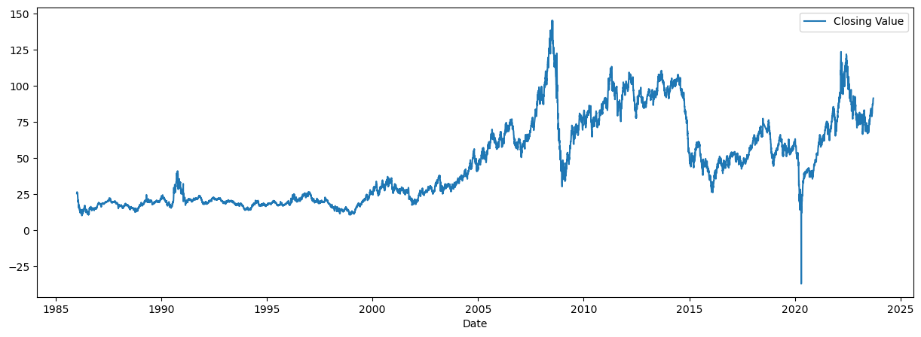
Insights
The price of crude reached $US145 in July 2008, which was the highest level ever recorded.
One of the main reasons why oil price went up in 2008 was the increase in demand from China and India.
In 2020, the price of crude oil crashed because of a lack of buyers, as countries went into lockdown due to COVID pandemic.
There are no seasonality in the data.

Slide 5

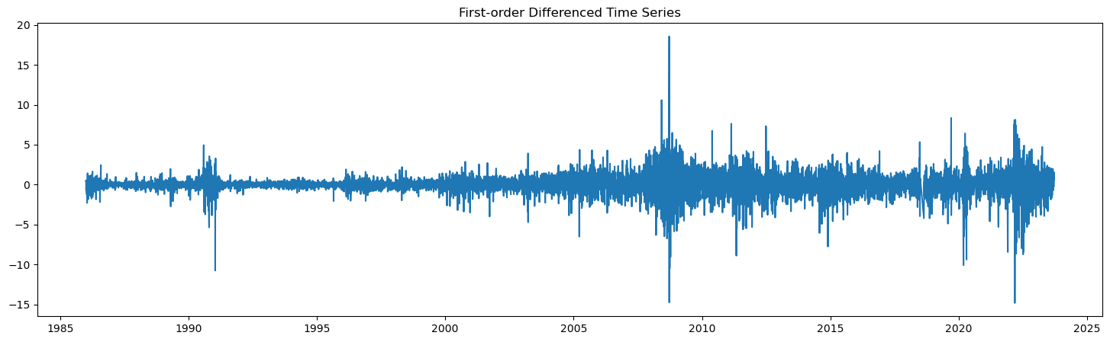
Data Preparation
Checked Stationarity using Dickey Fuller Test.
There’s no Stationarity in the data.
Using 1st Order Differencing, data was converted to Stationary Data.

Slide 6

Model Building
Tried building the model with different algorithms like –
ARIMA
KNN
Holt-Winters Method
Decision Tree
XG Boost

Slide 7

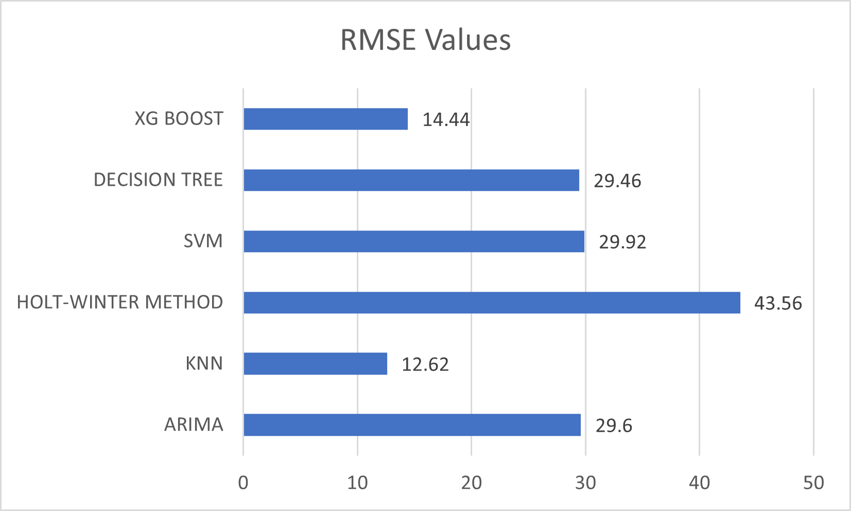
Model Evaluation

Slide 8
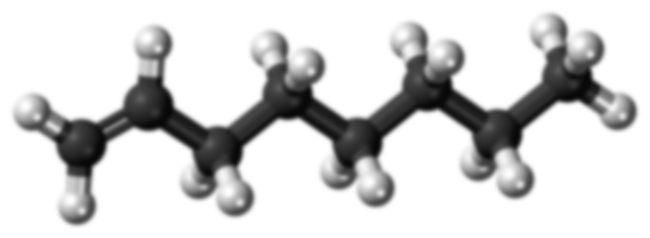
KNN Model
Train and Split Data
K Neighbors
Prepare Feature matrix [X] & Target Variable [y]
Forecast the Results
Fit The Model

Slide 9

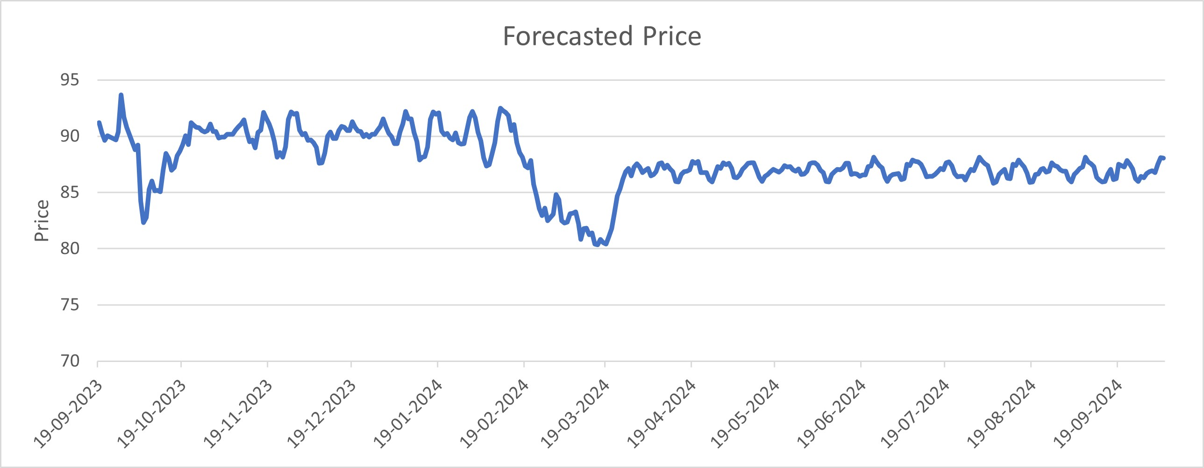
Forecasted Price

Slide 10
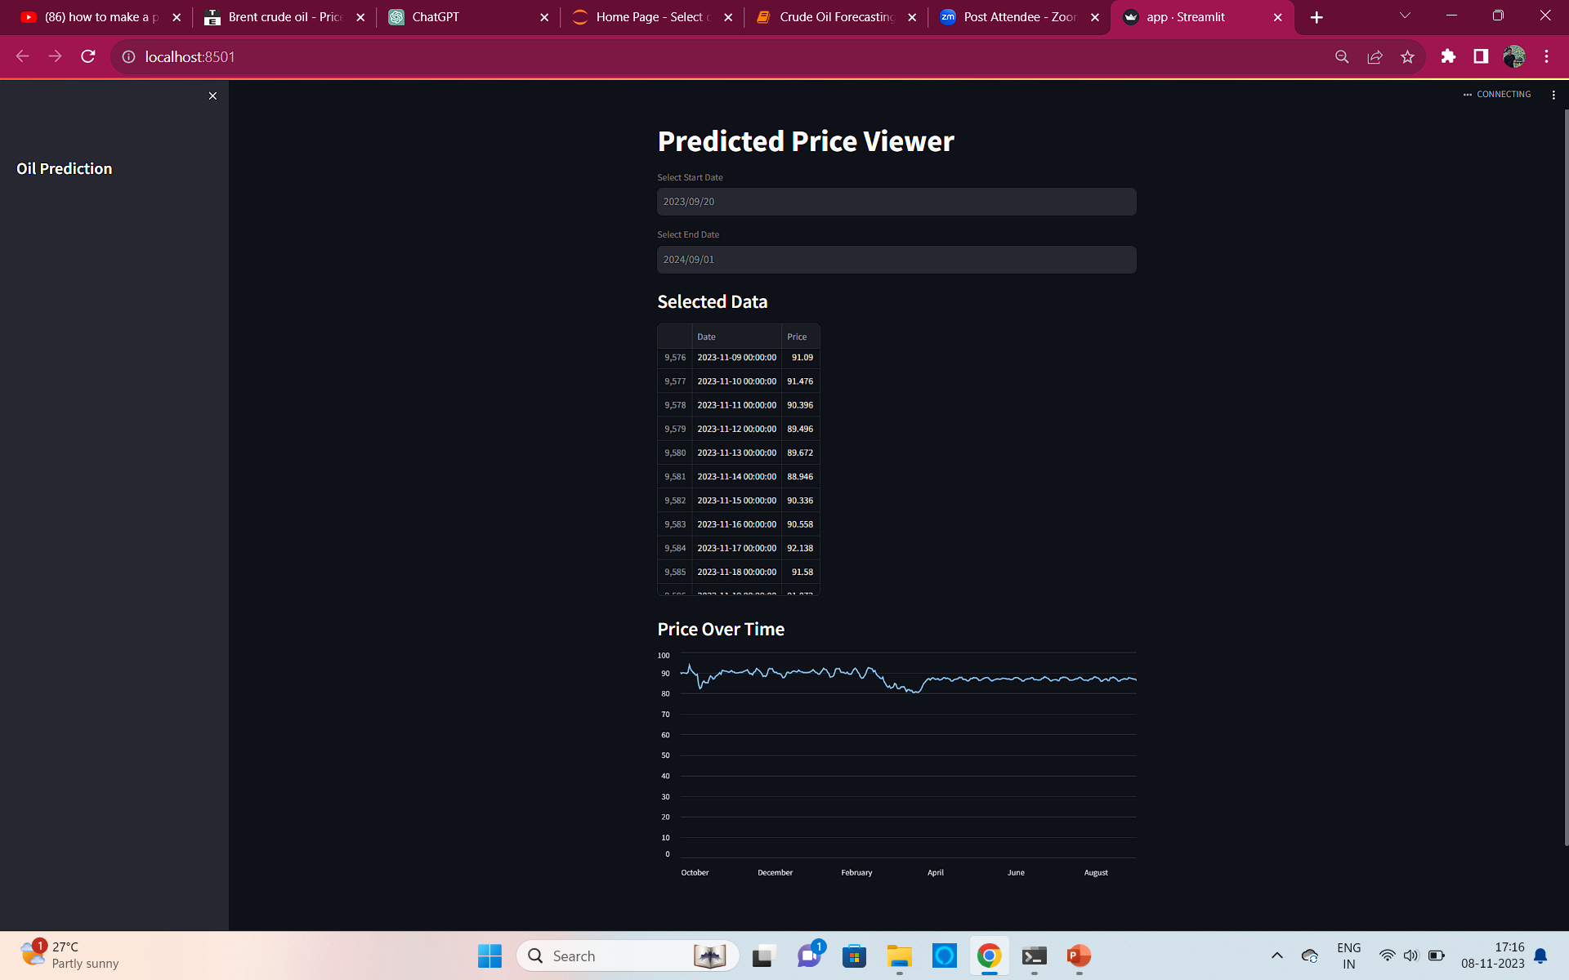
Deployment using STREAMLIT

Slide 11


OVERVIEW
Data Collection
Data Preprocessing
Stationery Check
Streamlit
Developer
Train data
KNN
Model
Evaluating Model
Test Data
Validating Model
User

Slide 12


