Slide 1
Data Structures and Algorithms (CS210A) Semester I – 2014-15
Lecture 12:
Majority element : an efficient and practical algorithm
word RAM model of computation: further refinements.

Slide 2

Majority element
Definition: Given a multiset $S$ of $n$ elements,
$x∈ S$ is said to be majority element if it appears more than $n/2$ times in $S$.
$S$ = {$a,b,d,z,b,w,b,b,z,b,b,b,b,c$}

Slide 3

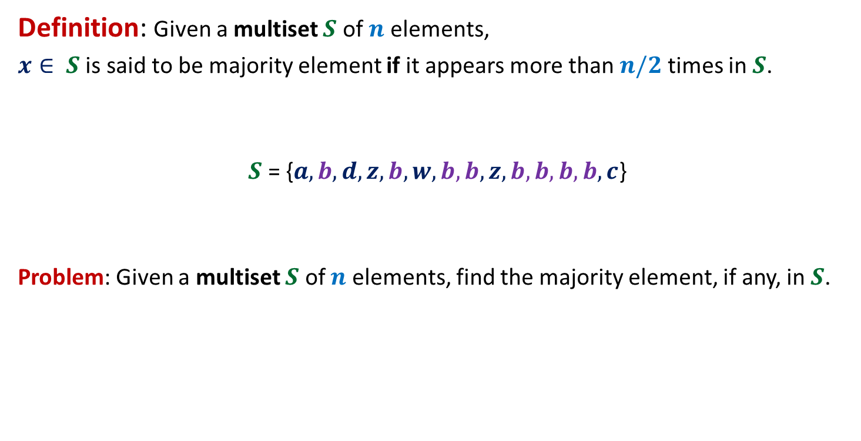
Majority element
Definition: Given a multiset $S$ of $n$ elements,
$x∈ S$ is said to be majority element if it appears more than $n/2$ times in $S$.
$S$ = {$a,b,d,z,b,w,b,b,z,b,b,b,b,c$}
Problem: Given a multiset $S$ of $n$ elements, find the majority element, if any, in $S$.
$$8$$

Slide 4

Majority element
Trivial algorithms:
Algorithm 1:
Count occurrence of each element
If there is any element with count > , report it.
Running time: ?
O($n^{2}$) time

Slide 5

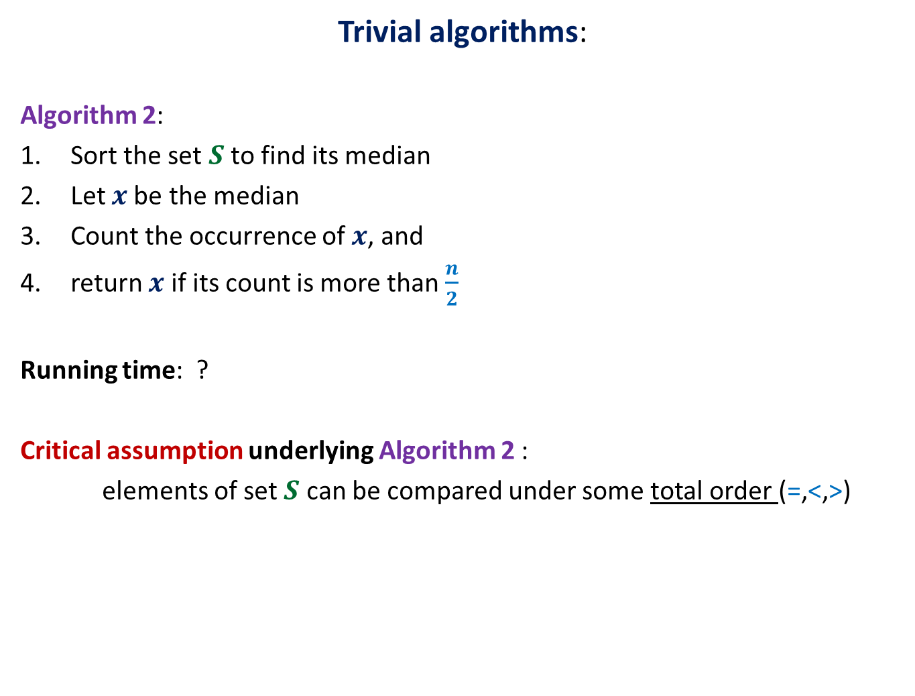
Majority element
Trivial algorithms:
Algorithm 2:
Sort the set $S$ to find its median
Let $x$be the median
Count the occurrence of $x$, and
return $x$ if its count is more than $\frac{n}{2}$
Running time: ?
Critical assumption underlying Algorithm 2 :
elements of set $S$ can be compared under some total order (=,<,>)
This assumption is
not justified in many real life applications.
O($n log n$) time

Slide 6
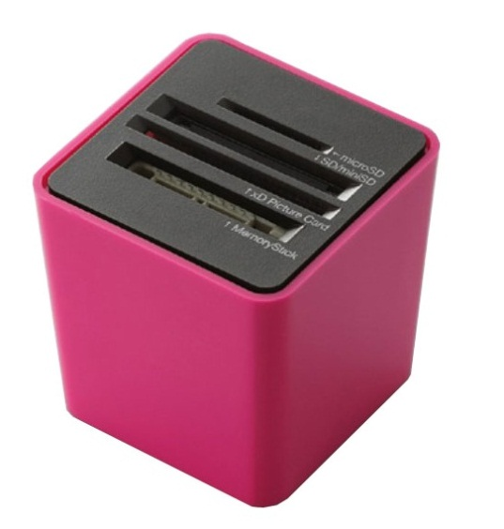

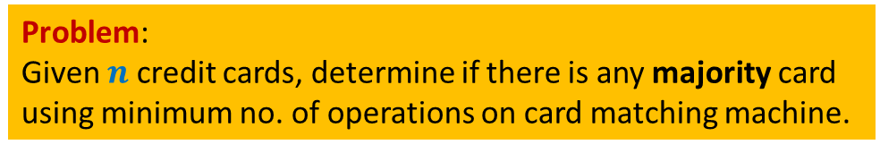
A real life application
Slots for inserting any two cards
Card-matching machine
This machine takes two cards and determines whether they are identical or not.
Problem:
Given $n$ credit cards, determine if there is any majority card
using minimum no. of operations on card matching machine.

Slide 7
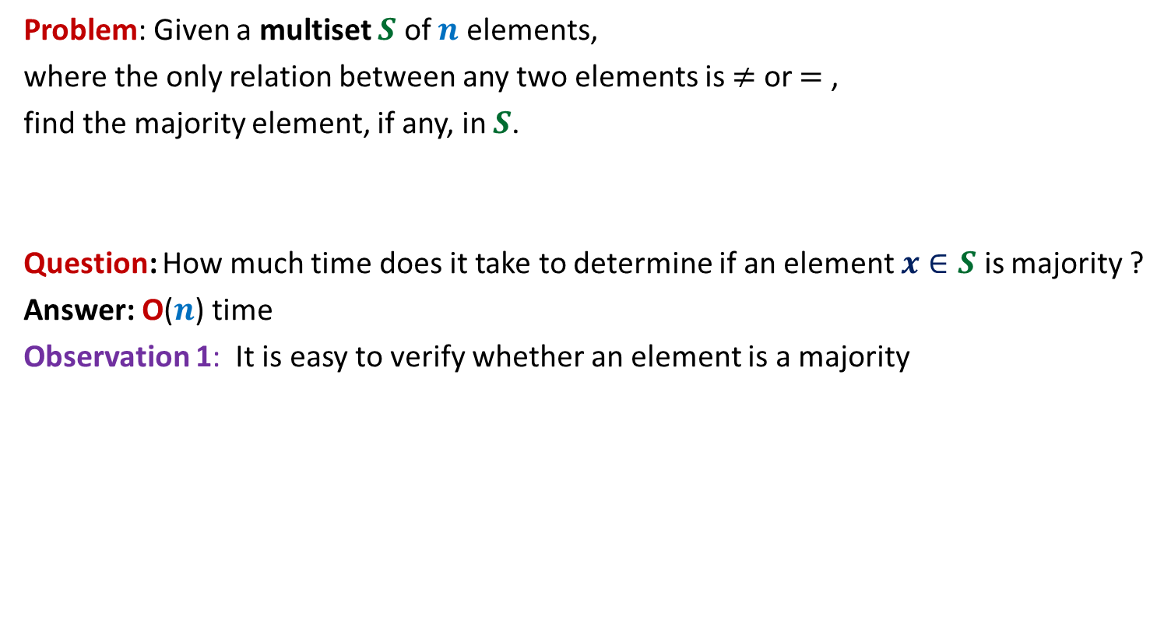
Some observations
Problem: Given a multiset $S$ of $n$ elements,
where the only relation between any two elements is $≠$ or $=$ ,
find the majority element, if any, in $S$.
Question: How much time does it take to determine if an element $x∈S$ is majority ?
Answer: O($n$) time
Observation 1: It is easy to verify whether an element is a majority

Slide 8


Some observations
Observation 2: whenever we cancel a pair of distinct elements from the array,
the majority element of the array remains preserved.
α
x
α
y
< $\frac{n}{2}$
> $\frac{n}{2}$
α
w
v
α
α
Majority
element
other
elements

Slide 9
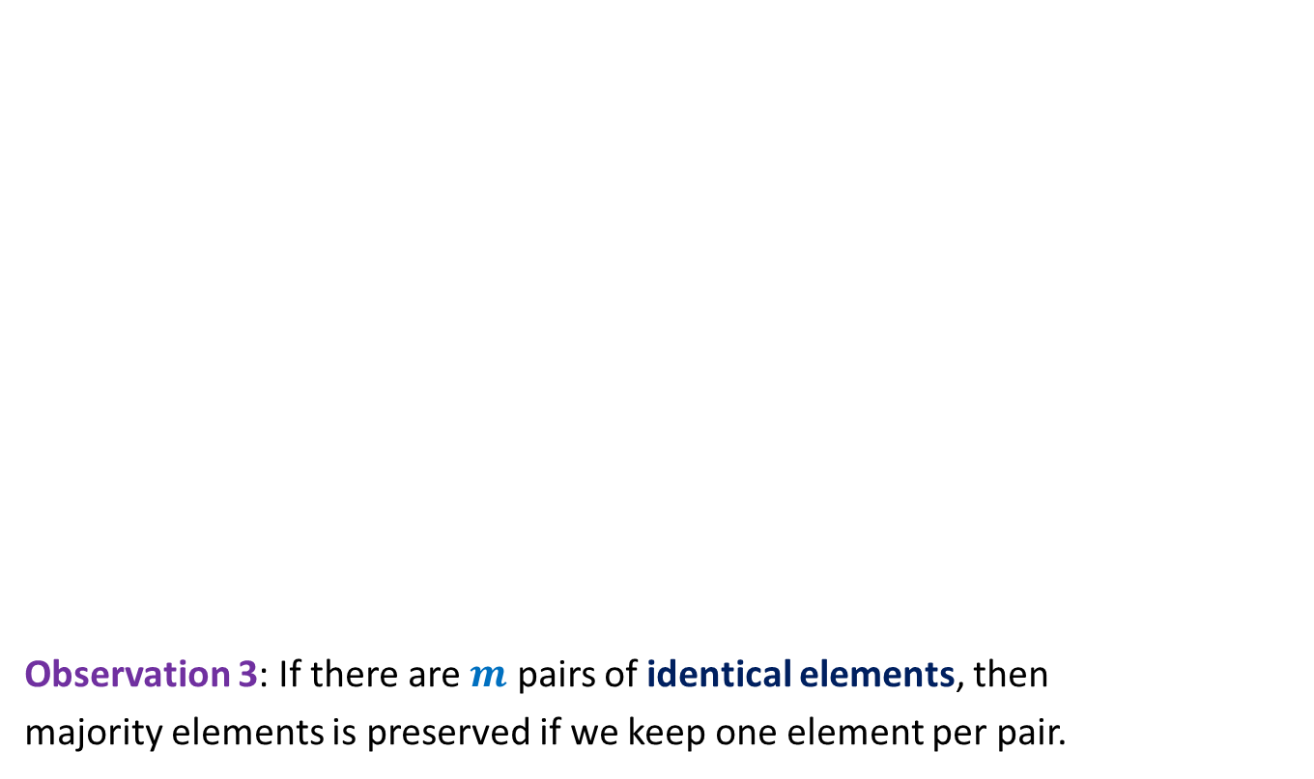


Some observations
Observation 3: If there are $m$ pairs of identical elements, then
majority elements is preserved if we keep one element per pair.
$a b c c c z c a b b c c c c d c$
$c c b b c c c c$
The problem size reduced by at least half.
$$c b c c$$

Slide 10

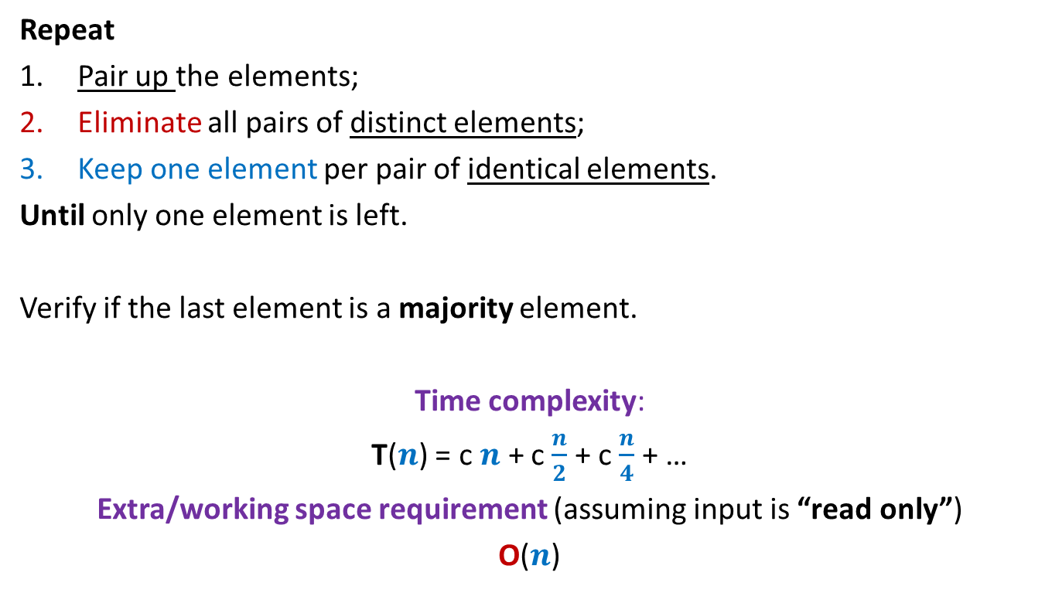
Algorithm for 2-majority element
Repeat
Pair up the elements;
Eliminate all pairs of distinct elements;
Keep one element per pair of identical elements.
Until only one element is left.
Verify if the last element is a majority element.
Time complexity:
T($n$) = c $n$ + c $\frac{n}{2}$ + c $\frac{n}{4}$ + …
Extra/working space requirement (assuming input is “read only”)
O($n$)
Take care if the no. of elements is odd
O($n$) time

Slide 11
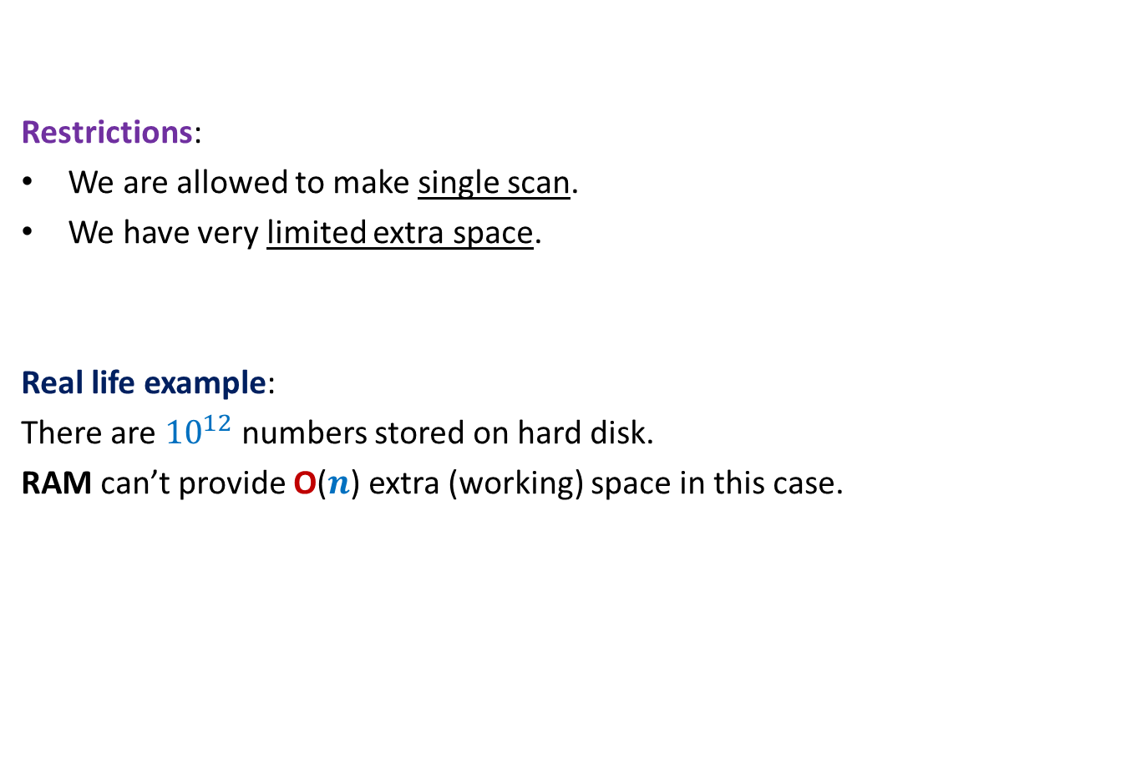
Further restrictions on the problem
Restrictions:
We are allowed to make single scan.
We have very limited extra space.
Real life example:
There are ${10}^{12}$ numbers stored on hard disk.
RAM can’t provide O($n$) extra (working) space in this case.
Our current algorithm doesn’t work
for this real life example.

Slide 12

Designing algorithm for 2-majority element single scan and using O($1$) extra space
Question: Should we design algorithm from scratch to meet these constraints ?
Answer: No! We should try to adapt or current algorithm to meet these constraints.
Question: How crucial is pairing of elements in our current algorithm ?
Think over this question deeply.

Slide 13
Designing algorithm for 2-majority element single scan and using O($1$) extra space
Insights:
We will never need to keep more than one element.
We need not keep multiple copies of an element explicitly.
Ponder over these insights and make an attempt to design the algorithm
before moving ahead ☺
Single scan
$a b c c c z c a b b c c c c d c$
Just cancel suitably whenever encounter two elements
Just keeping its count will suffice

Slide 14
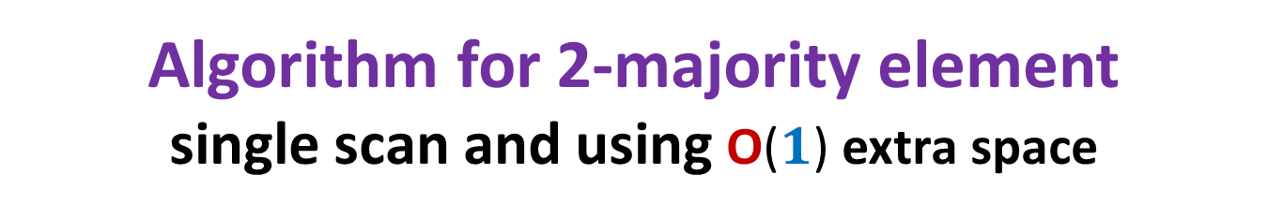
Algorithm for 2-majority element single scan and using O($1$) extra space
Algo-2-majority(A)
{ count← 0;
for(i=0 to n-1)
{ if ( count=0 ){ ? ;
? ;
}
else if(x<> A[i]) ? ;
else ? ;
}
Count the occurrences of x in A, and if it is more than n/2, then
print(x is 2-majority element) else print(there is no majority element in A)
}
x← A[i];
count← 1;
count ← count - 1
count← count + 1

Slide 15

Algorithm for 2-majority element single scan and using O($1$) extra space
Theorem: There is an algorithm that makes just a single scan and uses O($1$) extra space to compute majority element for a given multi-set.

Slide 16
Proving correctness of algorithm for 2-majority element
Home work Exercise to be solved in the next class

Slide 17
Word RAM model of computation
Further refinements

Slide 18
word RAM : a model of computation
Data
Processor
Program
RAM

Slide 19
Execution of a instruction (fetching the operands, arithmetic/logical operation, storing the result back into RAM)
Processor
RAM

Slide 20
word RAM model of computation: Characteristics
Word is the basic storage unit of RAM. Word is a collection of few bytes.
Each input item (number, name) is stored in binary format.
RAM can be viewed as a huge array of words. Any arbitrary location of RAM can be accessed in the same time irrespective of the location.
Data as well as Program reside fully in RAM.
Each arithmetic or logical operation (+,-,*,/,or, xor,…) involving a constant number of words takes a constant number of steps by the CPU.
Each arithmetic or logical operation (+,-,*,/,or, xor,…) involving O( log n) bits take a constant number of steps by the CPU, where n is the number of bits of input instance.

Slide 21
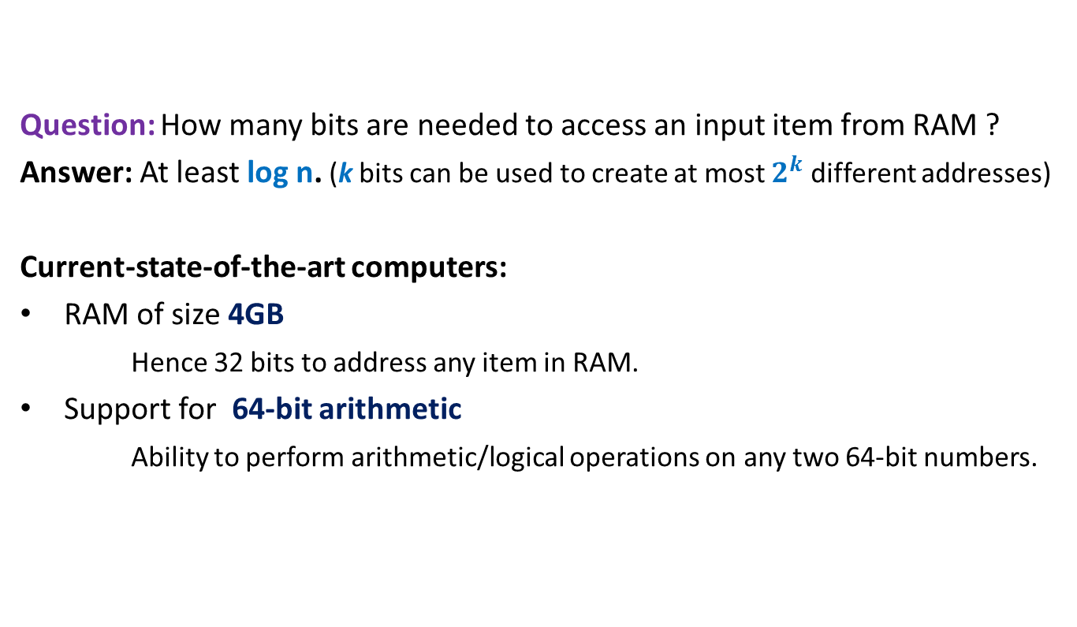
Justification for the extension
Question: How many bits are needed to access an input item from RAM ?
Answer: At least log n. (k bits can be used to create at most $2^{k}$ different addresses)
Current-state-of-the-art computers:
RAM of size 4GB
Hence 32 bits to address any item in RAM.
Support for 64-bit arithmetic
Ability to perform arithmetic/logical operations on any two 64-bit numbers.

