Slide 1
Data Structures and Algorithms (CS210A) Semester I – 2014-15
Lecture 13:
Algorithm paradigms
Algorithm paradigm of Divide and Conquer
Majority element : Proof of correctness of the algorithm from last class

Slide 2
Algorithm Paradigms

Slide 3
Algorithm Paradigm
Motivation:
Many problems whose algorithms are based on a common approach.
A need of a systematic study of the characteristics of such widely used approaches.
Algorithm Paradigms:
Divide and Conquer
Greedy Strategy
Dynamic Programming
Local Search

Slide 4
Divide and Conquer paradigm for Algorithm Design

Slide 5
Divide and Conquer paradigm An Overview
A problem in this paradigm is solved in the following way.
Divide the problem instance into two or more instances of the same problem.
Solve each smaller instances recursively (base case suitably defined).
Combine the solutions of the smaller instances to get the solution of the original instance.
This is usually the main nontrivial step in the design of an algorithm using divide and conquer strategy

Slide 6
Example 1
Sorting

Slide 7
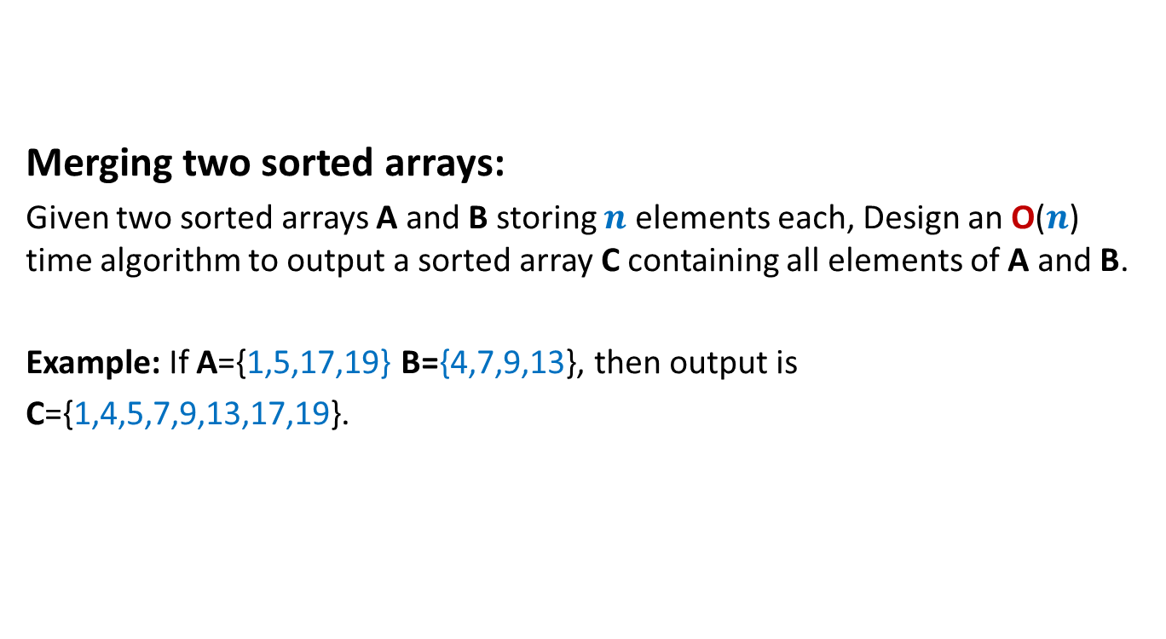
A problem in Practice sheet 1 (8 August)
Merging two sorted arrays:
Given two sorted arrays A and B storing $n$ elements each, Design an O($n$) time algorithm to output a sorted array C containing all elements of A and B.
Example: If A={1,5,17,19} B={4,7,9,13}, then output is
C={1,4,5,7,9,13,17,19}.

Slide 8
Merging two sorted arrays A and B
A
1
5
17 19
B
17 19
4
7
9
13
C
1
4
5 7 9 13

Slide 9
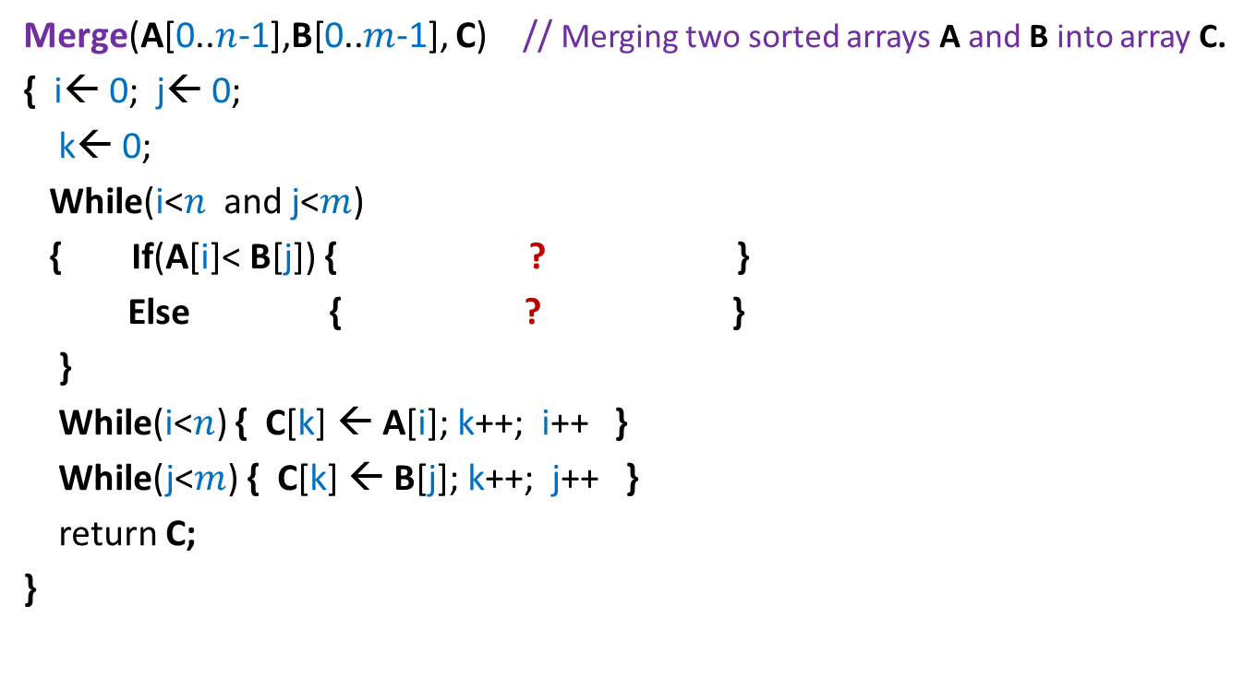
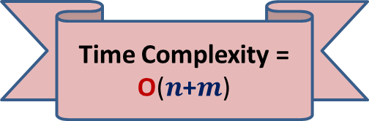
Pesudo-code for Merging two sorted arrays
Merge(A[0..$n$-1],B[0..$m$-1], C) // Merging two sorted arrays A and B into array C.
{ i← 0; j← 0;
k← 0;
While(i<$n$ and j<$m$)
{ If(A[i]< B[j]) { ? }
Else { ? }
}
While(i<$n$) { C[k] ← A[i]; k++; i++ }
While(j<$m$) { C[k] ← B[j]; k++; j++ }
return C;
}
Correctness : An exercise
C[k] ← A[i]; k++; i++
C[k] ← B[j]; k++; j++
Time Complexity = O($n$+$m$)

Slide 10

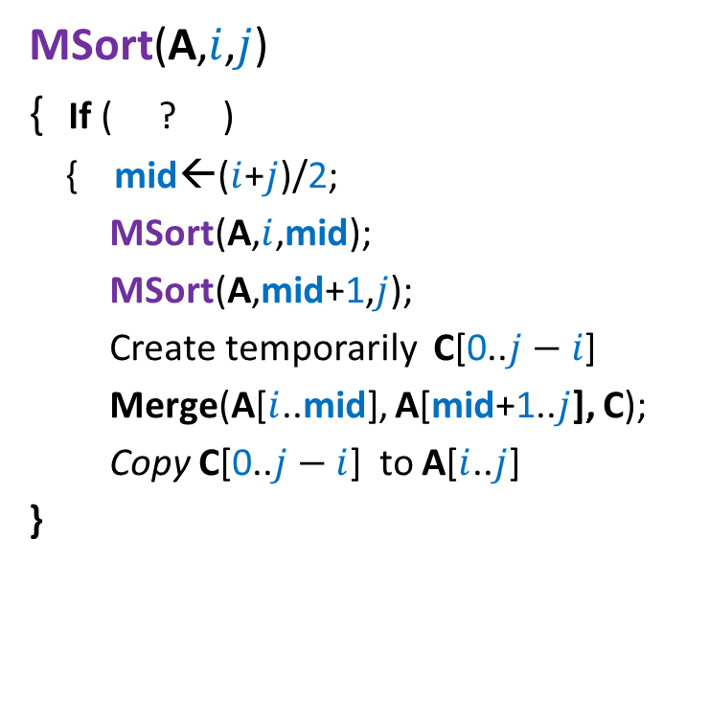
Divide and Conquer based sorting algorithm
MSort(A,$i$,$j$)
{ If ( ? )
{ mid←($i$+$j$)/2;
MSort(A,$i$,mid);
MSort(A,mid+1,$j$);
Create temporarily C[0..$j−i$]
Merge(A[$i$..mid], A[mid+1..$j$], C);
Copy C[0..$j−i$] to A[$i$..$j$]
}
// Sorting the subarray A[$i$..$j$].
i< j
Divide step
Combine/conquer step
This is Merge Sort algorithm

Slide 11
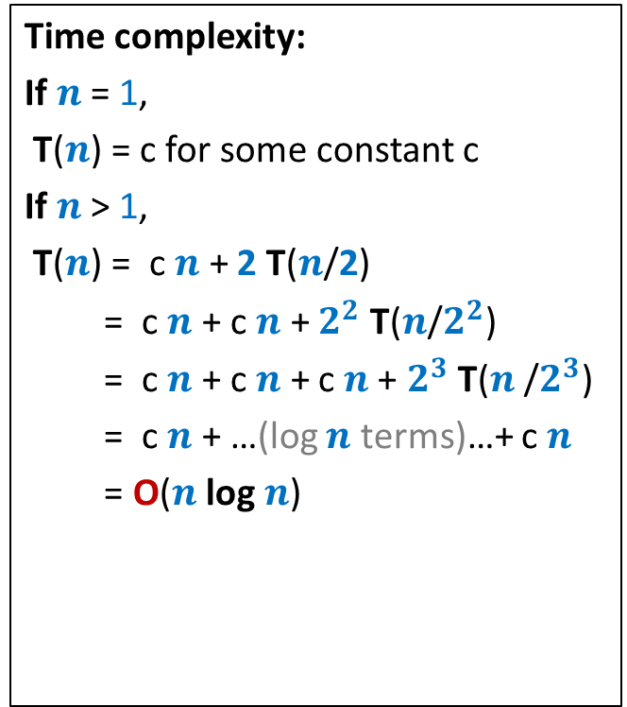




Divide and Conquer based sorting algorithm
MSort(A,$i$,$j$)
{ If ( ? )
{ mid←($i$+$j$)/2;
MSort(A,$i$,mid);
MSort(A,mid+1,$j$);
Create temporarily C[0..$j−i$]
Merge(A[$i$..mid], A[mid+1..$j$], C);
Copy C[0..$j−i$] to A[$i$..$j$]
}
Time complexity:
If $n$ = 1,
T($n$) = c for some constant c
If $n$ > 1,
T($n$) = c $n$ + 2 T($n$/2)
= c $n$ + c $n$ + $2^{2}$ T($n$/$2^{2}$)
= c $n$ + c $n$ + c $n$+ $2^{3}$ T($n$/$2^{3}$)
= c $n$ + …(log $n$ terms)…+ c $n$
= O($n$ log $n$)
// Sorting the subarray A[$i$..$j$].
i< j
T($n$/2)
T($n$/2)
c $n$

Slide 12
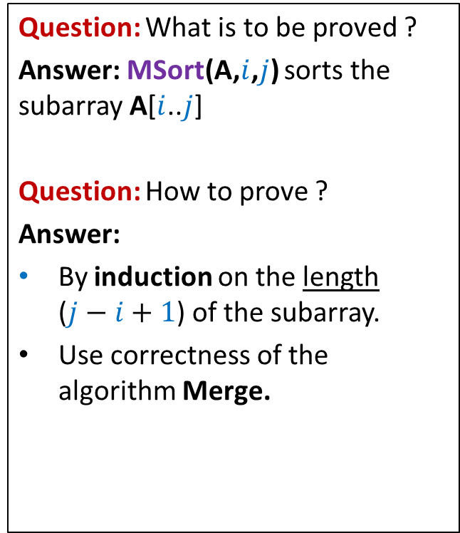
Proof of correctness of Merge-Sort
MSort(A,$i$,$j$)
{ If ( ? )
{ mid←($i$+$j$)/2;
MSort(A,$i$,mid);
MSort(A,mid+1,$j$);
Create temporarily C[0..$j−i$]
Merge(A[$i$..mid], A[mid+1..$j$], C);
Copy C[0..$j−i$] to A[$i$..$j$]
}
Question: What is to be proved ?
Answer: MSort(A,$i$,$j$) sorts the subarray A[$i$..$j$]
Question: How to prove ?
Answer:
By induction on the length ($j−i+1$) of the subarray.
Use correctness of the algorithm Merge.
// Sorting the subarray A[$i$..$j$].
i< j

Slide 13
Example 2
Faster algorithm for multiplying two integers

Slide 14
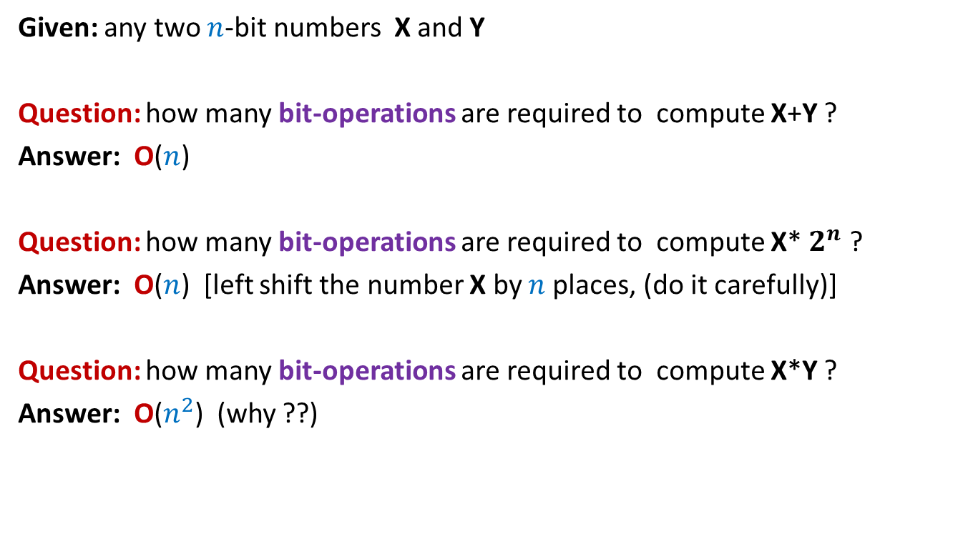
Addition is faster than multiplication
Given: any two $n$-bit numbers X and Y
Question: how many bit-operations are required to compute X+Y ?
Answer: O($n$)
Question: how many bit-operations are required to compute X* $2^{n}$ ?
Answer: O($n$) [left shift the number X by $n$places, (do it carefully)]
Question: how many bit-operations are required to compute X*Y ?
Answer: O($n^{2}$) (why ??)
Can we compute X*Y faster ??

Slide 15

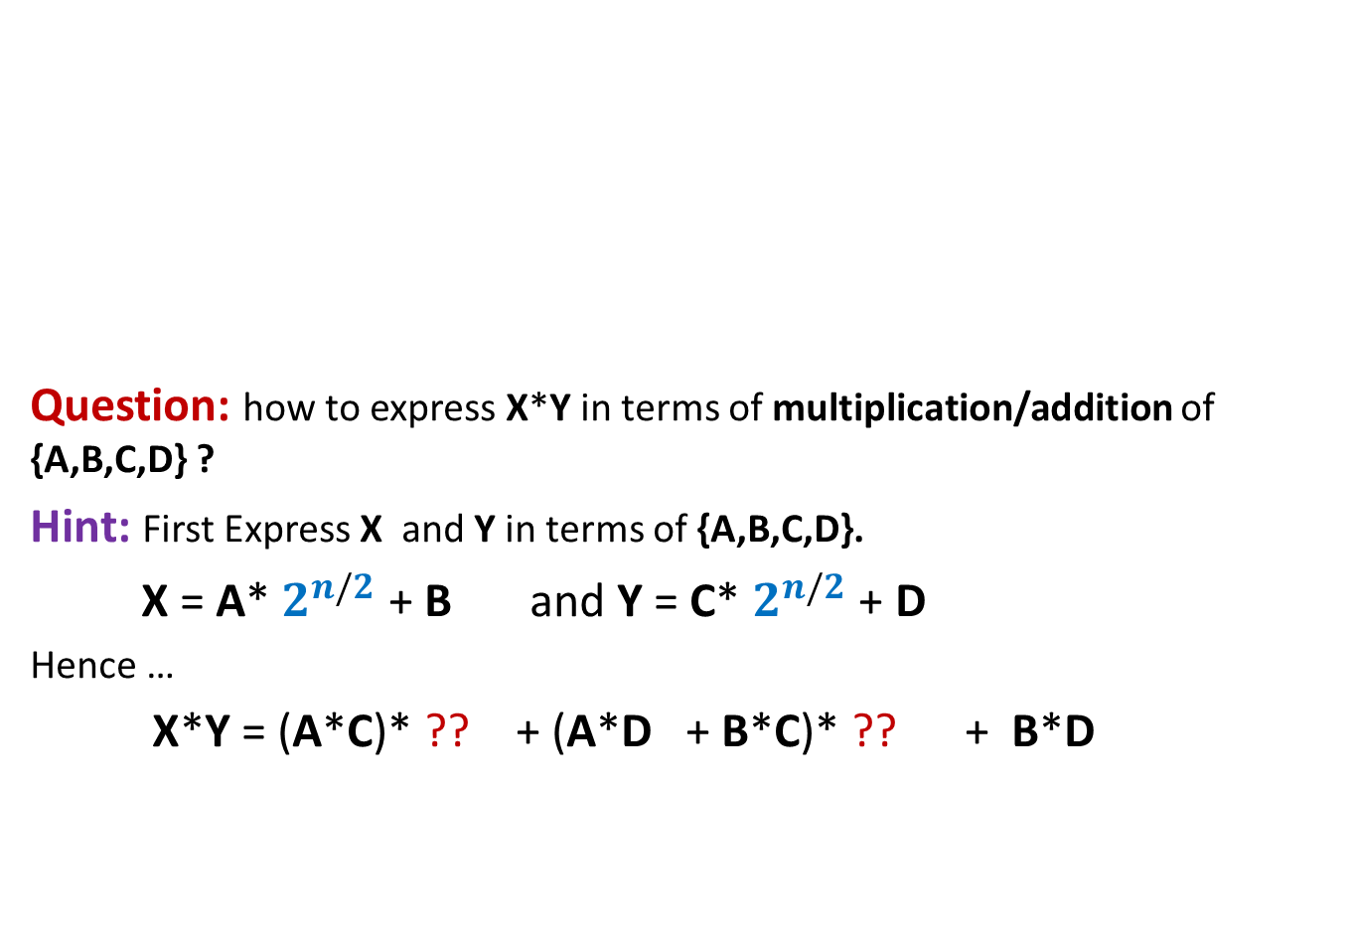

Pursuing Divide and Conquer approach
MSB
LSB
Question: how to express X*Y in terms of multiplication/addition of {A,B,C,D} ?
Hint: First Express X and Y in terms of {A,B,C,D}.
X = A* $2^{n/2}$ + B and Y = C* $2^{n/2}$ + D
Hence …
X*Y = (A*C)* ?? + (A*D + B*C)* ?? + B*D
A
B
X
n-1 n-2…......………………n/2.............................2 1 0
4 multiplications
C
D
Y
$$2^{n}$$
$$2^{n/2}$$

Slide 16

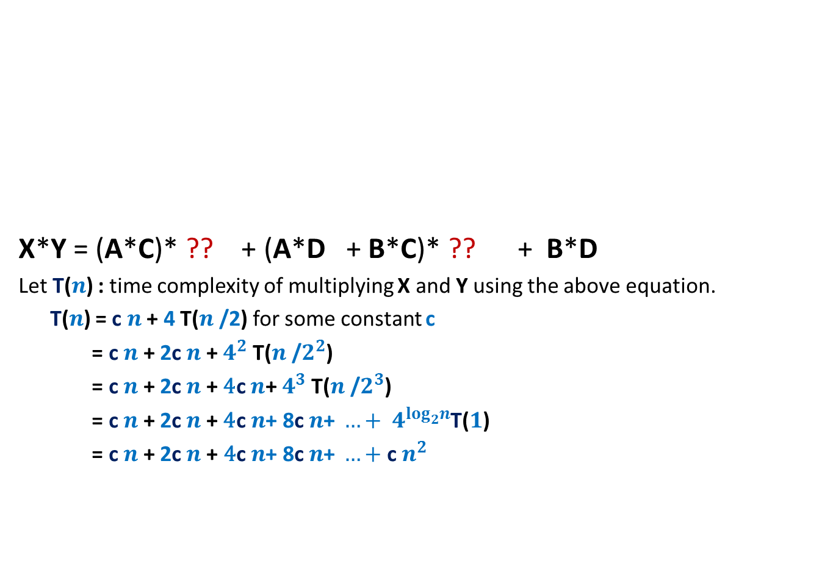


Pursuing Divide and Conquer approach
MSB
LSB
X*Y = (A*C)* ?? + (A*D + B*C)* ?? + B*D
Let T($n$) : time complexity of multiplying X and Y using the above equation.
T($n$) = c $n$ + 4 T($n$/2) for some constant c
= c $n$ + 2c $n$ + $4^{2}$ T($n$/$2^{2}$)
= c $n$ + 2c $n$ + ${\text{4}\text{c} n\text{+} 4}^{3}$ T($n$/$2^{3}$)
= c $n$ + 2c $n$ + ${\text{4}\text{c} n\text{+ 8}\text{c} n\text{+ }…+ 4}^{\log_{2}^{}n}$T($1$)
= c $n$+ 2c $n$+ ${\text{4}\text{c} n\text{+ 8}\text{c} n\text{+ }…+\text{c} n}^{2 }$
A
B
X
n-1 n-2…......………………n/2.............................2 1 0
C
D
Y
$$2^{n}$$
$$2^{n/2}$$
O($n^{2}$) time algo

Slide 17
Pursuing Divide and Conquer approach
MSB
LSB
X*Y = (A*C)* ?? + (A*D + B*C)* ?? + B*D
Observation: A*D + B*C = (A-B)*(D-C) + A*C + B*D
Question: How many multiplications do we need now to compute X*Y ?
Answer: 3 multiplications :
A*C
B*D
(A-B)*(D-C) .
A
B
X
n-1 n-2…......………………n/2.............................2 1 0
C
D
Y
$$2^{n}$$
$$2^{n/2}$$

Slide 18



Pursuing Divide and Conquer approach
MSB
LSB
X*Y = (A*C)* ?? + ((A-B)*(D-C) + A*C + B*D)* ?? + B*D
Let T($n$) : time complexity of the new algo for multiplying two $n$-bit numbers
T($n$) = c $n$ + 3 T($n$/2) for some constant c
= c $n$ + 3 c $\frac{n}{2}$ + $3^{2}$ T($n$/$2^{2}$)
= c $n$ + 3c $\frac{n}{2}$ + $\text{9}\text{c}\frac{n}{4}\text{+}$ + … + ?
= O($n^{\log_{2}^{}3}$) = O($n^{1.58}$)
A
B
X
n-1 n-2…......………………n/2.............................2 1 0
C
D
Y
$$2^{n}$$
$$2^{n/2}$$
$3^{\log_{2}^{}n}$ T($1$)

Slide 19
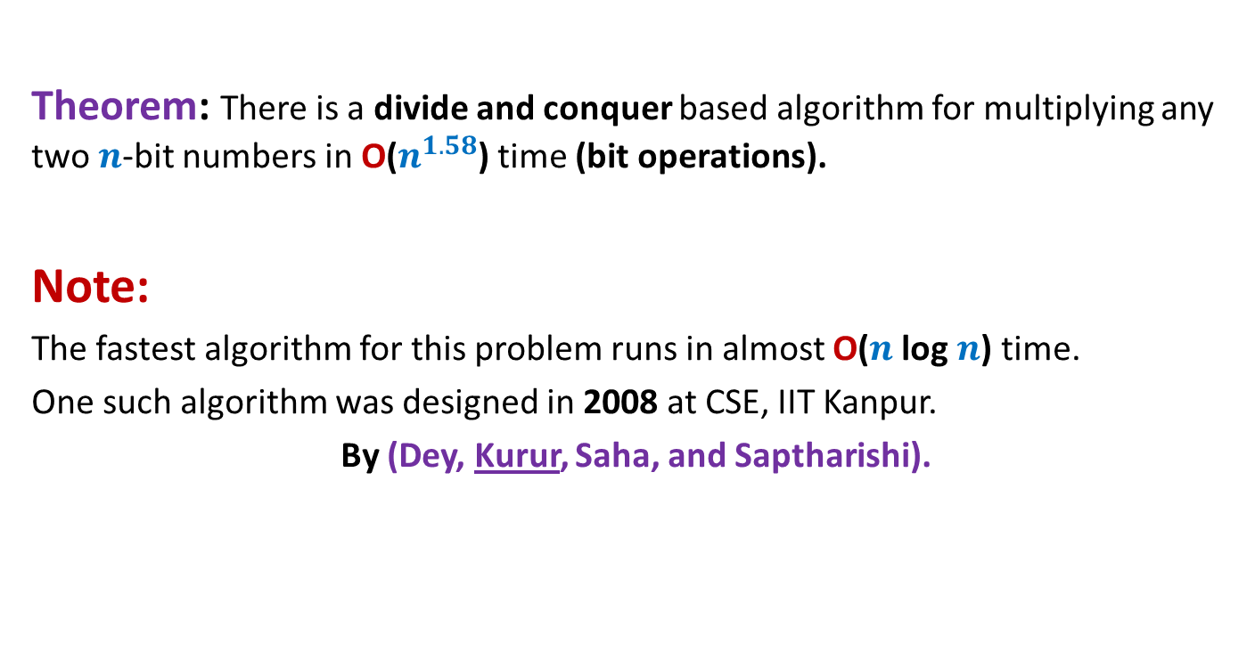
Conclusion
Theorem: There is a divide and conquer based algorithm for multiplying any two $n$-bit numbers in O($n^{1.58}$) time (bit operations).
Note:
The fastest algorithm for this problem runs in almost O($n$ log $n$) time.
One such algorithm was designed in 2008 at CSE, IIT Kanpur.
By (Dey, Kurur, Saha, and Saptharishi).

Slide 20
Example 3
Counting the number of “inversions” in an array

Slide 21
Counting Inversions in an array Problem description
Definition (Inversion): Given an array A of size n, a pair (i,j), 0≤i<j<n is called an inversion if A[i]>A[j].
Example:
Inversions are : (1,2), (1,4), (3,4), (1,6), (3,6), (5,6), (5,7)
AIM: An efficient algorithm to count the number of inversions in an array A.
0 1 2 3 4 5 6 7
A
3 15 8 19 9 67 11 27

Slide 22
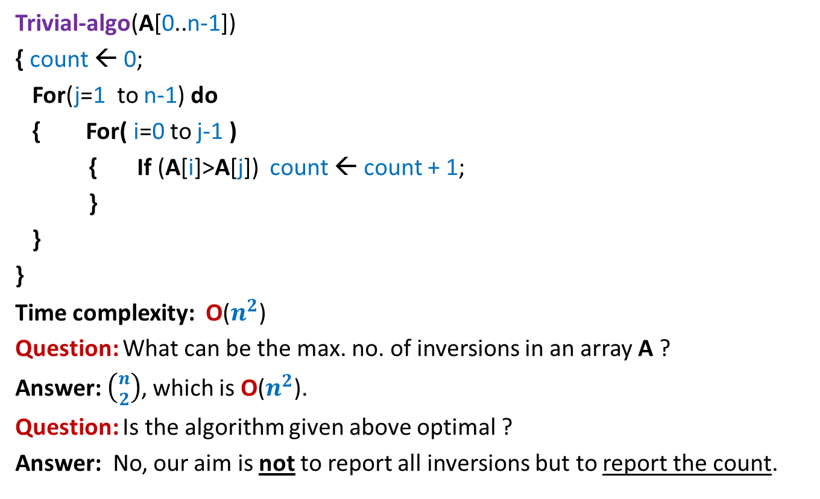
Counting Inversions in an array Problem familiarization
Trivial-algo(A[0..n-1])
{ count ← 0;
For(j=1 to n-1) do
{ For( i=0 to j-1 )
{ If (A[i]>A[j]) count ← count + 1;
}
}
}
Time complexity: O($n^{2}$)
Question: What can be the max. no. of inversions in an array A ?
Answer: $\left({n \atop 2}\right)$, which is O($n^{2}$).
Question: Is the algorithm given above optimal ?
Answer: No, our aim is not to report all inversions but to report the count.
Ponder over the divide and conquer algorithm for this problem. We shall discuss it in the next class.

Slide 23
Proof of correctness
Algorithm for majority element

Slide 24
Algorithm for majority element
Algo-majority(A){
count← 0;
for(i=0 to n-1)
{ if (count=0)
{ x← A[i];
count← 1;
}
else if(x<> A[i])
count ← count - 1;
else
count← count + 1;
}
if x appears more than n/2, then
print(x is majority element)
else print(no majority element)
Question: What is to be proved ?
Answer: For every possible instance of A, the output of algorithm is correct.
Observation: If A does not have any majority element, the output of the algorithm is correct.
➔
Inference: To prove correctness, it suffices to prove the following:
If A has a majority element, say α, then at the end of the For loop, x=α

Slide 25
Algorithm for majority element
Algo-majority(A){
count← 0;
for(i=0 to n-1)
{ if (count=0)
{ x← A[i];
count← 1;
}
else if(x<> A[i])
count ← count - 1;
else
count← count + 1;
}
if x appears more than n/2, then
print(x is majority element)
else print(no majority element)
Inference: To prove correctness, it suffices to prove the following:
If A has a majority element, say α, then at the end of the For loop, x=α

Slide 26



Question: What assertion holds at the end of $i$th iteration ?
answer: x is a majority element of {A[0],A[1],…,A[$i$-1]} ?
Single scan algorithm
$$i$$
$$A$$
A wrong
NO

Slide 27
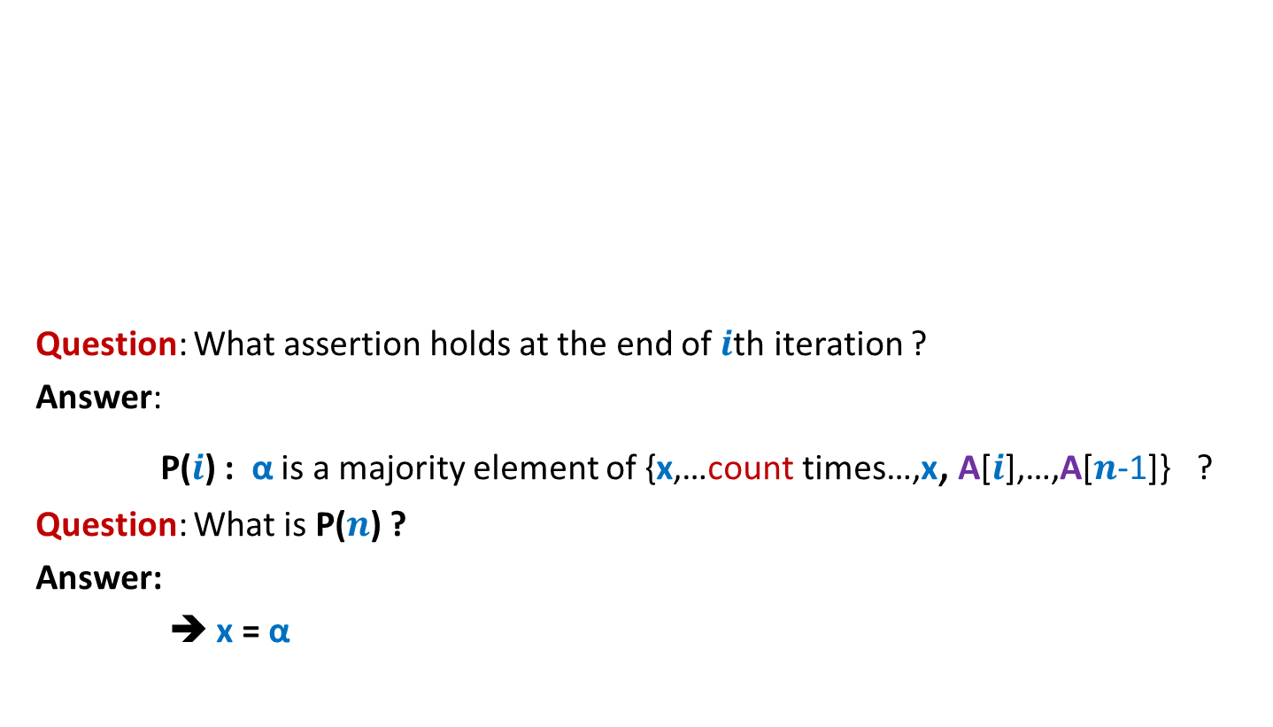
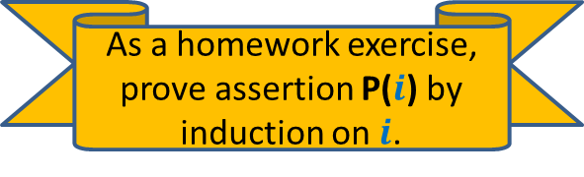
Question: What assertion holds at the end of $i$th iteration ?
Answer:
P($i$) : α is a majority element of {x,…count times…,x, A[$i$],…,A[$n$-1]} ?
Question: What is P($n$) ?
Answer:
➔ x = α
Single scan algorithm
$$i$$
$$A$$
α is a majority element of {x,…count times…,x}
As a homework exercise, prove assertion P($i$) by induction on $i$.
This is what we required ☺

