Slide 1
Data Structures and Algorithms (CS210A) Semester I – 2014-15
Lecture 14:
Algorithm paradigm of Divide and Conquer : Counting the number of Inversions
Another sorting algorithm based on Divide and Conquer : Quick Sort

Slide 2
Divide and Conquer paradigm An Overview
A problem in this paradigm is solved in the following way.
Divide the problem instance into two or more instances of the same problem.
Solve each smaller instances recursively (base case suitably defined).
Combine the solutions of the smaller instances to get the solution of the original instance.
This is usually the main nontrivial step in the design of an algorithm using divide and conquer strategy

Slide 3
Role of Data Structures in designing efficient algorithms
Definition: A collection of data elements arranged and connected in a way
which can facilitate efficient executions of a
(possibly long) sequence of operations.
Parameters:
Query/Update time
Space
Preprocessing time

Slide 4

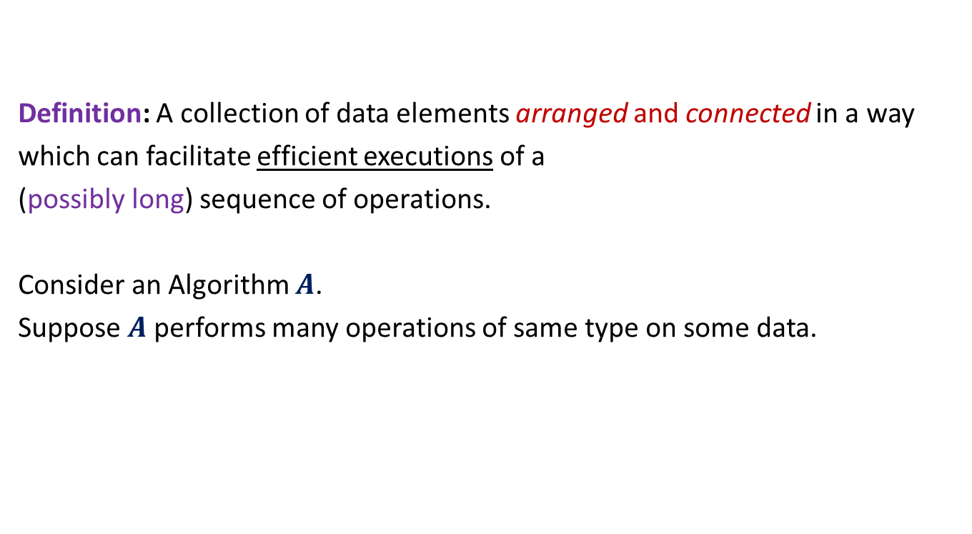
Role of Data Structures in designing efficient algorithms
Definition: A collection of data elements arranged and connected in a way
which can facilitate efficient executions of a
(possibly long) sequence of operations.
Consider an Algorithm $A$.
Suppose $A$performs many operations of same type on some data.
Improving time complexity of these operations
Improving the time complexity of $A$.
So, it is worth designing a suitable data structure.

Slide 5
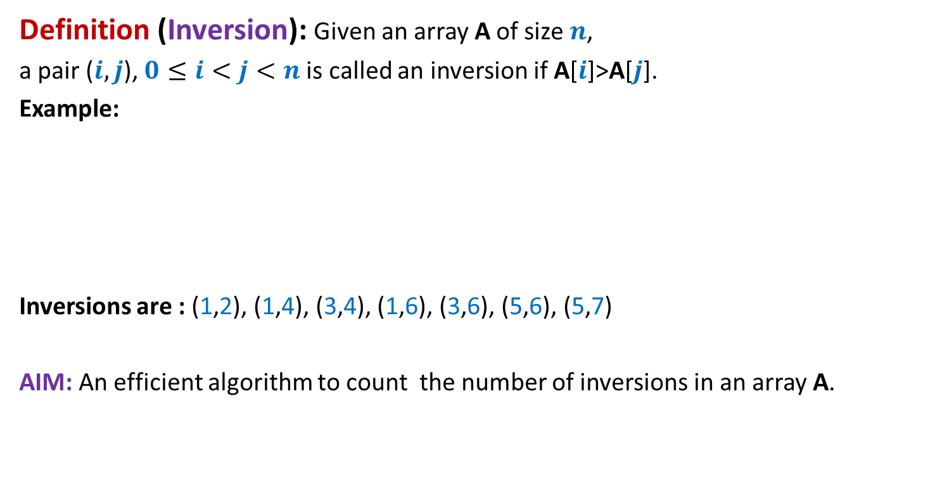
Counting Inversions in an array Problem description
Definition (Inversion): Given an array A of size $n$,
a pair ($i,j$), $0≤i<j<n$is called an inversion if A[$i$]>A[$j$].
Example:
Inversions are : (1,2), (1,4), (3,4), (1,6), (3,6), (5,6), (5,7)
AIM: An efficient algorithm to count the number of inversions in an array A.
0 1 2 3 4 5 6 7
A
3 15 8 19 9 67 11 27

Slide 6
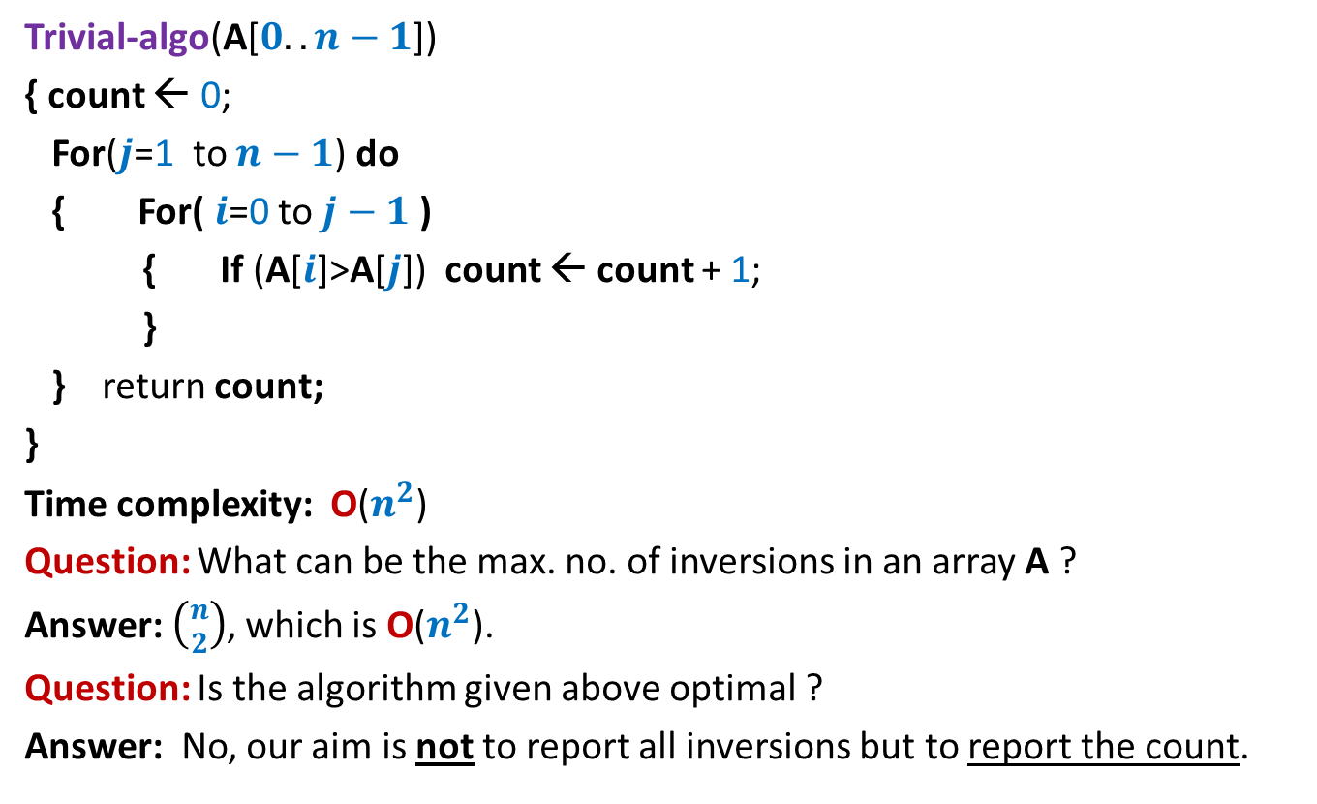
Counting Inversions in an array Problem familiarization
Trivial-algo(A[$0..n−1$])
{ count ← 0;
For($j$=1 to $n−1$) do
{ For( $i$=0 to $j−1$ )
{ If (A[$i$]>A[$j$]) count ← count + 1;
}
} return count;
}
Time complexity: O($n^{2}$)
Question: What can be the max. no. of inversions in an array A ?
Answer: $\left({n \atop 2}\right)$, which is O($n^{2}$).
Question: Is the algorithm given above optimal ?
Answer: No, our aim is not to report all inversions but to report the count.

Slide 7
Let us try to design a Divide and Conquer based algorithm

Slide 8



How do we approach using divide & conquer
$${count}_{I}$$
$${count}_{II}$$
0 1 2 3 4 5 6 7
A
3 15 8 19 9 67 11 27
$${count}_{III}$$

Slide 9
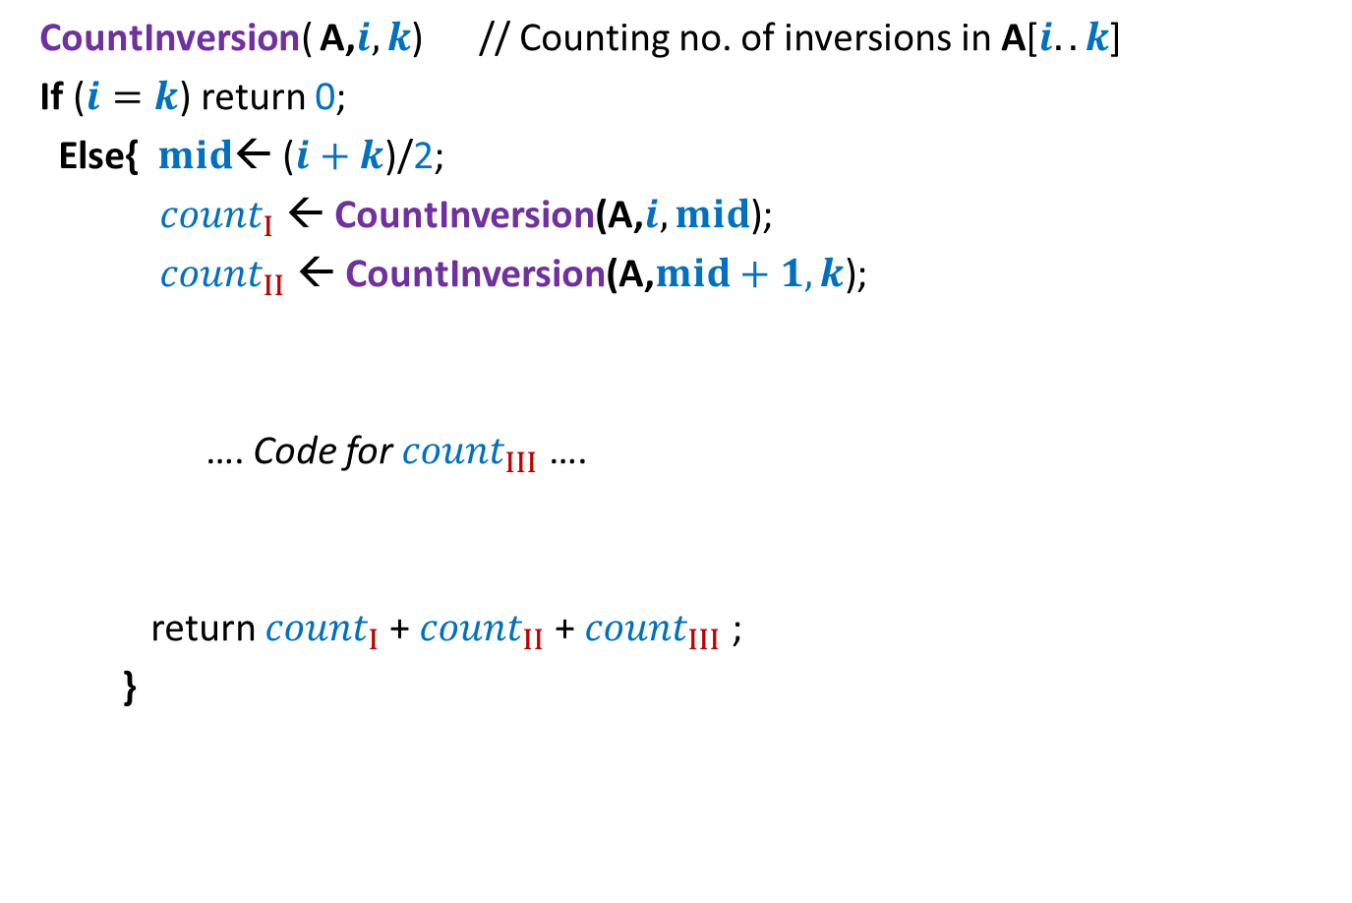
Counting Inversions Divide and Conquer based algorithm
CountInversion( A,$i,k$) // Counting no. of inversions in A[$i..k$]
If ($i=k$) return 0;
Else{ $mid$← ($i+k$)/2;
${count}_{I}$ ← CountInversion(A,$i,mid$);
${count}_{II}$ ← CountInversion(A,$mid+1,k$);
…. Code for ${count}_{III}$ ….
return ${count}_{I}$+ ${count}_{II}$+ ${count}_{III}$ ;
}

Slide 10

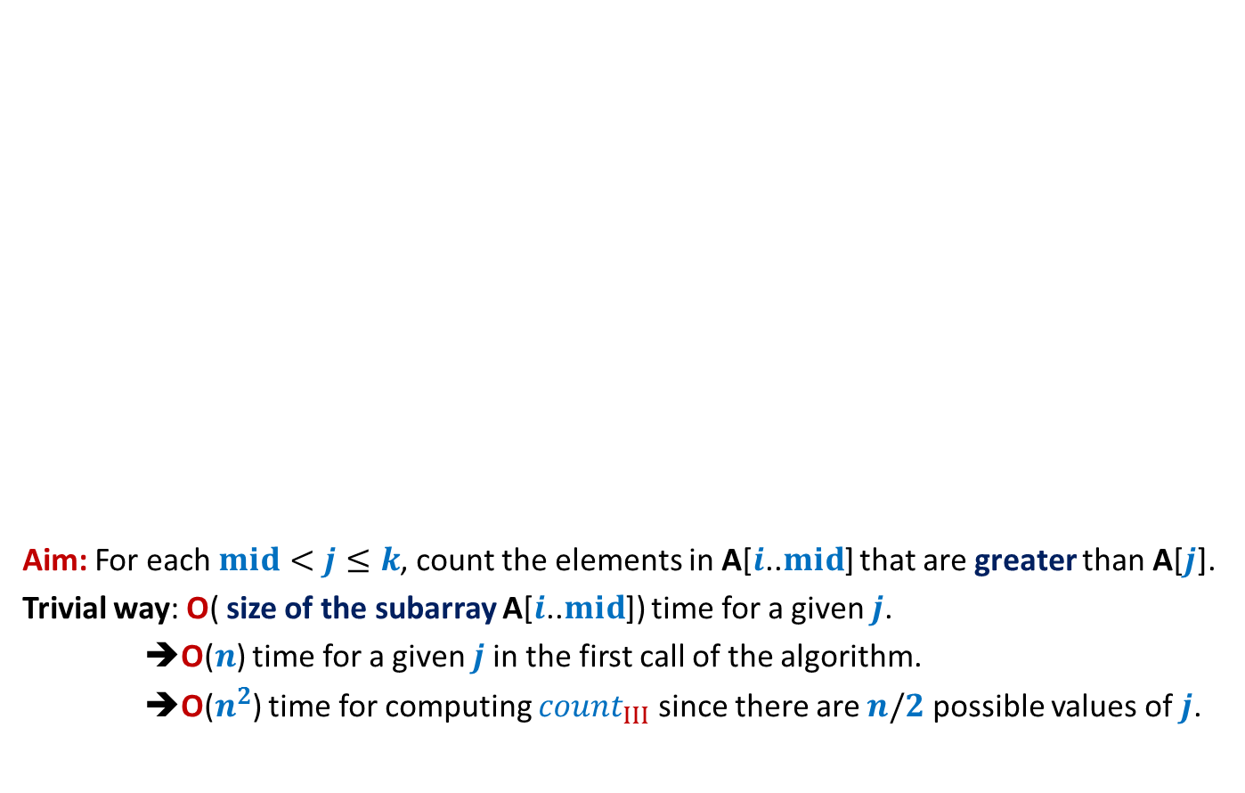

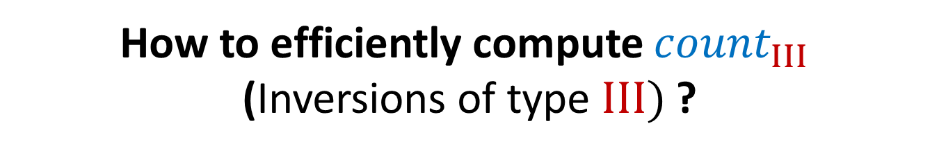


How to efficiently compute ${count}_{III}$ (Inversions of type $III)$ ?
Aim: For each $mid<j≤k$, count the elements in A[$i$..$mid$] that are greater than A[$j$].
Trivial way: O( size of the subarray A[$i$..$mid$]) time for a given $j$.
➔O($n$) time for a given $j$in the first call of the algorithm.
➔O($n^{2}$) time for computing ${count}_{III}$ since there are $n/2$ possible values of $j$.
$$i$$
$$j$$
$$k$$
A
3 15 8 19 9 67 11 27
O($n^{2}$) time algo
$${count}_{III}$$

Slide 11
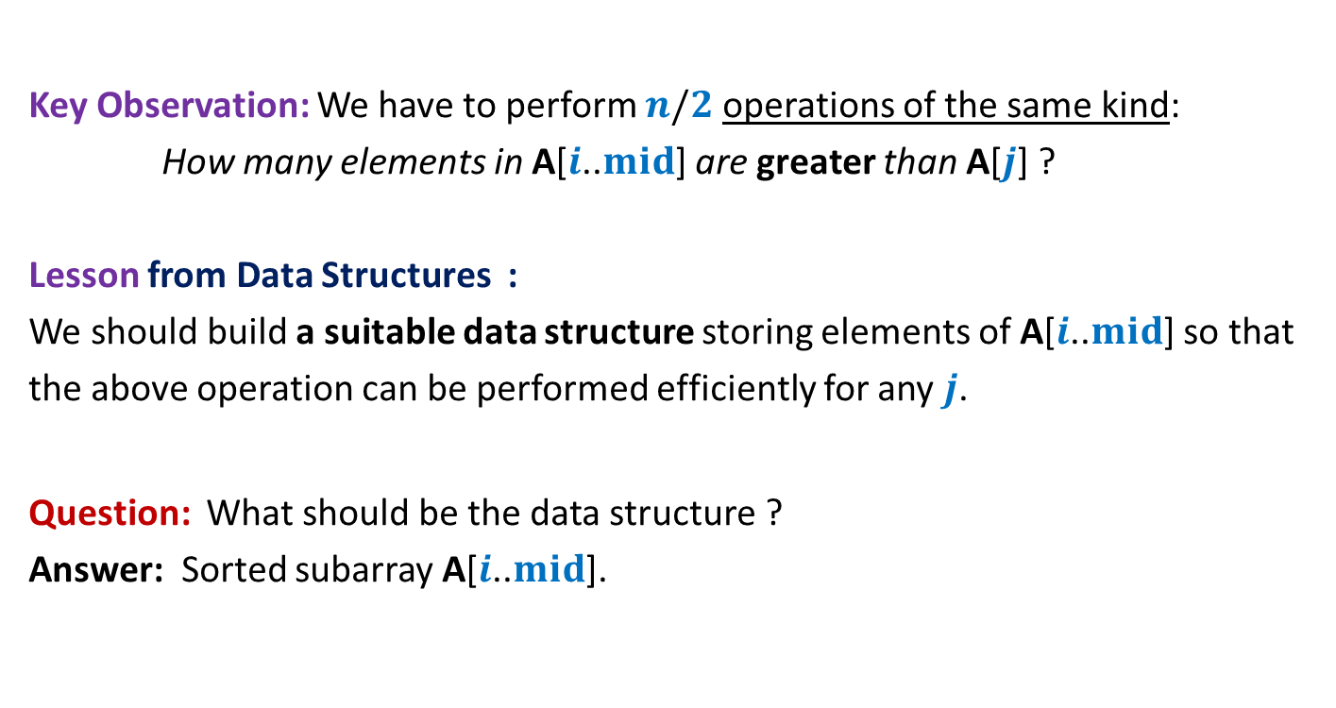
How to efficiently compute ${count}_{III}$ (Inversions of type $III)$ ?
Key Observation: We have to perform $n/2$ operations of the same kind:
How many elements in A[$i$..$mid$] are greater than A[$j$] ?
Lesson from Data Structures :
We should build a suitable data structure storing elements of A[$i$..$mid$] so that
the above operation can be performed efficiently for any $j$.
Question: What should be the data structure ?
Answer: Sorted subarray A[$i$..$mid$].

Slide 12
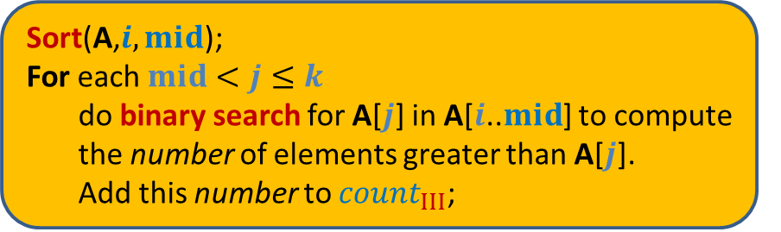
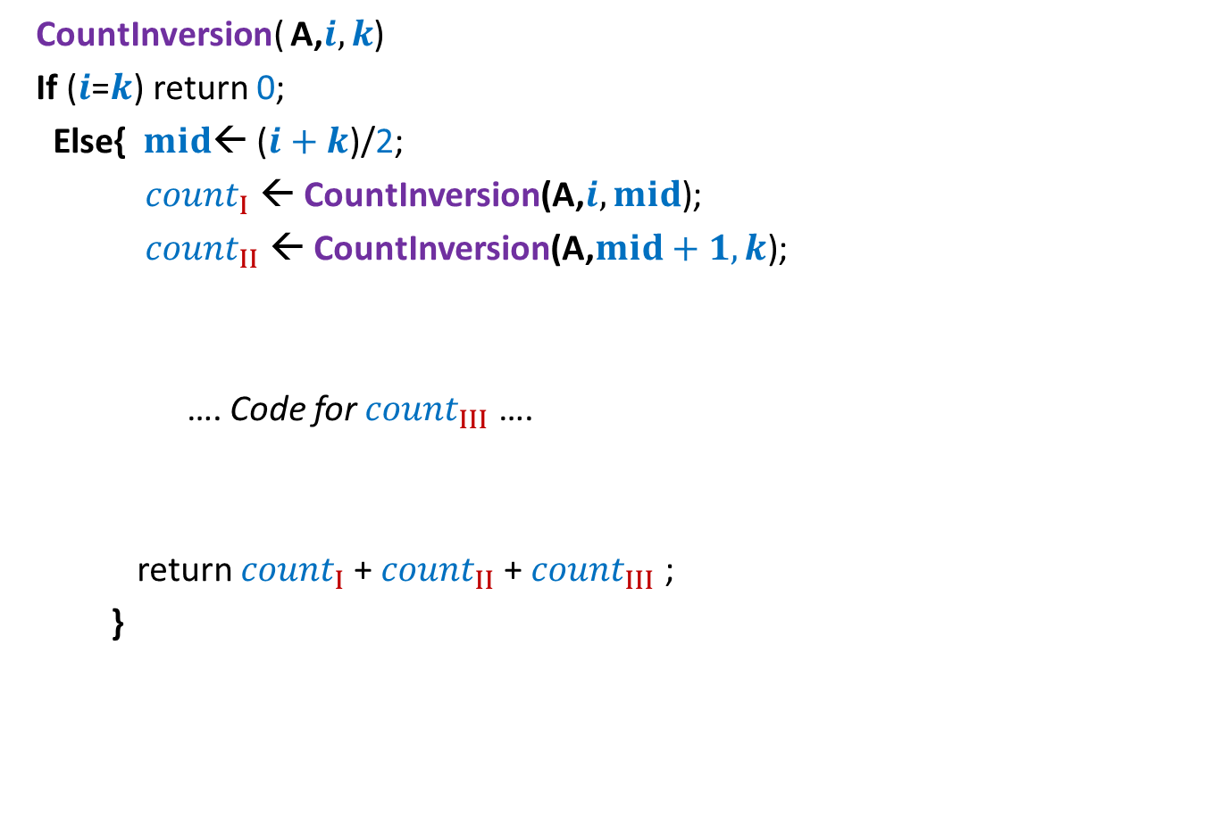


Counting Inversions First algorithm based on divide & conquer
CountInversion( A,$i,k$)
If ($i$=$k$) return 0;
Else{ $mid$← ($i+k$)/2;
${count}_{I}$ ← CountInversion(A,$i,mid$);
${count}_{II}$ ← CountInversion(A,$mid+1,k$);
…. Code for ${count}_{III}$ ….
return ${count}_{I}$+ ${count}_{II}$+ ${count}_{III}$ ;
}
2 T($n/2$)
Sort(A,$i,mid$);
For each $mid<j≤k$
do binary search for A[$j$] in A[$i$..$mid$] to compute
the number of elements greater than A[$j$].
Add this number to ${count}_{III}$;
c $n$ log $n$

Slide 13
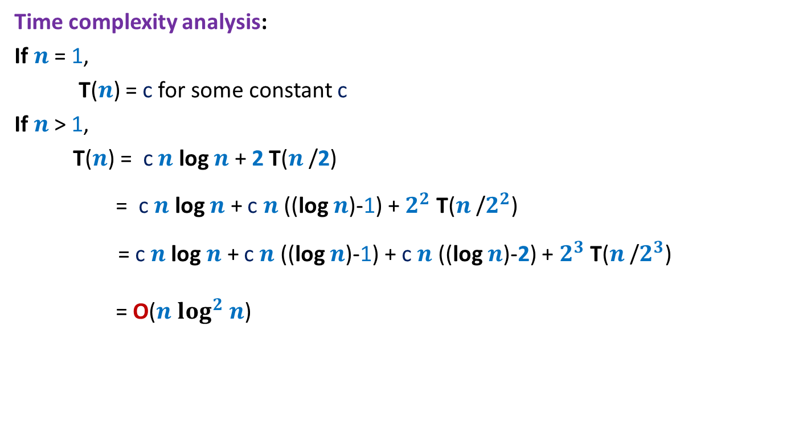
Counting Inversions First algorithm based on divide & conquer
Time complexity analysis:
If $n$ = 1,
T($n$) = c for some constant c
If $n$ > 1,
T($n$) = c $n$ log $n$ + 2 T($n$/2)
= c $n$ log $n$ + c $n$ ((log $n$)-1) + $2^{2}$ T($n$/$2^{2}$)
= c $n$log $n$ + c $n$ ((log $n$)-1) + c $n$ ((log $n$)-2) + $2^{3}$ T($n$/$2^{3}$)
= O($n$ $\log^{2}$ $n$)
Can we improve it further ?

Slide 14
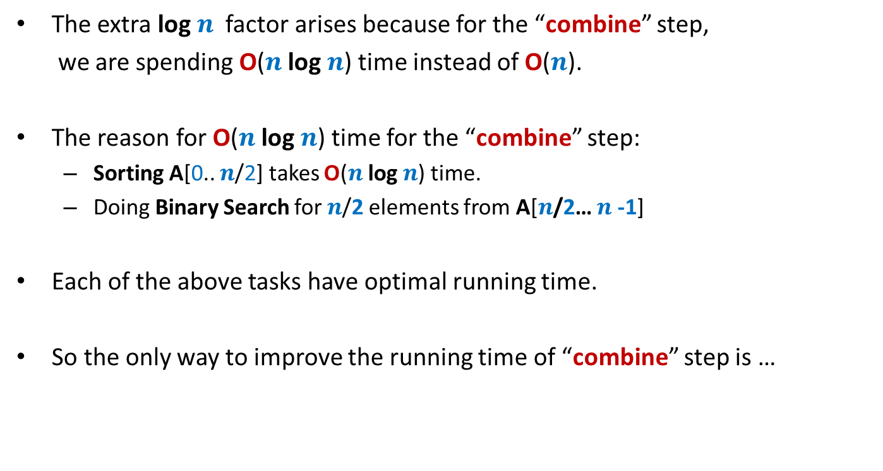
Sequence of observations To achieve better running time
The extra log $n$ factor arises because for the “combine” step,
we are spending O($n$ log $n$) time instead of O($n$).
The reason for O($n$ log $n$) time for the “combine” step:
Sorting A[0.. $n$/2] takes O($n$ log $n$) time.
Doing Binary Search for $n$/2 elements from A[$n$/2… $n$-1]
Each of the above tasks have optimal running time.
So the only way to improve the running time of “combine” step is …
some new idea

Slide 15
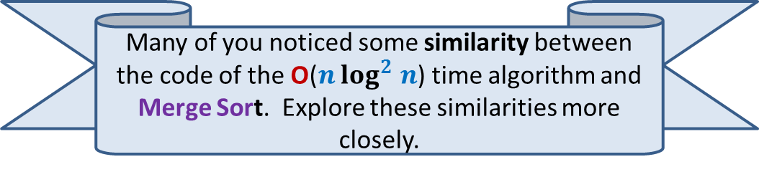
Learn from the past knowledge
Many of you noticed some similarity between the code of the O($n$ $\log^{2}$ $n$) time algorithm and Merge Sort. Explore these similarities more closely.

Slide 16
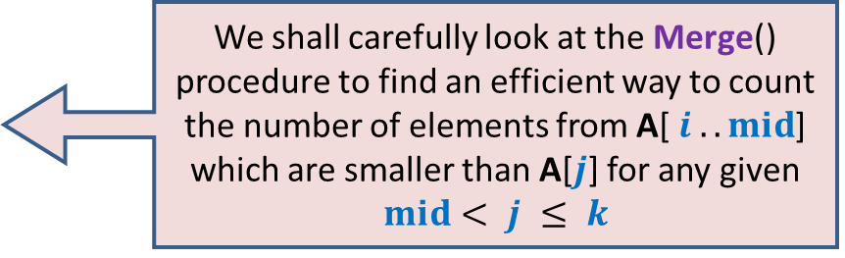
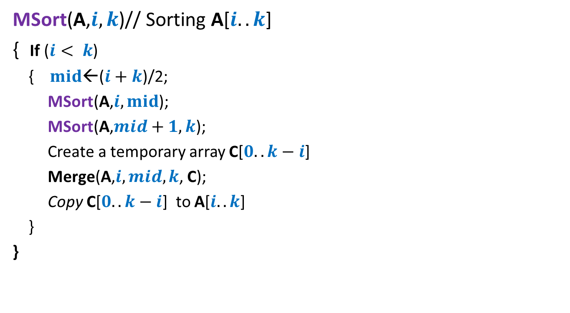
Revisiting MergeSort algorithm
MSort(A,$i,k$)// Sorting A[$i..k$]
{ If ($i< k$)
{ $mid$←($i+k$)/2;
MSort(A,$i,mid$);
MSort(A,$mid+1,k$);
Create a temporary array C[$0..k−i$]
Merge(A,$i,mid,k$, C);
Copy C[$0..k−i$] to A[$i..k$]
}
}
We shall carefully look at the Merge() procedure to find an efficient way to count the number of elements from A[ $i ..mid$] which are smaller than A[$j$] for any given $mid< j ≤ k$

Slide 17

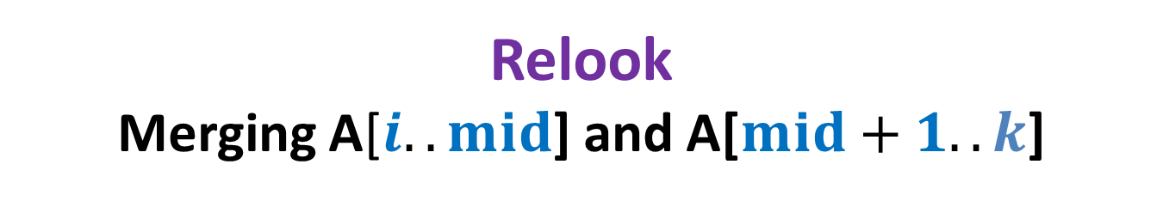
Relook Merging A[$i..mid$] and A[$mid+1..k$]
Sorted
Sorted
A
x
x
$$j$$
>x
C

Slide 18
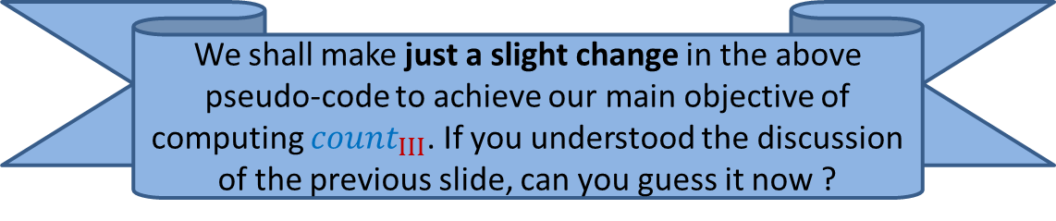
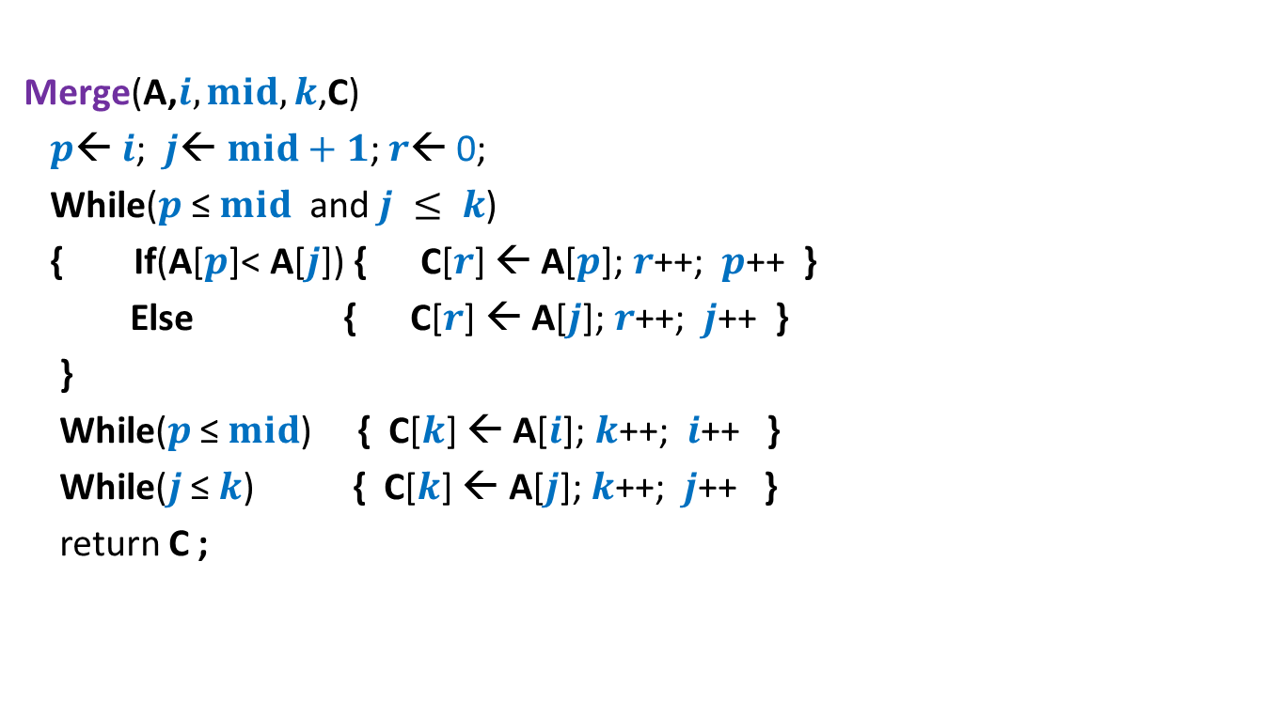
Pesudo-code for Merging two sorted arrays
Merge(A,$i,mid,k$,C)
$p$← $i$; $j$← $mid+1$; $r$← 0;
While($p$ ≤ $mid$ and $j ≤ k$)
{ If(A[$p$]< A[$j$]) { C[$r$] ← A[$p$]; $r$++; $p$++ }
Else { C[$r$] ← A[$j$];$r$++; $j$++ }
}
While($p$ ≤ $mid$) { C[$k$] ← A[$i$]; $k$++; $i$++ }
While($j$ ≤ $k$) { C[$k$] ← A[$j$]; $k$++; $j$++ }
return C ;
We shall make just a slight change in the above pseudo-code to achieve our main objective of computing ${count}_{III}$. If you understood the discussion of the previous slide, can you guess it now ?

Slide 19

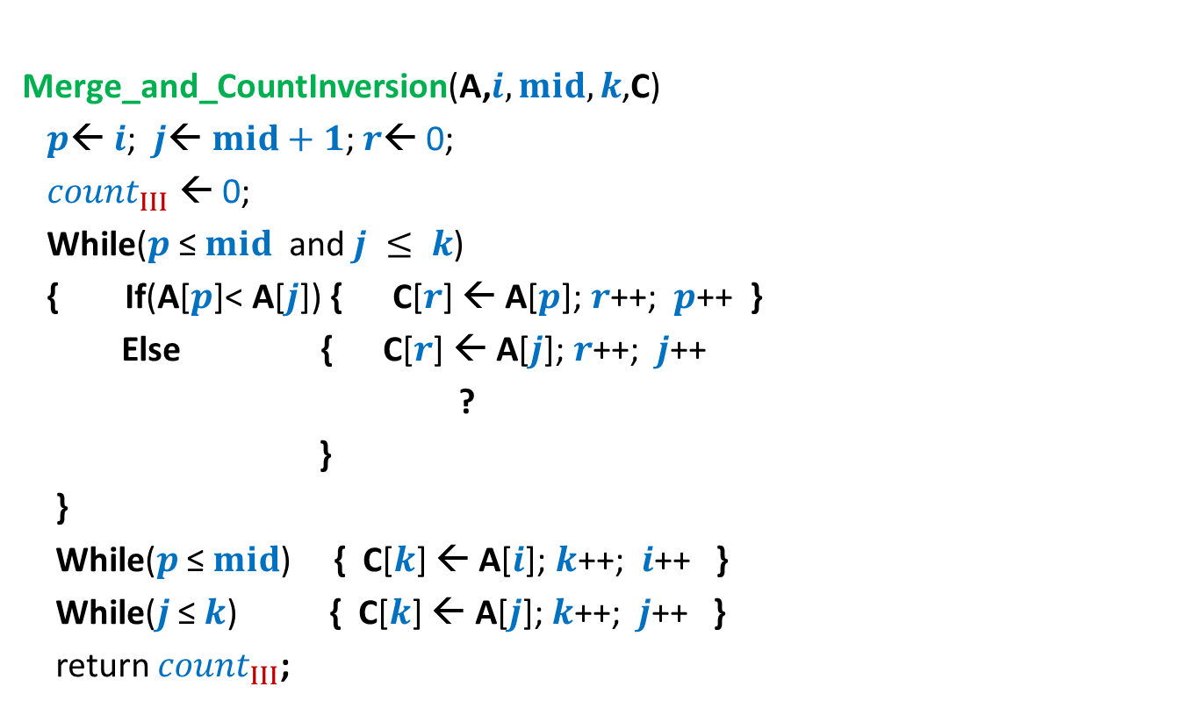
Pesudo-code for Merging and counting inversions
Merge_and_CountInversion(A,$i,mid,k$,C)
$p$← $i$; $j$← $mid+1$; $r$← 0;
${count}_{III}$ ← 0;
While($p$ ≤ $mid$ and $j ≤ k$)
{ If(A[$p$]< A[$j$]) { C[$r$] ← A[$p$]; $r$++; $p$++ }
Else { C[$r$] ← A[$j$];$r$++; $j$++
?
}
}
While($p$ ≤ $mid$) { C[$k$] ← A[$i$]; $k$++; $i$++ }
While($j$ ≤ $k$) { C[$k$] ← A[$j$]; $k$++; $j$++ }
return ${count}_{III}$;
${count}_{III}$ ← ${count}_{III}$ + (mid-p+1);

Slide 20

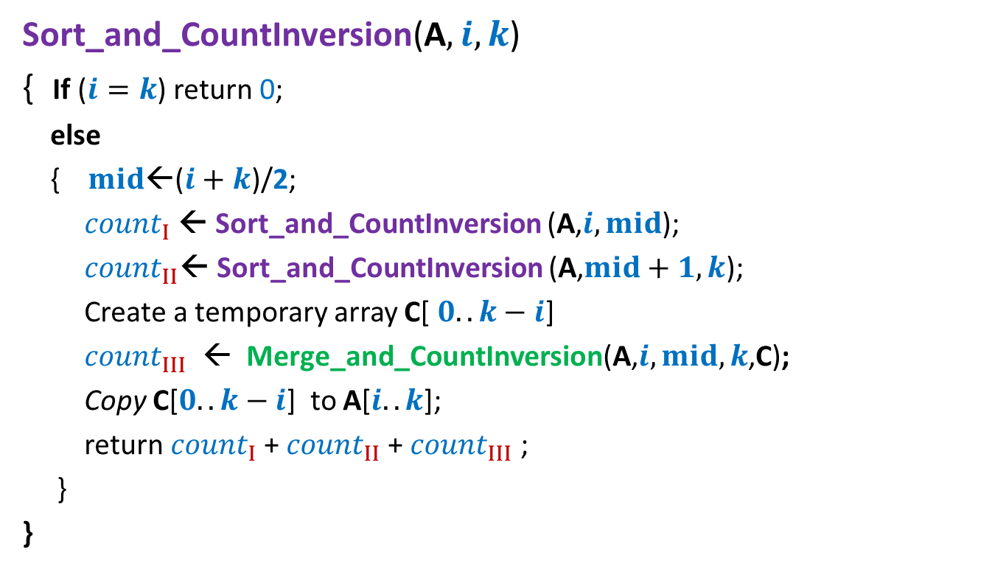

Counting Inversions Final algorithm based on divide & conquer
Sort_and_CountInversion(A$,i,k$)
{ If ($i=k$) return 0;
else
{ $mid$←($i+k$)/2;
${count}_{I}$← Sort_and_CountInversion (A,$i,mid$);
${count}_{II}$← Sort_and_CountInversion (A,$mid+1,k$);
Create a temporary array C[ $0..k−i$]
${count}_{III}$ ← Merge_and_CountInversion(A,$i,mid,k$,C);
Copy C[$0..k−i$] to A[$i..k$];
return ${count}_{I}$+ ${count}_{II}$+ ${count}_{III}$ ;
}
}
$2$ T($n/2$)
O($n$)

Slide 21
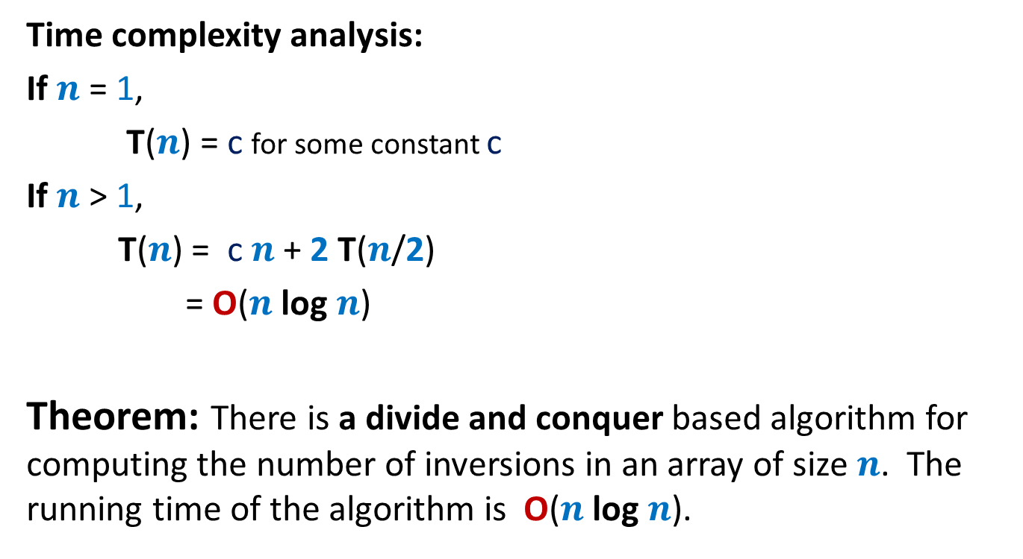
Counting Inversions Final algorithm based on divide & conquer
Time complexity analysis:
If $n$ = 1,
T($n$) = c for some constant c
If $n$ > 1,
T($n$) = c $n$ + 2 T($n$/2)
= O($n$ log $n$)
Theorem: There is a divide and conquer based algorithm for computing the number of inversions in an array of size $n$. The running time of the algorithm is O($n$ log $n$).

Slide 22
QuickSort
Another sorting algorithm based on divide and conquer

Slide 23
Is there any alternate way to divide ?
0 1 2 3 4 5 6 7 8
x
In MergeSort, we divide the input instance in an obvious manner.

Slide 24
0 1 2 3 4 5 6 7 8
>x
<x
x

Slide 25
This procedure is called Partition.
It rearranges the elements so that all elements less than x appear to the left of x and all elements greater than x appear to the right of x.
0 1 2 3 4 5 6 7 8
Can you now guess a divide and conquer algorithm for sorting based on Partition() ?
0 1 2 3 4 5 6 7 8
<x
>x

Slide 26
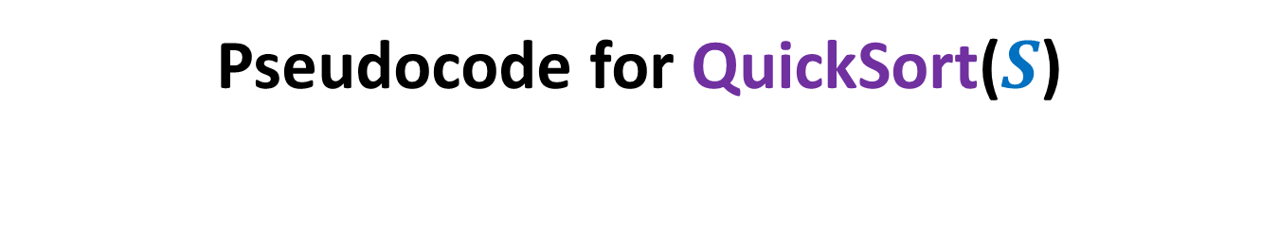
Pseudocode for QuickSort($S$)
QuickSort($S$)
{ If (|$S$|>1)
Pick and remove an element $x$from $S$;
($S_{<x}$, $S_{>x}$)← Partition($S$,$x$);
return( Concatenate(QuickSort($S_{<x}$), $x$, QuickSort($S_{>x}$))
}

Slide 27

Pseudocode for QuickSort($S$) When the input $S$is stored in an array
QuickSort($A$,$l$, $r$)
{ If ($l$ < $r$)
$i$← Partition($A$,$l$,$r$); // $i$ is index where element $A$[$l$] is finally placed
QuickSort($A$,$l$, $i−1$);
QuickSort($A$,$i+1$, $r$)
}
View this algorithm from various perspectives. For almost all practical purposes, this is the most efficient algorithm for sorting. It outperforms MergeSort by a significant factor.

Slide 28
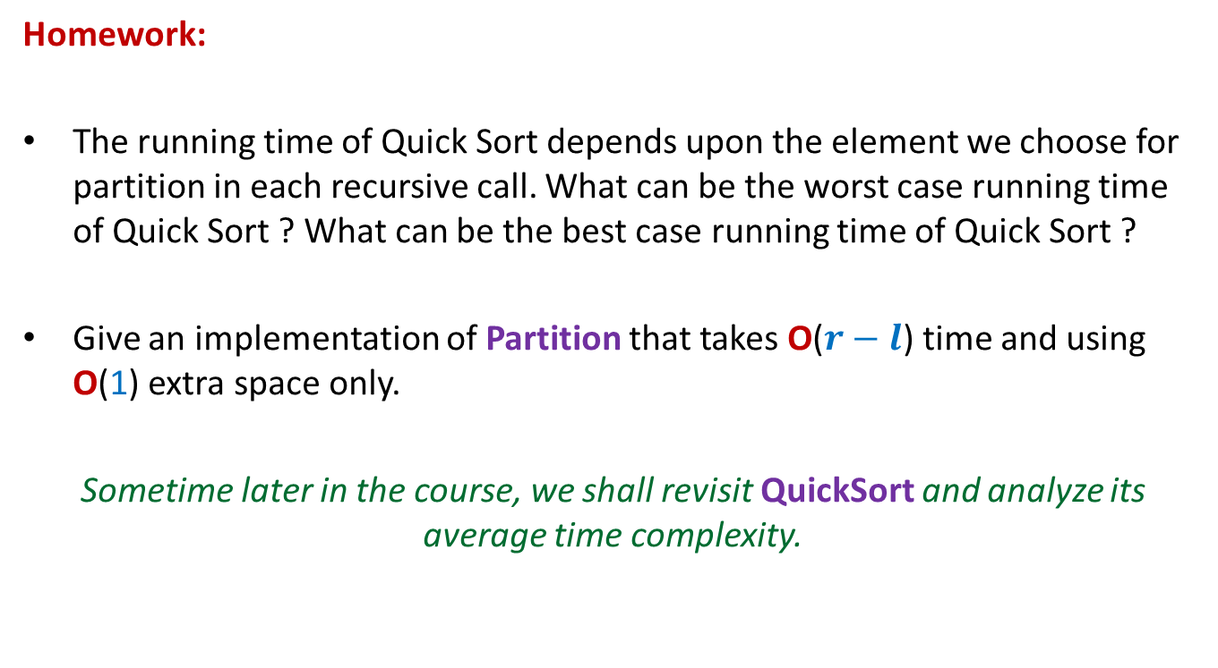
QuickSort
Homework:
The running time of Quick Sort depends upon the element we choose for partition in each recursive call. What can be the worst case running time of Quick Sort ? What can be the best case running time of Quick Sort ?
Give an implementation of Partition that takes O($r−l$) time and using O(1) extra space only.
Sometime later in the course, we shall revisit QuickSort and analyze its average time complexity.

