Slide 1
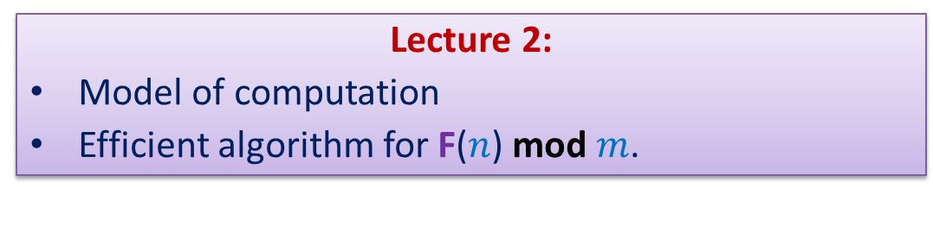
Data Structures and Algorithms (CS210A) Semester I – 2014-15
Lecture 2:
Model of computation
Efficient algorithm for F($n$) mod $m$.

Slide 2
An important Lesson from Lecture 1
Design of efficient algorithm is very important.
(One can learn this lesson in the real sense only after he/she does the corresponding implementation totally himself/herself. Otherwise it is just one of those bookish facts which one believes/remembers)

Slide 3
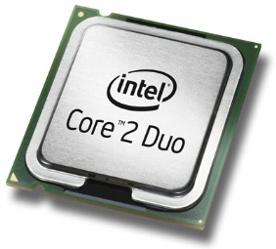
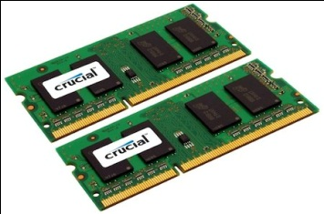

Recall from Lecture 1: Current-state-of-the-art Desktop
A processor (CPU)
speed = few GHz
(a few nanoseconds to execute an instruction)
Internal memory (RAM)
size = a few GB (Stores few million bytes/words)
speed = a few GHz(a few nanoseconds to read a byte/word)
External Memory (Hard Disk Drive)
size = a few tera bytes
speed : seek time = miliseconds
transfer rate= a billion bytes per second

Slide 4
Models of computation
Why do we need such models?
In order to analyze the efficiency of an algorithm, we need a model of computation which is simpler and still captures the essence of the real world computer.
Models :
Word RAM model
Bit complexity model
Universal RAM model
Cell probe model
….
We shall deal mainly with word-RAM model due to its simplicty and higher degree of closeness to the real world computer.

Slide 5
word RAM : a model of computation
Data
Processor
Program
RAM

Slide 6
How is an instruction executed?
Decoding instruction
fetching the operands
performing arithmetic/logical operation
storing the result back
into RAM
➔ Each instruction takes a few cycles (click ticks) to get executed.
Processor
RAM

Slide 7
word RAM model of computation: Characteristics
Word is the basic storage unit of RAM. Word is a collection of few bytes.
Each input item (number, name) is stored in binary format.
RAM can be viewed as a huge array of words. Any arbitrary location of RAM can be accessed in the same time irrespective of the location.
Data as well as Program reside fully in RAM.
Each arithmetic or logical operation (+,-,*,/,or, xor,…) involving a constant number of words takes a constant number of cycles (steps) by the CPU.

Slide 8

Homework 1 from Lecture 1
Computing F($n$) mod $m$

Slide 9
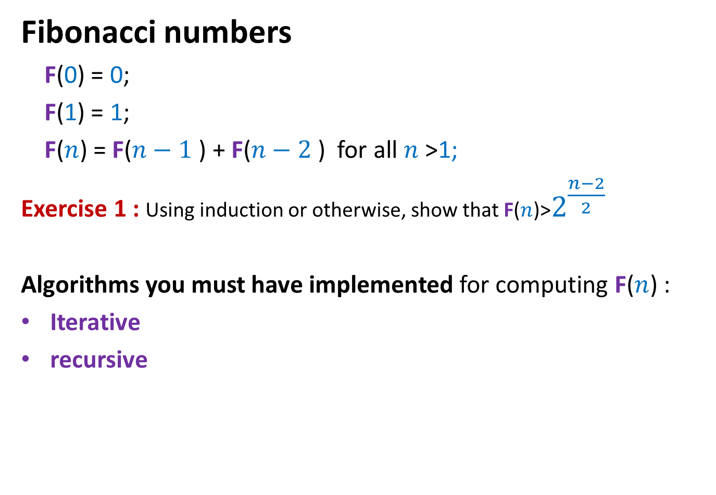
Algorithms for Fibonacci numbers
Fibonacci numbers
F(0) = 0;
F(1) = 1;
F($n$) = F($n−1$) + F($n−2$) for all $n$ >1;
Exercise 1 : Using induction or otherwise, show that F($n$)>$2^{\frac{n−2}{2}}$
Algorithms you must have implemented for computing F($n$) :
Iterative
recursive

Slide 10
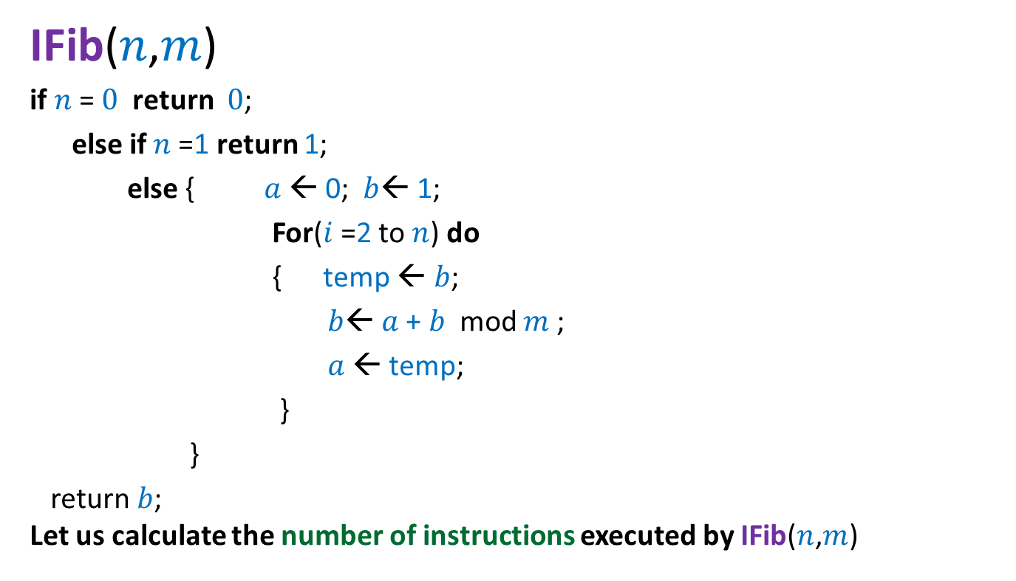

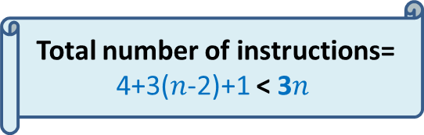
Iterative Algorithm for F($n$) mod $m$
Total number of instructions= 4+3($n$-2)+1 < 3$n$
IFib($n$,$m$)
if $n$= $0$ return $0$;
else if $n$=1 return 1;
else { $a$ ← 0; $b$← 1;
For($i$=2 to $n$) do
{ temp ← $b$;
$b$← $a$+ $b$ mod $m$;
$a$← temp;
}
}
return $b$;
Let us calculate the number of instructions executed by IFib($n$,$m$)
4 instructions
n-2 iterations
3 instructions per iteration
the final instruction

Slide 11
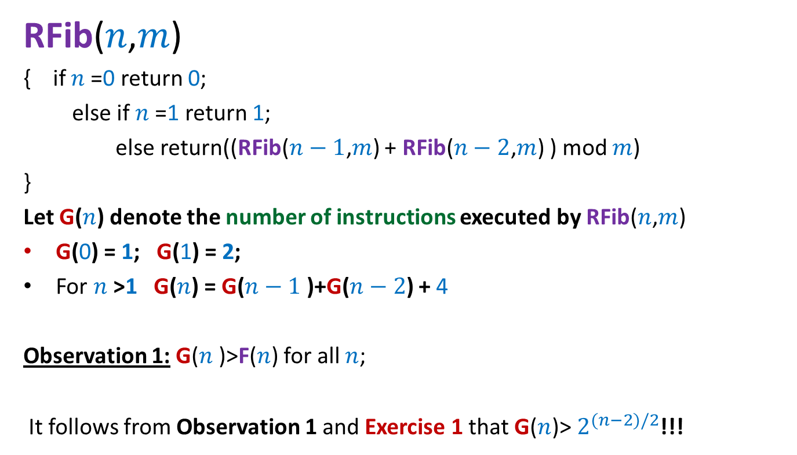
Recursive algorithm for F(n) mod m
RFib($n$,$m$)
{ if $n$=0 return 0;
else if $n$=1 return 1;
else return((RFib($n−1$,$m$) + RFib($n−2$,$m$) ) mod $m$)
}
Let G($n$) denote the number of instructions executed by RFib($n$,$m$)
G(0) = 1; G(1) = 2;
For $n$>1 G($n$) = G($n−1$)+G($n−2$) + 4
Observation 1: G($n$)>F($n$) for all $n$;
It follows from Observation 1 and Exercise 1 that G($n$)> $2^{(n−2)/2}$!!!

Slide 12
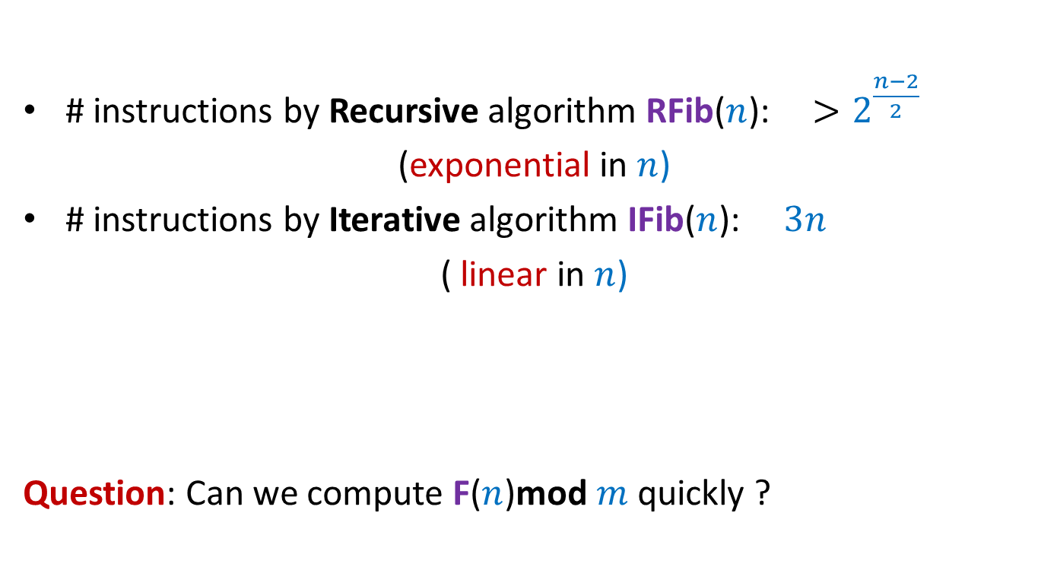

Algorithms for F($n$)mod $m$
# instructions by Recursive algorithm RFib($n$): $>2^{\frac{n−2}{2}}$
(exponential in $n$)
# instructions by Iterative algorithm IFib($n$): $3n$
( linear in $n$)
Question: Can we compute F($n$)mod $m$quickly ?
None of them works for entire range of long long int $n$ and int $m$

Slide 13

How to compute F($n$)mod $m$quickly ?
… need some better insight …

Slide 14
A warm-up example
How good are your programming skills ?

Slide 15
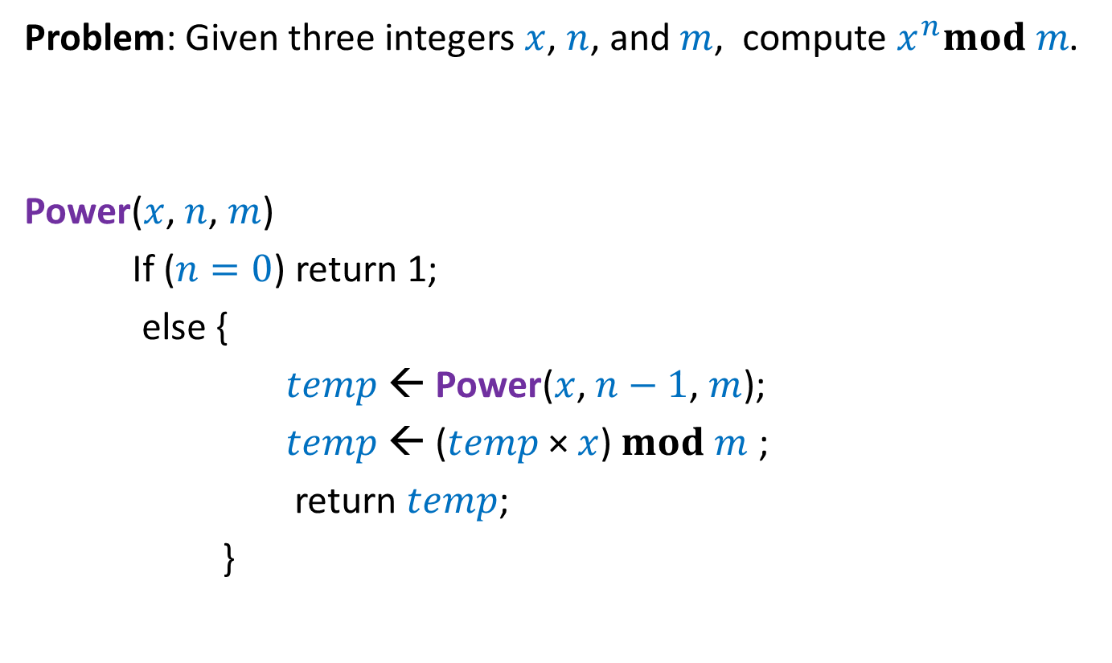

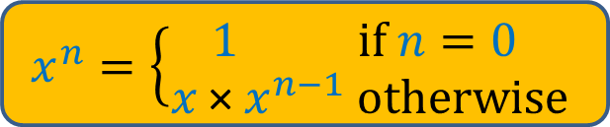
Compute $x^{n}mod m$
Problem: Given three integers $x$, $n$, and $m$, compute $x^{n}mod m$.
Power($x$, $n$, $m$)
If ($n=0$) return 1;
else {
$temp$← Power($x$, $n−1$, $m$);
$temp$← ($temp$× $x$) $mod m$ ;
return $temp$;
}
$$x^{n}=\left\{\begin{aligned}1 if n=0 \\ x \text{×} x^{n−1} otherwise\end{aligned}\right.$$
4 instructions
excluding the
Recursive call

Slide 16


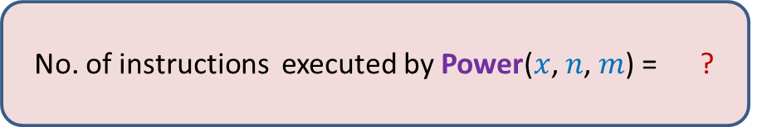
Compute $x^{n}mod m$
Problem: Given three integers $x$, $n$, and $m$, compute $x^{n}mod m$.
Power($x$, $n$, $m$)
Power($x$, $n−1$, $m$);
Power($x$, $n−2$, $m$);
Power($x$, $0$, $m$)
$$x^{n}=\left\{\begin{aligned}1 if n=0 \\ x \text{×} x^{n−1} otherwise\end{aligned}\right.$$
No. of instructions executed by Power($x$, $n$, $m$) = ?
$$4n$$

Slide 17
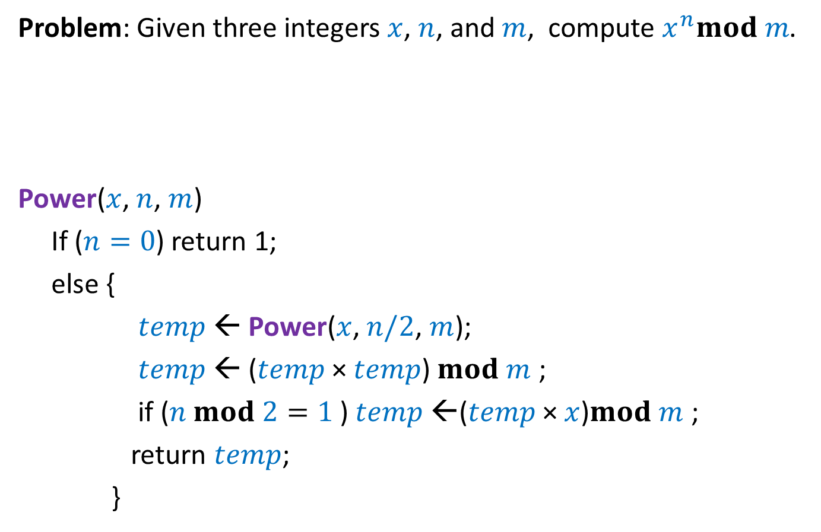
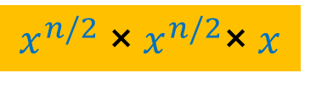
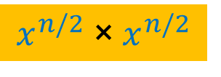
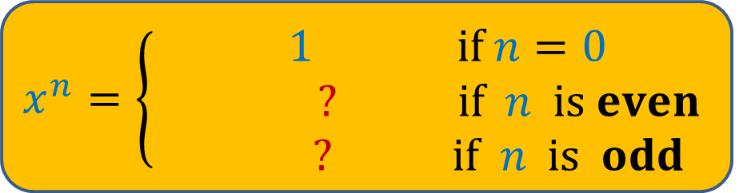
Compute $x^{n}mod m$
Problem: Given three integers $x$, $n$, and $m$, compute $x^{n}mod m$.
Power($x$, $n$, $m$)
If ($n=0$) return 1;
else {
$temp$← Power($x$, $n/2$, $m$);
$temp$← ($temp$× $temp$) $mod m$ ;
if ($n mod 2=1$) $temp$←($temp$× $x$)$mod m$ ;
return $temp$;
}
$$x^{n}=\left\{\begin{aligned} 1 if n=0 \\ ? if n is even \\ ? if n is odd\end{aligned}\right.$$
$$x^{n/2} \text{× }x^{n/2}$$
$$x^{n/2} \text{× }x^{n/2}\text{×} x$$
5 instructions
excluding the
Recursive call

Slide 18

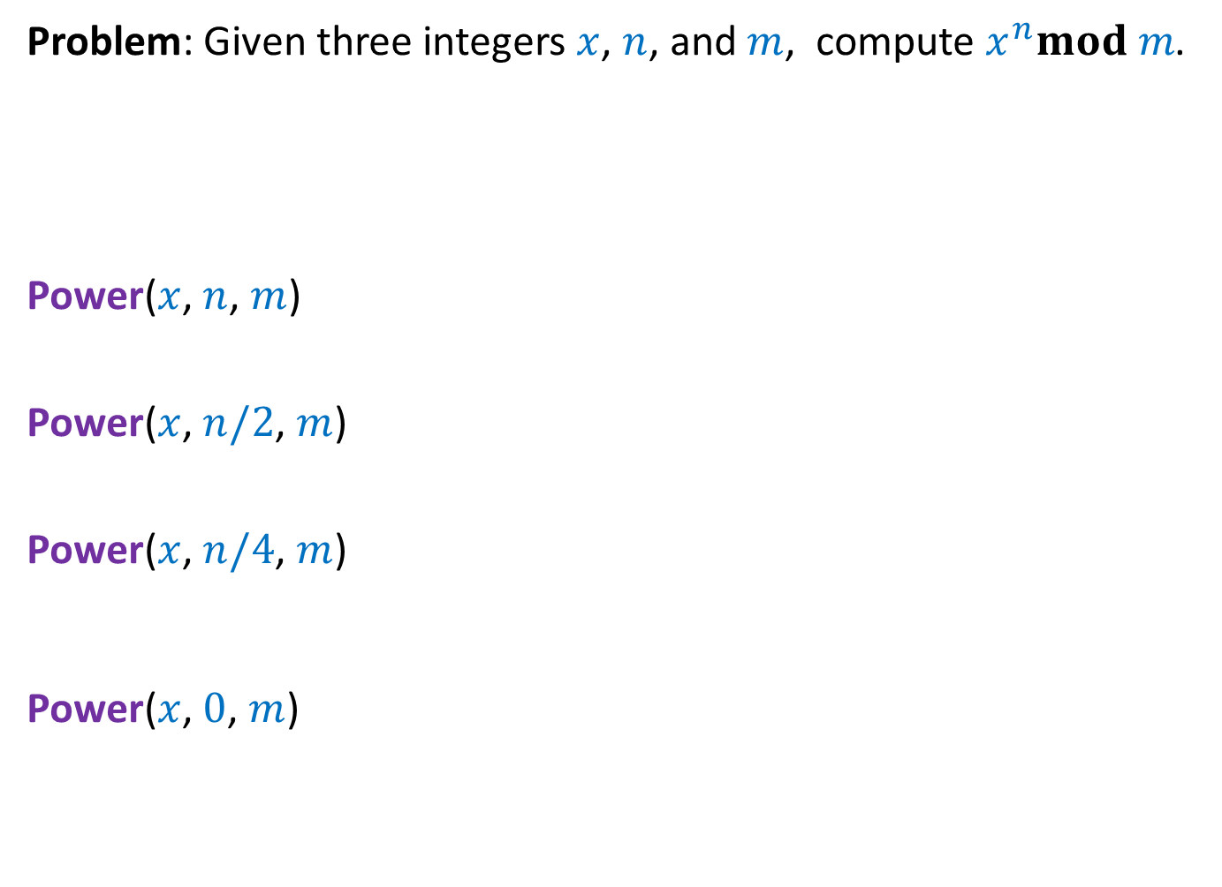

Compute $x^{n}mod m$
Problem: Given three integers $x$, $n$, and $m$, compute $x^{n}mod m$.
Power($x$, $n$, $m$)
Power($x$, $n/2$, $m$)
Power($x$, $n/4$, $m$)
Power($x$, $0$, $m$)
$$x^{n}=\left\{\begin{aligned} 1 if n=0 \\ ? if n is even \\ ? if n is odd\end{aligned}\right.$$
$$x^{n/2} \text{× }x^{n/2}$$
$$x^{n/2} \text{× }x^{n/2}\text{×} x$$
No. of instructions executed by Power($x$, $n$, $m$) = ?
$$5 \log_{2} n$$

Slide 19

Efficient Algorithm for F($n$)mod $m$

Slide 20


Efficient algorithm for F($n$)mod $m$
Idea1 : Can we express F($n$) as $a^{n}$ for some constant $a$ ?
Unfortunately no.

Slide 21
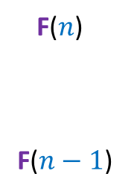
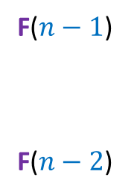

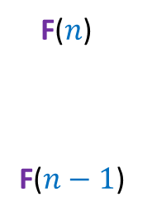
Idea 2
F($n$)
F($n−1$)
1
1 0
F($n−1$)
F($n−2$)
?
Unfolding the RHS of this equation, we get …
$$n−1$$
1
0
F($n$)
F($n−1$)
1
1 0

Slide 22
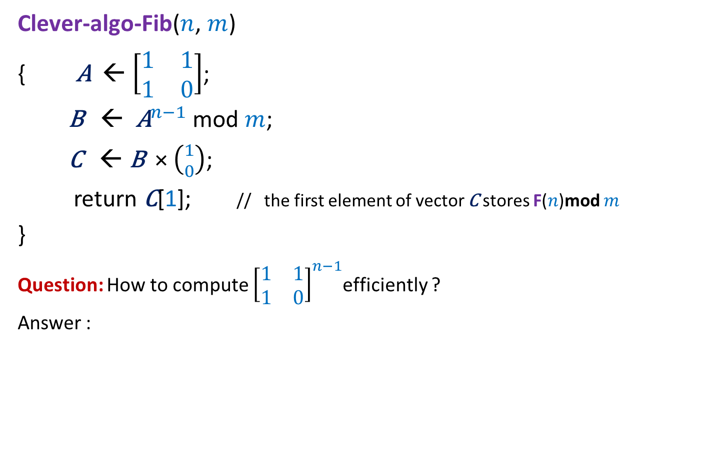


A clever algorithm for F($n$)mod $m$
Clever-algo-Fib($n$, $m$)
{ $\text{A}$← $\left[\begin{matrix}1 & 1 \\ 1 & 0\end{matrix}\right]$;
$\text{B}$ ← ${\text{A}}^{n−1}$ mod $m$;
$\text{C}$ ← $\text{B}$ × $\left({1 \atop 0}\right)$;
return $\text{C}$[1]; // the first element of vector $\text{C}$ stores F($n$)mod $m$
}
Question: How to compute ${\left[\begin{matrix}1 & 1 \\ 1 & 0\end{matrix}\right]}^{n−1}$efficiently ?
Answer :
Inspiration from Algorithm for $x^{n}mod m$

Slide 23
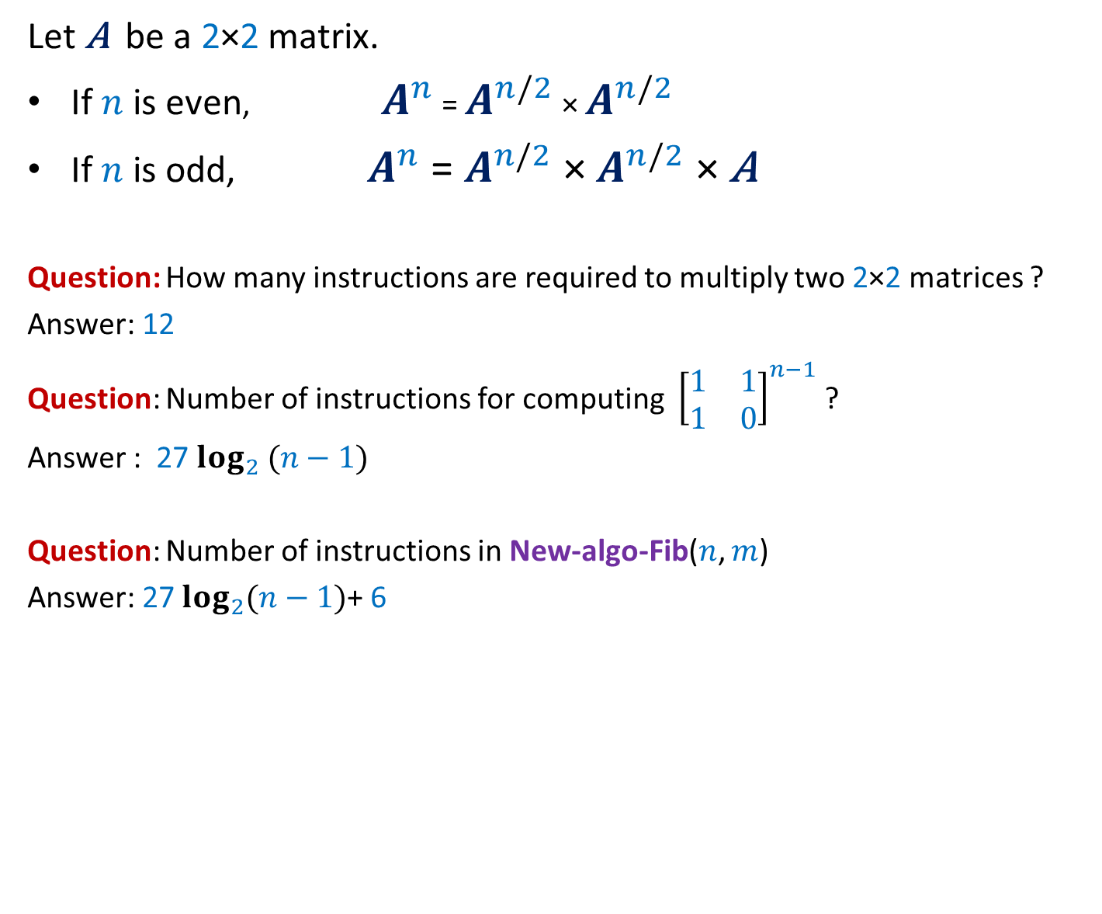
A clever algorithm for F($n$)mod $m$
Let $\text{A}$ be a 2×2 matrix.
If $n$ is even, $A^{n}$ = $A^{n/2}$ × $A^{n/2}$
If $n$ is odd, $A^{n}$ = $A^{n/2}$ × $A^{n/2}$ × $\text{A}$
Question: How many instructions are required to multiply two 2×2 matrices ?
Answer: 12
Question: Number of instructions for computing ${\left[\begin{matrix}1 & 1 \\ 1 & 0\end{matrix}\right]}^{n−1}$ ?
Answer : 27 $\log_{2} (n−1)$
Question: Number of instructions in New-algo-Fib($n$, $m$)
Answer: 27 $\log_{2}(n−1)$+ 6

Slide 24
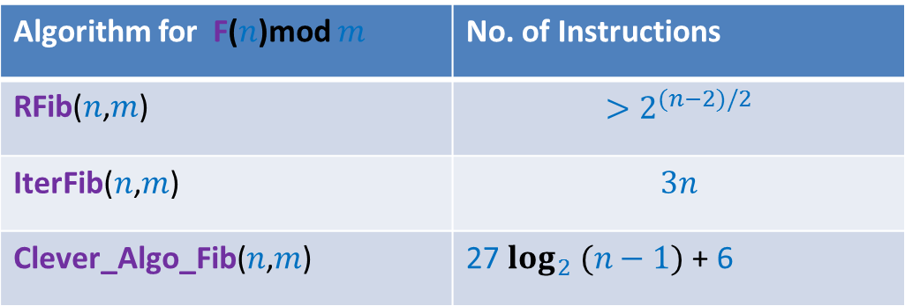
Which algorithm is better ?
Algorithm for F($n$)mod $m$ | No. of Instructions
RFib($n$,$m$) | $$>2^{(n−2)/2}$$
IterFib($n$,$m$) | $$3n$$
Clever_Algo_Fib($n$,$m$) | 27 $\log_{2} (n−1)$ + 6
Find out yourself ?
Assignment 1

