Slide 1
Data Structures and Algorithms (CS210A) Semester I – 2014-15
Lecture 20:
Solving some practice sheet problems
Overview of the 2nd half of course.

Slide 2
Practice problems
Sheet 4

Slide 3
How to insert 4 ?
11
2
14
1
7
15
5
8
4

Slide 4
How to insert 4 ?
11
left rotation
2
14
1
7
15
5
8
4

Slide 5
How to insert 4 ?
Right rotation
11
7
14
2
8
15
1
5
4

Slide 6
How to insert 4 ?
7
2
11
1
5
8
14
4
15

Slide 7
How to insert 4 ?
7
2
11
1
5
8
14
4
15

Slide 8
How to insert 4 ?
7
2
11
1
5
8
14
4
15
All properties of red-black tree are restored now☺

Slide 9
How to delete 9 ?
root
3
15
9
26
5
11
19
37
17
20

Slide 10

How to delete 9 ?
root
3
15
q
5
s
26
9
11
19
37
$$−$$
17
20

Slide 11

How to delete 9 ?
root
3
15
q
5
26
11
19
37
$$−$$
$$−$$
$$−$$
17
20

Slide 12
How to delete 9 ?
root
3
Right rotation
s
15
q
5
26
11
19
37
$$−$$
$$−$$
$$−$$
17
20

Slide 13
How to delete 9 ?
root
3
15
q
5
19
17
26
11
$$−$$
$$−$$
$$−$$
20
37

Slide 14
How to delete 9 ?
root
3
left rotation
s
15
q
5
19
17
26
11
$$−$$
$$−$$
$$−$$
20
37

Slide 15

How to delete 9 ?
root
3
swap colors
19
15
q
26
5
17
20
37
11
$$−$$
$$−$$
$$−$$

Slide 16
How to delete 9 ?
root
3
19
15
q
26
5
17
20
37
11
$$−$$
$$−$$
$$−$$
$$−$$

Slide 17
How to delete 9 ?
root
3
19
15
q
26
5
17
20
37
11
$$−$$
$$−$$
$$−$$
$$−$$
All properties of red-black tree are restored now☺

Slide 18
Practice problems
Sheet 2

Slide 19
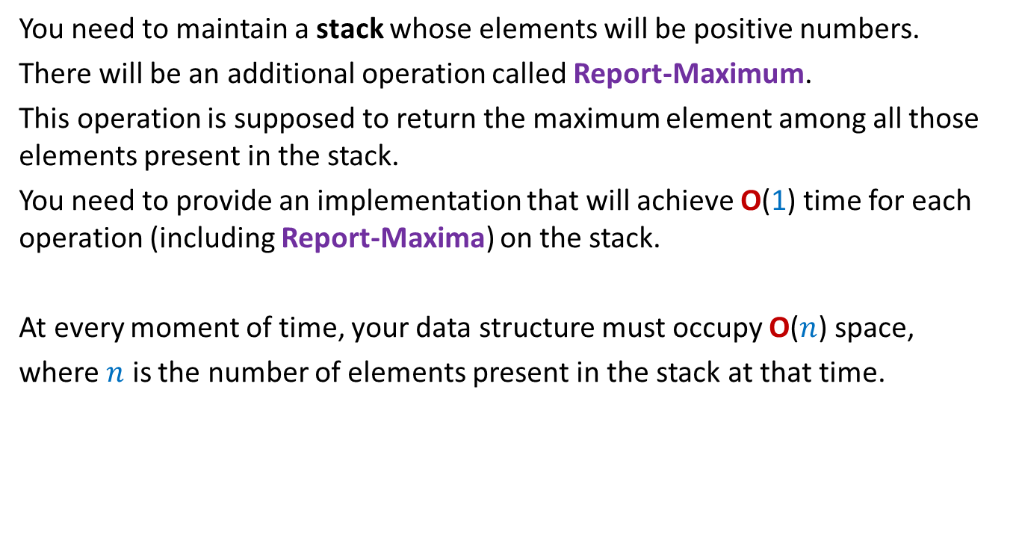
Stack with maxima
You need to maintain a stack whose elements will be positive numbers.
There will be an additional operation called Report-Maximum.
This operation is supposed to return the maximum element among all those elements present in the stack.
You need to provide an implementation that will achieve O(1) time for each operation (including Report-Maxima) on the stack.
At every moment of time, your data structure must occupy O($n$) space,
where $n$ is the number of elements present in the stack at that time.

Slide 20
Stack with maxima
Solution sketch:
Keep two stacks
One stack for usual pushing and popping of elements
Another stack for storing ?
(Give details of push and pop operations now)
Question : Is it possible to achieve this goal using just one stack ?
Answer: Yes.
Ponder over this question with free mind without any worry (because it will not be asked in the exams of this course.)
Max of all elements in the stack

Slide 21
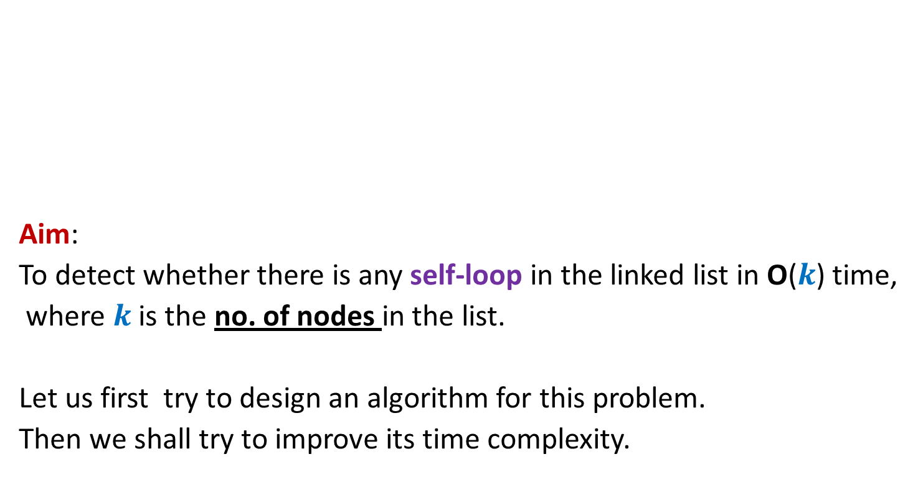
Detecting self-loop in linked list
Aim:
To detect whether there is any self-loop in the linked list in O($k$) time,
where $k$is the no. of nodes in the list.
Let us first try to design an algorithm for this problem.
Then we shall try to improve its time complexity.

Slide 22
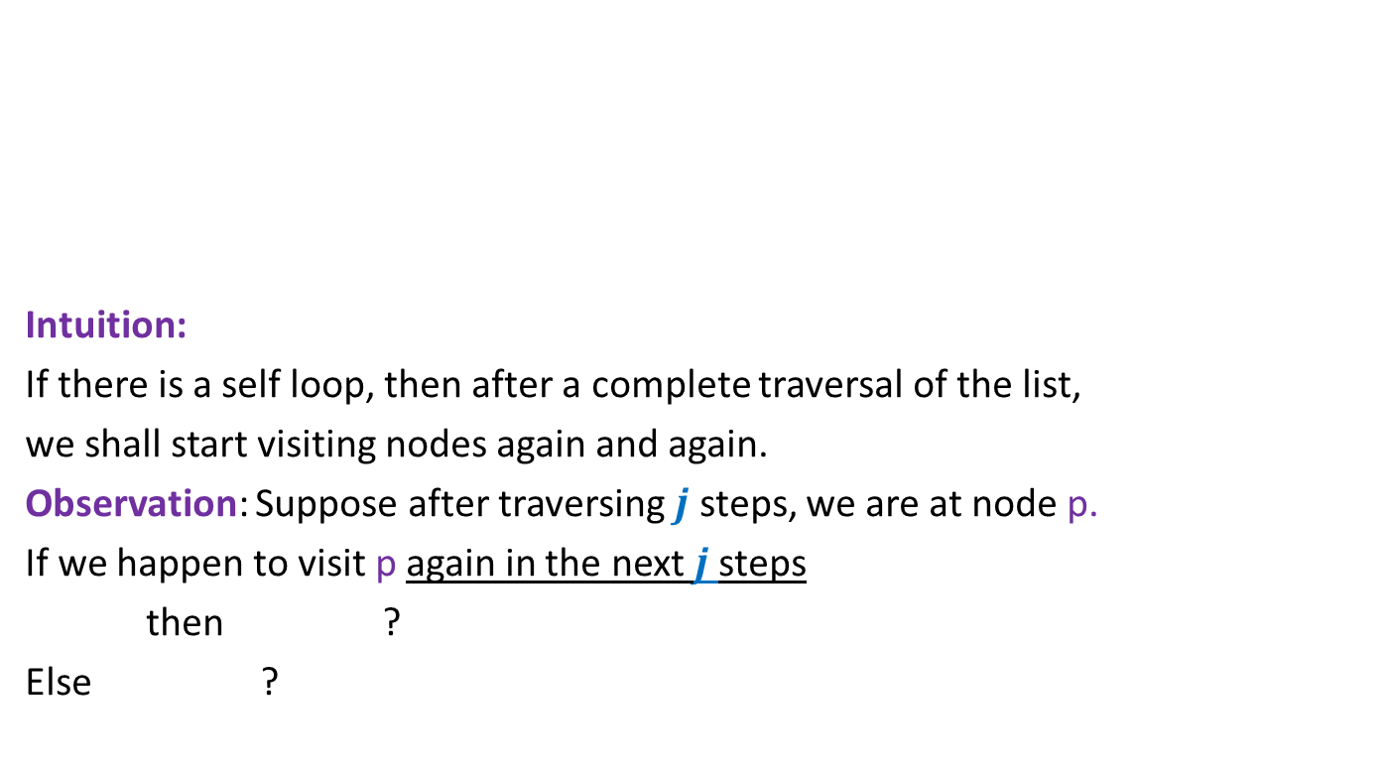
Detecting self-loop in linked list
Intuition:
If there is a self loop, then after a complete traversal of the list,
we shall start visiting nodes again and again.
Observation: Suppose after traversing $j$ steps, we are at node p.
If we happen to visit p again in the next $j$steps
then ?
Else ?
Translate this observation into an algorithm.
There is a self loop
There is no self loop in the prefix of length $j$ of the list

Slide 23

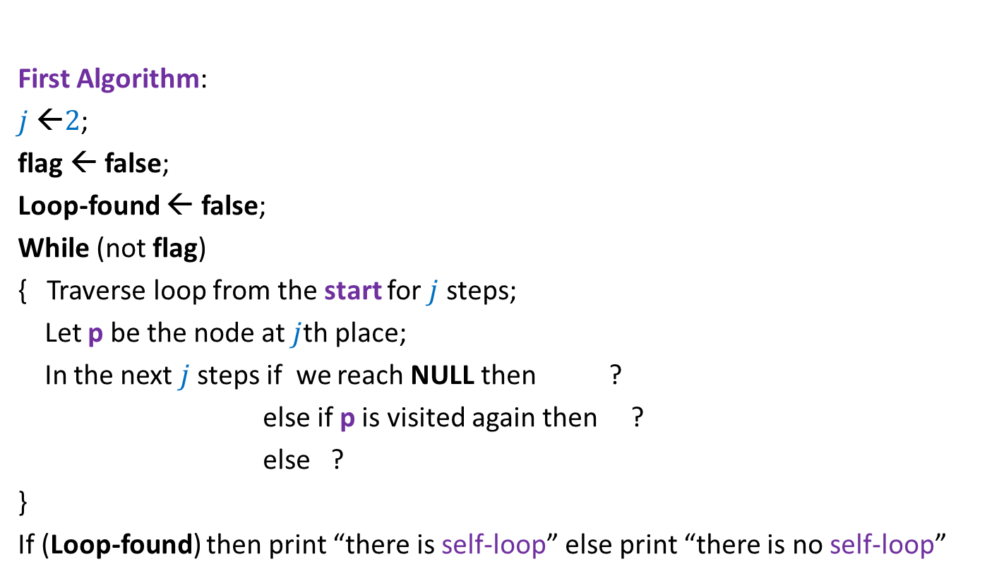

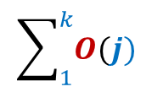
Detecting self-loop in linked list
The correctness of the algorithm follows from the previous slide.
Time complexity :
First Algorithm:
$j$ ←$2$;
flag ← false;
Loop-found ← false;
While (not flag)
{ Traverse loop from the start for $j$ steps;
Let p be the node at $j$th place;
In the next $j$steps if we reach NULL then ?
else if p is visited again then ?
else ?
}
If (Loop-found) then print “there is self-loop” else print “there is no self-loop”
$$\sum_{1}^{k}{O(j)}$$
= $O(k^{2})$
flag← true;
{Loop-found ← true; flag← true }
$j$ ←$j+1$;

Slide 24
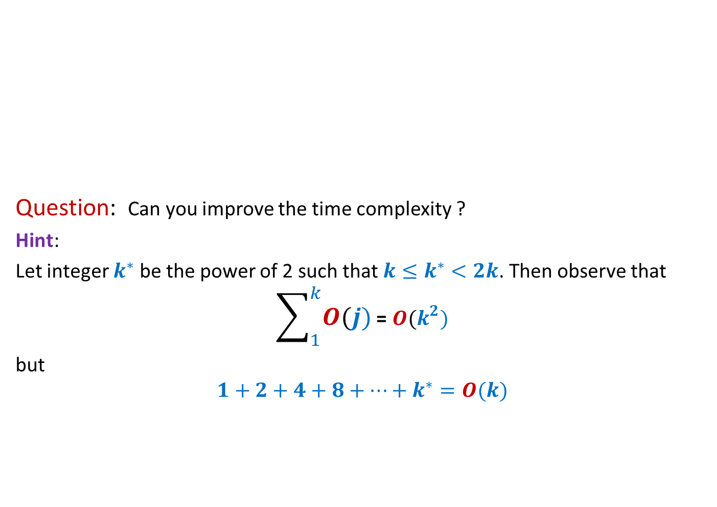
Detecting self-loop in linked list
Question: Can you improve the time complexity ?
Hint:
Let integer $k^{∗}$ be the power of 2 such that ${k≤k}^{∗}<2k$. Then observe that
$$\sum_{1}^{k}{O(j)}\text{=} O(k^{2})$$
but
$$1+2+4+8+…+k^{∗}=O(k)$$
Use this hint to speed-up the First algorithm.

Slide 25

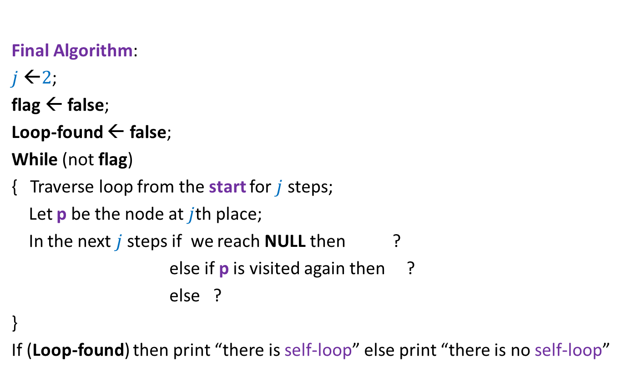
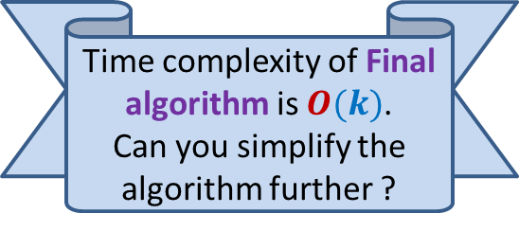
Detecting self-loop in linked list
Time complexity of Final algorithm is $O(k)$.
Can you simplify the algorithm further ?
Final Algorithm:
$j$ ←$2$;
flag ← false;
Loop-found ← false;
While (not flag)
{ Traverse loop from the start for $j$ steps;
Let p be the node at $j$th place;
In the next $j$steps if we reach NULL then ?
else if p is visited again then ?
else ?
}
If (Loop-found) then print “there is self-loop” else print “there is no self-loop”
flag← true;
{Loop-found ← true; flag← true }
$j$ ←$2∗j$;

Slide 26
Practice problems
Sheet 3

Slide 27
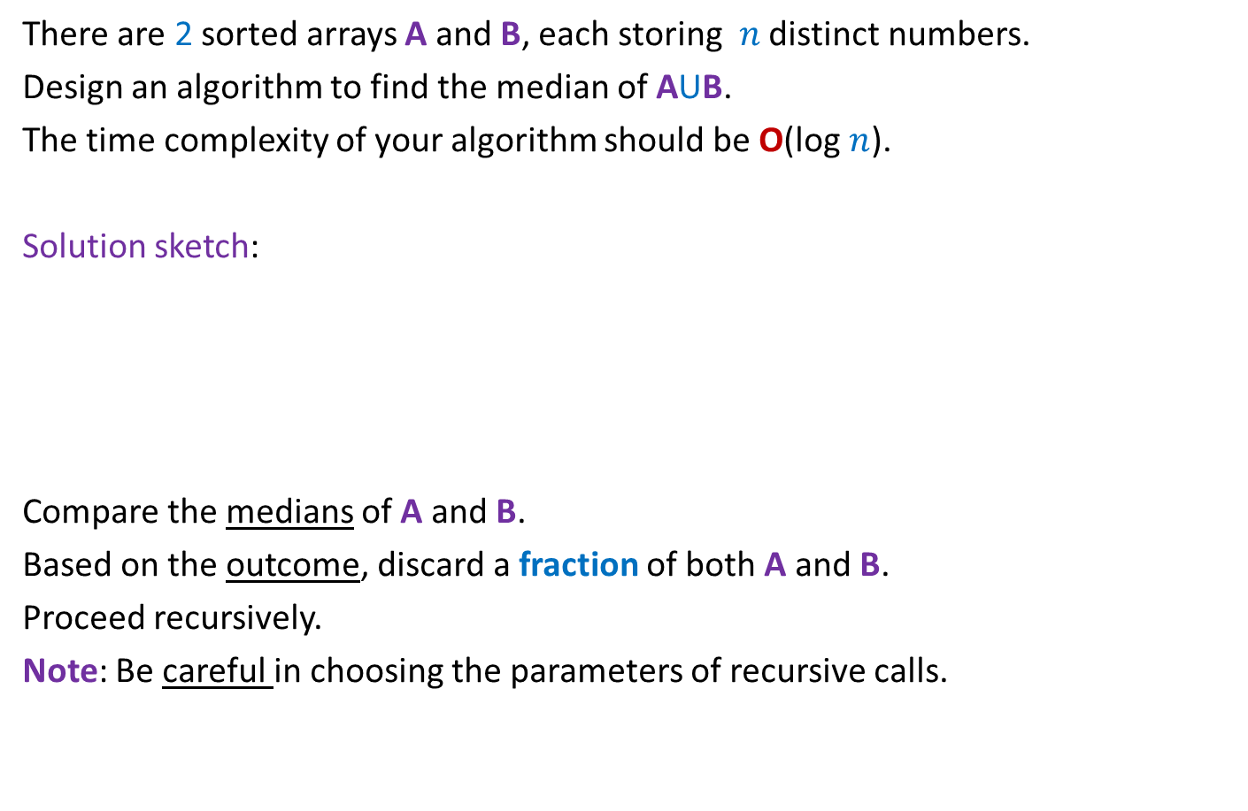
Median of 2 arrays
There are 2 sorted arrays A and B, each storing $n$ distinct numbers.
Design an algorithm to find the median of AUB.
The time complexity of your algorithm should be O(log $n$).
Solution sketch:
Compare the medians of A and B.
Based on the outcome, discard a fraction of both A and B.
Proceed recursively.
Note: Be careful in choosing the parameters of recursive calls.
67
A
88
B

Slide 28
Rest of the course
Graph algorithms
(we shall cover it just after the mid-semester exam.)
Greedy algorithms
Incredible data structures

