Slide 1
Data Structures and Algorithms (CS210A) Semester I – 2014-15
Lecture 24
A data structure problem for graphs.
Depth First Search (DFS) Traversal
Novel application: computing biconnected components of a graph

Slide 2
BFS Traversal in Undirected Graphs
Theorem:
BFS Traversal from x visits all vertices reachable from x in the given graph.
x
b
w
f
u
h
v
d
g
r
y
s
c

Slide 3
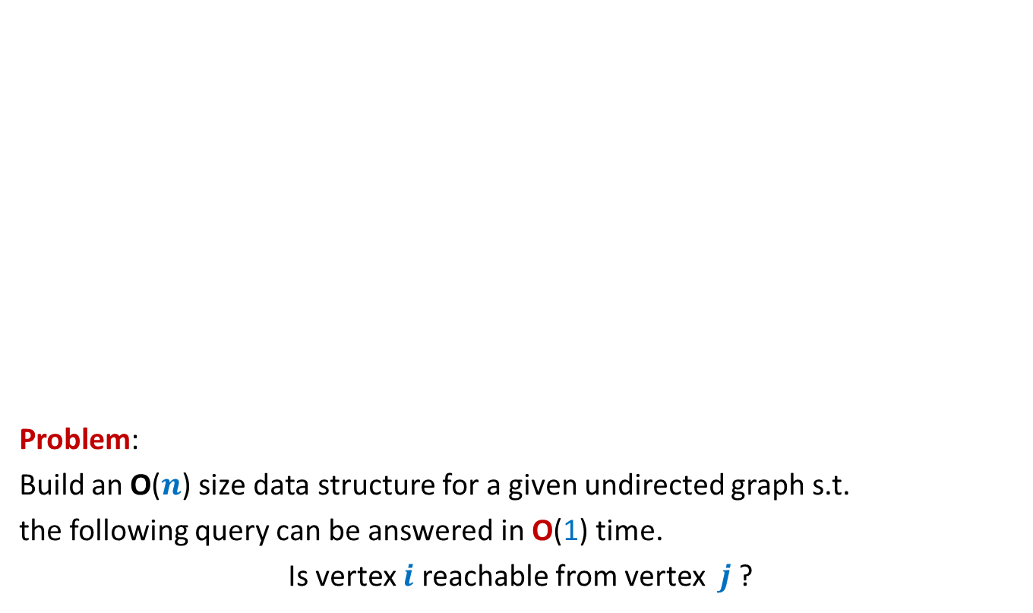
Connectivity problem in a Graph
Problem:
Build an O($n$) size data structure for a given undirected graph s.t.
the following query can be answered in O(1) time.
Is vertex $i$ reachable from vertex $j$ ?

Slide 4
Connectivity problem in a Graph
Problem:
Build an O($n$) size data structure for a given undirected graph s.t.
the following query can be answered in O(1) time.
Is vertex $i$ reachable from vertex $j$ ?

Slide 5
Connectivity problem in a Graph
Problem:
Build an O($n$) size data structure for a given undirected graph s.t.
the following query can be answered in O(1) time.
Is vertex $i$ reachable from vertex $j$ ?

Slide 6
Connectivity problem in a Graph
Problem:
Build an O($n$) size data structure for a given undirected graph s.t.
the following query can be answered in O(1) time.
Is vertex $i$ reachable from vertex $j$ ?

Slide 7
Connectivity problem in a Graph
BFS(x)
CreateEmptyQueue(Q);
Visited(x) ← true;
Enqueue(x,Q);
While(Not IsEmptyQueue(Q))
{ v ←Dequeue(Q);
For each neighbor w of v
{ if (Visited(w) = false)
{ Visited(w) ← true ;
Enqueue(w, Q);
}
}
}
Connectivity(G)
{ For each vertex x Visited(x)← false;
For each vertex v in V
If (Visited(v) = false) BFS(x);
return Label;
}
Label[x] ← x;
Label[w] ← x ;
Create an array Label;

Slide 8
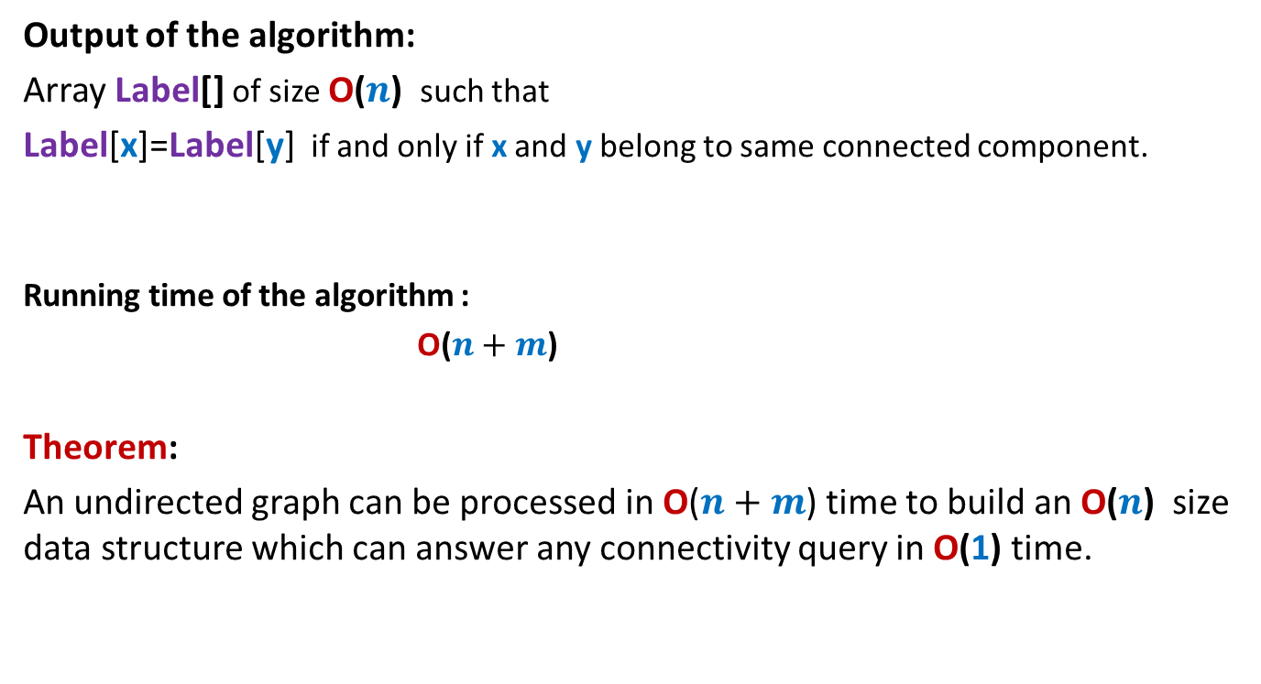
Analysis of the algorithm
Output of the algorithm:
Array Label[] of size O($n$) such that
Label[x]=Label[y] if and only if x and y belong to same connected component.
Running time of the algorithm :
O($n+m$)
Theorem:
An undirected graph can be processed in O($n+m$) time to build an O($n$) size data structure which can answer any connectivity query in O(1) time.

Slide 9
Is there alternate way to traverse a graph ?
Yes
More Natural
More Powerful

Slide 10

Try to get inspiration from your “human executable method” to design
“a machine executable algorithm” for traversing a graph.
Suppose you go to Paris. You wish to travel to various monuments.
How will you do it without any map or asking any one for directions ?

Slide 11
Non-triviality of graph traversal
Avoiding loop:
How to avoid visiting a vertex multiple times ?
(keeping track of vertices already visited)
Finite number of steps :
The traversal must stop in finite number of steps.
Completeness :
We must visit all vertices reachable from the start vertex x.

Slide 12
A natural way to traverse a graph
recursive
We need a mechanism to
Avoid visiting a vertex multiple times
Trace back in case we reach a dead end.
y
v
w
f
We can solve it by keeping a label “Visited” for each vertex
like in BFS traversal.
b
h
d
g
u
r
Recursion takes care of it ☺
z
s
c

Slide 13
DFS traversal of G
DFS(v)
{ Visited(v) ← true;
For each neighbor w of v
{ if (Visited(w) = false)
{ DFS(w) ;
}
}
}
DFS-traversal(G)
{ For each vertex vϵ V { Visited(v)← false; }
For each vertex v ϵ V {
If (Visited(v ) = false) DFS(v);
}
}
……..;
Add a few extra statements here
to get an efficient algorithm
for a new problem ☺
……..;

Slide 14
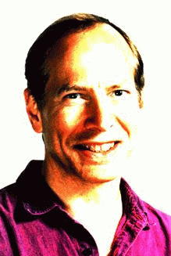
DFS traversal
a milestone in the area of graph algorithms
Invented by Robert Endre Tarjan in 1972
One of the pioneers in the field of data structures and algorithms.
Got the Turing award (equivalent to Nobel prize) for his fundamental contribution to data structures and algorithms.
DFS traversal has proved to be a very elegant and powerful tool for graph algorithms.

Slide 15
DFS traversal
a milestone in the area of graph algorithms
Applications:
Connected components of a graph.
Biconnected components of a graph.
(Is the connectivity of a graph robust to failure of any node ?)
Finding bridges in a graph.
(Is the connectivity of a graph robust to failure of any edge)
Planarity testing of a graph
(Can a given graph be embedded on a plane so that no two edges intersect ?)
Strongly connected components of a directed graph.
(the extension of connectivity in case of directed graphs)

Slide 16
Insight into DFS through an example
DFS(v) begins
v visits y
DFS(y) begins
y visits f
DFS(f) begins
f visits b
DFS(b) begins
all neighbors of b are already visited
DFS(b) ends
control returns to DFS(f)
f visits h
DFS(h) begins
…. and so on ….
After visiting z, control returns tor→c→s→u→h→f→y→v
v visits w
DFS(w) begins
…. and so on ….
y
v
w
f
b
h
d
g
u
r
z
s
c

Slide 17
Insight into DFS through an example
Observation1: (Recursive nature of DFS)
If DFS(v) invokes DFS(w), then
DFS(w) finishes ? DFS(v).
y
v
w
f
b
h
d
g
before
u
r
z
s
c

Slide 18
Insight into DFS through an example
Question :
When DFS reaches a vertex u, what is the role of vertices already visited ?
y
v
w
f
b
h
d
g
u
r
The traversal will not proceed along the vertices which are already visited. Hence the visited vertices act as a barrier for the traversal from u.
z
s
c

Slide 19
Insight into DFS through an example
X
Observation 2:
Let X be the set of vertices visited before DFS traversal reaches vertex u for the first time.
The DFS(u) pursued now is like
fresh DFS(u) executed in graph G\X.
NOTE:
G\X is the graph G after removal of all vertices X along with their edges.
y
v
w
f
b
h
d
g
u
r
z
s
c

Slide 20
Proving that DFS(v) visits all vertices reachable from v
By induction on the
size of connected component of v
Can you figure out the inductive assertion now?
Think over it. It is given on the following slide…

Slide 21
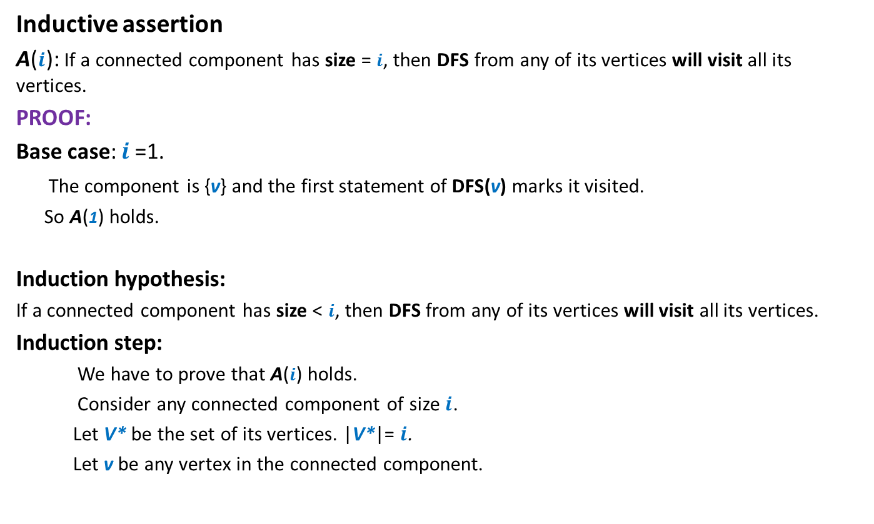
Inductive assertion
A($i$): If a connected component has size = $i$, then DFS from any of its vertices will visit all its vertices.
PROOF:
Base case: $i$=1.
The component is {v} and the first statement of DFS(v) marks it visited.
So A(1) holds.
Induction hypothesis:
If a connected component has size < $i$, then DFS from any of its vertices will visit all its vertices.
Induction step:
We have to prove that A($i$) holds.
Consider any connected component of size $i$.
Let V* be the set of its vertices. |V*|= $i$.
Let v be any vertex in the connected component.
Watch the following slides
very slowly and very carefully.

Slide 22


DFS(v)
Let y be the first neighbor visited by v.
A= the set of vertices such that every path from
y to them passes through v.
B= V*\A.
A= {v, g, w, d}
B= {y, b, f, h, u, s, c, r, z}
Question: What is DFS(y) like ?
Answer: DFS(y) in G\{v}.
Question: What is the connected component of y in G\{v} ?
y
v
w
f
b
|A|< i since y$∉$ A
h
d
g
|B|< i since v$∉$ B
u
r
z
s
c

Slide 23
DFS(v)
Let y be the first neighbor visited by v.
A= the set of vertices such that every path from
y to them passes through v.
B= V*\A.
A= {v, g, w, d}
B= {y, b, f, h, u, s, c, r, z}
Question: What is DFS(y) like ?
Answer: DFS(y) in G\{v}.
Question: What is the connected component of y in G\{v} ?
Answer: B.
|B|< i, so by I.H., DFS(y) visits entire set B & we return to v.
Question: What is DFS(v) like when DFS(y) finishes ?
Answer: DFS(v) in G\B.
Question: What is the connected component of v in G\B ?
y
v
w
f
b
|A|< i since y$∉$ A
h
d
g
|B|< i since v$∉$ B
u
r
z
s
c

Slide 24
DFS(v)
Let y be the first neighbor visited by v.
A= the set of vertices such that every path from
y to them passes through v.
B= V*\A.
A= {v, g, w, d}
B= {y, b, f, h, u, s, c, r, z}
Question: What is DFS(y) like ?
Answer: DFS(y) in G\{v}.
Question: What is the connected component of y in G\{v} ?
Answer: B.
|B|< i, so by I.H., DFS(y) visits entire set B & we return to v.
Question: What is DFS(v) like when DFS(y) finishes ?
Answer: DFS(v) in G\B.
Question: What is the connected component of v in G\B ?
Answer: A.
|A|< i, so by I.H., DFS(v) pursued after finishing DFS(y) visits entire set A.
y
v
w
f
b
|A|< i since y$∉$ A
h
d
g
|B|< i since v$∉$ B
u
r
z
s
c
Hence entire component of v gets visited

Slide 25

Theorem: DFS(v) visits all vertices of the connected component of v.
Exercise:
Use DFS traversal to compute all connected components of a given G in time O($m+n$).

