Slide 1
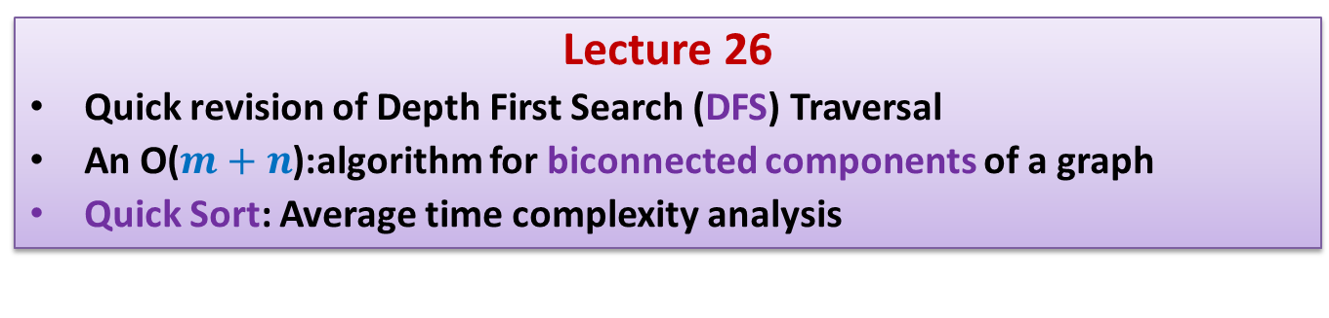
Data Structures and Algorithms (CS210A) Semester I – 2014-15
Lecture 26
Quick revision of Depth First Search (DFS) Traversal
An O($m+n$):algorithm for biconnected components of a graph
Quick Sort: Average time complexity analysis

Slide 2
Quick revision of Depth First Search (DFS) Traversal

Slide 3
DFS traversal of G
DFS(v)
{ Visited(v) ← true;
For each neighbor w of v
{ if (Visited(w) = false)
{ DFS(w) ;
}
}
}
DFS-traversal(G)
{
For each vertex vϵ V { Visited(v)← false }
For each vertex v ϵ V { If (Visited(v ) = false) DFS(v) }
}
DFN[v] ← dfn ++;
……..;
……..;
dfn ← 0;

Slide 4
DFN number
DFN[x] :
The number at which x gets visited during DFS traversal.
y
v
1
0
10
w
f
2
3
b
4
h
12
11
d
g
u
5
r
8
z
6
9
s
7
c

Slide 5
DFS(v) computes a tree rooted at v
If x is ancestor of y then
DFN[x] ? DFN[y]
Question: Is a DFS tree unique ?
Answer: No.
Question:
Can any rooted tree be obtained through DFS ?
Answer: No.
y
v
<
w
f
b
h
d
g
u
r
z
s
c
A DFS tree rooted at v

Slide 6
Always remember
Instead of looking at a graph,
look at its picture in terms of any of its DFS traversal
non-tree edge ➔ back edge

Slide 7
A novel application of DFS traversal
Definition: A connected graph is said to be biconnected
if there does not exit any vertex whose removal disconnects the graph.
Motivation: To design robust networks (immune to any single node failure).
Determining if a graph G is biconnected

Slide 8
Is this graph biconnected ?
No.
y
v
w
f
b
h
d
g
u
r
z
s
c

Slide 9

A trivial algorithms for checking bi-connectedness of a graph
For each vertex v, determine if G\{v} is connected
(One may use either BFS or DFS traversal here)
Time complexity of the trivial algorithm : O($mn$)

Slide 10
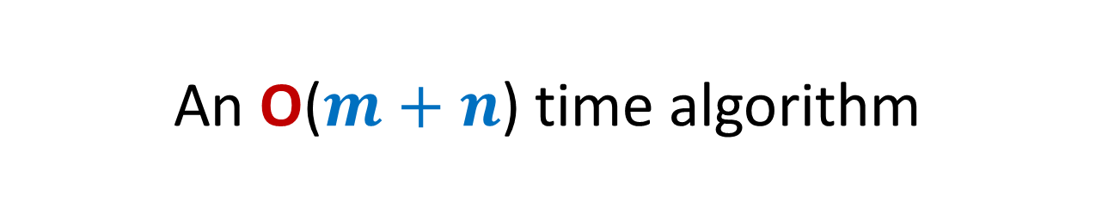
An O($m+n$) time algorithm
A single DFS traversal

Slide 11

An O($m+n$) time algorithm
A formal characterization of the problem.
(articulation points)
Exploring relationship between articulation point & DFS tree.
Using the relation cleverly to design an efficient algorithm.

Slide 12
This graph is NOT biconnected
The removal of any of {v,f,u} can destroy connectivity.
v,f,u are called the articulation points of G.
y
v
w
f
b
h
d
g
u
r
z
s
c

Slide 13
A formal definition of articulaton point
Definition: A vertex x is said to be articulation point if there exist two distinct vertices u and v such that every path between u and v passes through x.
Observation: A graph is biconnected if none of its vertices is an articulation point.
AIM:
Design an algorithm to compute all articulation points in a given graph.
u
x
v

Slide 14
Some observations
A leaf node can never be an a.p. ?
Root is an a.p. iff it has two or more children.
v
What about an internal node ?

Slide 15
Necessary and Sufficient condition for x to be articulation point
root
< 5
Theorem1:
An internal node x is articulation point iff
x has at least one child y s.t. there is no back edge from subtree(y) to ancestor of x.
➔ No back edge from subtree(y) going to a vertex “higher” than x.
z
?
x
5
How to define the notion “higher” than x ?
y
6
Use DFN numbering
9

Slide 16

Necessary and Sufficient condition for x to be articulation point
root
< 5
Theorem1:
An internal node x is articulation point iff
x has at least one child y s.t. there is no back edge from subtree(y) to ancestor of x.
High_pt(v):
DFN of the highest ancestor of v to which there is a back edge from subtree(v).
Theorem2:
An internal node x is articulation point iff
it has a child, say y, in DFS tree such that
High_pt(y) ? DFN(x).
z
?
Invent a new function
x
5
y
6
9
$$≥$$

Slide 17
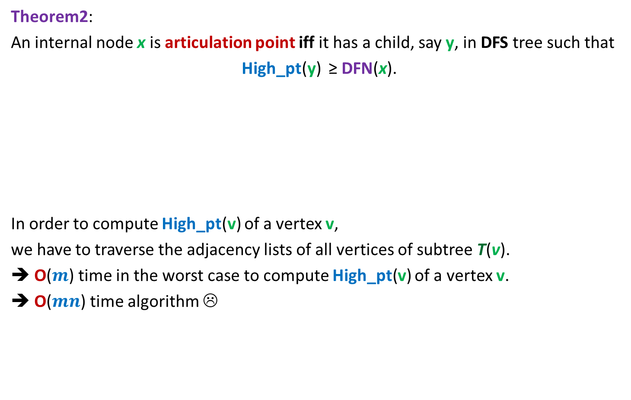
Theorem2:
An internal node x is articulation point iff it has a child, say y, in DFS tree such that
High_pt(y) ≥ DFN(x).
In order to compute High_pt(v) of a vertex v,
we have to traverse the adjacency lists of all vertices of subtree T(v).
➔ O($m$) time in the worst case to compute High_pt(v) of a vertex v.
➔ O($mn$) time algorithm ☹
Good ☺!
But how to transform this Theorem into an efficient algorithm for articulation points ?

Slide 18
How to compute High_pt(v) efficiently ?
root
Question: Can we express High_pt(v) in terms of its children and proper ancestors?
Exploit recursive structure of DFS tree.
v

Slide 19
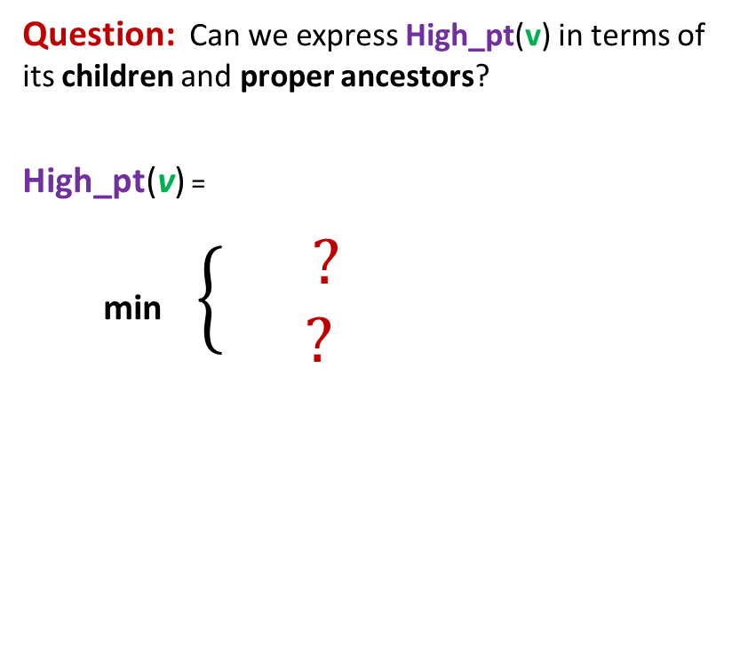
How to compute High_pt(v) efficiently ?
root
Question: Can we express High_pt(v) in terms of its children and proper ancestors?
High_pt(v) =
min $\left\{\begin{aligned} ? \\ ?\end{aligned}\right.$
High_pt(w)
If w=child(v)
v
(v,w) ϵ E
If w = proper
ancestor of v
DFN(w)

Slide 20
The novel algorithm
The algorithm will output an array AP[] such that
AP[v]= true if and only if v is an articulation point.

Slide 21
Algorithm for articulation points in a graph G
DFS(v)
{ Visited(v) ← true; DFN[v] ← dfn ++;
For each neighbor w of v
{ if (Visited(w) = false)
{ DFS(w) ;
}
}
}
DFS-traversal(G)
{ dfn ← 0;
For each vertex vϵ V { Visited(v)← false; }
For each vertex v ϵ V { If (Visited(v ) = false) DFS(v) }
}
High_pt[v]←∞ ;
Parent(w) ← v;
……..;
……..;
……..;
AP[v]← false

Slide 22
Algorithm for articulation points in a graph G
DFS(v)
{ Visited(v) ← true; DFN[v] ← dfn ++;
For each neighbor w of v
{ if (Visited(w) = false)
{
}
}
}
DFS-traversal(G)
{ dfn ← 0;
For each vertex vϵ V { Visited(v)← false; }
For each vertex v ϵ V { If (Visited(v ) = false) DFS(v) }
}
High_pt[v]←∞ ;
Parent(w)← v; DFS(w);
……..;
High_pt(v) ← min(High_pt(v), High_pt(w));
……..;
If High_pt(w) ≥ DFN[v] AP[v] ← true
Else if (Parent(v) ≠ w)
High_pt(v) ← min(DFN(w), High_pt(v))
……..;
AP[v]← false

Slide 23

Conclusion
Theorem2 : For a given graph G=(V,E), all articulation points can be computed in O($m+n$) time.

Slide 24
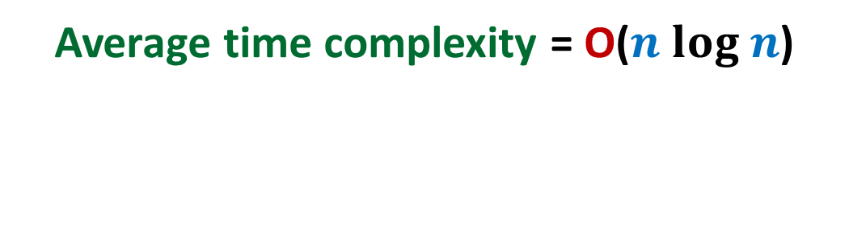
QuickSort
Average time complexity = O($n log n$)

Slide 25
Pseudocode for QuickSort($S$)
QuickSort($S$)
{ If (|$S$|>1)
Pick and remove an element $x$from $S$;
($S_{<x}$, $S_{>x}$)← Partition($S$,$x$);
return( Concatenate(QuickSort($S_{<x}$), $x$, QuickSort($S_{>x}$))
}

Slide 26
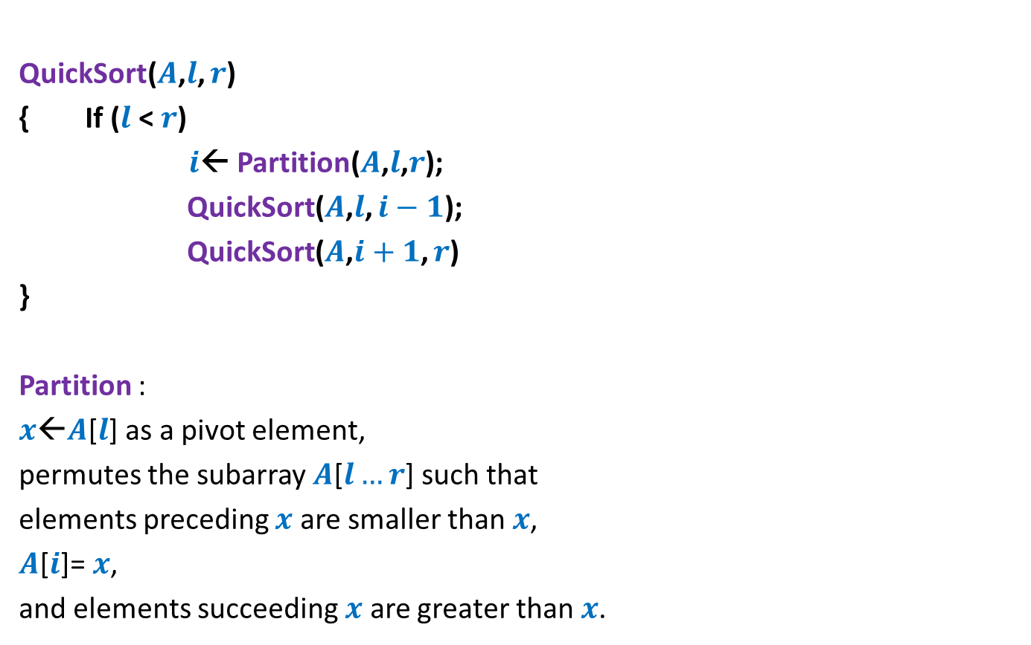
Pseudocode for QuickSort($S$) When the input $S$is stored in an array
QuickSort($A$,$l$, $r$)
{ If ($l$ < $r$)
$i$← Partition($A$,$l$,$r$);
QuickSort($A$,$l$, $i−1$);
QuickSort($A$,$i+1$, $r$)
}
Partition :
$x$←$A$[$l$] as a pivot element,
permutes the subarray $A$[$l…r$] such that
elements preceding $x$ are smaller than $x$,
$A$[$i$]= $x$,
and elements succeeding $x$ are greater than $x$.

Slide 27


Example: Partition($A$,$0$,$8$)
0 1 2 3 4 5 6 7 8
>x
<x
x
What happens after Partition($A$,$0$,$8$)

Slide 28
Example: Partition($A$,$0$,$8$)
0 1 2 3 4 5 6 7 8
0 1 2 3 4 5 6 7 8
<x
>x

Slide 29
Analyzing average time complexity of QuickSort
Part 1
Deriving the recurrence

Slide 30

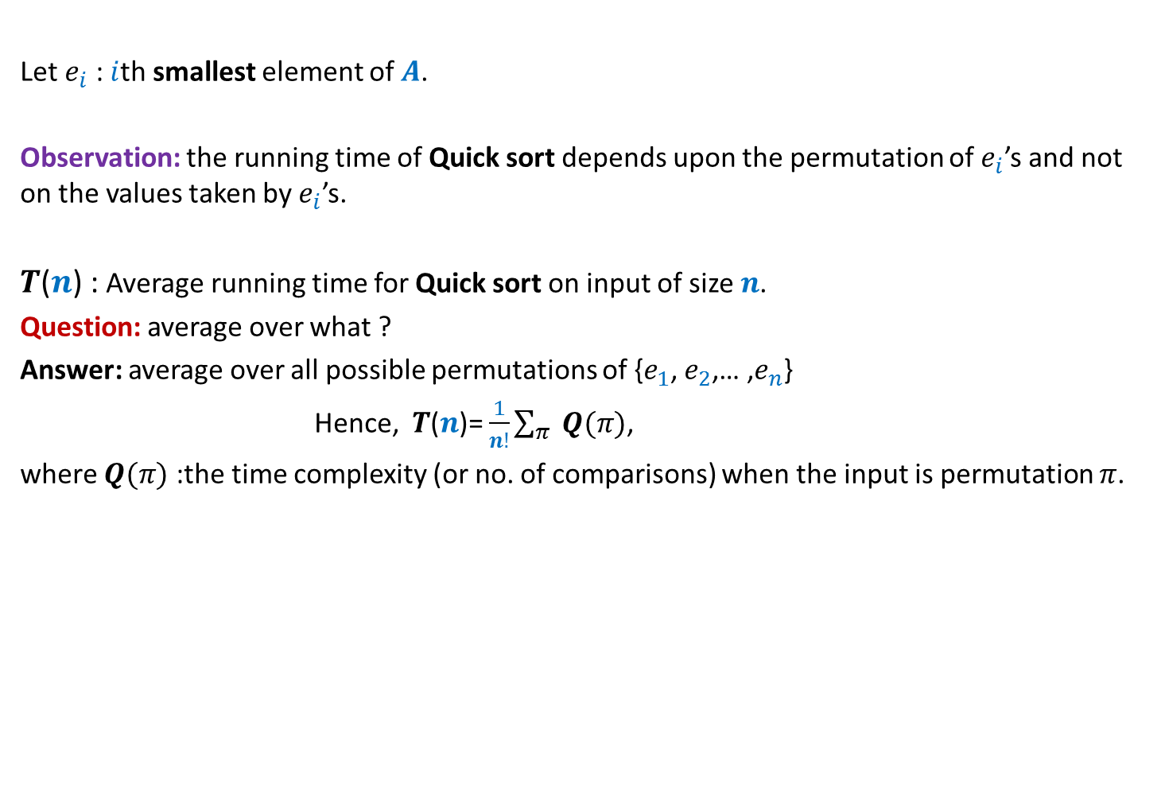

Analyzing average time complexity of QuickSort
Let $e_{i}$ : $i$th smallest element of $A$.
Observation: the running time of Quick sort depends upon the permutation of $e_{i}$’s and not on the values taken by $e_{i}$’s.
$T$($n$) : Average running time for Quick sort on input of size $n$.
Question: average over what ?
Answer: average over all possible permutations of {$e_{1}$, $e_{2}$,… ,$e_{n}$}
Hence, $T$($n$)= $\frac{1}{n!}\sum_{π }{Q(π)}$,
where $Q(π)$ :the time complexity (or no. of comparisons) when the input is permutation $π$.
Think for at least 5-10 minutes to find alternate way to calculate $T$($n$).
We shall give discuss two such ways tomorrow.
Calculating $T$($n$) from definition/scratch is impractical, if not impossible.

