Slide 1
Data Structures and Algorithms (CS210A) Semester I – 2014-15
Lecture 31
Magical applications of Binary trees -II

Slide 2
Recap of Last Lecture

Slide 3
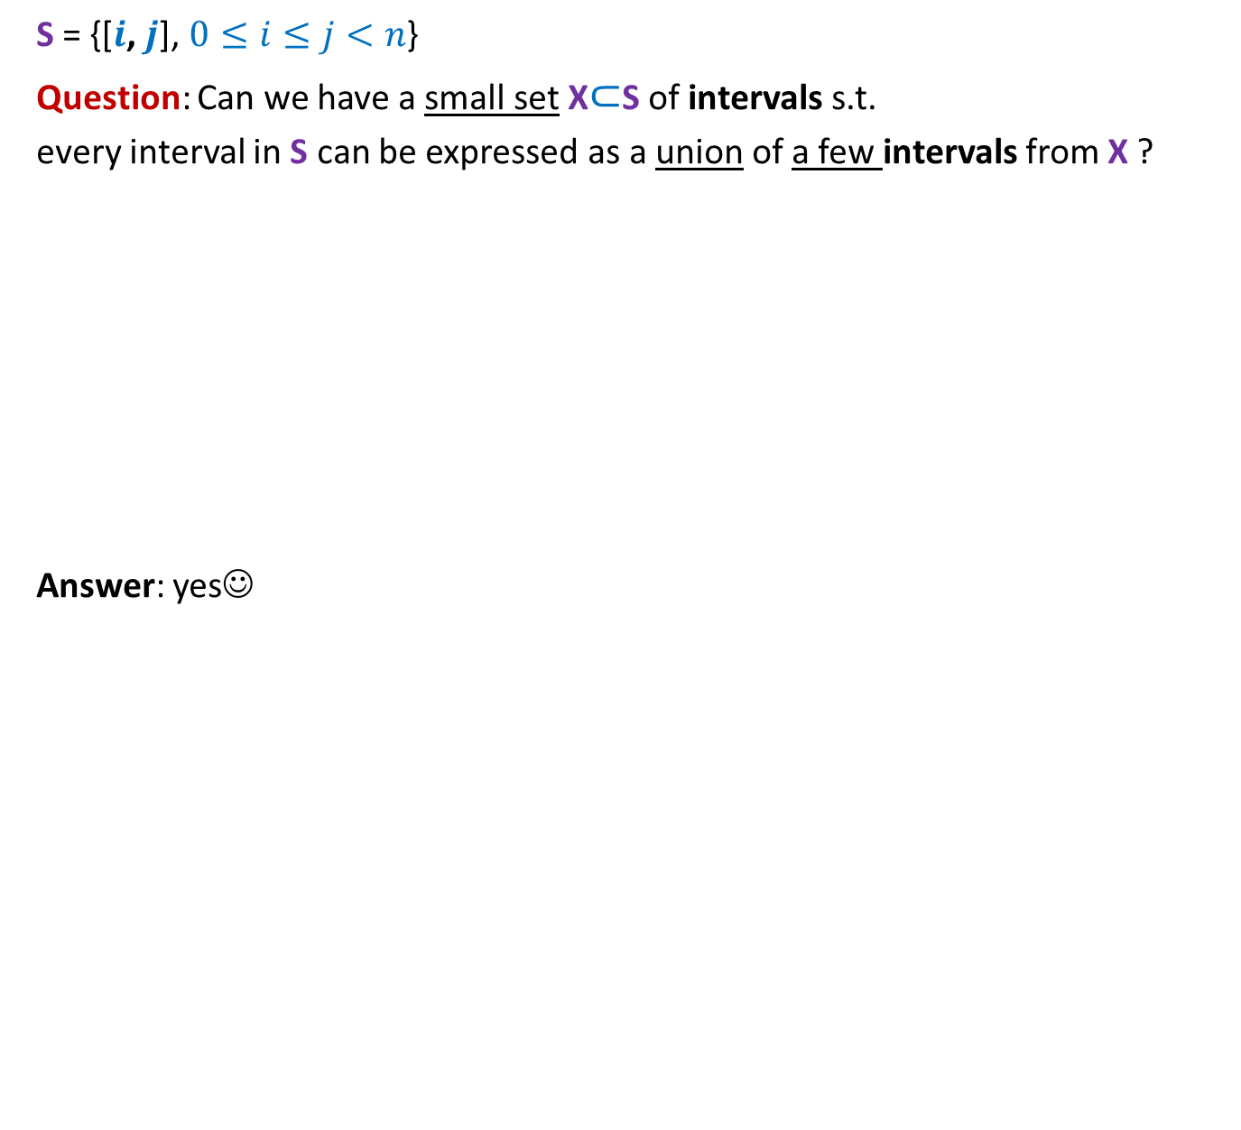
Intervals
S = {[$i$, $j$], $0≤i≤j<n$}
Question: Can we have a small set X$⊂$S of intervals s.t.
every interval in S can be expressed as a union of a few intervals from X ?
Answer: yes☺
$\left[0,0\right] \left[1,1\right] \left[2,2\right] \left[3,3\right] \left[4,4\right] \left[5,5\right] \left[6,6\right] \left[7,7\right] \left[8,8\right] \left[9,9\right] …………………………………. [15,15]$

Slide 4



Hierarchy of intervals
$$[0,15]$$
$$[0,7]$$
$$[8,15]$$
$\left[0,3\right] [4,7]$ $\left[8,11\right] [12,15]$
$\left[0,1\right] \left[2,3\right] \left[4,5\right] \left[6,7\right] \left[8,9\right] \left[10,11\right] \left[12,13\right] [14,15]$
$\left[0,0\right] \left[1,1\right] \left[2,2\right] \left[3,3\right] \left[4,4\right] \left[5,5\right] \left[6,6\right] \left[7,7\right] \left[8,8\right] \left[9,9\right] …………………………………. [15,15]$

Slide 5

Hierarchy of intervals
$$[0,15]$$
Observation: There are $2n$intervals such that
any interval [$i$, $j$] can be expressed as union of O(log $n$) basic intervals ☺
$$[0,7]$$
$$[8,15]$$
$\left[0,3\right] [4,7]$ $\left[8,11\right] [12,15]$
$\left[0,1\right] \left[2,3\right] \left[4,5\right] \left[6,7\right] \left[8,9\right] \left[10,11\right] \left[12,13\right] [14,15]$
$\left[0,0\right] \left[1,1\right] \left[2,2\right] \left[3,3\right] \left[4,4\right] \left[5,5\right] \left[6,6\right] \left[7,7\right] \left[8,8\right] \left[9,9\right] …………………………………. [15,15]$

Slide 6

Hierarchy of intervals
$$[0,15]$$
Observation: There are $2n$intervals such that
any interval [$i$, $j$] can be expressed as union of O(log $n$) basic intervals ☺
$$[0,7]$$
$$[8,15]$$
$\left[0,3\right] [4,7]$ $\left[8,11\right] [12,15]$
$\left[0,1\right] \left[2,3\right] \left[4,5\right] \left[6,7\right] \left[8,9\right] \left[10,11\right] \left[12,13\right] [14,15]$
$\left[0,0\right] \left[1,1\right] \left[2,2\right] \left[3,3\right] \left[4,4\right] \left[5,5\right] \left[6,6\right] \left[7,7\right] \left[8,8\right] \left[9,9\right] …………………………………. [15,15]$
Relation to a sequence ?

Slide 7
Which data structure emerges ?
$$[0,15]$$
$$[0,7]$$
$$[8,15]$$
$\left[0,3\right] [4,7]$ $\left[8,11\right] [12,15]$
$\left[0,1\right] \left[2,3\right] \left[4,5\right] \left[6,7\right] \left[8,9\right] \left[10,11\right] \left[12,13\right] [14,15]$
$\left[0,0\right] \left[1,1\right] \left[2,2\right] \left[3,3\right] \left[4,4\right] \left[5,5\right] \left[6,6\right] \left[7,7\right] \left[8,8\right] \left[9,9\right] …………………………………. [15,15]$
Sequence
${ x}_{0}$ ${ x}_{1}{ x}_{2 }x_{3}$ $x_{4}{ x}_{5}$ ${ x}_{6}$ ${ x}_{7}{ x}_{8 }x_{9}$ $x_{10}{ x}_{11}$ ${ x}_{12}$ ${ x}_{13}{ x}_{14 }x_{15}$

Slide 8
A Binary tree
$$[0,15]$$
How to perform Operation on an interval ?
$$[0,7]$$
$$[8,15]$$
$\left[0,3\right] [4,7]$ $\left[8,11\right] [12,15]$
$$\left[0,1\right] \left[2,3\right] \left[4,5\right] \left[6,7\right] \left[8,9\right] \left[10,11\right] \left[12,13\right] [14,15]$$
${ x}_{0}$ ${ x}_{1}{ x}_{2 }x_{3}$ $x_{4}{ x}_{5}$ ${ x}_{6}$ ${ x}_{7}{ x}_{8 }x_{9}$ $x_{10}{ x}_{11}$ ${ x}_{12}$ ${ x}_{13}{ x}_{14 }x_{15}$
What value should you keep in internal nodes ?

Slide 9
$$[0,15]$$
How to perform Operation on an interval ?
$$[0,7]$$
$$[8,15]$$
$\left[0,3\right] [4,7]$ $\left[8,11\right] [12,15]$
$$\left[0,1\right] \left[2,3\right] \left[4,5\right] \left[6,7\right] \left[8,9\right] \left[10,11\right] \left[12,13\right] [14,15]$$
${ x}_{0}$ ${ x}_{1}{ x}_{2 }x_{3}$ $x_{4}{ x}_{5}$ ${ x}_{6}$ ${ x}_{7}{ x}_{8 }x_{9}$ $x_{10}{ x}_{11}$ ${ x}_{12}$ ${ x}_{13}{ x}_{14 }x_{15}$

Slide 10
Problem 2
Dynamic Range-minima

Slide 11

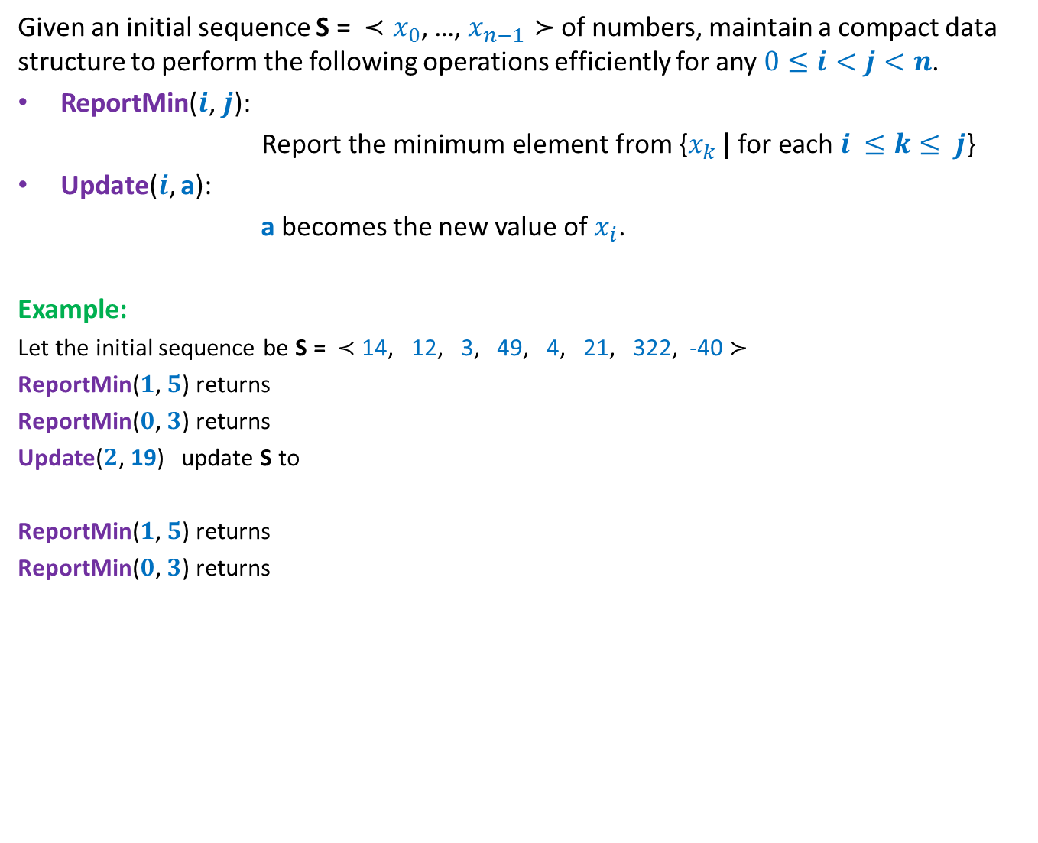
Dynamic Range Minima Problem
Given an initial sequence S = ${≺x}_{0}$, …, $x_{n−1}≻$ of numbers, maintain a compact data structure to perform the following operations efficiently for any $0≤i<j<n$.
ReportMin($i\text{,} j\text{): }$
$\text{Report} \text{the} \text{minimum} \text{element} \text{from} \text{\{}x_{k }\text{|} \text{for} \text{each} i ≤k≤ j$}
Update($i$, a):
a becomes the new value of $x_{i}$.
Example:
Let the initial sequence be S = $≺$ 14, 12, 3, 49, 4, 21, 322, -40 $≻$
ReportMin($1\text{,} 5\text{)}$ returns
ReportMin($0\text{,} 3\text{)}$ returns
Update($2$, 19) update S to
ReportMin($1\text{,} 5\text{)}$ returns
ReportMin($0\text{,} 3\text{)}$ returns
3
3
$≺$ 14, 12, 19, 49, 4, 21, 322, -40 $≻$
4
12

Slide 12
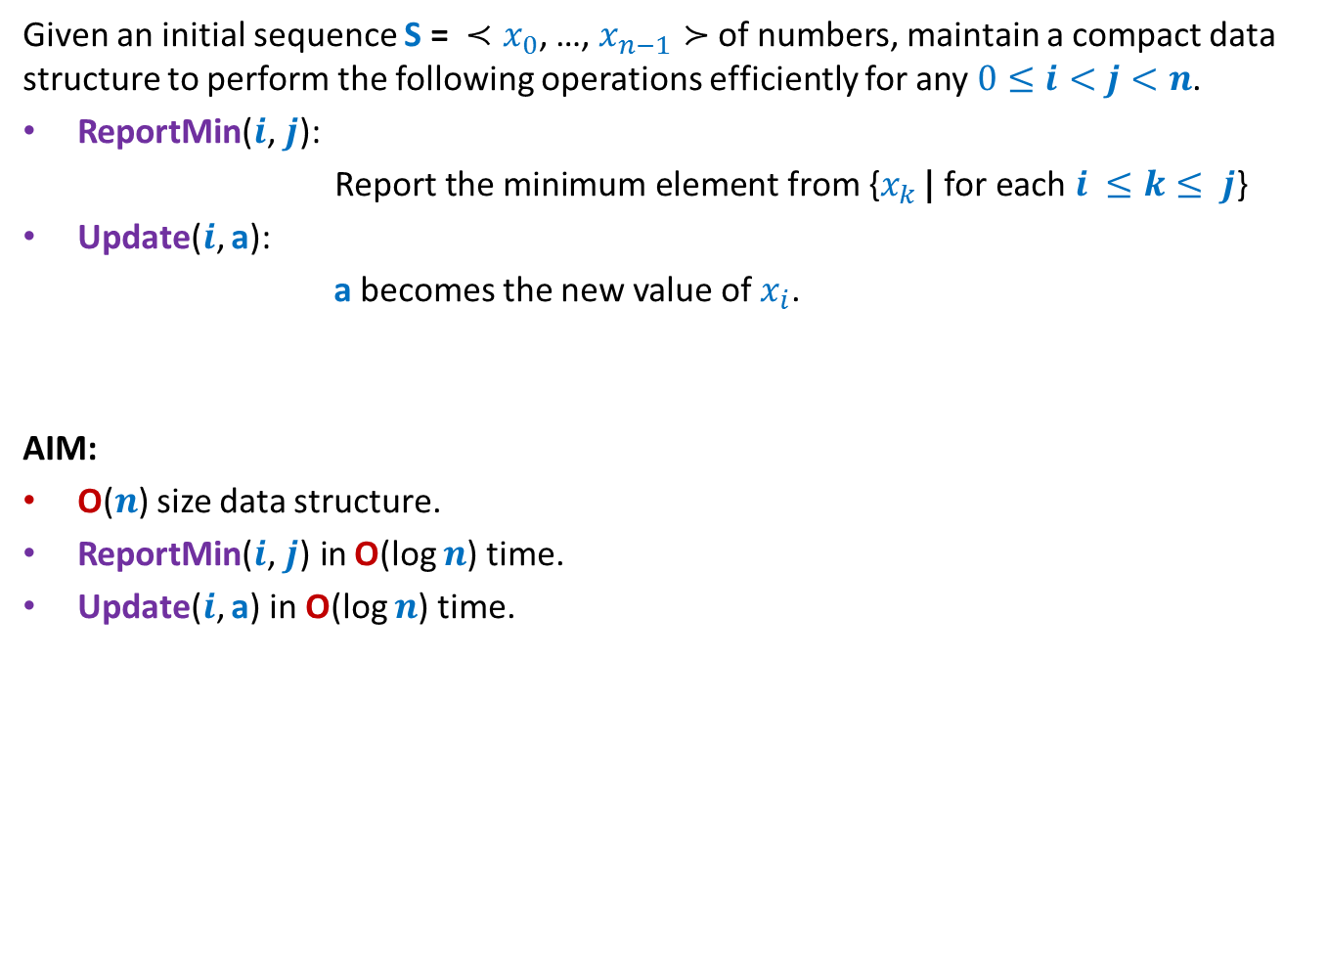
Dynamic Range Minima Problem
Given an initial sequence S = ${≺x}_{0}$, …, $x_{n−1}≻$ of numbers, maintain a compact data structure to perform the following operations efficiently for any $0≤i<j<n$.
ReportMin($i\text{,} j\text{): }$
$\text{Report} \text{the} \text{minimum} \text{element} \text{from} \text{\{}x_{k }\text{|} \text{for} \text{each} i ≤k≤ j$}
Update($i$, a):
a becomes the new value of $x_{i}$.
AIM:
O($n$) size data structure.
ReportMin($i\text{,} j\text{)} \text{in}$O(log $n$) time.
Update($i$, a) in O(log $n$) time.

Slide 13
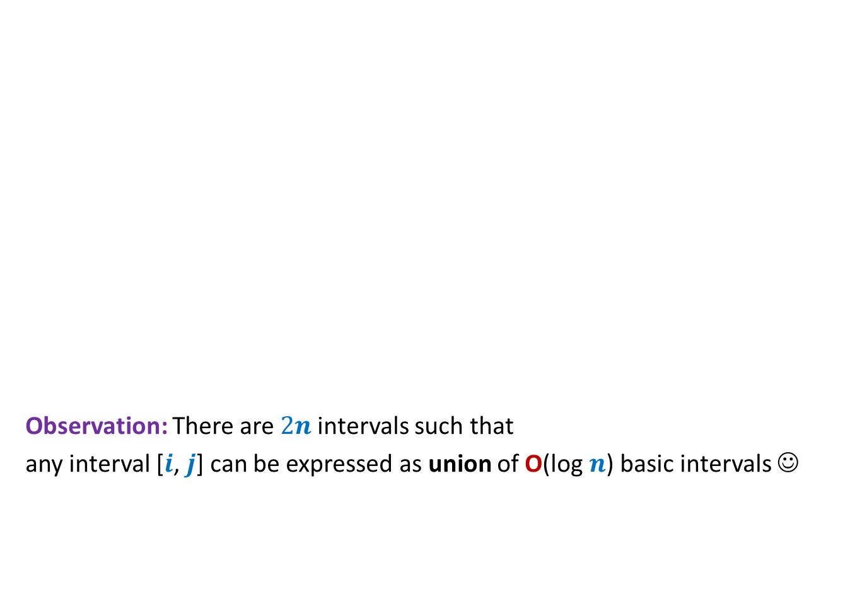
Hierarchy of intervals
$$[0,15]$$
Observation: There are $2n$intervals such that
any interval [$i$, $j$] can be expressed as union of O(log $n$) basic intervals ☺
$$[0,7]$$
$$[8,15]$$
$\left[0,3\right] [4,7]$ $\left[8,11\right] [12,15]$
$\left[0,1\right] \left[2,3\right] \left[4,5\right] \left[6,7\right] \left[8,9\right] \left[10,11\right] \left[12,13\right] [14,15]$
$\left[0,0\right] \left[1,1\right] \left[2,2\right] \left[3,3\right] \left[4,4\right] \left[5,5\right] \left[6,6\right] \left[7,7\right] \left[8,8\right] \left[9,9\right] …………………………………. [15,15]$
${ x}_{0}$ ${ x}_{1}{ x}_{2 }x_{3}$ $x_{4}{ x}_{5}$ ${ x}_{6}$ ${ x}_{7}{ x}_{8 }x_{9}$ $x_{10}{ x}_{11}$ ${ x}_{12}$ ${ x}_{13}{ x}_{14 }x_{15}$

Slide 14
Data structure for dynamic range minima
Question: What should be stored in an internal node v ?
Answer: minimum value stored in subtree(v).
2
4
2
4
21
8
2
4
9
21
29
25
8
2
11
Initial
sequence
4 14 9 17 23 21 29 91 37 25 8 33 2 67 11 44
${ x}_{0}$ ${ x}_{1}{ x}_{2 }x_{3}$ $x_{4}{ x}_{5}$ ${ x}_{6}$ ${ x}_{7}{ x}_{8 }x_{9}$ $x_{10}{ x}_{11}$ ${ x}_{12}$ ${ x}_{13}{ x}_{14 }x_{15}$

Slide 15
Data structure for dynamic range minima
How to do Report-Min(2,10) ?
2
4
2
4
21
8
2
4
9
21
29
25
8
2
11
Initial
sequence
4 14 9 17 23 21 29 91 37 25 8 33 2 67 11 44
${ x}_{0}$ ${ x}_{1}{ x}_{2 }x_{3}$ $x_{4}{ x}_{5}$ ${ x}_{6}$ ${ x}_{7}{ x}_{8 }x_{9}$ $x_{10}{ x}_{11}$ ${ x}_{12}$ ${ x}_{13}{ x}_{14 }x_{15}$

Slide 16
Data structure for dynamic range minima
How to do Report-Min(2,10) ?
2
4
2
4
21
8
2
4
9
21
29
25
8
2
11
Initial
sequence
4 14 9 17 23 21 29 91 37 25 8 33 2 67 11 44
${ x}_{0}$ ${ x}_{1}{ x}_{2 }x_{3}$ $x_{4}{ x}_{5}$ ${ x}_{6}$ ${ x}_{7}{ x}_{8 }x_{9}$ $x_{10}{ x}_{11}$ ${ x}_{12}$ ${ x}_{13}{ x}_{14 }x_{15}$

Slide 17



Data structure for dynamic range minima
0
Data structure: An array A of size 2n-1.
Copy the sequence S = ${≺x}_{0}$, …, $x_{n−1}≻$ into ??
Leaf node corresponding to $x_{i}$= ??
How to check if a node is left child or right child of its parent ?
(if index of the node is odd, then the node is left child, else the node is right child)
2
1 2
4
2
3 4 5 6
4
21
8
2
7 8 9 10 11 12 13 14
4
9
21
29
25
8
2
11
Initial
sequence
4 14 9 17 23 21 29 91 37 25 8 33 2 67 11 44
15 16 17 18 19 20 21 22 23 24 25 26 27 28 29 30
A[$n−1$]…A[$2n−2$]
A[($n−1)+i$]

Slide 18

Update($i,a$)
Update($i,a$)
$i$← $(n−1)+i$;
A[$i$]← $a$;
$i$ ← $\left\lfloor (i−1)/2\right\rfloor$ ;
While( ?? )
{
}
Homework

Slide 19


Update($i,a$)
Update($i,a$)
$i$← $(n−1)+i$;
A[$i$]← $a$;
$i$ ← $\left\lfloor (i−1)/2\right\rfloor$ ;
While( ?? )
{
If($a$< A[$i$]) A[$i$]← $a$;
$i$ ← $\left\lfloor (i−1)/2\right\rfloor$ ;
}
$i$≥ 0
There is an error in the above pseudocode. Try spotting it.
(thanks to Karan Singh for pointing it out in the class)

Slide 20

Update($i,a$)
Update($i,a$)
$i$← $(n−1)+i$;
A[$i$]← $a$;
$i$ ← $\left\lfloor (i−1)/2\right\rfloor$ ;
While( ?? )
{
If( A[$2i+1$]< A[$2i+2$])
A[$i$]← A[$2i+1$]
else
A[$i$]← A[$2i+2$] ;
$i$ ← $\left\lfloor (i−1)/2\right\rfloor$ ;
}
$i$≥ 0
This is the correct pseudocode.

Slide 21
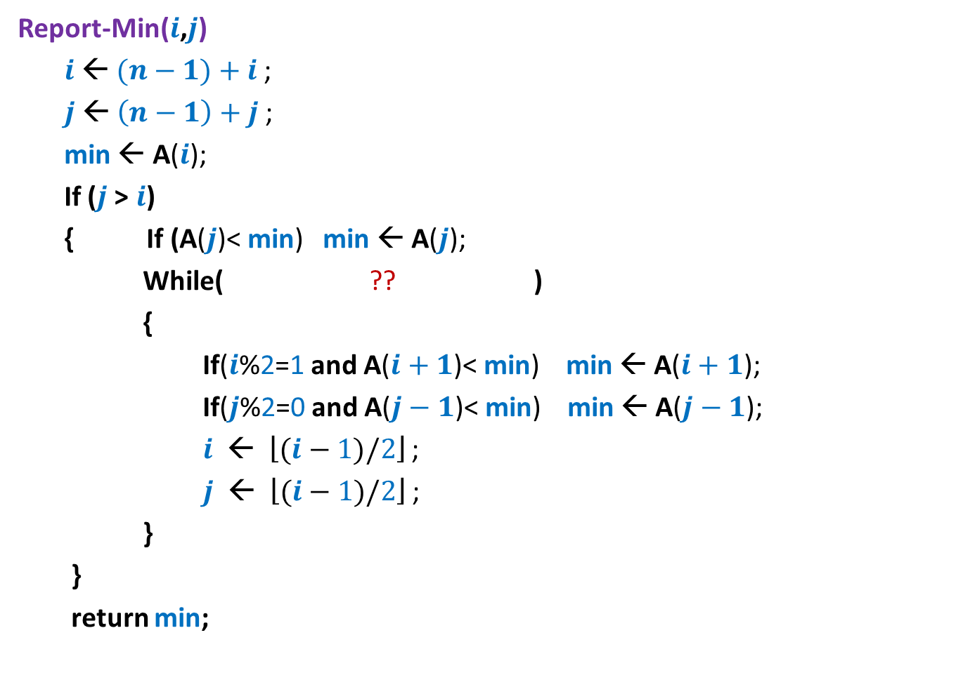


Report-Min($i$,$j$)
Report-Min($i$,$j$)
$i$← $(n−1)+i$;
$j$← $\left(n−1\right)+j$;
min ← A($i$);
If ($j$> $i$)
{ If (A($j$)< min) min ← A($j$);
While( ?? )
{
If($i$%2=1 and A($i+1$)< min) min ← A($i+1$);
If($j$%2=0 and A($j−1$)< min) min ← A($j−1$);
$i$ ← $\left\lfloor (i−1)/2\right\rfloor$ ;
$j$ ← $\left\lfloor (i−1)/2\right\rfloor$ ;
}
}
return min;
$\left\lfloor (i−1)/2\right\rfloor$ <> $\left\lfloor (j−1)/2\right\rfloor$

Slide 22
Proof of correctness
Let T be the tree data structure for Dynamic Range-minima problem.
Let u be any node in T.
Question:
What can we say about value(u) after a series of operations ?
After every operation:
value(u) is minimum among all values stored in the leaf nodes of subtree(u).
To prove the correctness of our datastructure/algorithm, you need to prove that the above mentioned assertion holds after each Update() operation. (Do it as a small exercise (4-5 sentences only)).

Slide 23
Proof of correctness
Let T be the tree data structure for Dynamic Range-minima problem.
Let u be any node in T.
Question:
What can we say about value(u) after a series of operations ?
Answer:
After every operation:
value(u) is minimum among all values stored in the leaf nodes of subtree(u).

Slide 24
Another interesting problem on sequences

Slide 25
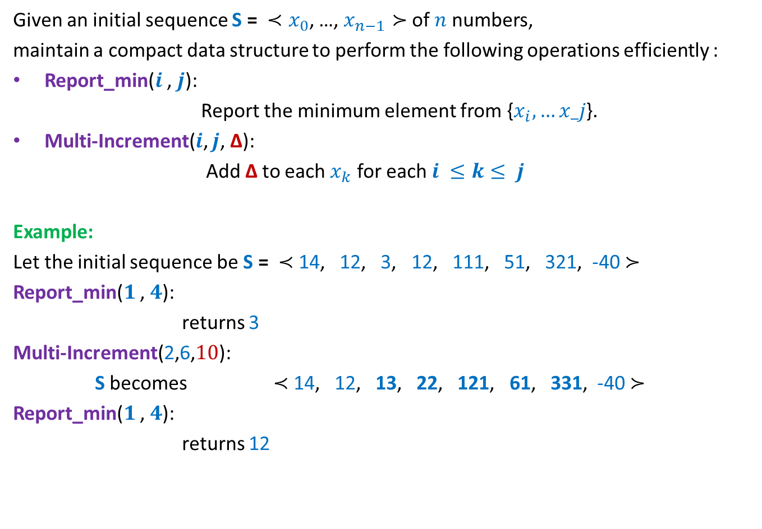
Practice Problem
Given an initial sequence S = ${≺x}_{0}$, …, $x_{n−1}≻$ of $n$numbers,
maintain a compact data structure to perform the following operations efficiently :
Report_min($i$ , $j$):
Report the minimum element from {$x_{i},…x_j$}.
Multi-Increment($i$, $j$, ∆):
Add ∆ to each $x_{k}$ for each $i ≤k≤ j$
Example:
Let the initial sequence be S = $≺$ 14, 12, 3, 12, 111, 51, 321, -40 $≻$
Report_min($1$ , $4$):
returns 3
Multi-Increment(2,6,$10$):
S becomes $≺$ 14, 12, 13, 22, 121, 61, 331, -40 $≻$
Report_min($1$ , $4$):
returns 12

Slide 26
An challenging problem on sequences
For winter vacation
(not for the exam)

Slide 27
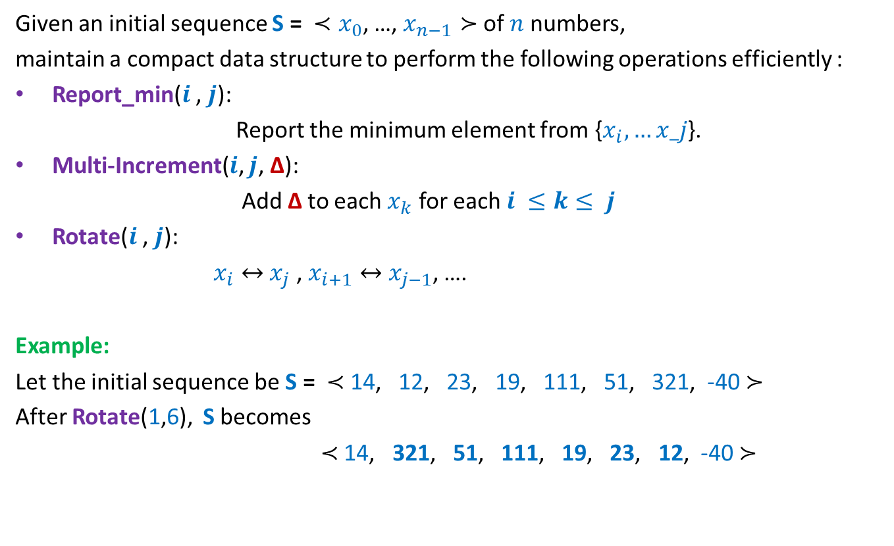

$∗$ Problem
Given an initial sequence S = ${≺x}_{0}$, …, $x_{n−1}≻$ of $n$numbers,
maintain a compact data structure to perform the following operations efficiently :
Report_min($i$ , $j$):
Report the minimum element from {$x_{i},…x_j$}.
Multi-Increment($i$, $j$, ∆):
Add ∆ to each $x_{k}$ for each $i ≤k≤ j$
Rotate($i$ , $j$):
$x_{i}↔$ $x_{j}$ , $x_{i+1}↔$ $x_{j−1}$, ….
Example:
Let the initial sequence be S = $≺$ 14, 12, 23, 19, 111, 51, 321, -40 $≻$
After Rotate(1,6), S becomes
$≺$ 14, 321, 51, 111, 19, 23, 12, -40 $≻$

Slide 28
Problem 4
A data structure for sets

Slide 29

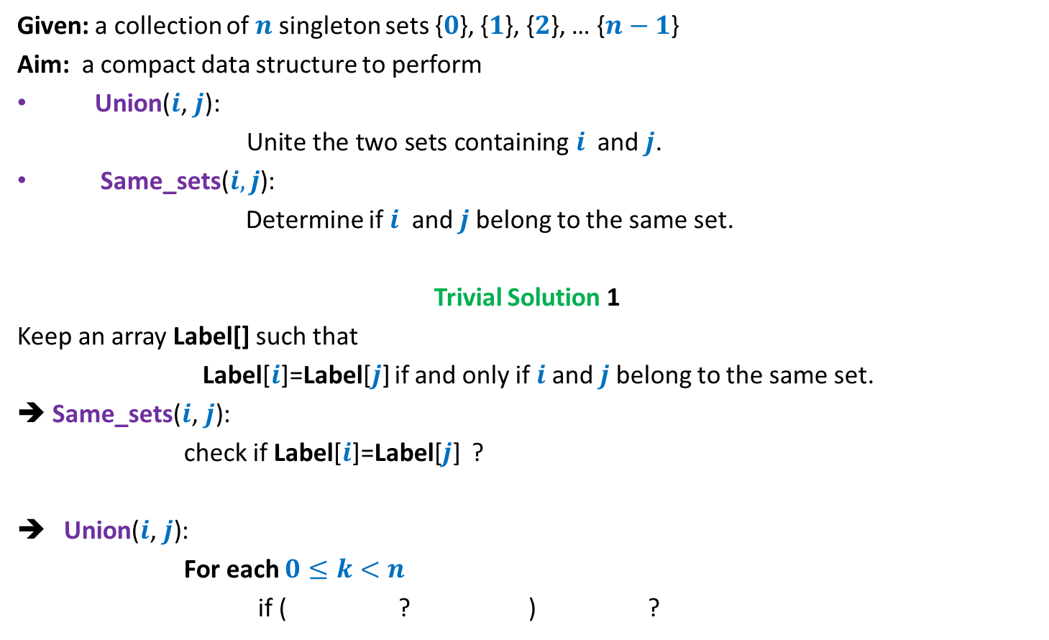


Sets under operations
Given: a collection of $n$singleton sets {$0$}, {$1$}, {$2$}, … {$n−1$}
Aim: a compact data structure to perform
Union($i\text{,} j\text{): }$
$\text{Unite} \text{the} \text{two} \text{sets} \text{containing} i$ and $j$.
Same_sets($i,j$):
Determine if $i$ and $j$belong to the same set.
Trivial Solution 1
Keep an array Label[] such that
Label[$i$]=Label[$j$] if and only if $i$and $j$belong to the same set.
➔ Same_sets($i\text{,} j\text{)}$:
check if Label[$i$]=Label[$j$] ?
Union($i\text{,} j\text{)}$:
For each $0≤k<n$
if ( ? ) ?
O(1) time
O($n$) time
Label[$k$]= Label[$i$]
Label[$k$] ← Label[$j$])

Slide 30
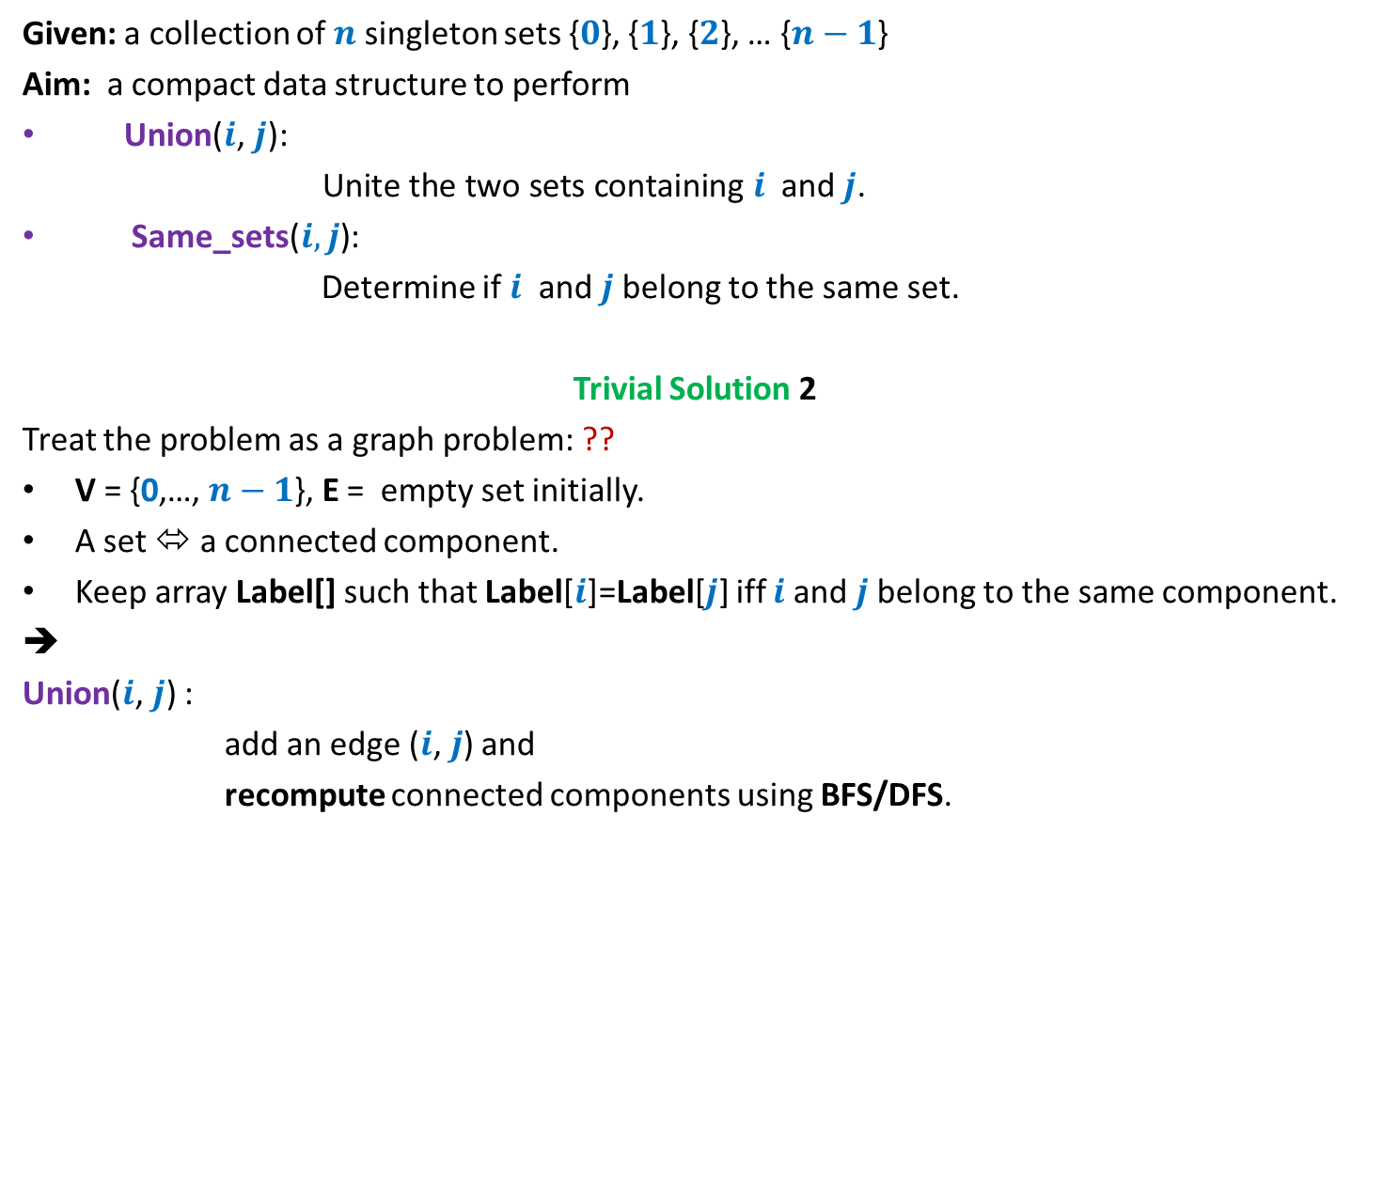
Sets under operations
Given: a collection of $n$singleton sets {$0$}, {$1$}, {$2$}, … {$n−1$}
Aim: a compact data structure to perform
Union($i\text{,} j\text{): }$
$\text{Unite} \text{the} \text{two} \text{sets} \text{containing} i$ and $j$.
Same_sets($i,j$):
Determine if $i$ and $j$belong to the same set.
Trivial Solution 2
Treat the problem as a graph problem: ??
V = {0,…, $n−1$}, E = empty set initially.
A set ⬄ a connected component.
Keep array Label[] such that Label[$i$]=Label[$j$] iff $i$and $j$belong to the same component.
➔
Union($i\text{,} j\text{)}$ :
add an edge ($i\text{,} j$) and
recompute connected components using BFS/DFS.
Connected component
O($n$) time

Slide 31
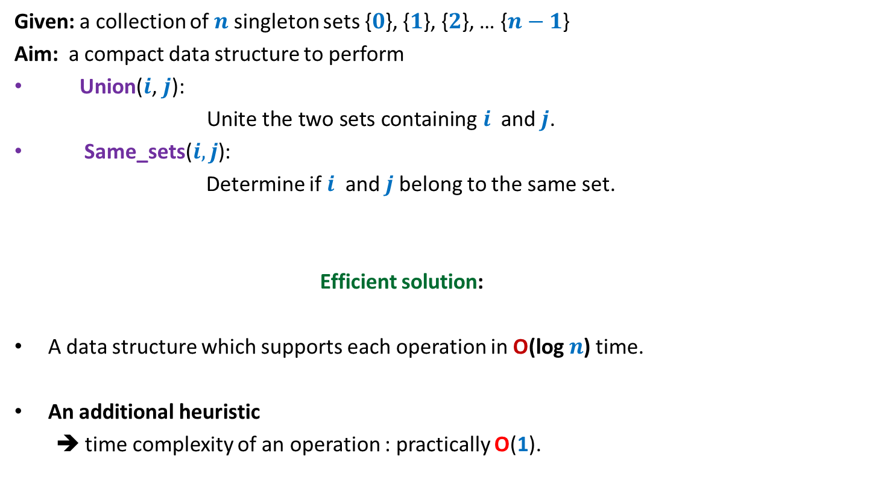
Sets under operations
Given: a collection of $n$singleton sets {$0$}, {$1$}, {$2$}, … {$n−1$}
Aim: a compact data structure to perform
Union($i\text{,} j\text{): }$
$\text{Unite} \text{the} \text{two} \text{sets} \text{containing} i$ and $j$.
Same_sets($i,j$):
Determine if $i$ and $j$belong to the same set.
Efficient solution:
A data structure which supports each operation in O(log $n$) time.
An additional heuristic
➔ time complexity of an operation : practically O(1).

